Slide 1
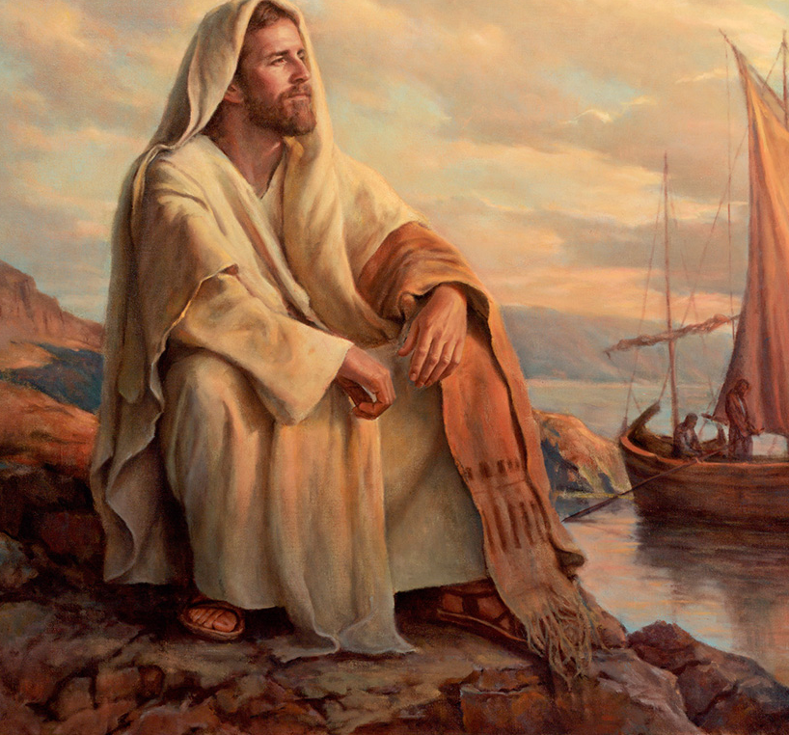
The Life of Christ

Slide 2

Seven Periods of Jesus’ Life
Years of Preparation
Beginning of Ministry
Great Galilean Ministry
Periods of Retirement
Close of Ministry
Last Week
Resurrection and Exaltation

Slide 3
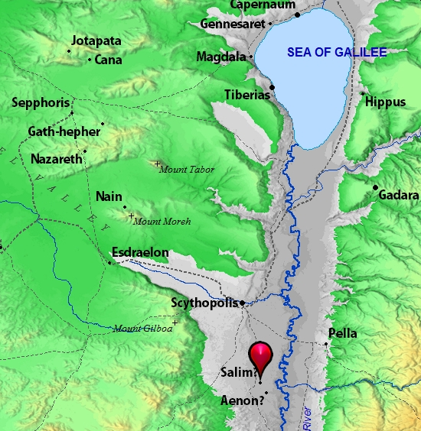
Beginning of Jesus’ Ministry: John’s Further Testimony (John 3:22-36)
John was baptizing in Aenon near Salim.
  There was “much water there.”
  A dispute arose between the Jews and John’s disciples about purification.
John’s disciples tell him that Jesus is baptizing and drawing a lot of people.
In answer, John exalts Jesus (Jn. 3:27-36).
  John is not the Christ. He is the friend of the groom. Jesus must increase, and John must decrease.
  Jesus is from above; He speaks God’s words.
  Eternal life “abides in” believers in Jesus, but God’s wrath abides in unbelievers.

Slide 4
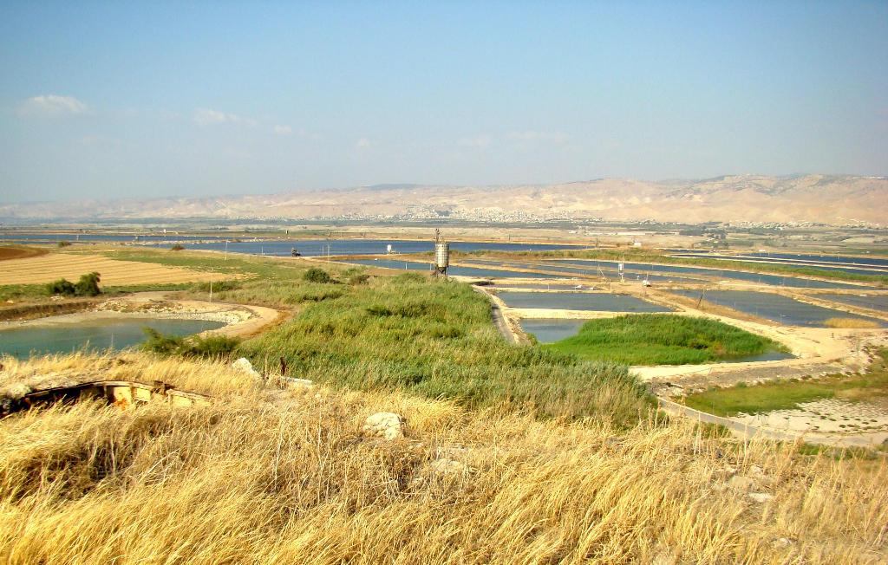
Abundant water supply at Aenon near Salim
Photo by Leon Mauldin

Slide 5
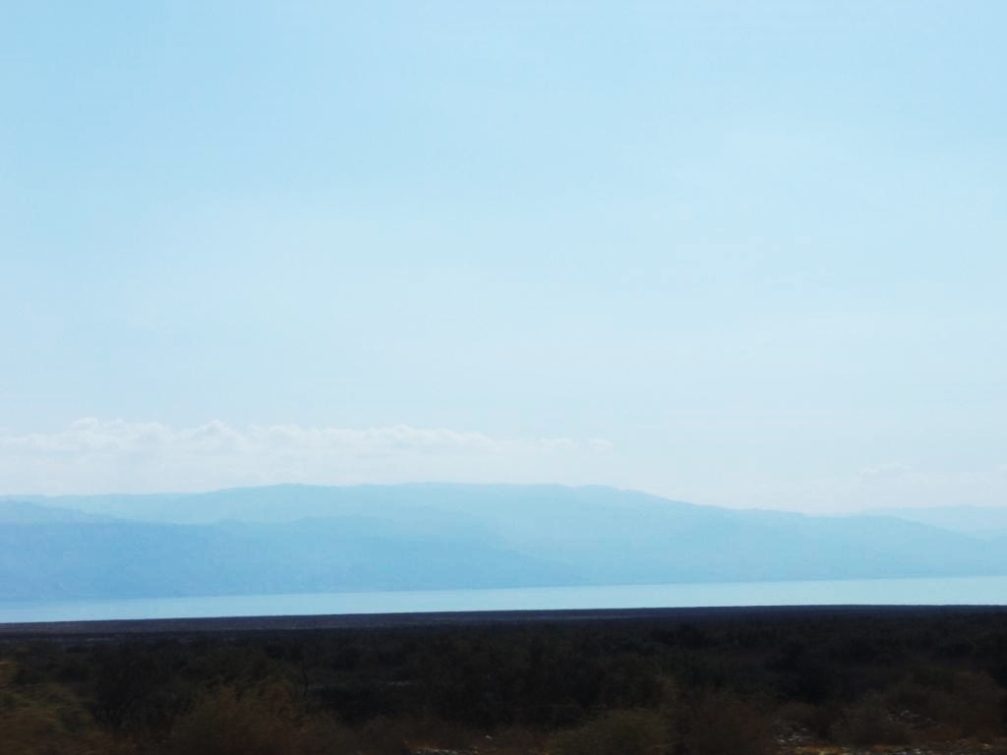
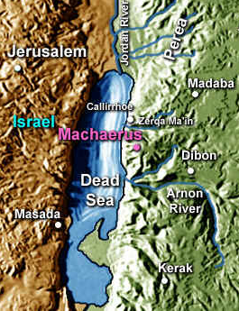
John rebukes Herod Antipas (Matthew 14:2-4; Luke 3:19-20; Mark 6:14-29)
John the Baptist rebukes Herod because Herod had married his brother Philip’s wife.
  Herod imprisons John for Herodias’s sake.
Herod does not kill John immediately:
  He fears the multitude because they hold John to be a prophet.
  He also likes to hear John.

Slide 6
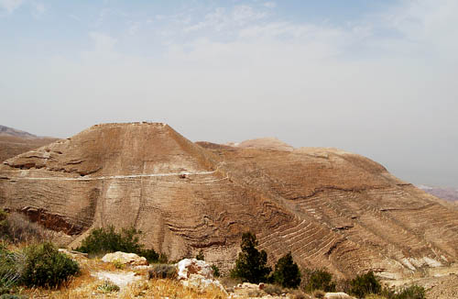
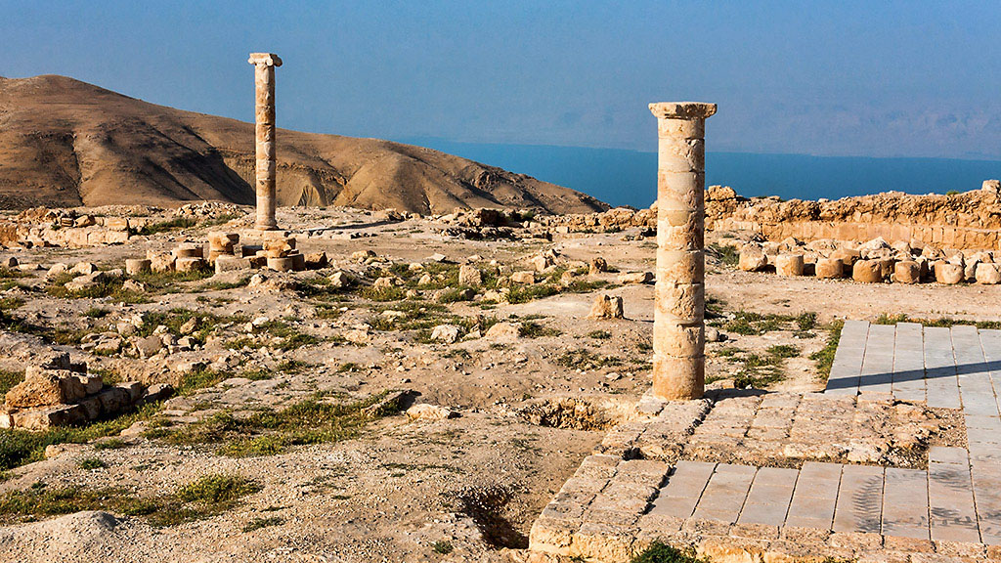
Machaerus
Josephus records that Herod sent John to Machaerus where he was imprisoned and put to death. (Antiquities 18:116-119)
“Machaerus has an impressive location overlooking the Dead Sea from the east. The citadel is located about 2300 feet above sea level. This would make it about 3600 feet above the Dead Sea.” (Quote & photos by Ferrell Jenkins).

Slide 7
Herod has John Beheaded
(Mark 6:14-29)
Herod’s birthday feast occasions an opportunity for Herodias to have John killed (6:21-29).
  The daughter of Herodias dances and pleases Herod.
  He promises her whatever she wants up to half his kingdom.
  Herodias instructs her to ask for the head of John.
Herod is sorry but fulfills her request “because of the oaths and because of those who sat with him.”
  The executioner beheads John in prison and brings the head to the girl who then presents it to Herodias.
  John’s disciples take the corpse and bury it.
Notes:
Sins that led to John’s death:
An unlawful marriage.
Resentment and bitterness (on the part of Herodias).
A presumably lustful dance.
A rash and prideful promise.
Prideful unwillingness to reverse a sinful promise.

Slide 8
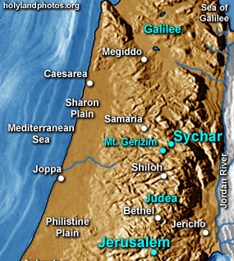
Jesus Leaves Judea and Travels Through Samaria (Matthew 4:12; Mark 1:14; Luke 4:14; John 4:1-4)
Jesus leaves Judea when the Pharisees learn how many disciples He is making.
He needed to travel through Samaria.
He comes to the city of Sychar, near the ground that Jacob gave to Joseph.
Jacob’s well is there.

Slide 9
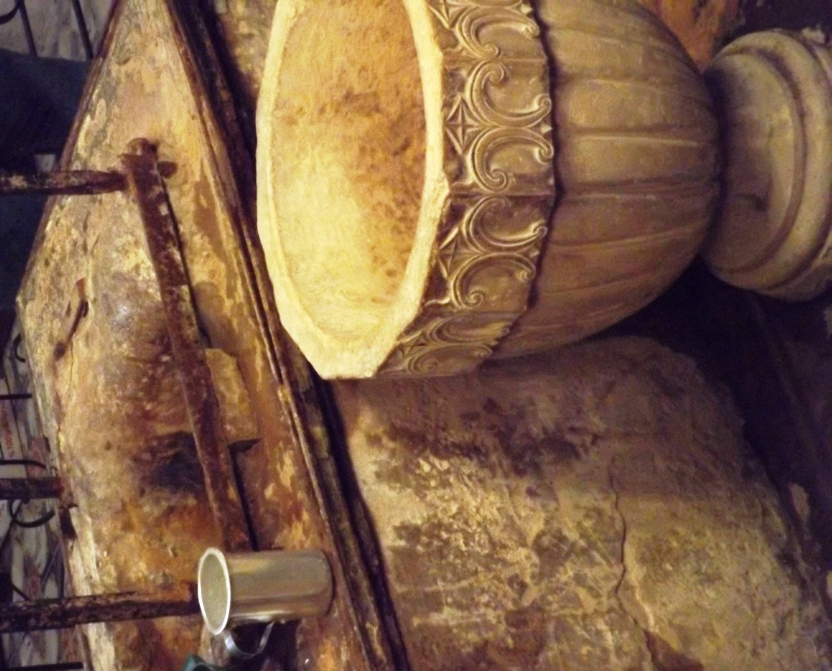
Jesus’ discussion with the Samaritan woman (John 4:4-42)
Jesus asks a Samaritan woman who had come to draw water to give Him a drink.
The woman is surprised that Jesus made this request, “for Jews have now dealings with Samaritans.”
Jesus said she would have asked Him for living water if she knew the gift of God and who Jesus was.
The woman doubts.
  How could Jesus give her water when the well is deep; He has nothing to draw with?
  Is He greater than Jacob?
Notes:
Jacob's Well in Nablus, West Bank, Israel is estimated to be 100–115 feet (30–35 meters) deep. The well is located in a crypt under the floor of a Greek Orthodox church, and visitors can access it by entering the church and descending stairs to the crypt.

Slide 10
Jesus’ discussion with the Samaritan woman (John 4:4-42)
Jesus contrasts the living water with the well water.
  One would thirst again after drinking the well water, but after drinking the living water, one would never thirst.
The woman wants the living water so that she will not have to keep coming to the well.
Notes:
Jacob's Well in Nablus, West Bank, Israel is estimated to be 100–115 feet (30–35 meters) deep. The well is located in a crypt under the floor of a Greek Orthodox church, and visitors can access it by entering the church and descending stairs to the crypt.

Slide 11
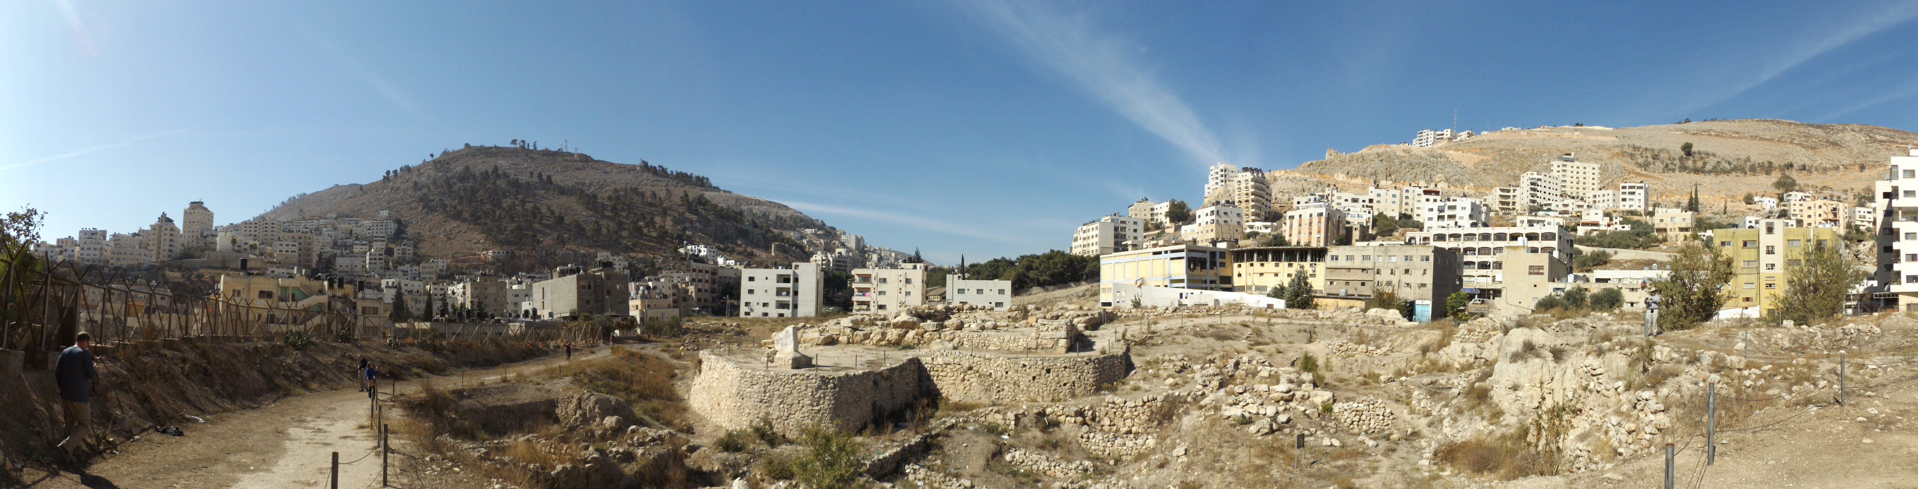
Jesus’ discussion with the Samaritan woman (John 4:4-42)
Jesus tells her about her current and past marital status.
The woman perceives that Jesus is a prophet.
She asks a question about the proper location of worship.
Jesus tells her that neither location will determine who are the true worshipers. God is seeking to be worshiped in spirit and in truth.

Slide 12
Jesus’ discussion with the Samaritan woman (John 4:4-42)
The woman is expecting the Messiah to come with all the answers.
Jesus identifies Himself as the Messiah.
When the disciples return, they are surprised to find Jesus conversing with a Samaritan woman.
The woman leaves her waterpot at the well to go and tell the villagers.
The “food” of Jesus is to do His Father’s will and finish His work.
Who sowed the harvest that was now ready?
What were the reasons the Samaritans believed?

Slide 13
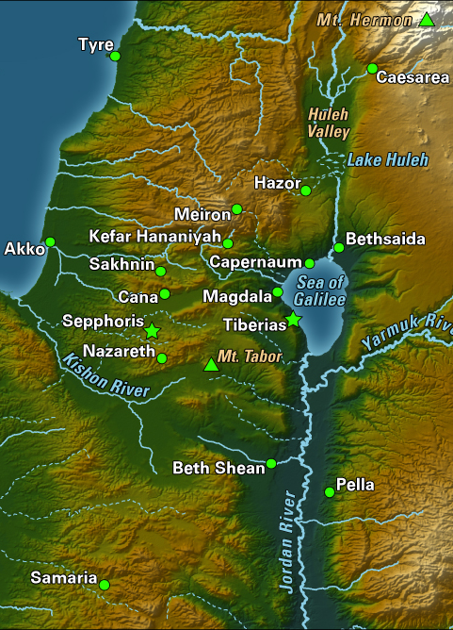
Jesus Arrives in Galilee
(Matthew 4:12-17; Mark 1:14-15; Luke 4:14-15; John 4:43-45)
The Galileans welcome Jesus because they had seen the miracles He had performed in Jerusalem (Jn. 4:45).
He dwells in Capernaum (Mt. 4:13).
News of Him spreads throughout the region (Lk. 4:14-15).
The theme of Jesus’ preaching is repentance (Mt. 4:17; Mk. 1:14-15).
Notes:
John 4:45 So when He came to Galilee, the Galileans received Him, having seen all the things He did in Jerusalem at the feast; for they also had gone to the feast.
Matthew 4:12-17 Now when Jesus heard that John had been put in prison, He departed to Galilee. 13 And leaving Nazareth, He came and dwelt in Capernaum, which is by the sea, in the regions of Zebulun and Naphtali, 14 that it might be fulfilled which was spoken by Isaiah the prophet, saying: 15 "THE LAND OF ZEBULUN AND THE LAND OF NAPHTALI, BY THE WAY OF THE SEA, BEYOND THE JORDAN, GALILEE OF THE GENTILES: 16 THE PEOPLE WHO SAT IN DARKNESS HAVE SEEN A GREAT LIGHT, AND UPON THOSE WHO SAT IN THE REGION AND SHADOW OF DEATH LIGHT HAS DAWNED." 17 From that time Jesus began to preach and to say, "Repent, for the kingdom of heaven is at hand.“
Mark 1:14-15 Now after John was put in prison, Jesus came to Galilee, preaching the gospel of the kingdom of God, 15 and saying, "The time is fulfilled, and the kingdom of God is at hand. Repent, and believe in the gospel."
Luke 4:14-15 Then Jesus returned in the power of the Spirit to Galilee, and news of Him went out through all the surrounding region. 15 And He taught in their synagogues, being glorified by all.

