Slide 1
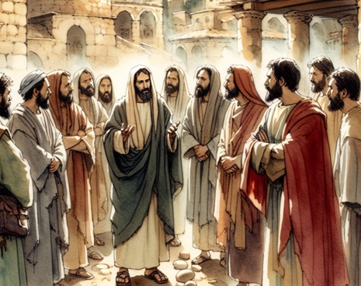
The Life of Christ Part 2
Periods Of Retirement

Slide 2

Seven Periods of Jesus’ Life
Years of Preparation
Beginning of Ministry
Great Galilean Ministry
Periods of Retirement
Close of Ministry
Last Week
Resurrection and Exaltation

Slide 3
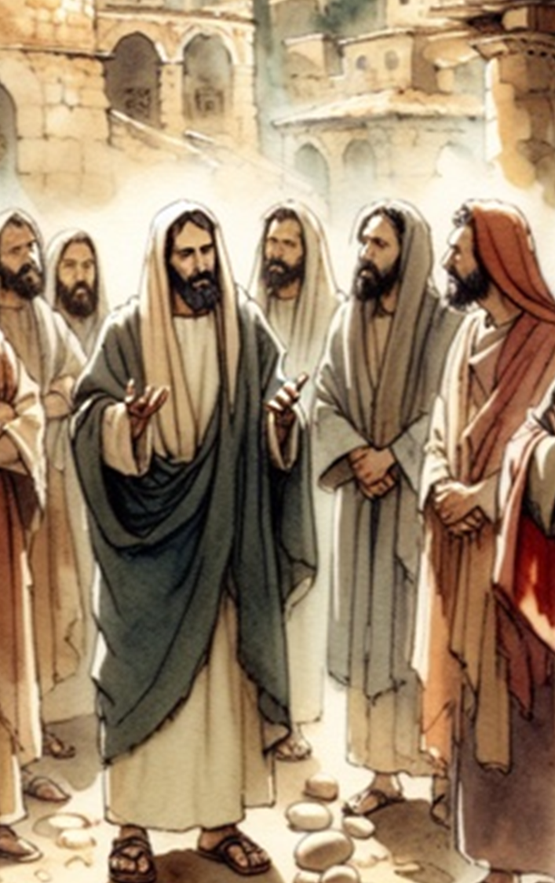
Life of Christ (2) Lesson 7 -- Overview
Feast of Tabernacles
Woman caught in Adultery
John 7:1– 8:11

Slide 4
Heading to Jerusalem (John 7:2-10; Luke 9:51-56)
Jesus’ unbelieving brothers goad Him to openly attend the Feast of Tabernacles, but Jesus knows what He is doing and the timetable of His plans.*
He leaves later and goes privately through Samaria to Jerusalem
Speak to the children of Israel, saying: 'The fifteenth day of this seventh month shall be the Feast of Tabernacles for seven days to the LORD. On the first day there shall be a holy convocation. You shall do no customary work on it. For seven days you shall offer an offering made by fire to the LORD. On the eighth day you shall have a holy convocation, and you shall offer an offering made by fire to the LORD. It is a sacred assembly, and you shall do no customary work on it. (Leviticus 23:34-36)
Notes:
4
*In the last six months or so before Jesus’ crucifixion, John makes mention of the Feast of Tabernacles (October), the Feast of Dedication (late December, John 10), and the Passover (early spring).
Leviticus 23:34-36 "Speak to the children of Israel, saying: 'The fifteenth day of this seventh month shall be the Feast of Tabernacles for seven days to the LORD. 35 On the first day there shall be a holy convocation. You shall do no customary work on it. 36 For seven days you shall offer an offering made by fire to the LORD. On the eighth day you shall have a holy convocation, and you shall offer an offering made by fire to the LORD. It is a sacred assembly, and you shall do no customary work on it.

Slide 5
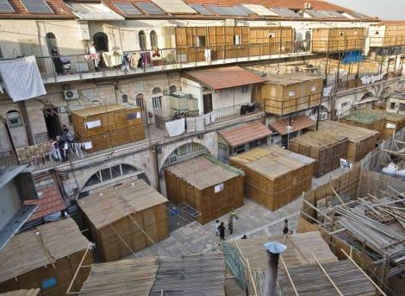
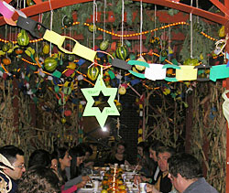
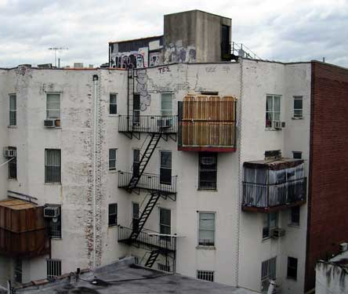
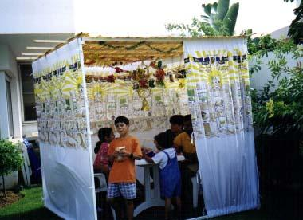
The Feast of Tabernacles (Sukkot) as celebrated in Modern Judaism
Celebrated on the 15th day of Tishri
[varies from late September to late October]
Leviticus 23:34-36
Notes:
Sukkot 2024 begins at sunset on October 16, 2024 and ends at nightfall on October 23, 2024.

Slide 6
Feast of Tabernacles John 7:1-13
Jesus did not want to walk in Judea because the Jews are now seeking to kill Him (7:1).
Jesus’ physical brothers are going to the Feast of Tabernacles in Jerusalem, and they attempt to pressure Jesus to go (7:2-4; cf. Matthew 13:55).
At this point, even His brothers did not believe in Him.
Later, they would become faithful followers (Acts 1:13-14).
Jesus declines to go with his brothers (7:6-10).
His time had “not yet fully come.”*
He initially remains in Galilee, but after His brothers go, He goes up to the feast in secret.
Notes:
*Note: Several translations have Jesus saying, “I am not YET going to the Feast,” not “I am not going” (cf. NKJV, NIV)
Mt 13:55 "Is this not the carpenter's son? Is not His mother called Mary? And His brothers James, Joses, Simon, and Judas?
Acts 1:13-14 And when they had entered, they went up into the upper room where they were staying: Peter, James, John, and Andrew; Philip and Thomas; Bartholomew and Matthew; James the son of Alphaeus and Simon the Zealot; and Judas the son of James. 14 These all continued with one accord in prayer and supplication, with the women and Mary the mother of Jesus, and with His brothers.
James, who was later prominent in the Jerusalem church (Acts 15; Galatians 2) and wrote book of James.
Jude, wrote the book of Jude.

Slide 7
Feast of Tabernacles (John 7:11-19)
The “Jews”* seek Jesus at the Feast (7:11-13)
The people have widely varying opinions about Jesus.
But no speaks openly about Jesus “for fear of the Jews.”
Jesus makes His appearance, teaching in the temple at about the midpoint of the 8 day Feast (7:14-19).
The Jews marvel: “How does this Man know letters, having never studied?"
Jesus explains that anyone who wills to do God’s will would know the true source of His teaching.
He who speaks from himself seeks his own glory, not God’s!
Moses had given them the Law, but they sought to kill Jesus!
Notes:
John uses the term “the Jews” almost exclusively of the Jewish leaders who opposed Jesus.
The Jews, the people, those from Jerusalem, the crowd – all with differing viewpoints and agendas!

Slide 8
Feast of Tabernacles (John 7:20-24)
The people wonder who is seeking to kill Jesus and why (7:20-24).
The people think Jesus has a demon. Who is seeking to kill Him?
Jesus explains.
The Jews would circumcise on the Sabbath in order to keep the Law.
But Jesus had healed a man on the Sabbath, so they wanted to kill Him (cf. John 5).
“Do not judge according to appearance, but judge with righteous judgment.”

Slide 9
Feast of Tabernacles (John 7:25-31)
Some from Jerusalem wonder, “Could this be the Christ?”
There is rampant confusion and misinformation:
“Do the rulers know indeed that this is truly the Christ?
“We know where this Man is from; but when the Christ comes, no one knows where He is from."
Jesus declares that they actually do know where He is from – He is from God!
The reason those who sought to take Him did not was “because His hour had not yet come.”
Many of the people believe in Him, saying, "When the Christ comes, will He do more signs than these which this Man has done?

Slide 10
Feast of Tabernacles (John 7:32-39)
The Pharisees send officers to arrest Jesus.
Jesus continues teaching:
He will be with them a little while longer and then return to the One who sent Him. They could not follow.
The Jews wonder if He will seek to hide from them by going to the dispersion and teaching Greeks.
On the last day of the Feast, Jesus offers living water!
If anyone thirsts, let him come to Me and drink.
He who believes in Me, as the Scripture has said, out of his heart will flow rivers of living water."
This He spoke concerning the Spirit, whom believers would receive.

Slide 11
Feast of Tabernacles (John 7:40-53)
The people are divided over Jesus.
Some from the crowd said, “Truly this is the prophet.”
Others said, “This is the Christ.”
Some asked, “Will the Christ come out of Galilee?”
Shouldn’t the Christ come from Bethlehem?
Some wanted to arrest Jesus, but no one lays a hand on Him.

Slide 12
Feast of Tabernacles (John 7:40-53)
The officers return the Pharisees empty-handed, and the Pharisees ask, “Why have you not brought Him?”
The officers respond, "No man ever spoke like this Man!"
Then the Pharisees answered them, "Are you also deceived?” “Have any of the rulers or the Pharisees believed in Him?” “But this crowd that does not know the law is accursed."
Nicodemus objects: “Does our law judge a man before it hears him and knows what he is doing?"
They answered and said to him, "Are you also from Galilee? Search and look, for no prophet has arisen out of Galilee."
Notes:
Note—Capernaum means “tomb of Nahum” or “village of Nahum” and some scholars believe Nahum was from there.
Jonah was from Gath-hepher which was a city in Galilee (2 Kings 14:25).
Isaiah prophesied the Messiah would preach in Galilee Isaiah 9:1-2 Nevertheless the gloom will not be upon her who is distressed, As when at first He lightly esteemed The land of Zebulun and the land of Naphtali, And afterward more heavily oppressed her, By the way of the sea, beyond the Jordan, In Galilee of the Gentiles. 2 The people who walked in darkness Have seen a great light; Those who dwelt in the land of the shadow of death, Upon them a light has shined.

Slide 13
Woman Caught in Adultery John 8:1-11
The scribes and Pharisees bring Him a woman caught in adultery; in the very act.
The Law called for her death (and the death of the man).
Leviticus 20:10; Deuteronomy 22:22-24
Why bring her to Jesus? Why not take her to the Sanhedrin?
They were testing/tempting Him.
The Law says to stone her. The Romans say we can’t.
NOTE: Roman law did not allow the Jews to punish by death.
Notes:
On the authenticity of John 7:53-8:11—It's in nearly everybody's Bible. Scholars have reasons for leaving it there. There is much more to consider than whether or not it's in the oldest manuscripts. Here are just a couple of things.
The earliest manuscripts may not always be the best. Maybe the best are the ones that were copied the most. Personally, I do not blindly trust the earlier manuscripts to the degree so many modern scholars and scholarly sheep do. I think the Textus Receptus and the Majority Text should carry A LOT of weight when we consider the providence of God in preserving His word.
In any case, John 7:53--8:11 is in the Latin Vulgate, produced by Jerome about 400 A.D., who would have been translating from Greek texts that pre-date most of our oldest manuscripts.
Le 20:10 'The man who commits adultery with another man's wife, he who commits adultery with his neighbor's wife, the adulterer and the adulteress, shall surely be put to death.
De 22:22 "If a man is found lying with a woman married to a husband, then both of them shall die-the man that lay with the woman, and the woman; so you shall put away the evil from Israel.
De 17:6 "Whoever is deserving of death shall be put to death on the testimony of two or three witnesses; he shall not be put to death on the testimony of one witness. 7 "The hands of the witnesses shall be the first against him to put him to death, and afterward the hands of all the people. So you shall put away the evil from among you.

Slide 14
Woman Caught in Adultery John 8:1-11
Jesus took a long pause before answering – as if ignoring the question. Then He put the decision back on them and waited.
“He who is without sin among you, let him throw a stone at her first."
They left one-by-one, starting with the oldest. Each is convicted!
Only Jesus and the woman are left.
He did not condemn her. He did not condemn her to death for adultery (John 3:17; Luke 19:10).
He did not say she was forgiven (as He does other times).*
He told her to “go and sin no more.”
Notes:
John 3:17 "For God did not send His Son into the world to condemn the world, but that the world through Him might be saved.
Luke 19:10 "for the Son of Man has come to seek and to save that which was lost.“
Luk_5:20 When He saw their faith, He said to him, "Man, your sins are forgiven you."
Luk_5:23 Which is easier, to say, 'Your sins are forgiven you,' or to say, 'Rise up and walk'?
Luk_7:48 Then He said to her, "Your sins are forgiven.“
Does Jesus fail to condemn adultery? Does He in any way indicate adultery is sin?
Some commentators say this passage was omitted in reading to early churches (thus the question about authenticity) because it lacks a clear condemnation of adultery.
Does this relate in any way to Matthew 23:23 discussion of justice and mercy and faith?

