Slide 1
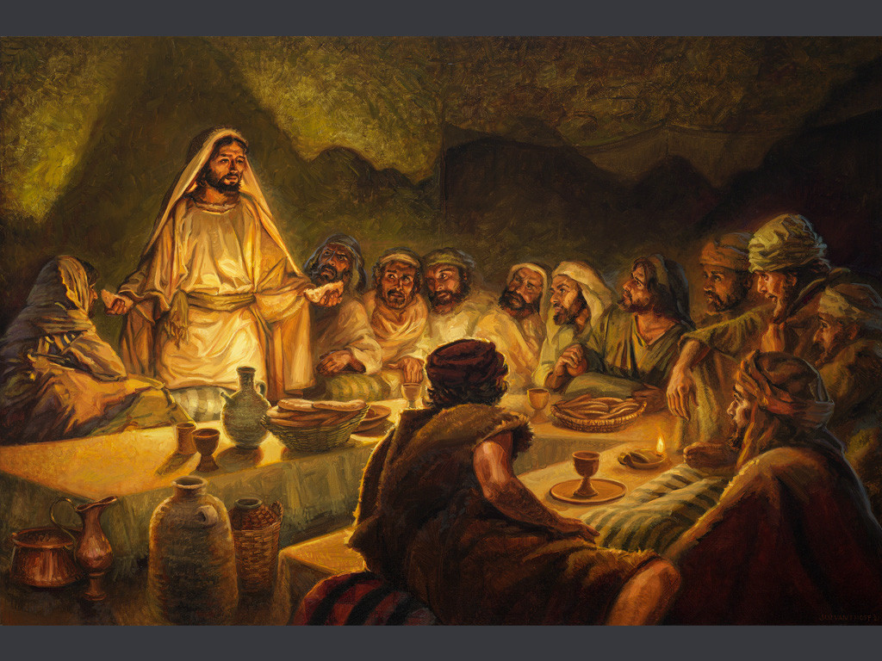
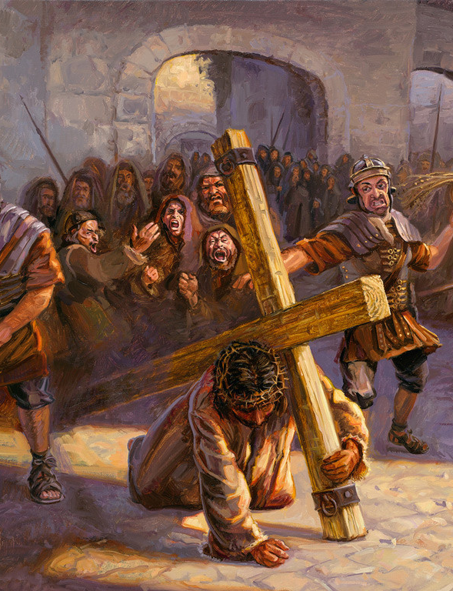
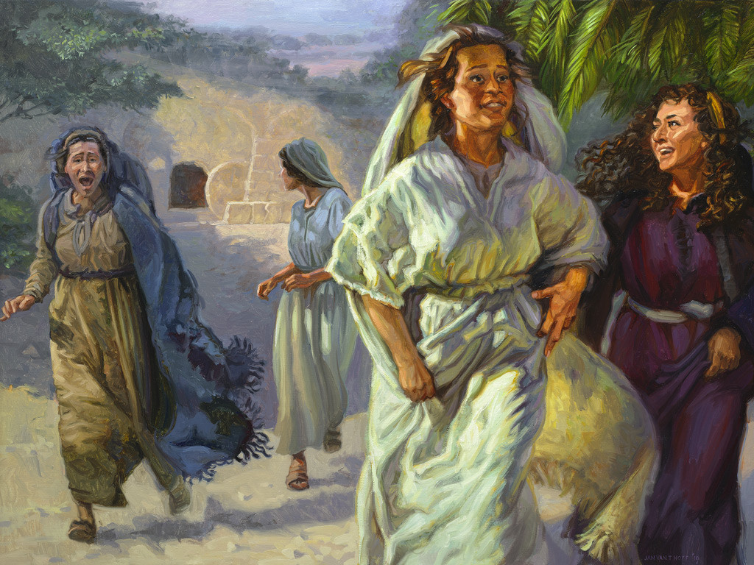
The Life of Christ
Part 3
Final Week  Resurrection  Appearances  Exaltation
Notes:
Images courtesy of Hoff/Gospelimages.com

Slide 2

Seven Periods of Jesus’ Life
Years of Preparation
Beginning of Ministry
Great Galilean Ministry
Periods of Retirement
Close of Ministry
Last Week
Resurrection and Exaltation

Slide 3
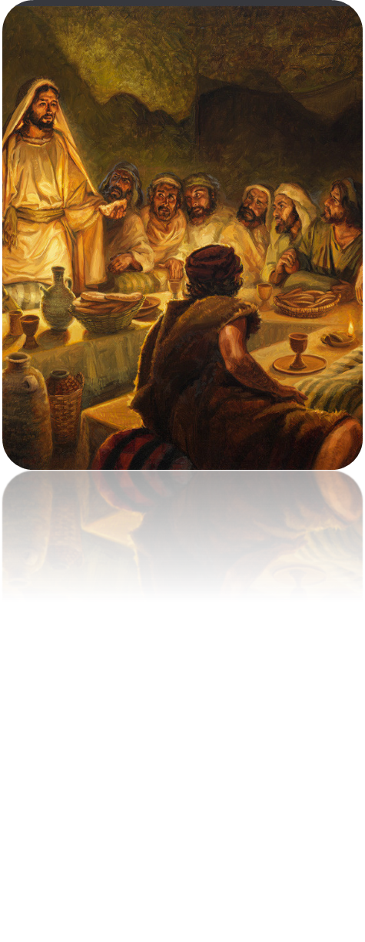
Life of Christ (3)
Lesson 2-- Overview
John 11:55-12:19, Mark 11:1-14
Anointing at Bethany
Lessons from a Fig Tree
The Coronation Entry

Slide 4
Anointing in Bethany
(John 11:54—12:11)
  Mary anoints Jesus in Bethany.
    Jesus retires to Ephraim until Passover is near (11:54).
    As the Passover approaches, the Jewish leaders command the people to be on the lookout for Him so that they might seize Him (11:55-57).
    Jesus comes to Bethany six days before Passover (12:1).

Slide 5
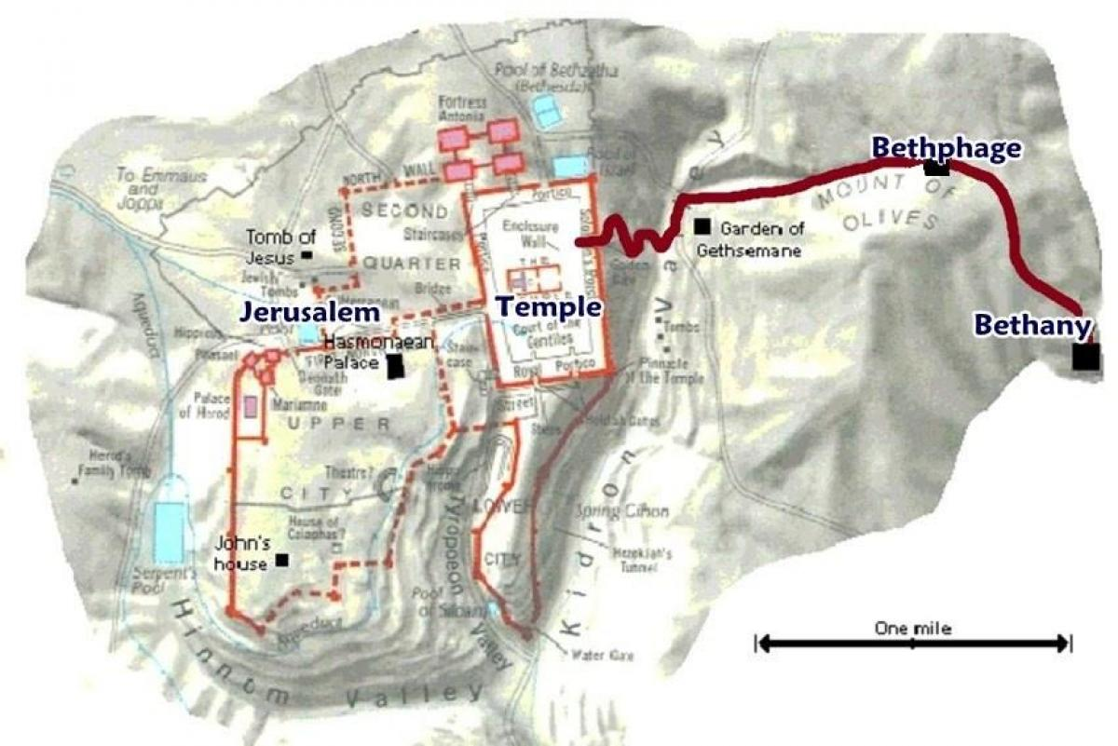
Garden of Gethsemane

Slide 6
Anointing in Bethany
(John 11:54—12:11)
  Mary anoints Jesus in Bethany.
    Jesus comes to Bethany six days before Passover (12:1).
    They give a dinner for Jesus there; Lazarus is in attendance and Martha is serving (12:2).
    Mary anoints Jesus with very costly oil of spikenard* and the house is filled with the fragrance (12:3).
    Judas objects saying that the oil could have been sold for 300 denarii and the proceeds given to the poor (12:4-6).
Notes:
Compare Matthew 26:6-13
*Spikenard is an essential oil derived from Nardostachys jatamansi, a flowering plant of the valerian family which grows in the Himalayas of Nepal, China, and India. It is a source of a type of intensely aromatic amber-colored essential oil, spikenard.
1 Timothy 6:9-10 But those who desire to be rich fall into temptation and a snare, and into many foolish and harmful lusts which drown men in destruction and perdition. 10 For the love of money is a root of all kinds of evil, for which some have strayed from the faith in their greediness, and pierced themselves through with many sorrows.
Matthew 26:10-13 But when Jesus was aware of it, He said to them, "Why do you trouble the woman? For she has done a good work for Me. 11 For you have the poor with you always, but Me you do not have always. 12 For in pouring this fragrant oil on My body, she did it for My burial. 13 Assuredly, I say to you, wherever this gospel is preached in the whole world, what this woman has done will also be told as a memorial to her.“
The village churches in Zimbabwe do not have contributions amounting to $10 per week…$50 in a five Sunday month. Our contribution total last month was $50,000.
Galatians 2:10 They desired only that we should remember the poor, the very thing which I also was eager to do.
Romans 15:26 For it pleased those from Macedonia and Achaia to make a certain contribution for the poor among the saints who are in Jerusalem.

Slide 7
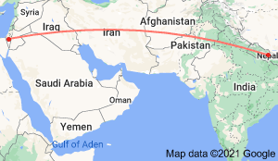
Spikenard is produced by steam distilling the roots of Nardostachys jatamansi, a flowering botanical that grows wild in the Himalayas, 3,000 miles from Israel.

Slide 8
Anointing in Bethany
(John 11:54—12:11)
  Mary anoints Jesus in Bethany.
    Judas objects saying that the oil could have been sold for 300 denarii and the proceeds given to the poor (12:4-6).
      His objection hid his true motive. As the keeper of the money box, he stole from it (cf. 1 Timothy 6:9-10).
    Jesus says to leave Mary alone.
      She had kept the oil for Jesus’ burial (12:7, cf. 19:38-42).
      There will always be poor people to help (12:8; Galatians 2:10).
Notes:
Compare Matthew 26:6-13
*Spikenard is an essential oil derived from Nardostachys jatamansi, a flowering plant of the valerian family which grows in the Himalayas of Nepal, China, and India. It is a source of a type of intensely aromatic amber-colored essential oil, spikenard.
1 Timothy 6:9-10 But those who desire to be rich fall into temptation and a snare, and into many foolish and harmful lusts which drown men in destruction and perdition. 10 For the love of money is a root of all kinds of evil, for which some have strayed from the faith in their greediness, and pierced themselves through with many sorrows.
Matthew 26:10-13 But when Jesus was aware of it, He said to them, "Why do you trouble the woman? For she has done a good work for Me. 11 For you have the poor with you always, but Me you do not have always. 12 For in pouring this fragrant oil on My body, she did it for My burial. 13 Assuredly, I say to you, wherever this gospel is preached in the whole world, what this woman has done will also be told as a memorial to her.“
The village churches in Zimbabwe do not have contributions amounting to $10 per week…$50 in a five Sunday month. Our contribution total last month was $50,000.
Galatians 2:10 They desired only that we should remember the poor, the very thing which I also was eager to do.
Romans 15:26 For it pleased those from Macedonia and Achaia to make a certain contribution for the poor among the saints who are in Jerusalem.

Slide 9
Anointing in Bethany
(John 11:54—12:11)
  The plot to kill Lazarus.
    A great many had come to the dinner to see Lazarus as well as Jesus (12:9).
    The chief priests also plotted to put Lazarus to death because many believed on Jesus on account of him (12:10-11; Romans 1:18).
Notes:
Killing a witness or destroying evidence is an age-old tactic of those who do not want the evidence examined, and who do not love the truth.
Romans 1:18 For the wrath of God is revealed from heaven against all ungodliness and unrighteousness of men, who suppress the truth in unrighteousness.

Slide 10
The Coronation Entry
(John 12:12-19; Mark 11:1-11)
  Jesus is acclaimed by the multitude (12:12-13).
    Multitudes who had come to the Passover learn that Jesus will be in attendance.
    They come out to greet him proclaiming “Hosanna! ‘Blessed is He who comes in the name of the Lord!’ The King of Israel!” (cf. Psalm 118:25-26).
  Jesus enters riding a young donkey (12:14-18).
    Jesus “found” a young donkey (Mark 11:1-8).
Notes:
The narrative of this entry into Jerusalem is found in all four Gospels.
Psalms 118:25-26 Save now, I pray, O LORD; O LORD, I pray, send now prosperity. (26) Blessed is he who comes in the name of the LORD! We have blessed you from the house of the LORD.
Even the way Jesus “found a young donkey” implies His Divine identity (Mark 11:1-8).
Zechariah 9:9 "Rejoice greatly, O daughter of Zion! Shout, O daughter of Jerusalem! Behold, your King is coming to you; He is just and having salvation, Lowly and riding on a donkey, A colt, the foal of a donkey.

Slide 11
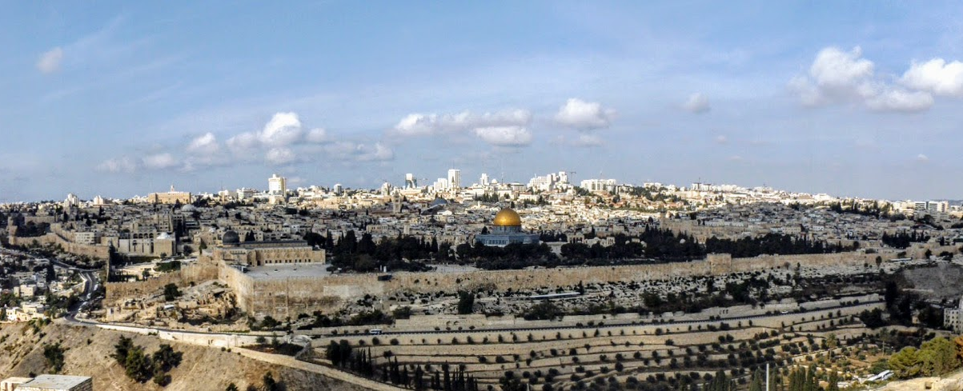
How Jesus “found” a young donkey.
As Jesus approaches Jerusalem He sends two disciples into a village to fetch a colt on which no one has sat (cf. Mark 11:1-6).
  If anyone asks what they are doing to He tells them to say that “The Lord has need of it.”
  As they are taking the colt, they are confronted by bystanders.
  They respond as Jesus commanded them, so the bystanders “let them go.”
Notes:
11

Slide 12
Garden of Gethsemane

Slide 13
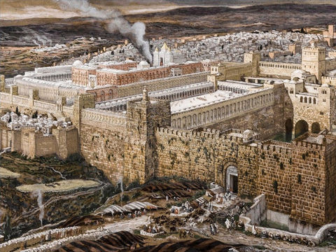
Notes:
The procession heads from the Mount of Olives towards Jerusalem.
(Luke 19:37). Reconstruction of Jerusalem and the Temple of Herod - James Tissot - Brooklyn Museum.

Slide 14
The Coronation Entry
(John 12:12-19)
  Jesus enters riding a young donkey (12:14-18).
    Jesus “found” a young donkey” (cf. Mark 11:1-8).
    It had been prophesied that the King would come to Jerusalem in this way (Zech. 9:9).
        This connection was not made by the disciples at first.
    Many who had been impressed with the raising of Lazarus also participated.
  The Pharisees are vexed to see Jesus’ following (12:19).
Notes:
The narrative of this entry into Jerusalem is found in all four Gospels.
Psalms 118:25-26 Save now, I pray, O LORD; O LORD, I pray, send now prosperity. (26) Blessed is he who comes in the name of the LORD! We have blessed you from the house of the LORD.
Even the way Jesus “found a young donkey” implies His Divine identity (Mark 11:1-8).
Zechariah 9:9 "Rejoice greatly, O daughter of Zion! Shout, O daughter of Jerusalem! Behold, your King is coming to you; He is just and having salvation, Lowly and riding on a donkey, A colt, the foal of a donkey.

Slide 15
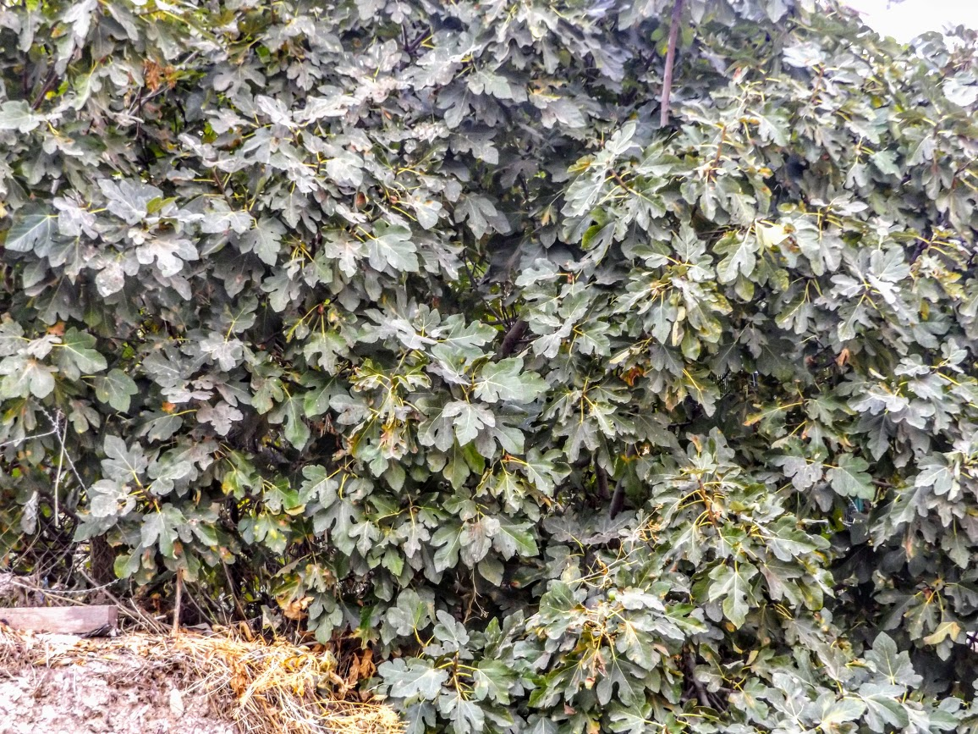
Jesus Enters Jerusalem; Curses a Fig Tree (Mark 11:12-14)
The next day as Jesus travels from Bethany to Jerusalem He is hungry (11:12-14)
  Seeing a fig tree, He examines it for fruit. Finding nothing but leaves He curses the tree: “Let no one eat fruit from you ever again.”
Notes:
15
Lush fig tree with no fruit near the Pool of Siloam [Picture taken just after I had walked through Hezekiah’s tunnel – I could have used a couple of figs about then!]

Slide 16
“We Would See Jesus”
(John 12:20-35)
  Greeks come seeking Jesus (12:20-22).
    They had come to the feast to worship.
    They approach Philip desiring to see Jesus.
  Jesus would ultimately “draw all people” to Himself (12:23-35).
    The hour had come for the Son of Man to be glorified (12:23-26).
      A grain of wheat must die to produce fruit.
      We must lose our life in this world to gain eternal life.
      In this way, we follow Jesus.
Notes:
The word for Greek is ̔Ἕλλην – properly a “Greek” and not the same as Ἑλληνιστής in Acts 6:1, “Greek speaking Jews.” These were apparently proselytes.

Slide 17
“We Would See Jesus”
(John 12:20-35)
  Jesus ultimately “draws all people” to Himself
  Jesus is troubled by the impending events, but He knows this is the reason He came (12:27; Gal. 4:4-5).
    His desire is that the Father be glorified (12:28).
    A voice from heaven declares it will be (12:29-30).
    The ruler of this world is cast out (12:31; Rev. 12).
    When Jesus is “lifted up” He will draw all people to Himself (12:32, cf. 20-21).
      This He said, signifying by what death He would die (12:33; John 3:14; 8:28).
      The people are confused; they had heard that the Christ would remain forever (12:34; 2 Sam. 7:13).
Notes:
Galatians 4:4-5 But when the fullness of the time had come, God sent forth His Son, born of a woman, born under the law, 5 to redeem those who were under the law, that we might receive the adoption as sons.
Psalms 110:4 The LORD has sworn And will not relent, "You are a priest forever According to the order of Melchizedek.“
2 Samuel 7:13 He shall build a house for My name, and I will establish the throne of his kingdom forever.

