Slide 1
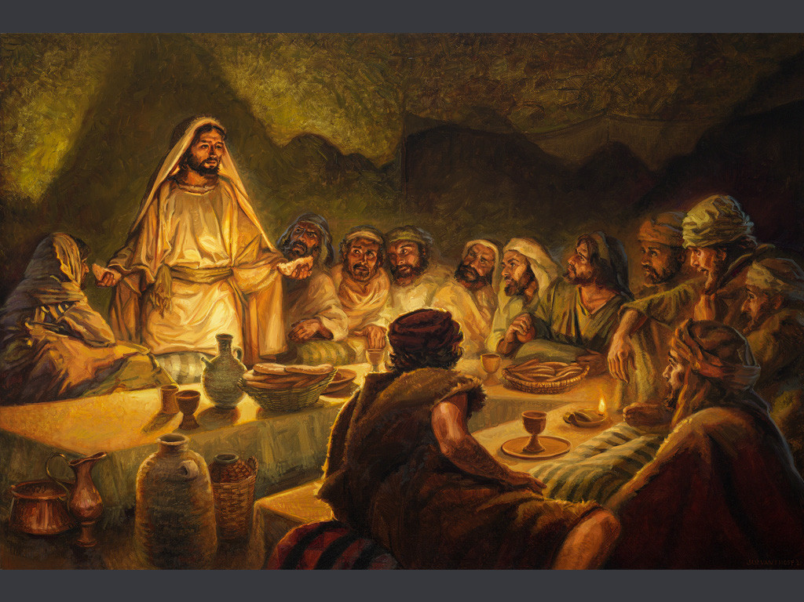
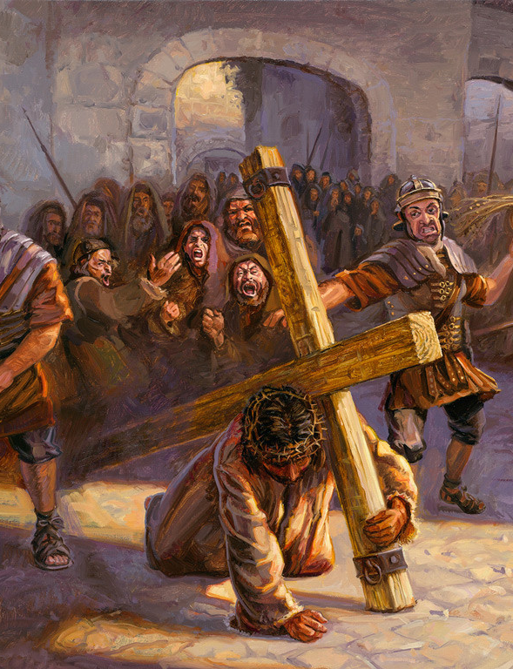
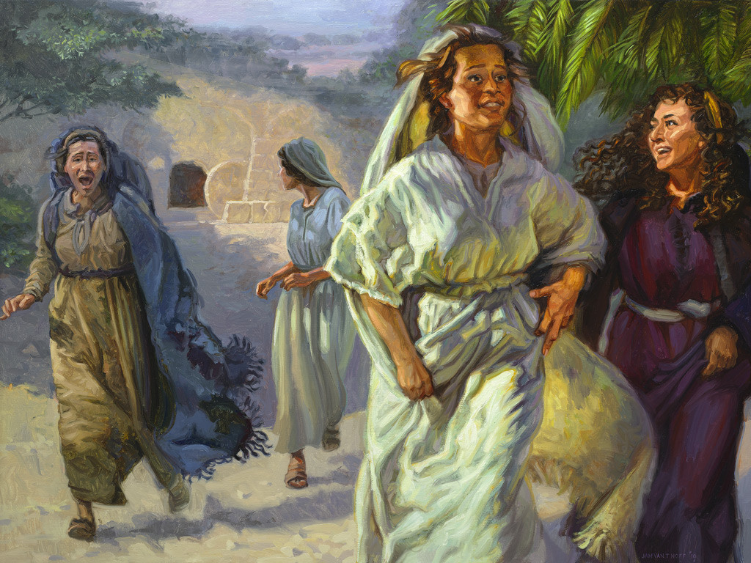
The Life of Christ
Part 3
Final Week  Resurrection  Appearances  Exaltation
Notes:
Images courtesy of Hoff/Gospelimages.com

Slide 2

Seven Periods of Jesus’ Life
Years of Preparation
Beginning of Ministry
Great Galilean Ministry
Periods of Retirement
Close of Ministry
Last Week
Resurrection and Exaltation

Slide 3
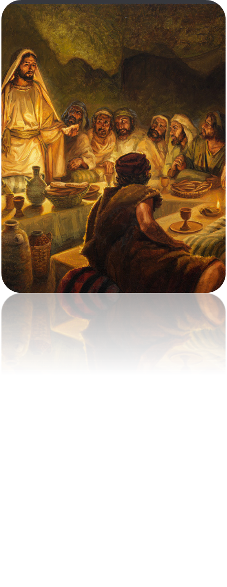
Life of Christ (3)
Lesson 3-- Overview
John 12:20-50; Mark 11:15-18
Cleansing of Temple
Significance of Jesus’ Death and Resurrection
Summary of Jesus’ Mission and Purpose

Slide 4
Possible Timetable of the Last Week
Friday—Jesus travels up from Jericho to Bethany
Saturday (Sabbath)—rest, anointing by Mary at Simon’s house
Sunday—Coronation (Triumphant Entry)
Monday—Cleansing Temple
Tuesday—Conflict and teaching in the Temple

Slide 5
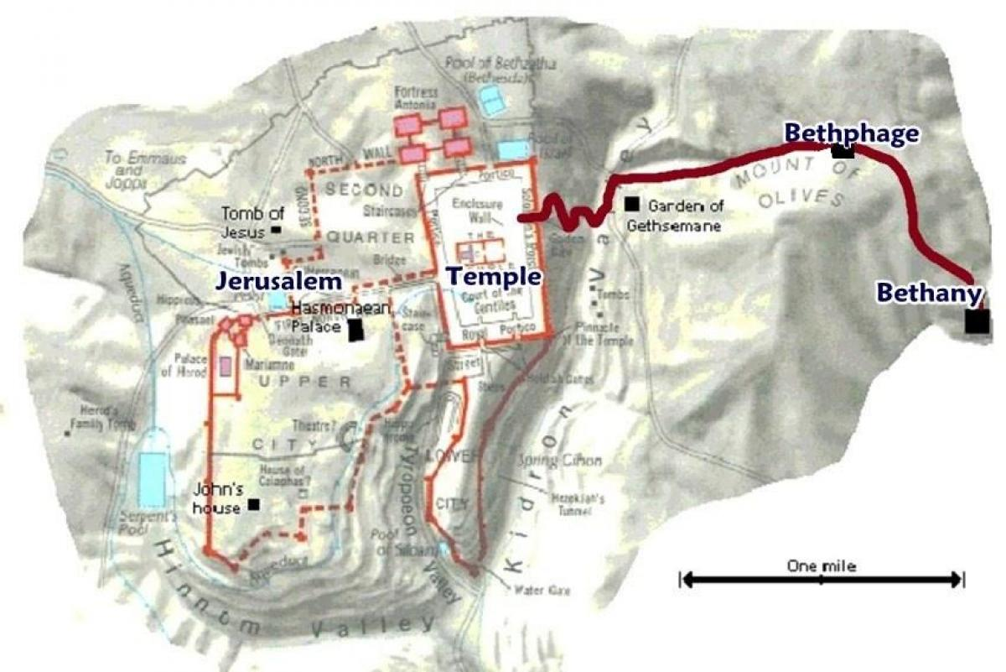
Garden of Gethsemane

Slide 6
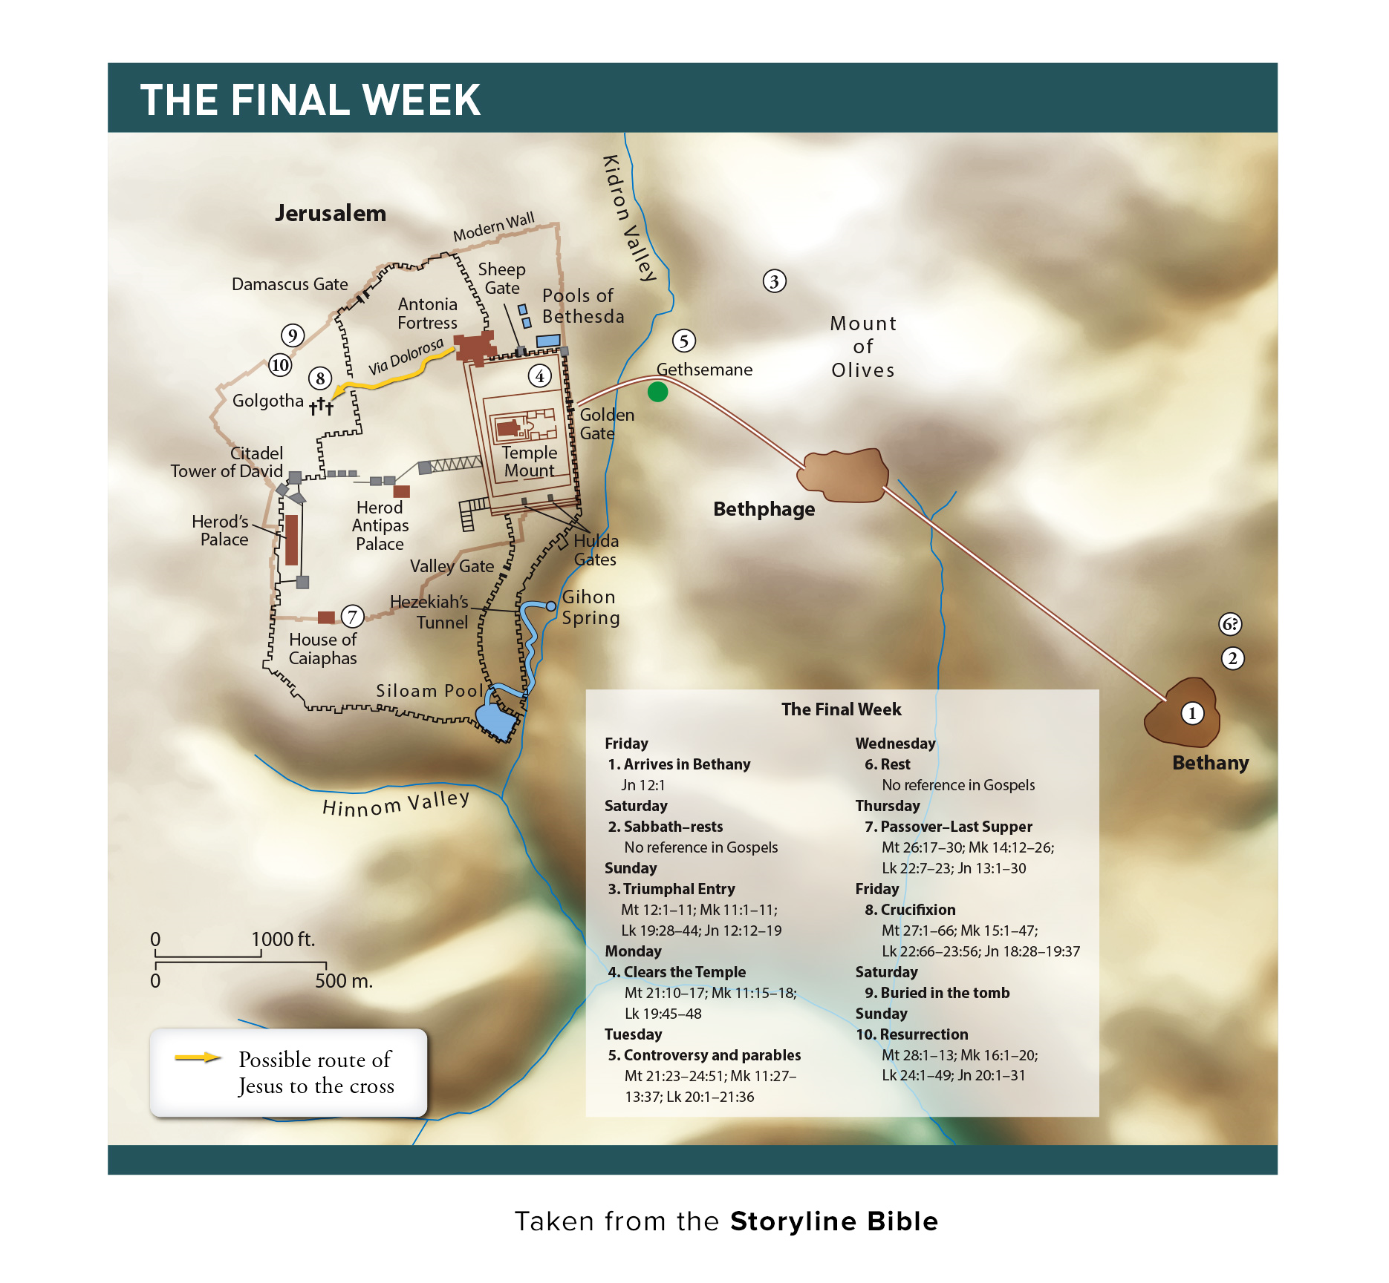
Notes:
3 – Coronation Entry
4 – Cleanses Temple

Slide 7
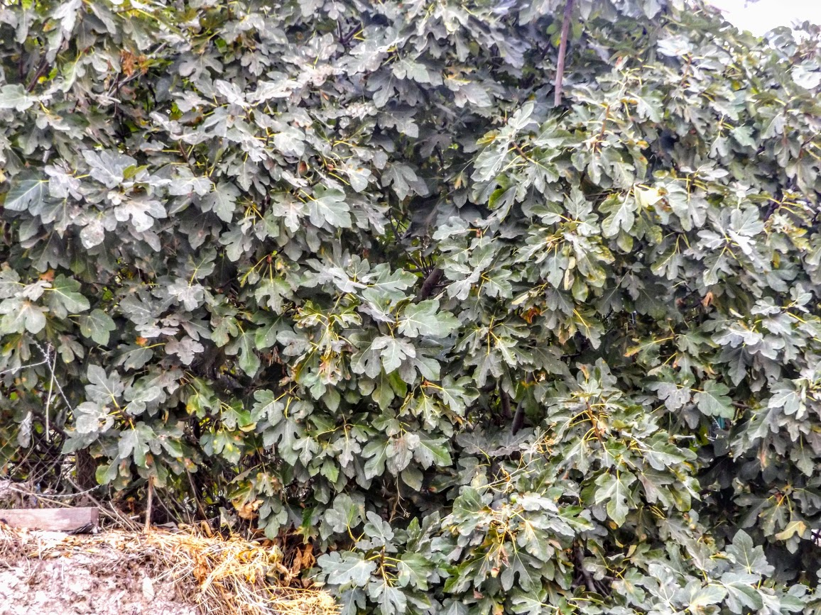
Jesus Enters Jerusalem; Curses a Fig Tree (Mark 11:12-14)
The next day as Jesus travels from Bethany to Jerusalem He is hungry (11:12-14)
  Seeing a fig tree, He examines it for fruit. Finding nothing but leaves He curses the tree: “Let no one eat fruit from you ever again.”
Notes:
7
Lush fig tree with no fruit near the Pool of Siloam [Picture taken just after I had walked through Hezekiah’s tunnel – I could have used a couple of figs about then!]

Slide 8
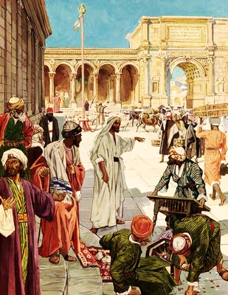
Cleansing the Temple (Mark 11:15-18)
Jesus enters the temple and drives out the buyers, sellers & money changers (11:15-17; cp. John 2:13-17).
  He would not allow anyone to carry wares through the temple.
  He taught that the Lord’s house should be a house of prayer, but they had made it into a den of thieves.
The scribes and chief priests sought to destroy Him; they feared Him because the people were astonished at His teaching (11:18).
Notes:
8
Jesus had “looked around” the temple the previous day, Mark 11:11
Luke 19:45-46 Then He went into the temple and began to drive out those who bought and sold in it, 46 saying to them, "It is written, 'MY HOUSE IS A HOUSE OF PRAYER,' but you have made it a 'DEN OF THIEVES.’ “ (also Matthew 21:12-13).

Slide 9
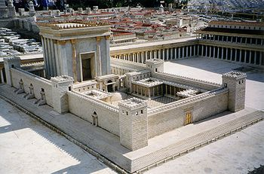

Slide 10
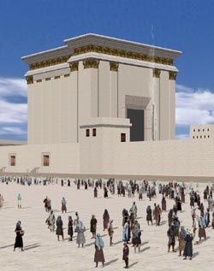
Multitudes in the Court of the Gentiles

Slide 11
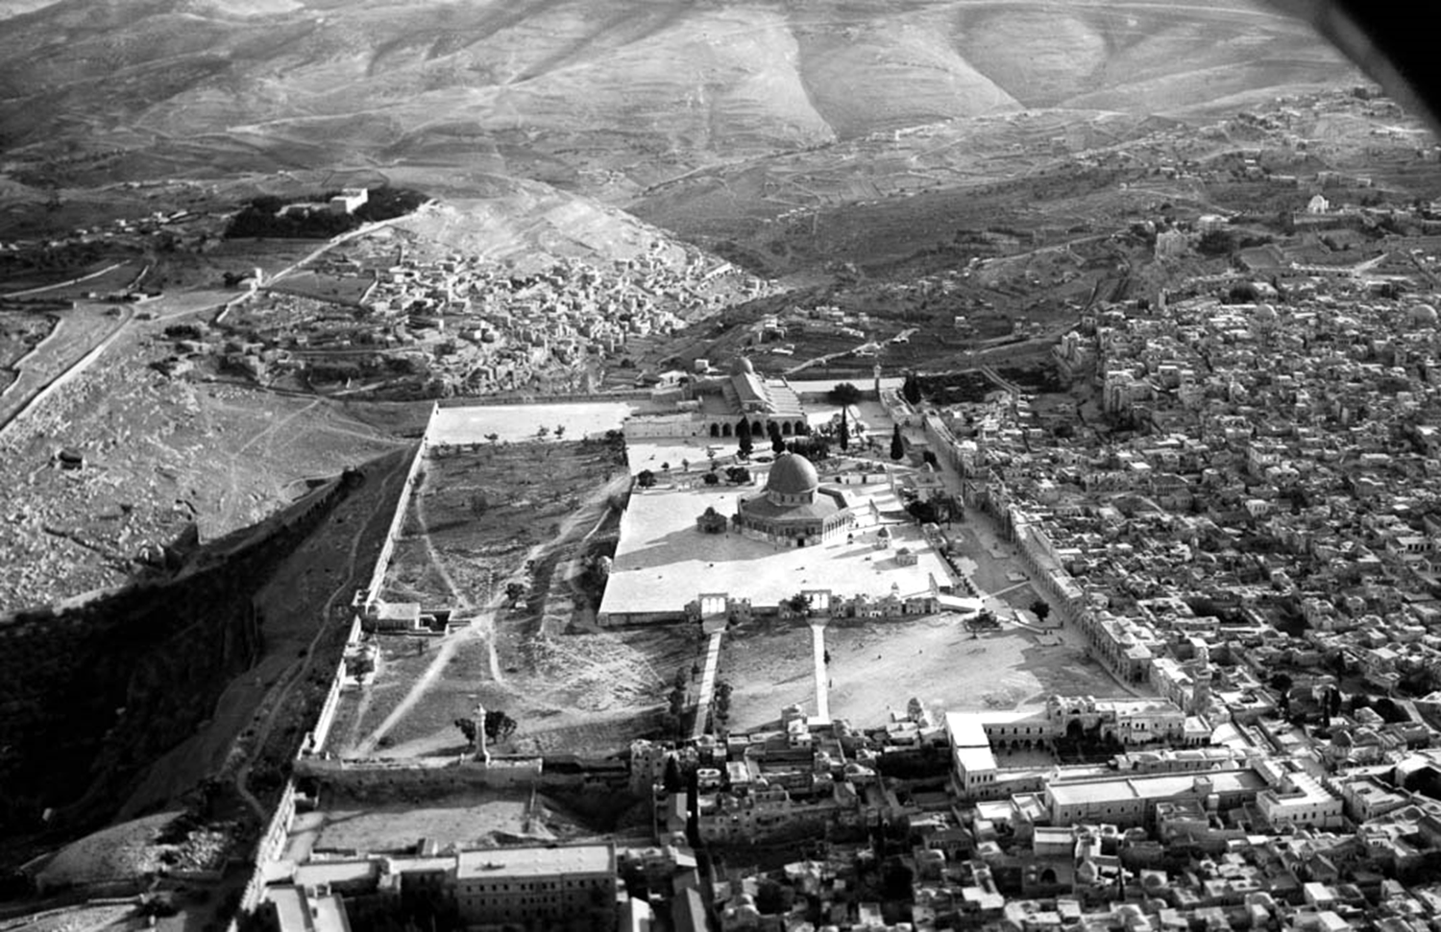
Notes:
This American Colony photograph was taken in 1931. The spaciousness of this area is more obvious without the olive groves that have been planted in recent decades. The size of the Temple Mount is about the equivalent of 24 football fields.
mat22135

Slide 12
“We Would See Jesus”
(John 12:20-35)
  Greeks come seeking Jesus (12:20-22).
    They had come to the feast to worship.
    They approach Philip desiring to see Jesus.
  Jesus would ultimately “draw all people” to Himself (12:23-35).
    The hour had come for the Son of Man to be glorified (12:23-26).
      A grain of wheat must die to produce fruit (cf. 1 Corinthians 15:35-37).
      We must lose our life to gain eternal life.
      In this way, we follow Jesus.
Notes:
The word for Greek is ̔Ἕλλην – properly a “Greek” and not the same as Ἑλληνιστής in Acts 6:1, “Greek speaking Jews.” These were apparently proselytes.
1 Corinthians 15:35-37 But someone will say, "How are the dead raised up? And with what body do they come?" 36 Foolish one, what you sow is not made alive unless it dies. 37 And what you sow, you do not sow that body that shall be, but mere grain—perhaps wheat or some other grain.

Slide 13
“We Would See Jesus”
(John 12:20-35)
  Jesus ultimately “draws all people” to Himself.
  Jesus is troubled by the impending events, but He knows this is the reason He came (12:27; Gal. 4:4-5).
    His desire is that the Father be glorified (12:28).
    A voice from heaven declares it will be (12:29-30).
    The ruler of this world is cast out (12:31; Rev. 12).
    When Jesus is “lifted up” He will draw all people to Himself (12:32, cf. 20-21).
      This He said, signifying by what death He would die (12:33; John 3:14; 8:28).
      The people are confused; they had heard that the Christ would remain forever (12:34; 2 Sam. 7:13).
Notes:
Galatians 4:4-5 But when the fullness of the time had come, God sent forth His Son, born of a woman, born under the law, 5 to redeem those who were under the law, that we might receive the adoption as sons.
John 3:14 And as Moses lifted up the serpent in the wilderness, even so must the Son of Man be lifted up,
John 8:28 Then Jesus said to them, "When you lift up the Son of Man, then you will know that I am He, and that I do nothing of Myself; but as My Father taught Me, I speak these things.
2 Samuel 7:13 He shall build a house for My name, and I will establish the throne of his kingdom forever.

Slide 14
The Jews Reject the Light of the World
(John 12:36-50)
  Jesus admonishes them to walk in the light (12:35).
  The Jews reject the light (12:36-43).
    Jesus exhorts them to “believe in the light” (12:36).
    But even though He had performed many signs, “they did not believe in Him” (12:37).
      This fulfilled multiple prophecies of Isaiah (12:38-41; Isaiah 53:1; 6:9-10).
      Isaiah had seen His glory and spoken of Him.
    However, even among the rulers many believed, but did not confess it because they feared being put out of the synagogue (12:42-43).
      They loved the praise of men more than God’s praise.
Notes:
Isaiah 53:1 Who has believed our report? And to whom has the arm of the LORD been revealed?
Isaiah 6:9-10 And He said, "Go, and tell this people: 'Keep on hearing, but do not understand; Keep on seeing, but do not perceive.' 10 "Make the heart of this people dull, And their ears heavy, And shut their eyes; Lest they see with their eyes, And hear with their ears, And understand with their heart, And return and be healed."

Slide 15
The Jews Reject the Light of the World
(John 12:36-50)
  Summary statement of Jesus’ mission and purpose.
  To believe in Him is to believe in the One who sent Him (12:44-45).
  He has come as a light so that believers need not abide in darkness (12:46-47).
    John 12:46 is the LAST time in John’s Gospel that Jesus is identified as the Light.
    It has been a predominate theme of His public ministry (1:4-5, 9; 8:12: 9:5; 12:35-36).
  His words are the standard of judgment because they are from the Father (12:48-49).
  He relies precisely on the Father’s words, because He knows they are everlasting life (12:50).
Notes:
John 12:46 is the LAST time in John’s Gospel Jesus is identified as the Light. It has been a predominate theme of His public ministry.
John 1:4 In Him was life, and the life was the light of men.
John 1:5 And the light shines in the darkness, and the darkness did not comprehend it.
John 1:9 That was the true Light which gives light to every man coming into the world.
John 8:12 Then Jesus spoke to them again, saying, "I am the light of the world. He who follows Me shall not walk in darkness, but have the light of life."
John 9:5 As long as I am in the world, I am the light of the world."
John 12:35 Then Jesus said to them, "A little while longer the light is with you. Walk while you have the light, lest darkness overtake you; he who walks in darkness does not know where he is going.
John 12:36 While you have the light, believe in the light, that you may become sons of light." These things Jesus spoke, and departed, and was hidden from them.
John 12:46 I have come as a light into the world, that whoever believes in Me should not abide in darkness.

