Slide 1
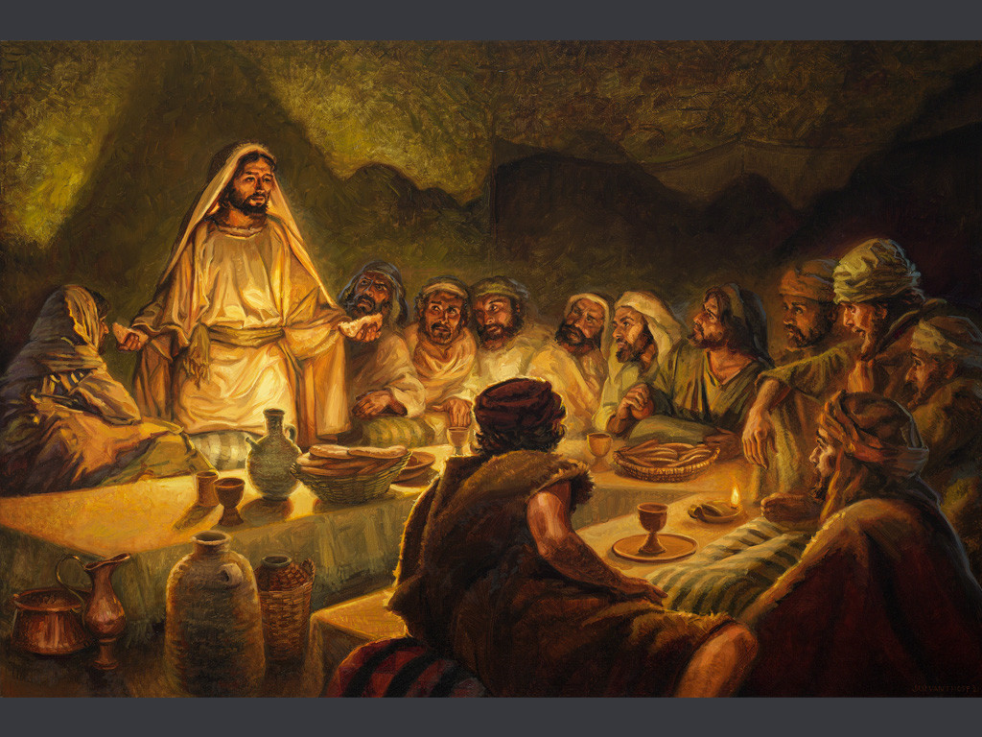
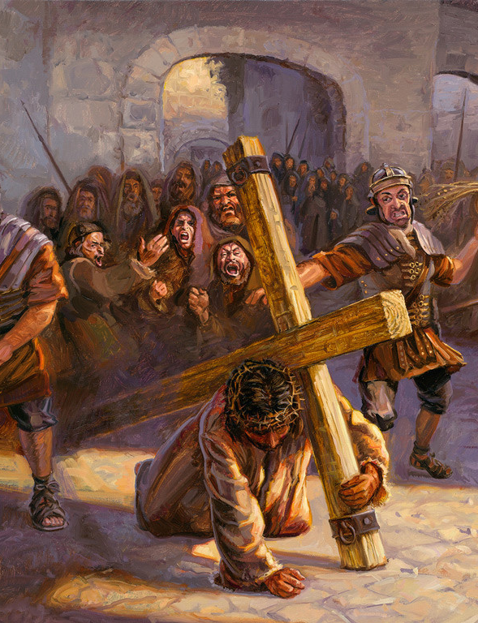
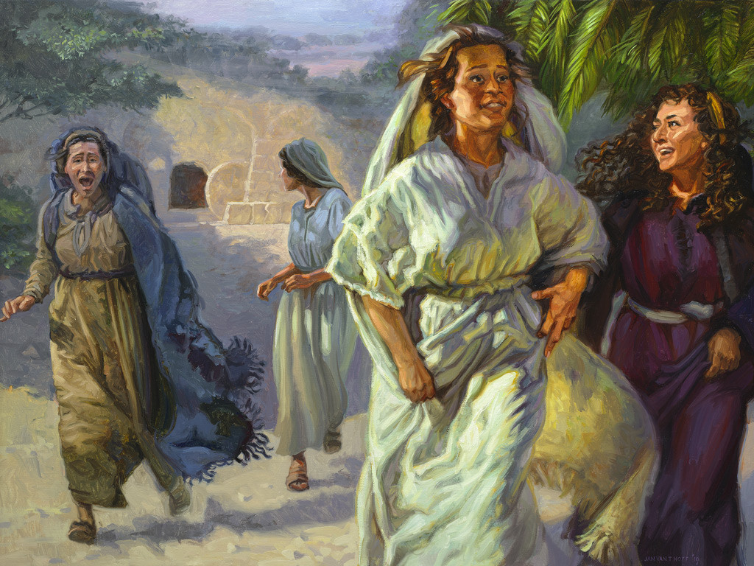
The Life of Christ Part 3
Final Week  Resurrection  Appearances  Exaltation
Notes:
Images courtesy of Hoff/Gospelimages.com

Slide 2

Seven Periods of Jesus’ Life
Years of Preparation
Beginning of Ministry
Great Galilean Ministry
Periods of Retirement
Close of Ministry
Last Week
Resurrection and Exaltation

Slide 3
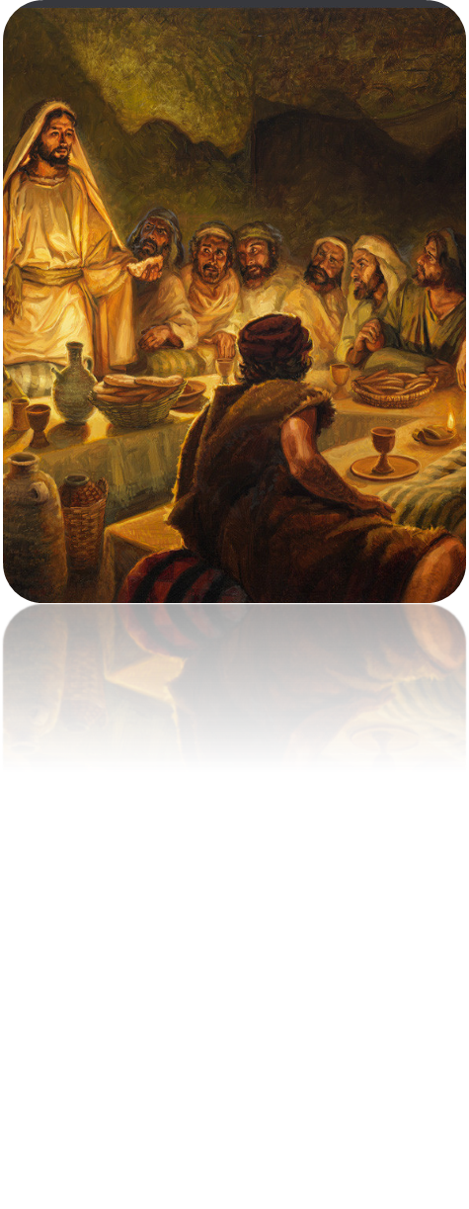
Life of Christ (3) Lesson 7 Overview
Matthew 24; Mark 13; Luke 21:5-38
Jesus warns of things to come: The Destruction of Jerusalem and His Second Coming

Slide 4
Overview of Matthew 24 and Mark 13
The message concerns the destruction of Jerusalem (Mt. 24: 1-35; Mk. 13:1-31) and the end of time (Matt. 24:36-51; Mk. 13:32-37).
Matthew 24:34-36 and Mark 13:30-32 give a clear break between the discussion of the two events; one would happen before the current generation passed away; no one knows when the other would happen.
The destruction of Jerusalem would change the course of history for Jews.
God’s power and purpose in punishing disobedient Israel could be clearly seen.
Jesus’ foreknowledge of the event proves His claim to be the Son of God.
Notes:
4
What destruction is being discussed?
Option 1 -- Matthew 24 (and related passages in Mark and Luke) refers to the destruction of Jerusalem with ‘hints’ of the final destruction while Matthew 25 deals with Christ’s second coming.
Option 2 There is an intermixing of the two. One question or answer may reference one time or the other or both.
Option 3 The first part of Matthew 24 is destruction of Jerusalem and last part (vs 35ff) and all of 25 deal with the second coming. “in many respects, the most difﬁcult problem in the evangelic record” (AB Bruce)
Truth Commentary on Matthew—
This discussion, commonly called the “Olivet Discourse,” has proven to be one of the most highly disputed sections of the entire gospel of Matthew. Some of this is due to differences that exist between the accounts in Matthew and the other synoptic gospels. A. B. Bruce considered this (together with its parallels in Mark and Luke) “in many respects, the most difﬁcult problem in the evangelic record” (287). This difﬁculty does not rest in the texts themselves—“every word of God is pure” (Prov. 30:5). The challenge comes in “rightly dividing the word of truth” (2 Tim. 2:15). The student of Scripture must consider additional details and the change in focus or emphasis from one account to another in order to properly discern the meaning of any passage of Scripture. Another reason this text is the focus of dispute is the fact that it has been so gravely misused by proponents of various false doctrines. Advocates of the false doctrines of both premillennialism (the view that Jesus will one day establish an earthly kingdom and reign for a thousand years) and preterism (the view that all future promises were fulﬁlled in the destruction of Jerusalem) have found in the Olivet Discourse what they imagine to be fodder to fuel their erroneous teachings. Neither of these extreme views is taught in Scripture, and Jesus’ words in this chapter and the next when carefully considered, are found to expose the error of both views and to reveal the magniﬁcent wisdom and foreknowledge of God. In this lesson Jesus revealed to his disciples not only things that would happen in the ﬁrst century involving the destruction of Jerusalem, but also on the Day of Judgment that is yet to come. E. G. Sewell is correct, “no man can familiarize himself with these facts and then doubt the truth of the claims of the divine origin of Jesus of Nazareth and the divine origin of the Christian religion” (Questions Answered, 515).1

Slide 5
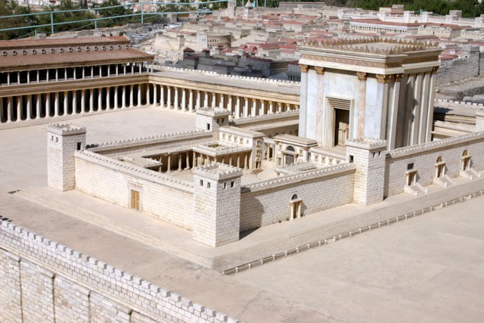
Jesus Warns of Coming Events (Mark 13:1-31; Matthew 24:1-51)
As Jesus leaves the temple, His disciples point out the stones and buildings.
Jesus responds that “Not one stone shall be left here upon another that shall not be thrown down” (Mt. 24:2).
On the Mount of Olives, the disciples ask, “when will these things be? And what will be the sign of Your coming, and of the end of the age" (Mt. 24:3)?
Notes:
5
Jesus leaves the temple Matthew 24:1-2
This would be Jesus’ last time in the temple
Disciples call His attention to the great stones of the temple
A great and beautiful structure Stones 70’lx12’hx18’w. The (former) place of the very presence of God. The place where the priest and Jewish leaders were no longer worshiping and living as God directed
According to Josephus, some of the stones were nearly seventy feet in length, twelve feet in height, and eighteen feet in breadth.
Photo credit HolyLandPhotos.org

Slide 6
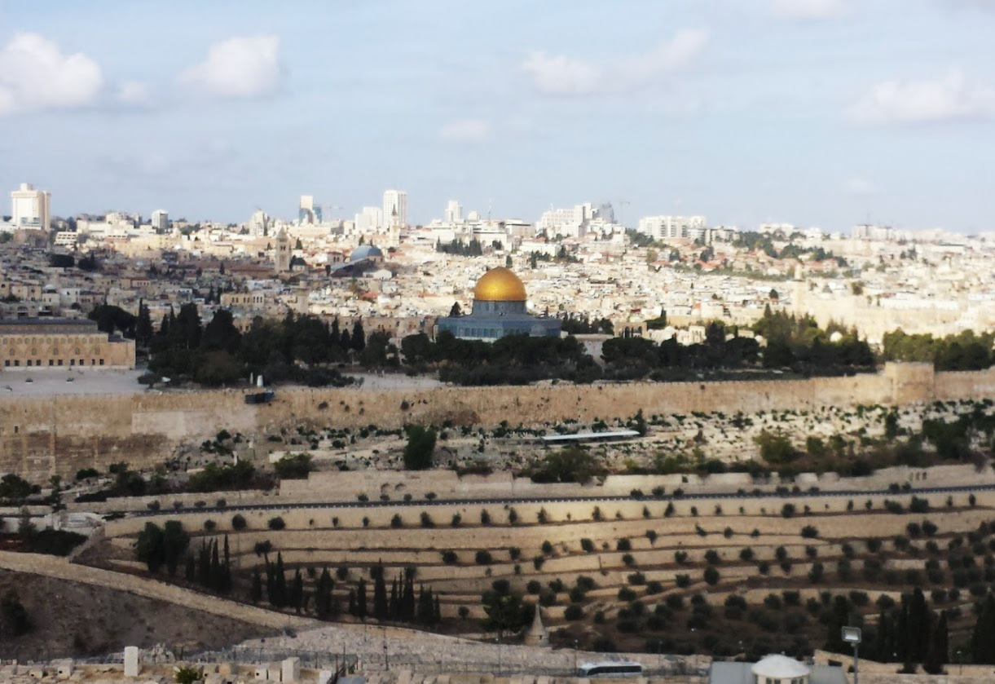
The Temple Mount as viewed from the Mount of Olives
Notes:
The temple mount as seen from the Mount of Olives (Olivet). Jesus and disciples may have had a clear view of it as they discussed its destruction. John’s gospel gives no record of this lengthy discourse; one of several indications that it was written AFTER the destruction of Jerusalem had occurred.

Slide 7
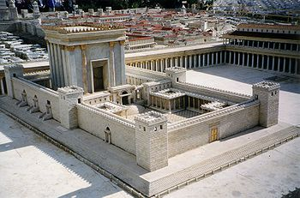
Jesus Warns of Coming Events
The temple was in the process of undergoing major reconstruction begun by Herod the Great in 20 B.C. (Jn. 2:20).
“The temple was built of hard, white stones, each of which was about 25 cubits in length, 8 in height, and 12 in width” (Josephus).
Notes:
7

Slide 8
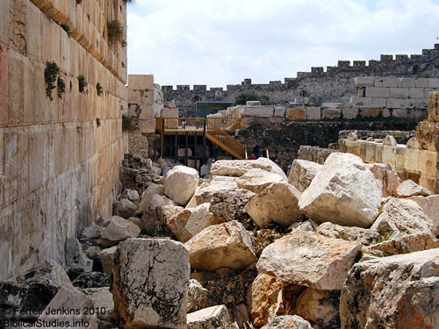
Temple Stones
)
Notes:
Jesus foretold the destruction of Jerusalem by the Roman armies in A.D. 70. The destruction was so complete that only the retaining walls around the Temple precinct were left standing. Archaeological excavations following 1967 have brought to light some of the rubble that was pushed from the platform into the Tyropoeon Valley on the western side. The stones are still impressive. (Photo and Text by Ferrell Jenkins)

Slide 9
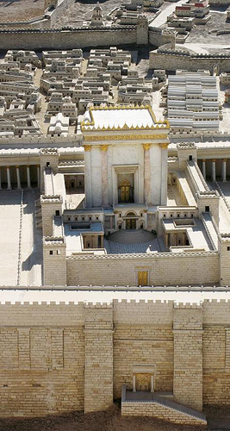
Jesus Warns of Coming Events (Mt. 24: 4-14; Mk. 13:5-13)
False christs (Mk. 13:6; Acts 5:36)
Wars and rumors of wars (13:7)
Earthquakes and famines (13:8)
Persecution of saints (13:9; cf. 2 Corinthians 11:24)
Gospel preached to the whole world (13:10; Col. 1:5-6, 23)
Divine help for the apostles as they preached in time of trial and tribulation (13:11-12)
Notes:
9
Colossians 1:5-6 because of the hope which is laid up for you in heaven, of which you heard before in the word of the truth of the gospel, (6) which has come to you, as it has also in all the world, and is bringing forth fruit, as it is also among you since the day you heard and knew the grace of God in truth;
Colossians 1:23 if indeed you continue in the faith, grounded and steadfast, and are not moved away from the hope of the gospel which you heard, which was preached to every creature under heaven, of which I, Paul, became a minister.

Slide 10
The Destruction of the Temple (Mark 13:14-30)
When the “abomination of desolation” appears, it is time to flee (13:14; Daniel 9:26-27).
Their flight should be… (13:15-18).
To a place of safety
Immediate
Difficult for mothers with infants
With prayers for God’s providence
The tribulation would be the worst ever seen, and only God’s mercy would enable survival (13:19-20).*
Disciples should beware of false christs during this time (13:21-22).
Disciples can be prepared because Jesus has told them beforehand what to expect (13:23).
Notes:
10
Daniel 9:26-27 "And after the sixty-two weeks Messiah shall be cut off, but not for Himself; And the people of the prince who is to come Shall destroy the city and the sanctuary. The end of it shall be with a flood, And till the end of the war desolations are determined. 27 Then he shall confirm a covenant with many for one week; But in the middle of the week He shall bring an end to sacrifice and offering. And on the wing of abominations shall be one who makes desolate, Even until the consummation, which is determined, Is poured out on the desolate."
Josephus wrote, "No other city ever suffered miseries, nor did any age, from the beginning of the world, ever breed a generation more fruitful in wickedness that this was."
And again: "If the miseries of all mankind from the creation were compared with those which the Jews then suffered, they would appear inferior."

Slide 11
The Destruction of the Temple (Mark 13:24-27)
The Lord Coming in Judgment Against Jerusalem
The language Jesus uses is similar to what the Lord used to describe judgments against other nations (13:24-25; Isaiah 13:1, 9-10; Joel 2:10, 31).
Cosmic chaos symbolizes political and social upheaval (cf. Luke 21:25-26).
These events will cause men to clearly see the power and glory of Jesus (13:26; cf. Mt. 24:30).
The true elect will then be gathered together (13:27, 20, 22, Isaiah 65:9-12; Romans 11:7).
This may symbolize their protection and safety in contrast to Israel whom the Lord judged in the destruction of Jerusalem.
Notes:
11
Isaiah 13:1 The burden against Babylon which Isaiah the son of Amoz saw.
Isaiah 13:9-10 Behold, the day of the LORD comes, Cruel, with both wrath and fierce anger, To lay the land desolate; And He will destroy its sinners from it. (10) For the stars of heaven and their constellations Will not give their light; The sun will be darkened in its going forth, And the moon will not cause its light to shine.
Luke 21:25-26 "And there will be signs in the sun, in the moon, and in the stars; and on the earth distress of nations, with perplexity, the sea and the waves roaring; 26 men's hearts failing them from fear and the expectation of those things which are coming on the earth, for the powers of the heavens will be shaken.
Matthew 24:30 Then the sign of the Son of Man will appear in heaven, and then all the tribes of the earth will mourn, and they will see the Son of Man coming on the clouds of heaven with power and great glory.
Isaiah 65:9-12 I will bring forth descendants from Jacob, And from Judah an heir of My mountains; My elect shall inherit it, And My servants shall dwell there. 10 Sharon shall be a fold of flocks, And the Valley of Achor a place for herds to lie down, For My people who have sought Me. 11 "But you are those who forsake the LORD, Who forget My holy mountain, Who prepare a table for Gad, And who furnish a drink offering for Meni. 12 Therefore I will number you for the sword, And you shall all bow down to the slaughter; Because, when I called, you did not answer; When I spoke, you did not hear, But did evil before My eyes, And chose that in which I do not delight."
Romans 11:7 What then? Israel has not obtained what it seeks; but the elect have obtained it, and the rest were blinded.

Slide 12
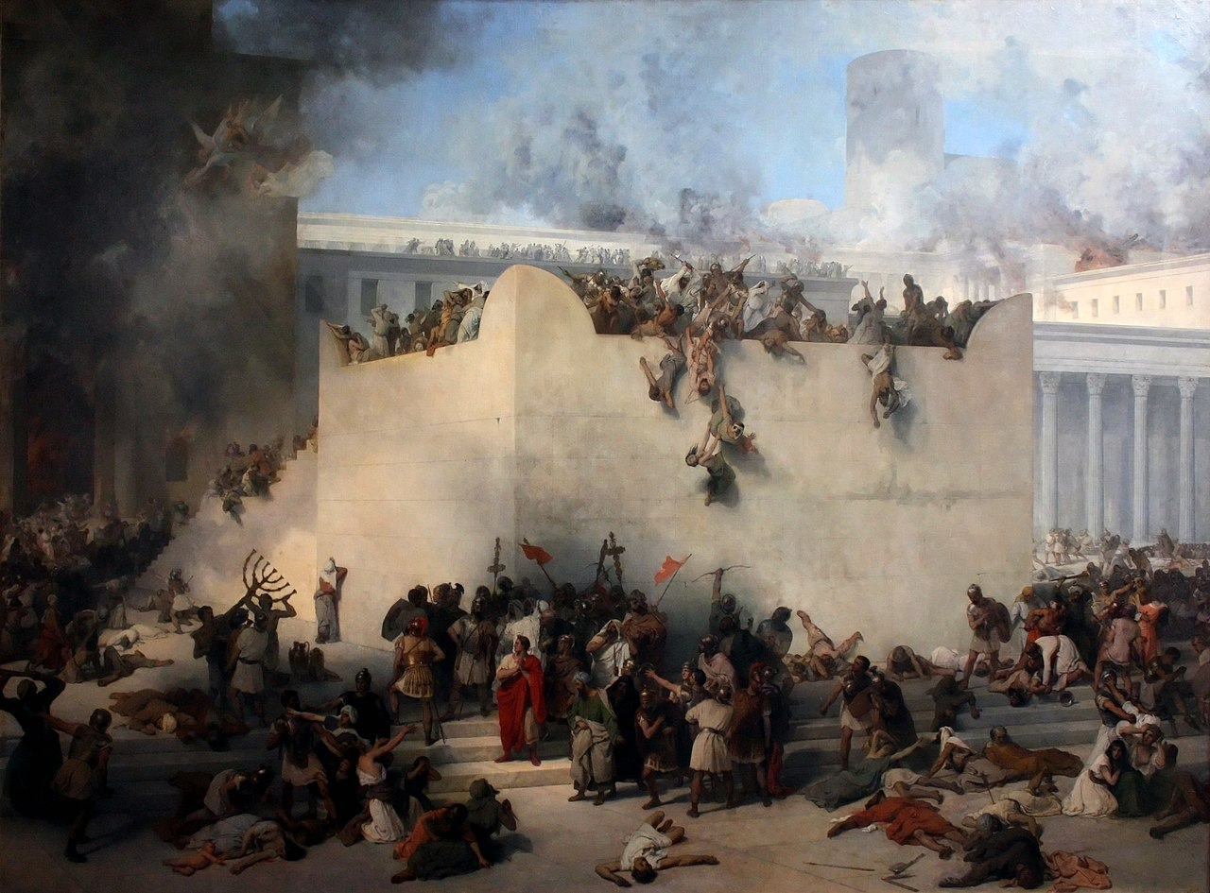
Destruction of the Temple in Jerusalem
Francesco Hayez

Slide 13
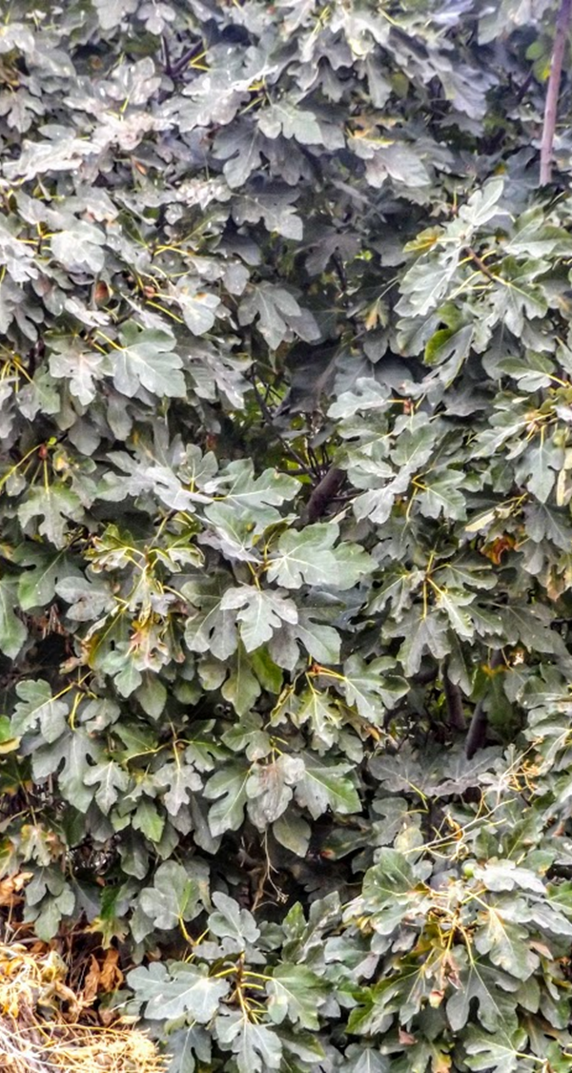
The Parable of the Fig Tree (Mark 13:28-31)
As the budding fig tree indicates that summer is near, the signs that Jesus gave would indicate that the destruction of Jerusalem was imminent (13:28-29)
It would be “near” and “at the door.”
The generation to whom Jesus spoke would not pass away before these things occurred (13:30)
Heaven and earth would pass away, but Jesus’ words would not (13:31).
Notes:
13

Slide 14
Jesus Warns of His Return (Matthew 24:36-50; Mark 13:32-37)
None but the Father knows the day or the hour when heaven and earth will pass away (13:32).
The disciples must therefore watch and pray to be ready at anytime (Mk. 13:33; Mt. 24:42).
It will be like the days of Noah; people HAD NOT prepared (Matt. 24:37-39).
Two individuals may be side by side; one is taken and the other is left (Matt. 24:40-41; 1 Thess. 4:16-17).
It will come like a thief in the night (Mt. 24:43-44).
It is like a man going away to a far country who commands his servants to watch for his return, but he does not tell them when it might be (Mk. 13:34-35).
We must not be found “sleeping” when the Master returns (Mk. 13:36).
We must WATCH! (Mk. 13:37; 1 Thess. 5:1-6).
Notes:
14
1 Thessalonians 4:16-17 For the Lord Himself will descend from heaven with a shout, with the voice of an archangel, and with the trumpet of God. And the dead in Christ will rise first. 17 Then we who are alive and remain shall be caught up together with them in the clouds to meet the Lord in the air. And thus we shall always be with the Lord.
1 Thessalonians 5:1-6 But concerning the times and the seasons, brethren, you have no need that I should write to you. (2) For you yourselves know perfectly that the day of the Lord so comes as a thief in the night. (3) For when they say, "Peace and safety!" then sudden destruction comes upon them, as labor pains upon a pregnant woman. And they shall not escape. (4) But you, brethren, are not in darkness, so that this Day should overtake you as a thief. (5) You are all sons of light and sons of the day. We are not of the night nor of darkness. (6) Therefore let us not sleep, as others do, but let us watch and be sober.

Slide 15
The Truth About the Second Coming -- IT HAS NOT HAPPENED!
The destruction of Jerusalem and the Second Coming of Christ are SEPARATE EVENTS in Matthew 24
Jerusalem’s destruction would coincide with the appearance of the “abomination of desolations” (24:4-22; Daniel 9:26-27).
Christ WOULD NOT come personally then (24:23-26)
When Christ comes, it will be evident to all (24:27)
The overthrow of a nation would be complete (24:29, cf. Isaiah 13:10; 34:4-5; Ezekiel 32:7-8)
This would be a sign of Christ’s power (24:30-31)
Men could KNOW when Jerusalem would be destroyed, and it would be soon (24:33-34).
No one KNOWS when Jesus will return (24:36-37).)
Notes:
Daniel 9:26-27 "And after the sixty-two weeks Messiah shall be cut off, but not for Himself; And the people of the prince who is to come Shall destroy the city and the sanctuary. The end of it shall be with a flood, And till the end of the war desolations are determined. 27 Then he shall confirm a covenant with many for one week; But in the middle of the week He shall bring an end to sacrifice and offering. And on the wing of abominations shall be one who makes desolate, Even until the consummation, which is determined, Is poured out on the desolate.“
Babylon, Isaiah 13:10 For the stars of heaven and their constellations Will not give their light; The sun will be darkened in its going forth, And the moon will not cause its light to shine.
Edom, Isaiah 34:4-5 All the host of heaven shall be dissolved, And the heavens shall be rolled up like a scroll; All their host shall fall down As the leaf falls from the vine, And as fruit falling from a fig tree. 5 "For My sword shall be bathed in heaven; Indeed it shall come down on Edom, And on the people of My curse, for judgment.
Egypt: Ezekiel 32:7-8 When I put out your light, I will cover the heavens, and make its stars dark; I will cover the sun with a cloud, And the moon shall not give her light. 8 All the bright lights of the heavens I will make dark over you, And bring darkness upon your land,' Says the Lord GOD.

