Slide 1

  Lessons From Acts
Lesson 9: Church Growth
A look at the growth of the early church

Slide 2
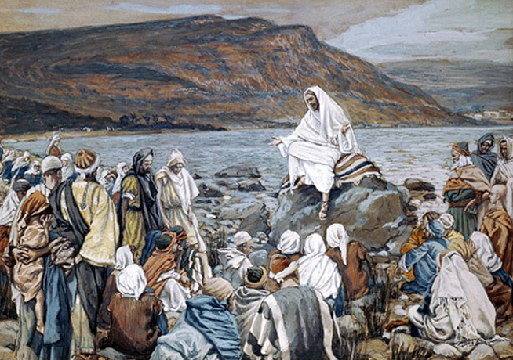
Church Growth Not Congregational Growth

Slide 3
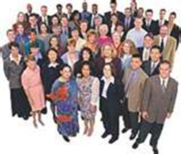
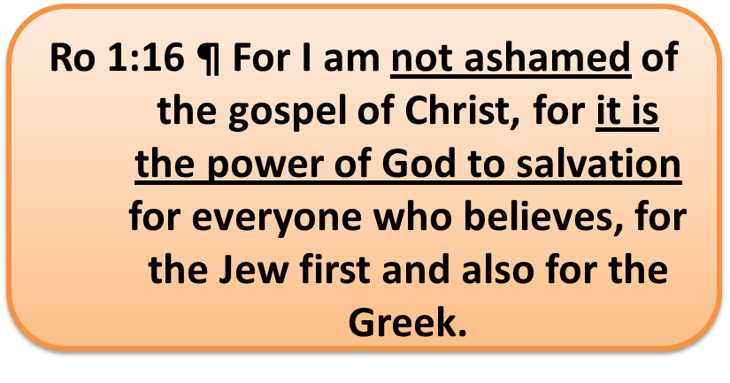
Church Growth
Church Growth Through Preaching (Gospel)
Church Growth Through Christian Growth
Church Grows or Shrinks During Trouble
Current Methods Foreign To Scripture

Slide 4

Church Growth Through Preaching
If I want the Church to grow, I MUST ensure people who do not know God “hear” the Gospel?

Slide 5
Growth Through Preaching
Ac 2:41 Then those who gladly received his word were baptized; and that day about three thousand souls were added to them.
Ac 2:46 So continuing daily with one accord in the temple, and breaking bread from house to house, they ate their food with gladness and simplicity of heart, 47 praising God and having favor with all the people. And the Lord added to the church daily those who were being saved.
How does one Join the Church?

Slide 6
Growth Through Preaching
Ac 6:1 Now in those days, when the number of the disciples was multiplying
Ac 6:7 Then the word of God spread, and the number of the disciples multiplied greatly in Jerusalem, and a great many of the priests were obedient to the faith.
Ac 8:5 Then Philip went down to the city of Samaria and preached Christ to them.
  …and the multitude with one accord heeded

Slide 7
Growth Through Preaching
Still Growing
  Ac 9:31 Then the churches throughout all Judea, Galilee, and Samaria had peace and were edified. And walking in the fear of the Lord and in the comfort of the Holy Spirit, they were multiplied.
  Ac 11:21 And the hand of the Lord was with them, and a great number believed and turned to the Lord.

Slide 8
Growth Through Preaching
Still Growing
  Ac 11:24 For he was a good man, full of the Holy Spirit and of faith. And a great many people were added to the Lord. 25 Then Barnabas departed for Tarsus to seek Saul. 26 And when he had found him, he brought him to Antioch. So it was that for a whole year they assembled with the church and taught a great many people. And the disciples were first called Christians in Antioch.
  Ac 12:24 But the word of God grew and multiplied.

Slide 9
Growth Through Preaching
In Paphos on Cyprus
  Ac 13:12 Then the proconsul believed, when he saw what had been done, being astonished at the teaching of the Lord.
Antioch in Pisidia
  Ac 13:42 So when the Jews went out of the synagogue, the Gentiles begged that these words might be preached to them the next Sabbath. 43 Now when the congregation had broken up, many of the Jews and devout proselytes followed Paul and Barnabas, who, speaking to them, persuaded them to continue in the grace of God. 44 On the next Sabbath almost the whole city came together to hear the word of God.

Slide 10
Growth Through Preaching
Gentiles
  Ac 13:48 Now when the Gentiles heard this, they were glad and glorified the word of the Lord. And as many as had been appointed to eternal life believed. 49 And the word of the Lord was being spread throughout all the region.
Phillip in Macedonia
  Ac 16:14 Now a certain woman named Lydia heard us. She was a seller of purple from the city of Thyatira, who worshiped God. The Lord opened her heart to heed the things spoken by Paul. 15 And when she and her household were baptized, she begged us, saying, "If you have judged me to be faithful to the Lord, come to my house and stay." So she persuaded us.

Slide 11
Growth Through Preaching
Corinth
  Ac 18:8 Then Crispus, the ruler of the synagogue, believed on the Lord with all his household. And many of the Corinthians, hearing, believed and were baptized.
Ephesus
  Ac 19:5 When they heard this, they were baptized in the name of the Lord Jesus…7 Now the men were about twelve in all.
  Ac 19:18 And many who had believed came confessing and telling their deeds…20 So the word of the Lord grew mightily and prevailed.

Slide 12
Growth Through Preaching
It was preached to all (Jew/Gentile, Rich/Poor, Jailor, Rulers and Royalty)
The emphasis was on the “Word” not the Messenger
Thought Question: Do we have fewer results due to less sowing of the seed?

Slide 13
Current Methods Foreign To Scripture
"What was responsible for your coming to Christ and this church?“
Their replies were:
  I had a special need - 3%
  I just walked in - 3%
  I liked the minister - 6%
  I visited there - 1%
  I liked the Bible classes - 5%
  I attended a gospel meeting - 0.5%
  I liked the programs - 3%
  A friend or relative invited me - 79%

Slide 14


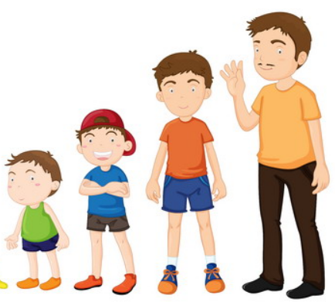
Growth Through Christian Growth
Eph 4:11-14 And he gave some to be apostles; and some, prophets; and some, evangelists; and some, pastors and teachers; for the perfecting of the saints, unto the work of ministering, unto the building up of the body of Christ: till we all attain unto the unity of the faith, and of the knowledge of the Son of God, unto a fullgrown man, unto the measure of the stature of the fulness of Christ: that we may be no longer children, tossed to and fro and carried about with every wind of doctrine,
1 Pet. 2:2 as newborn babes, desire the pure milk of the word, that you may grow thereby,

Slide 15

Growth Through Christian Growth
If I want the body to grow, I must ensure it receives nutrition and exercise

Slide 16
Growth Through Christian Growth
Unity And Building Up Those Who Believe
  Ac 4:32 Now the multitude of those who believed were of one heart and one soul
  Act 2:42 And they continued stedfastly in the apostles' teaching and fellowship, in the breaking of bread and the prayers.
  Act 9:22 But Saul increased the more in strength, and confounded the Jews that dwelt at Damascus, proving that this is the Christ.

Slide 17
Growth Through Christian Growth
Unity And Building Up Those Who Believe
  Act 14:21-22 … they returned to Lystra, Iconium, and Antioch, strengthening the souls of the disciples, exhorting them to continue in the faith,
  Ac 18:23 After he had spent some time there, he departed and went over the region of Galatia and Phrygia in order, strengthening all the disciples.

Slide 18
Growth Through Christian Growth
Unity And Building Up Those Who Believe
  Ac 18:27 And when he desired to cross to Achaia, the brethren wrote, exhorting the disciples to receive him; and when he arrived, he greatly helped those who had believed through grace; 28 for he vigorously refuted the Jews publicly, showing from the Scriptures that Jesus is the Christ.

Slide 19
Growth Through Christian Growth
Unity And Building Up Those Who Believe
  Ac 14:23 So when they had appointed elders in every church, and prayed with fasting, they commended them to the Lord in whom they had believed.
  Ac 20:27 "For I have not shunned to declare to you the whole counsel of God. 28 "Therefore take heed to yourselves and to all the flock, among which the Holy Spirit has made you overseers, to shepherd the church of God which He purchased with His own blood.

Slide 20
Growth Through Christian Growth
We have all “spiritual ages” here today
Do I look into the perfect law of liberty to see my true self? (James 1:22-25)
  What is my “Spiritual Age”?
  What am I doing to grow so that the Church may grow?

Slide 21
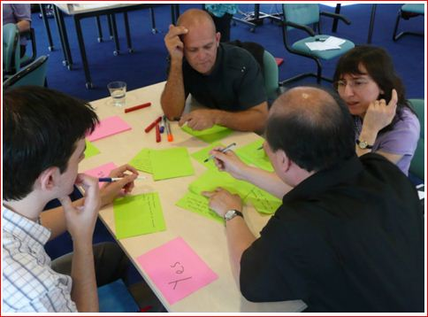
Church Growth During Trouble
Trouble will come, will it DESTROY or make us STRONGER?

Slide 22
Church Growth During Trouble
Does Prison Stop the Growth?
  Ac 5:14 And believers were increasingly added to the Lord, multitudes of both men and women,
  Ac 5:42 And daily in the temple, and in every house, they did not cease teaching and preaching Jesus as the Christ.
  Gamaliel’s Advise

Slide 23
Church Growth During Trouble
Does Trouble Among The Members Stops Growth?
  Ac 6:1 ¶ Now in those days, when the number of the disciples was multiplying, there arose a complaint against the Hebrews by the Hellenists, because their widows were neglected in the daily distribution.
Notice The Focus By The Apostles
  Ac 6:2,4 Then the twelve summoned the multitude of the disciples and said, "It is not desirable that we should leave the word of God and serve tables. … but we will give ourselves continually to prayer and to the ministry of the word."

Slide 24
Church Growth During Trouble
Does Persecution Stop the Growth?
  Ac 8:3 As for Saul, he made havoc of the church, entering every house, and dragging off men and women, committing them to prison.
  4 Therefore those who were scattered went everywhere preaching the word.
However, it wasn’t always this way
  Corinthians & Rev. 2-3
How will we react to trouble?

Slide 25
Current Methods Foreign To Scripture
"What was responsible for your coming to Christ and this church?“
Their replies were:
  I had a special need - 3%
  I just walked in - 3%
  I liked the minister - 6%
  I visited there - 1%
  I liked the Bible classes - 5%
  I attended a gospel meeting - 0.5%
  I liked the programs - 3%
  A friend or relative invited me - 79%

Slide 26
Ro 1:16 ¶ For I am not ashamed of the gospel of Christ, for it is the power of God to salvation for everyone who believes, for the Jew first and also for the Greek.

Slide 28
Current Methods Foreign To Scripture
Sports Teams
Have community garden for kids
Create an after-school care program, day care
Classes in church for stay at home moms
Babysitting classes - Mom's day out
Hold an Outdoor concert
Bring your dog to church Saturday evening
Have a table at the community yard sale, give away coffee, soda
"Gotta Go; Go with God" - Outreach NASCAR
Holiday Events

Slide 29
Current Methods Foreign To Scripture
Hold speaker series on issues of concern to the community
Contact book clubs - have sermons related to popular books
Specialty sermons to real world
A.A. or N. A. meetings
Singles night
Give a flower to visitors
Cowboys for Christ
Building Singage

