Slide 1
Revelation 8:1-13
The Seventh Seal introduces the Seven Trumpets
Revelation
The opening of the seventh seal produces a dramatic silence (8:1; Zeph. 1:7; Zech. 2:13)
John sees 7 angels given 7 trumpets (8:2; Joel 2)
He sees an angel offer incense on the golden altar before God’s throne – the incense with the prayers of the saints rise before God (8:3-4)
  The angel takes fire from the altar and throws it to the earth with dramatic results (noises, thunder, lightning, earthquake) (8:5)
God is about to answer the prayers of the saints with trouble on the earth! (Luke 18:7)

Slide 2
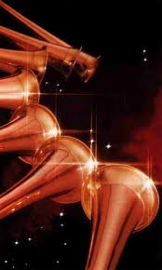
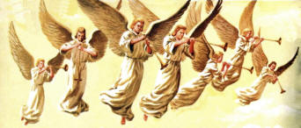
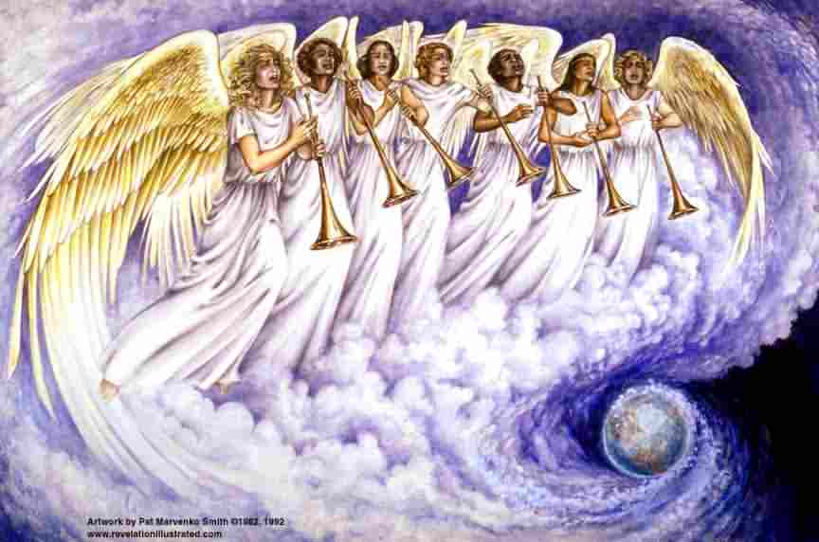
The Seven Trumpets
Revelation

Slide 3
Revelation 8:6-13
The First Four Trumpets Sound
Revelation
The angels prepare to sound their trumpets (8:6)
The first trumpet brings hail & fire mingled with blood to the earth. 1/3 of the vegetation is burned (8:7)
The second trumpet reveals a burning mountain thrown into the sea. 1/3 of the sea turns to blood, and 1/3 of sea creatures and ships are destroyed. (8:8-9)
The third trumpet reveals a star named Wormwood falling on the rivers, making them bitter and resulting in the death of many men (8:10-11)
The fourth trumpet darkens a third of the sun, moon and stars (8:12-13)
An angel pronounces 3 woes on the inhabitants of the earth because the 3 remaining trumpets are about to sound.

Slide 4
Revelation 8:6-13
Symbolism in the First Four Trumpets
Revelation
These apparent calamities of nature SYMBOLIZE measured punishments of God upon evil men in order to motivate repentance (see 9:20-21)
First Trumpet
  God used hail and fire both literally and symbolically to punish the enemies of His people (Ex. 9:13; Isa. 30:30)
  “A third” symbolizes that these punishments are partial.
  Trees and green grass may symbolize things which support human life and make it pleasurable.

Slide 5
Revelation 8:6-13
Symbolism in the First Four Trumpets
Revelation
Second Trumpet
A mountain represents a kingdom (Jeremiah 51:24-25)
The sea and waters in Revelation represent human society (Rev. 17:15)
The ships represent wealth and commerce (Rev. 18:17-19)
Third Trumpet
A “great star” is a world leader (Numbers 24:17; Isaiah 14:12)
He is called “wormwood” (cf. Lam. 3:15, 19) and his fall embitters life and results in death for many.

Slide 6
Revelation 8:6-13
Symbolism in the First Four Trumpets
Revelation
Fourth Trumpet
World powers (sun, moon and stars, Isaiah 13:10) do not shine as brightly as they otherwise might.
Another angel pronounces three “woes” upon the inhabitants of the earth because of the three remaining trumpets. (8:13)

Slide 7
Revelation 9:1-21
The Final 3 Trumpets bring Woes upon the Wicked
Revelation
Fifth trumpet:
A star falls from heaven with the key to the bottomless pit (9:1)
  The bottomless pit is the residing place of of evil beings (9:11; 11:7; 17:8; 20:3)
When he opens the pit, smoke ascends and darkens the sun and the air, and out of the smoke come locusts (9:2-3)
  Plagues of locusts were commonly used by God to chastise the wicked (Exodus 10:3-20; Deut. 28:37-38; Joel 1-2)

Slide 8
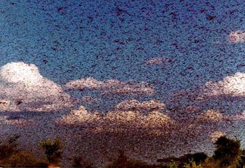
Sun & Air Darkened by Locust
Revelation

