Slide 1

  Lessons From Acts
Lesson 13: Boldness in Trials

Slide 2

Bold (adjective)
not hesitating or fearful in the face of actual or possible danger or rebuff; courageous and daring: a bold hero.
not hesitating to break the rules of propriety; forward; impudent: He apologized for being so bold as to speak to the emperor.

Slide 3
Scriptures on Boldness
Acts 13:46
Phil. 1:14
I Thess. 2:2
Philemon 8
Prov. 28:1

Slide 4
“with all boldness”
Acts 4:29-31
Peter and John arrested for preaching Jesus
Acts 4:8 – Peter filled with the Holy Spirit spoke
Acts 4:13 – They spoke with boldness
Acts 4:18, 21 – Threatened not to teach in the name of Jesus
Read Acts 4:29-31
  Prayer
  Place shaken
  Filled with Holy Spirit
  Spoke with boldness

Slide 5
“with all boldness”
Acts 4:29-31
Acts 4:29 "Now, Lord, look on their threats, and grant to Your servants that with all boldness they may speak Your word
that with all boldness they may speak Thy word--Rising above self, they ask only fearless courage to testify for their Master, and divine confirmation to their testimony by miracles of healing in His name.

Slide 6
Where did they get boldness?
Acts 4:29 "Now, Lord, look on their threats, and grant to Your servants that with all boldness they may speak Your word
Acts 4:31 And when they had prayed, the place where they were assembled together was shaken; and they were all filled with the Holy Spirit, and they spoke the word of God with boldness.

Slide 7
Paul asked for prayers for boldness
Eph. 6:13-20
  Putting on the armor of God
  Prayer for perseverance and supplication of the saints and Paul
18 praying always with all prayer and supplication in the Spirit, being watchful to this end with all perseverance and supplication for all the saints--
19 and for me, that utterance may be given to me, that I may open my mouth boldly to make known the mystery of the gospel

Slide 8
Paul asked for prayers for boldness
That I may open my mouth boldly...
He was in Rome. He was almost alone, he was surrounded by multitudes of the wicked. He was exposed to death. Yet he desired to speak boldly in the name of the Lord Jesus, and to invite sinners to repentance.
Lesson- A Christian in chains, and surrounded by the wicked, may speak boldly, and may have hope of success.

Slide 9
OT Example of Boldness
Exodus 14:1-14
8 And the LORD hardened the heart of Pharaoh king of Egypt, and he pursued the children of Israel; and the children of Israel went out with boldness.
10 And when Pharaoh drew near, the children of Israel lifted their eyes, and behold, the Egyptians marched after them. So they were very afraid, and the children of Israel cried out to the LORD.

Slide 10
OT Example of Boldness
Ex 14:13 And Moses said to the people, "Do not be afraid. Stand still, and see the salvation of the LORD, which He will accomplish for you today. For the Egyptians whom you see today, you shall see again no more forever.
14 "The LORD will fight for you, and you shall hold your peace."

Slide 11
NT Example of Boldness
Acts 9:18-29 – Saul converted, preaching immediately afterward
29 And he spoke boldly in the name of the Lord Jesus and disputed against the Hellenists, but they attempted to kill him.
Why would it take boldness for Saul to preach Jesus?
  Vs 21 – his history
  Vs 23 – plot to kill him
  Vs 26 – not accepted as a disciple at first

Slide 12
Our Boldness
Eph. 3:1-13
11 according to the eternal purpose which He accomplished in Christ Jesus our Lord,
12 in whom we have boldness and access with confidence through faith in Him.
Boldness here means, properly, boldness of speaking. Here it seems to mean, "freedom of speech (RSV);" and the idea is, that we may come to God now in prayer with confidence through the Lord Jesus.

Slide 13
Our Boldness
Read Heb. 4:14-16
Heb 4:16 Let us therefore come boldly to the throne of grace, that we may obtain mercy and find grace to help in time of need. (Confidence in God)

Slide 14
Our Boldness
Heb. 13:1-6
Heb 13:6 So we may boldly say: "The LORD is my helper; I will not fear. What can man do to me?“
We can, in such circumstances, while trusting the Lord, confidently apply to ourselves what God said in Psalm 118:6, "The Lord is my helper, I will not fear what man can do." God is omnipotent, man's power is limited; however strong man may be, he can do nothing against the Almighty.

Slide 15
Our Source of Boldness
Heb 13:5,6 - I will never leave thee, nor forsake thee…
This was said to Joshua (Josh. 1:5), but belongs to all the faithful servants of God. Old Testament promises may be applied to New Testament saints.
This promise contains the sum and substance of all the promises.
A true believer shall have the gracious presence of God with him in life, at death, and forever.

Slide 16
Promises
To Jacob - Gen 28:15 "Behold, I am with you and will keep you wherever you go, and will bring you back to this land; for I will not leave you until I have done what I have spoken to you."
To the Israelites - Deut 31:6 "Be strong and of good courage, do not fear nor be afraid of them; for the LORD your God, He is the One who goes with you. He will not leave you nor forsake you."

Slide 17
Promises
1 Chron 28:20 And David said to his son Solomon, "Be strong and of good courage, and do it; do not fear nor be dismayed, for the LORD God-my God-will be with you. He will not leave you nor forsake you, until you have finished all the work for the service of the house of the LORD.

Slide 18
Promises
Ps 37:25 I have been young, and now am old; Yet I have not seen the righteous forsaken, Nor his descendants begging bread.
Matt 6:25, 30 "Therefore I say to you, do not worry about your life, what you will eat or what you will drink; nor about your body, what you will put on. Is not life more than food and the body more than clothing?... Now if God so clothes the grass of the field, which today is, and tomorrow is thrown into the oven, will He not much more clothe you, O you of little faith?”

Slide 19
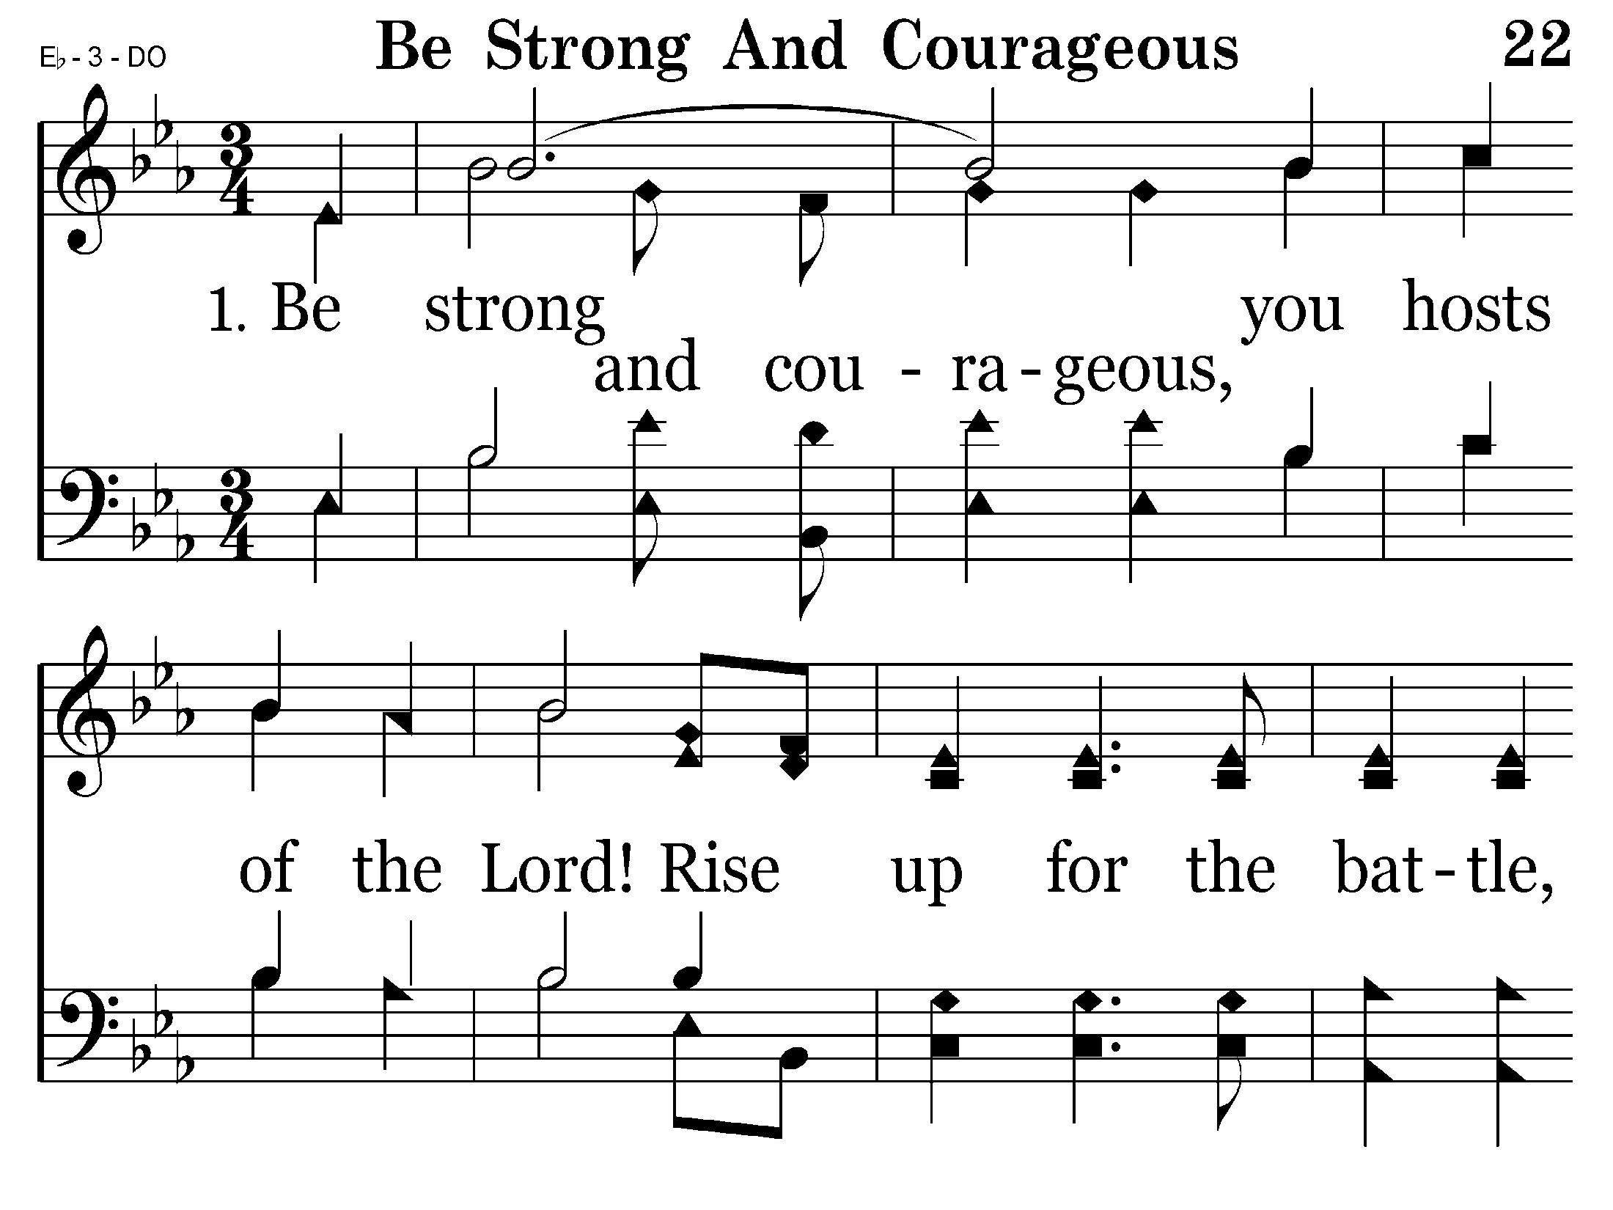
022 - Be Strong And Courageous - 1.1

Slide 20
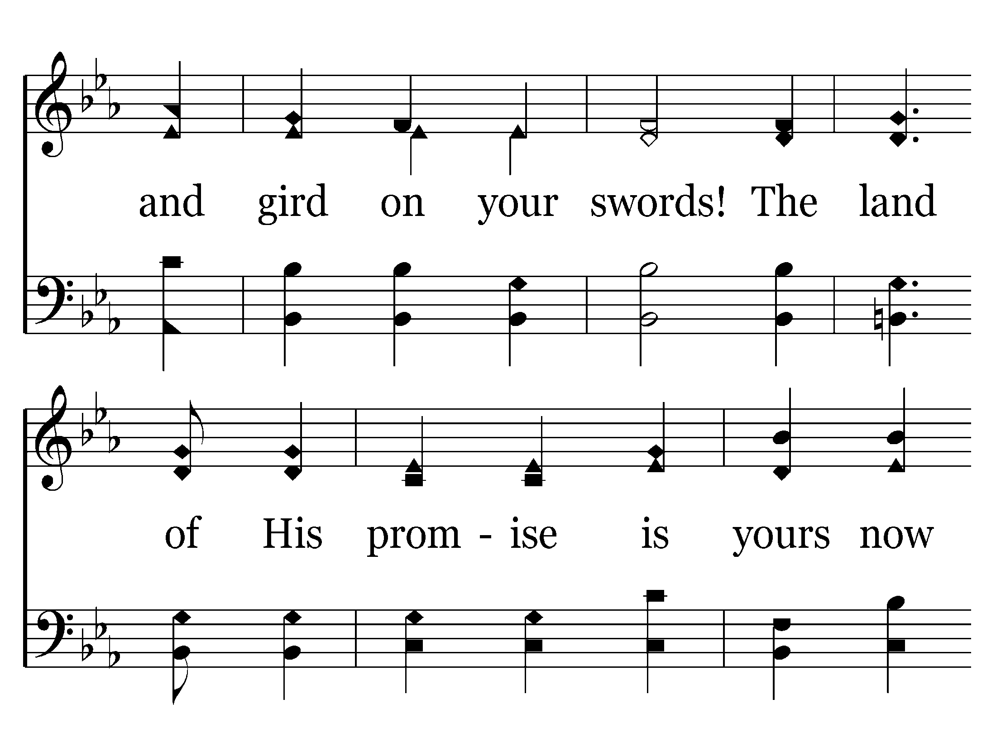
022 - Be Strong And Courageous - 1.2

Slide 21
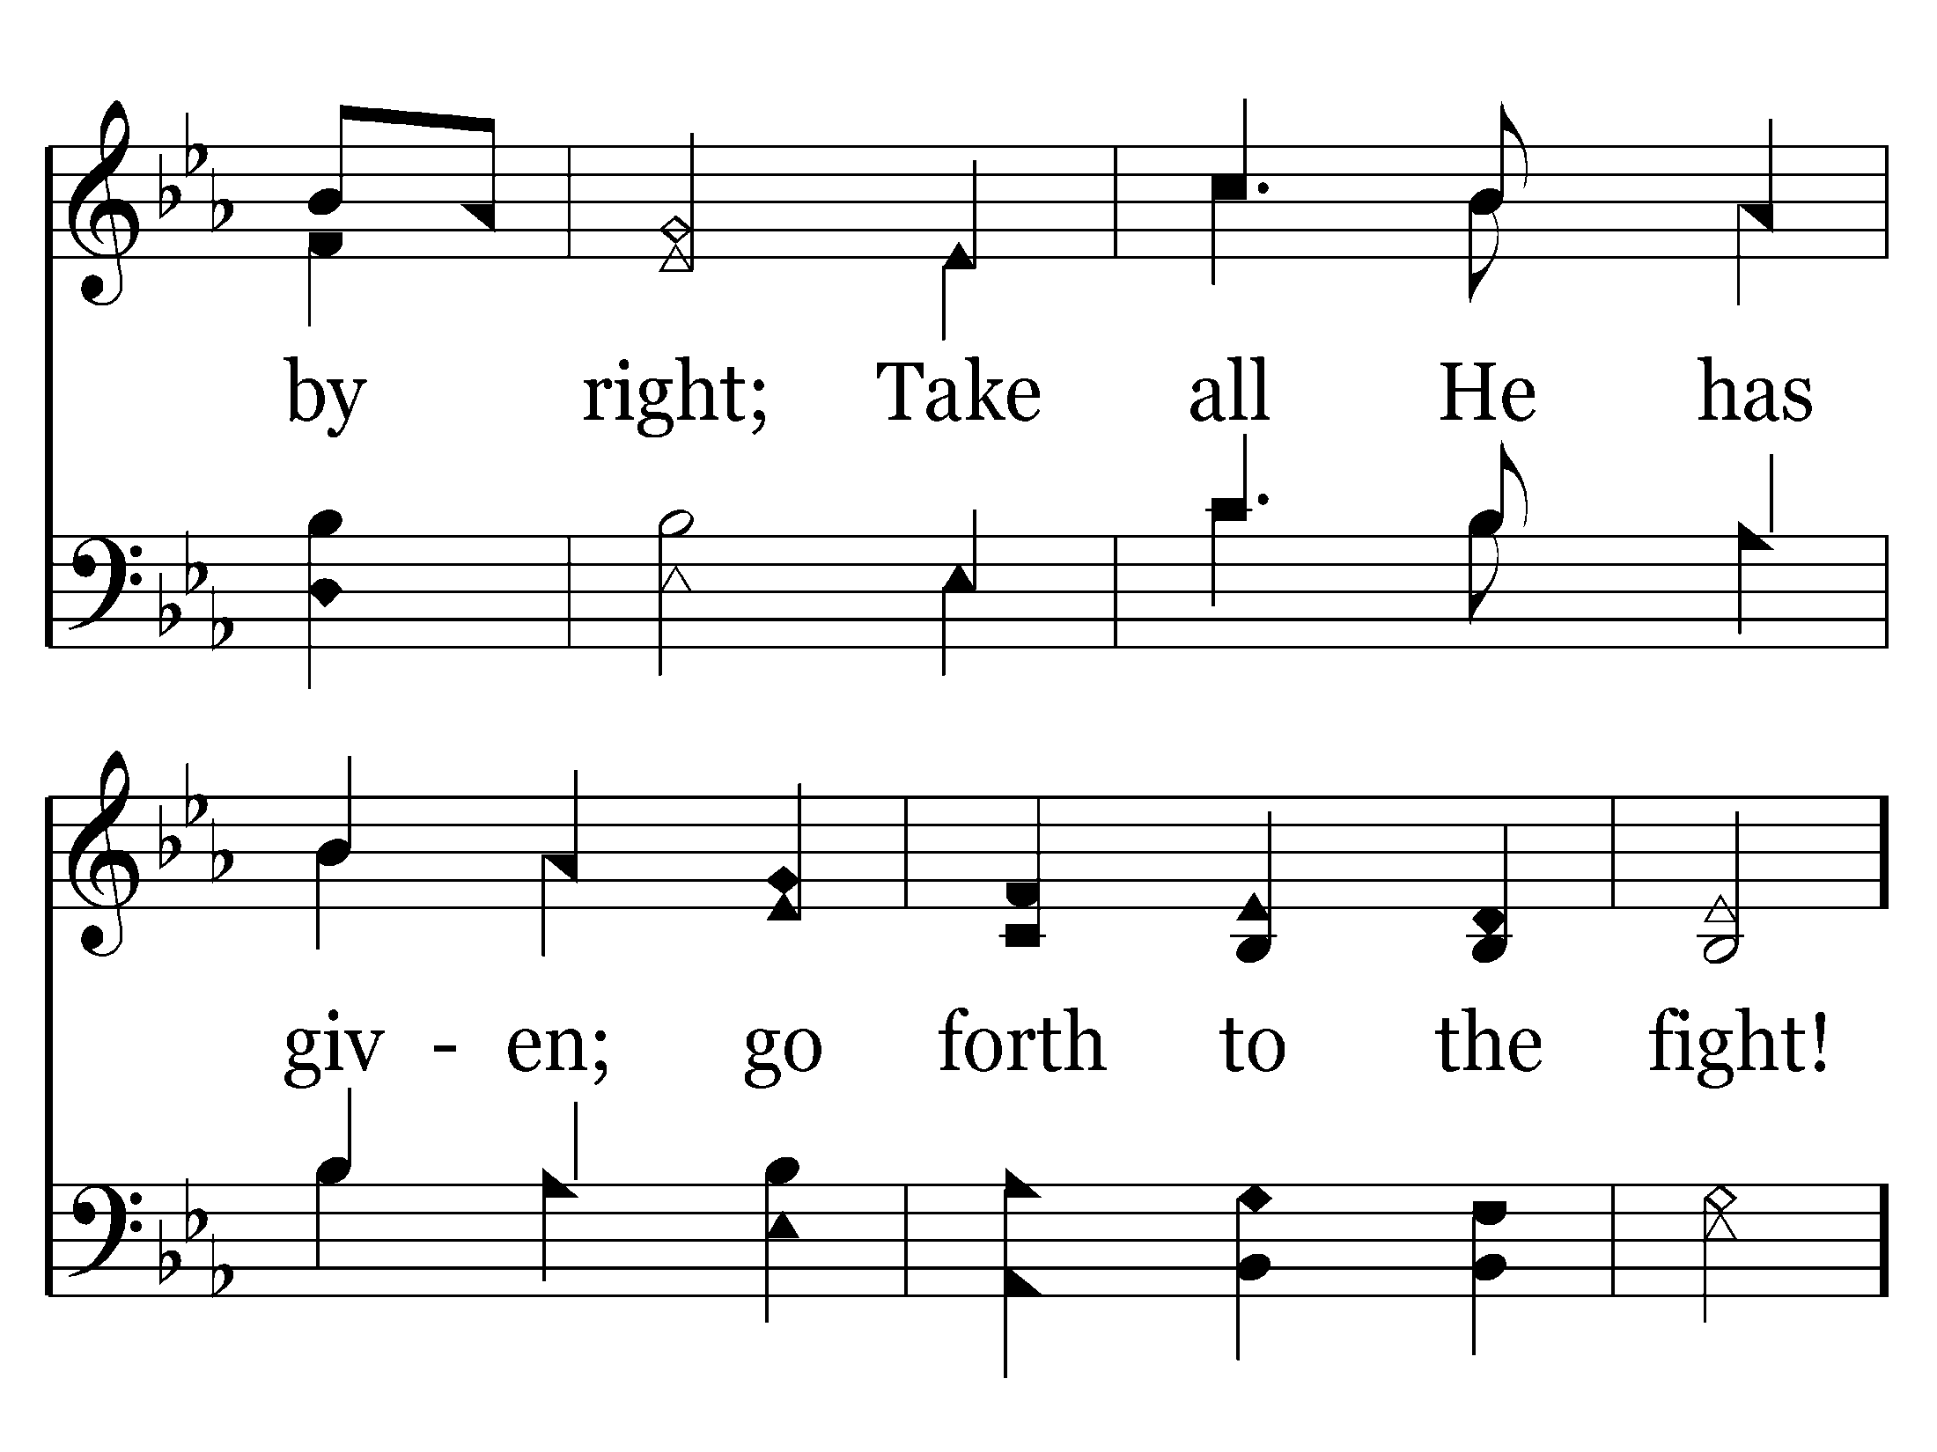
022 - Be Strong And Courageous - 1.3

Slide 22
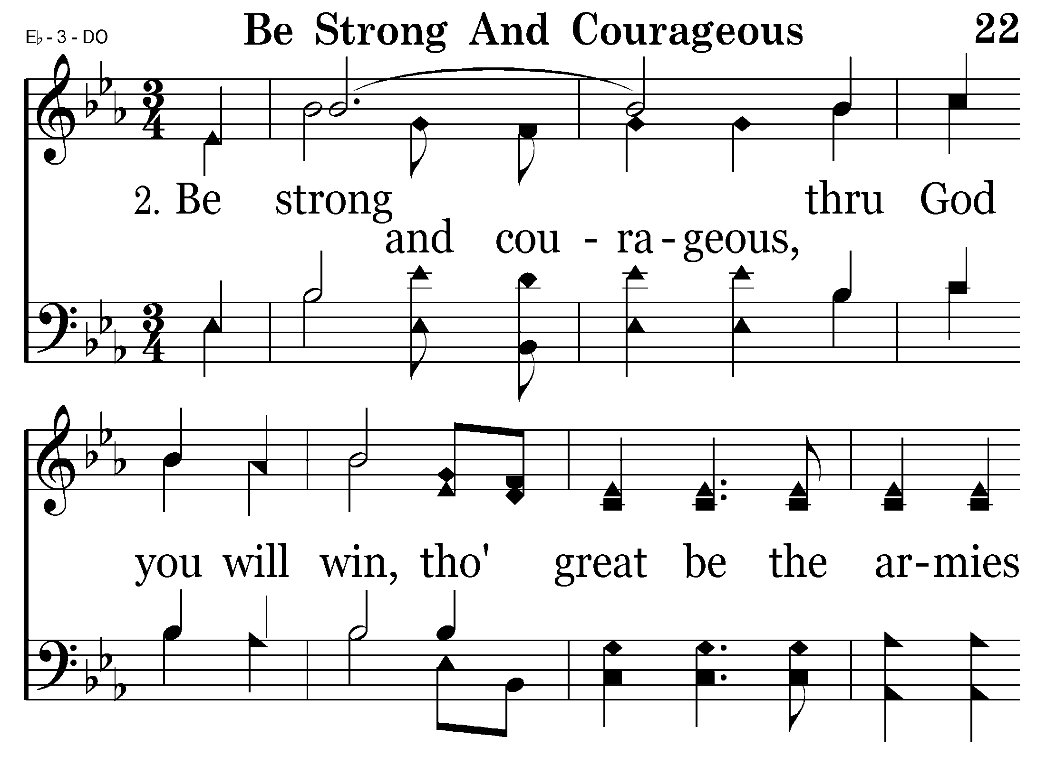
022 - Be Strong And Courageous - 2.1

Slide 23
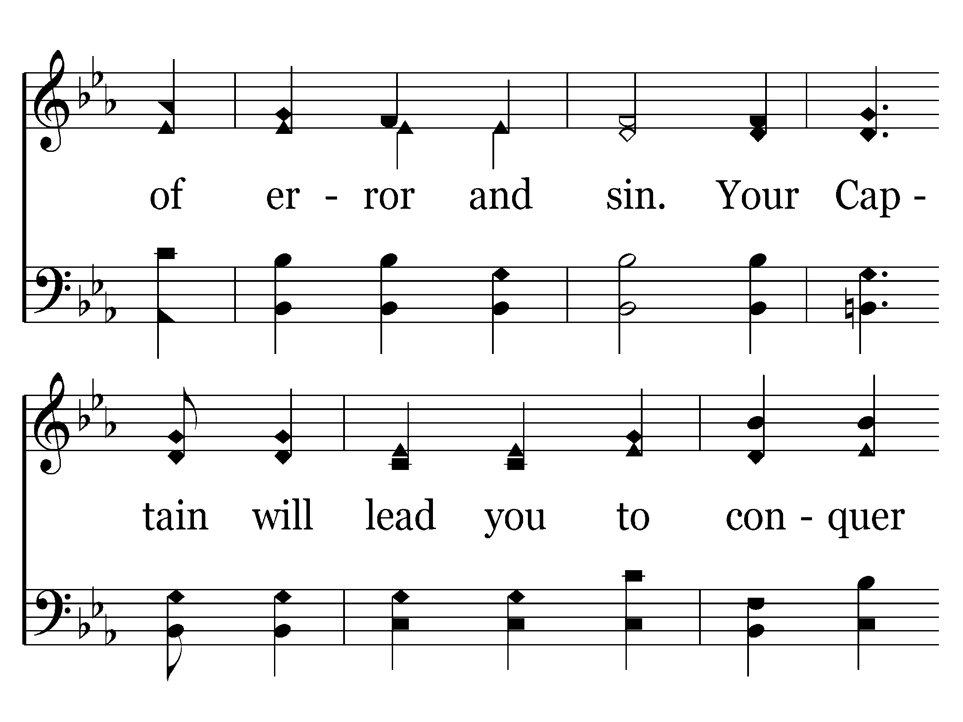
022 - Be Strong And Courageous - 2.2

Slide 24
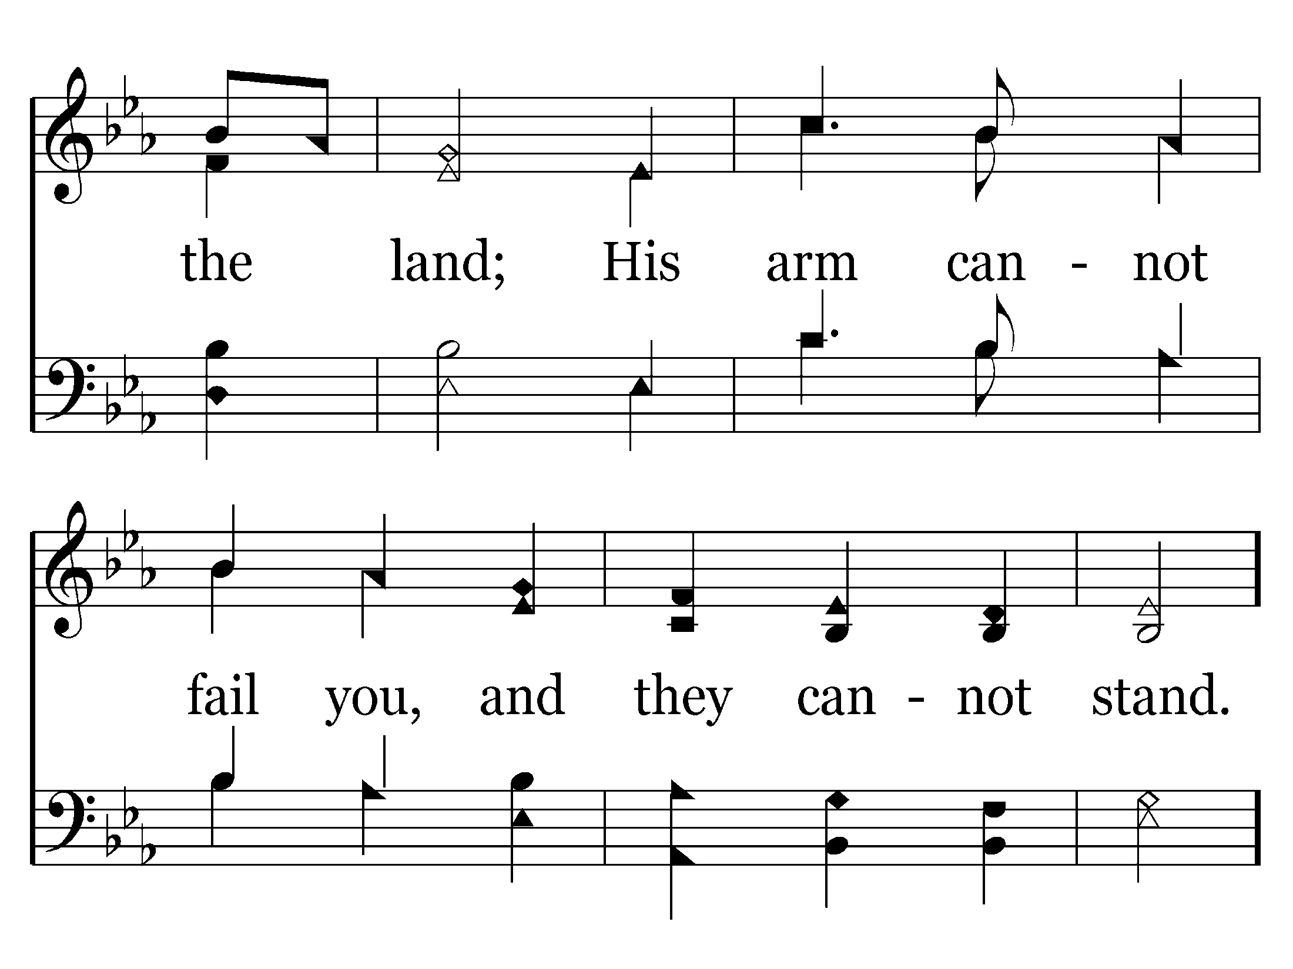
022 - Be Strong And Courageous - 2.3

Slide 25
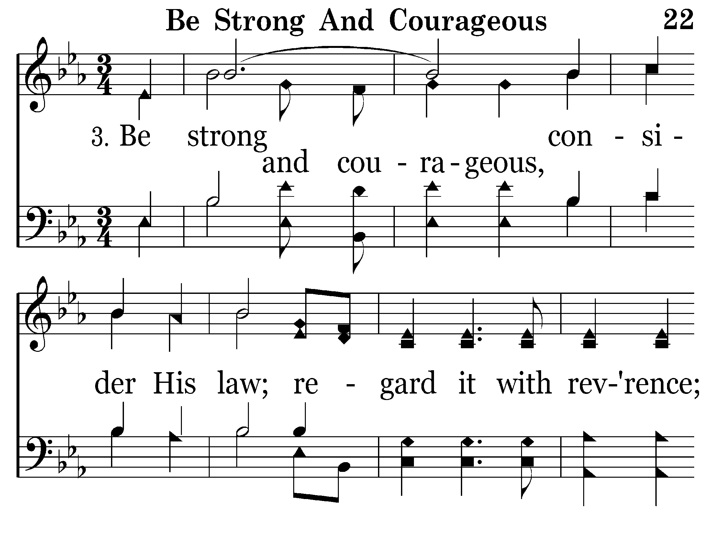
022 - Be Strong And Courageous - 3.1

Slide 26
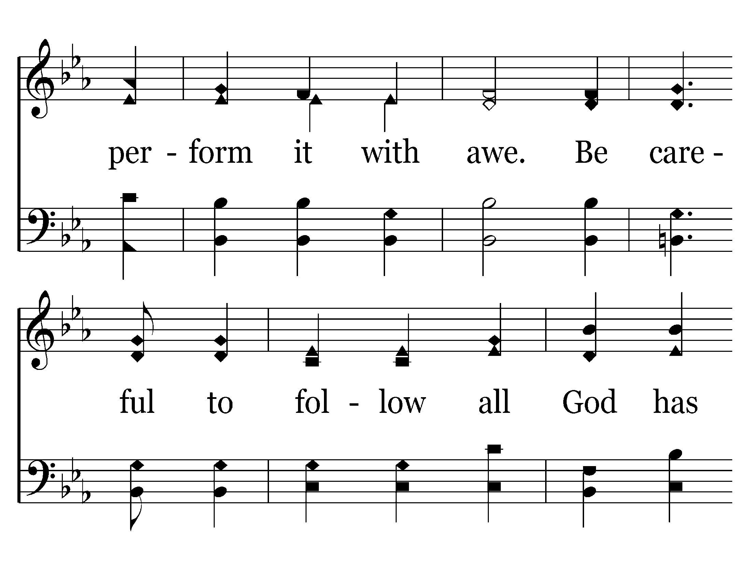
022 - Be Strong And Courageous - 3.2

Slide 27
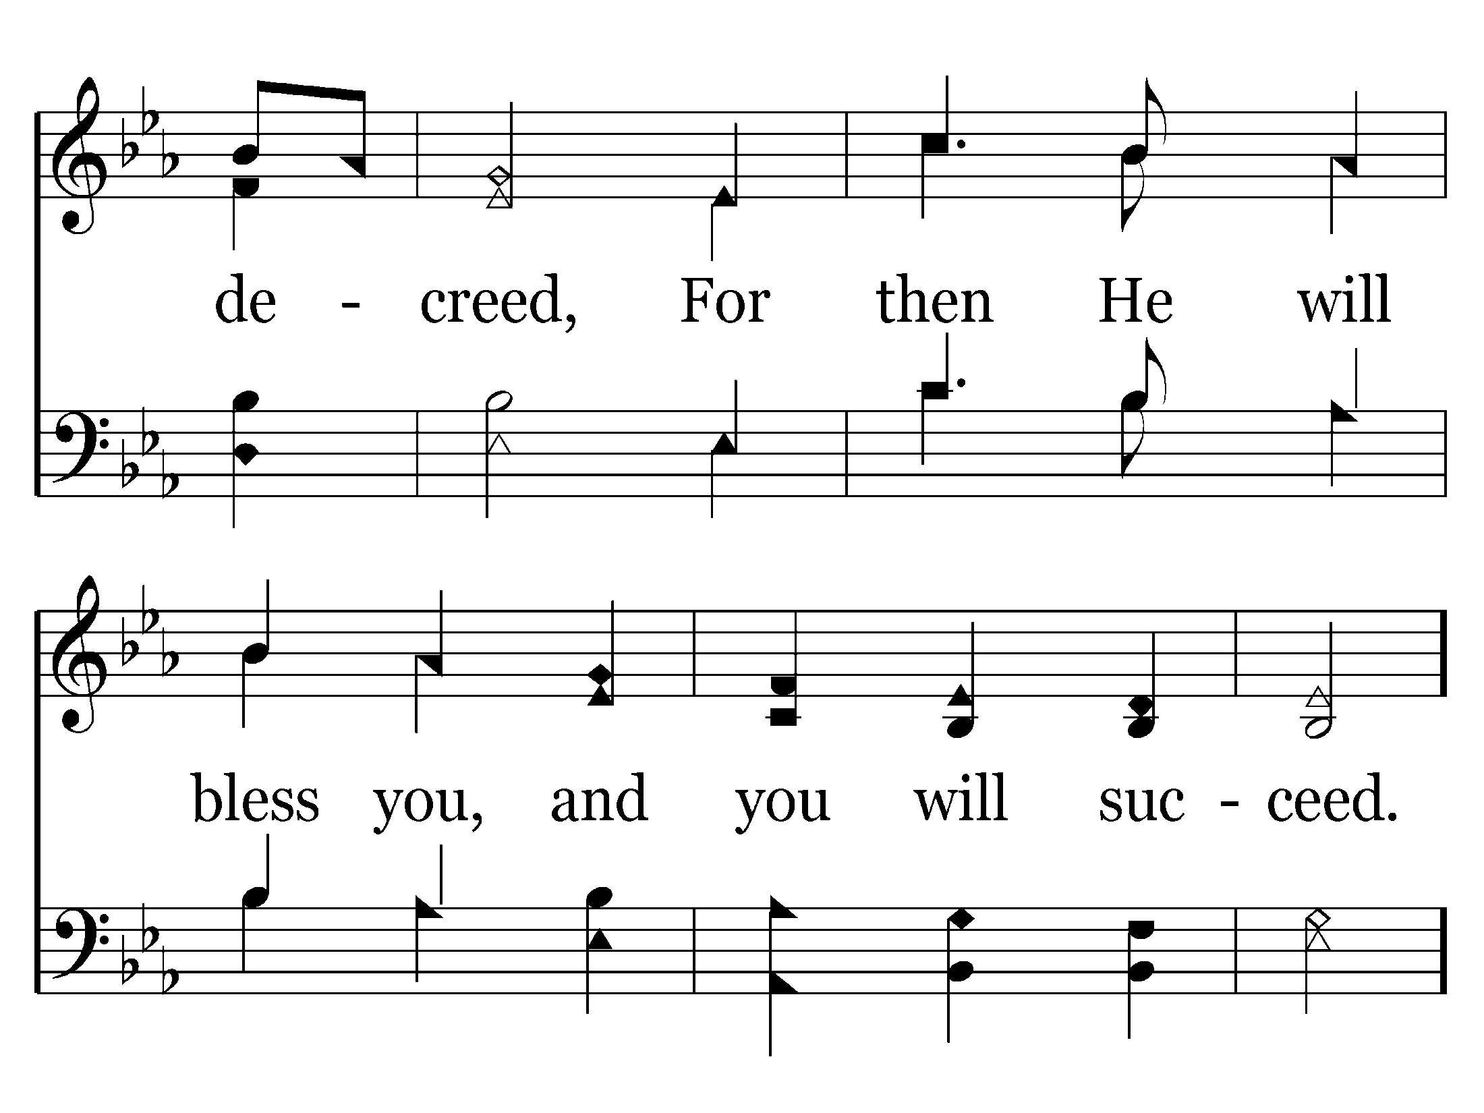
022 - Be Strong And Courageous - 3.3

Slide 28
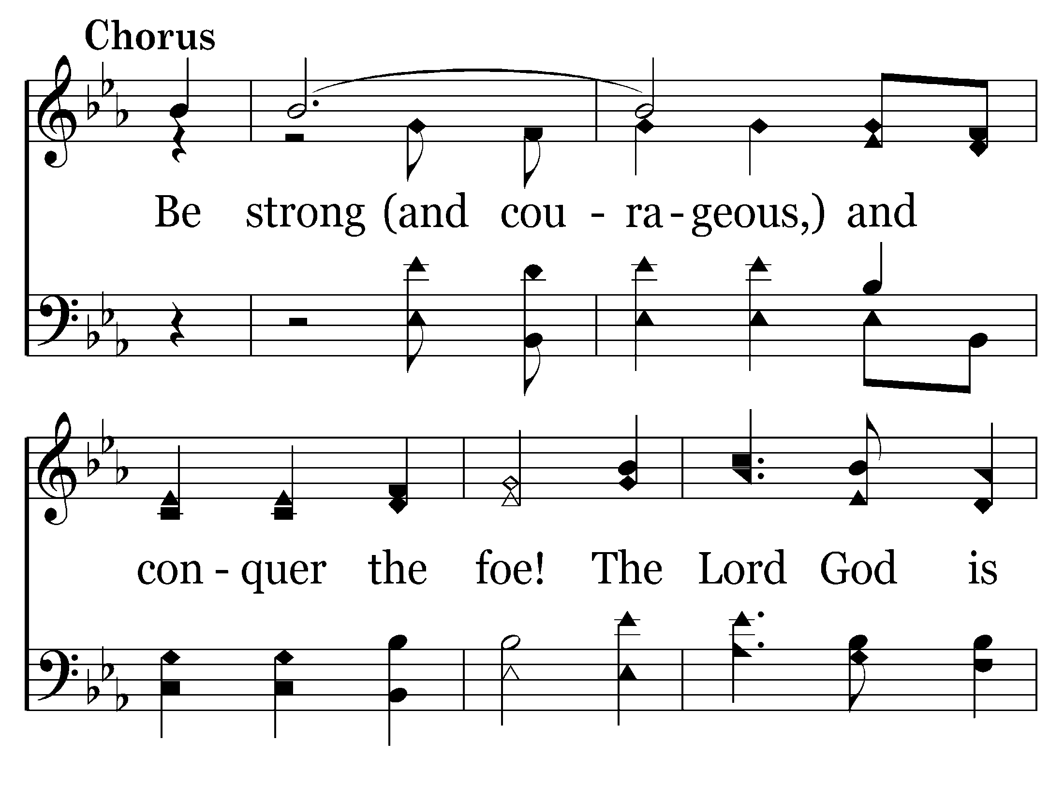
022 - Be Strong And Courageous - C.1

Slide 29
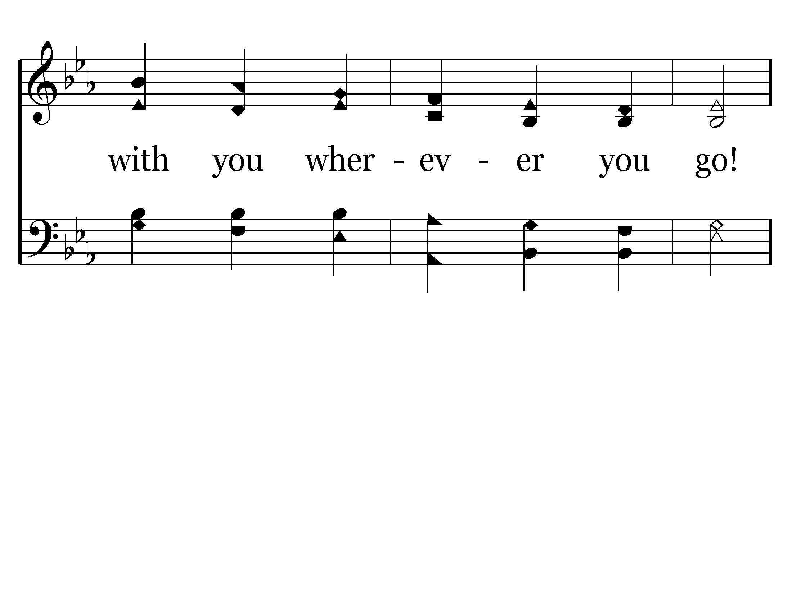
022 - Be Strong And Courageous - C.2

Slide 30
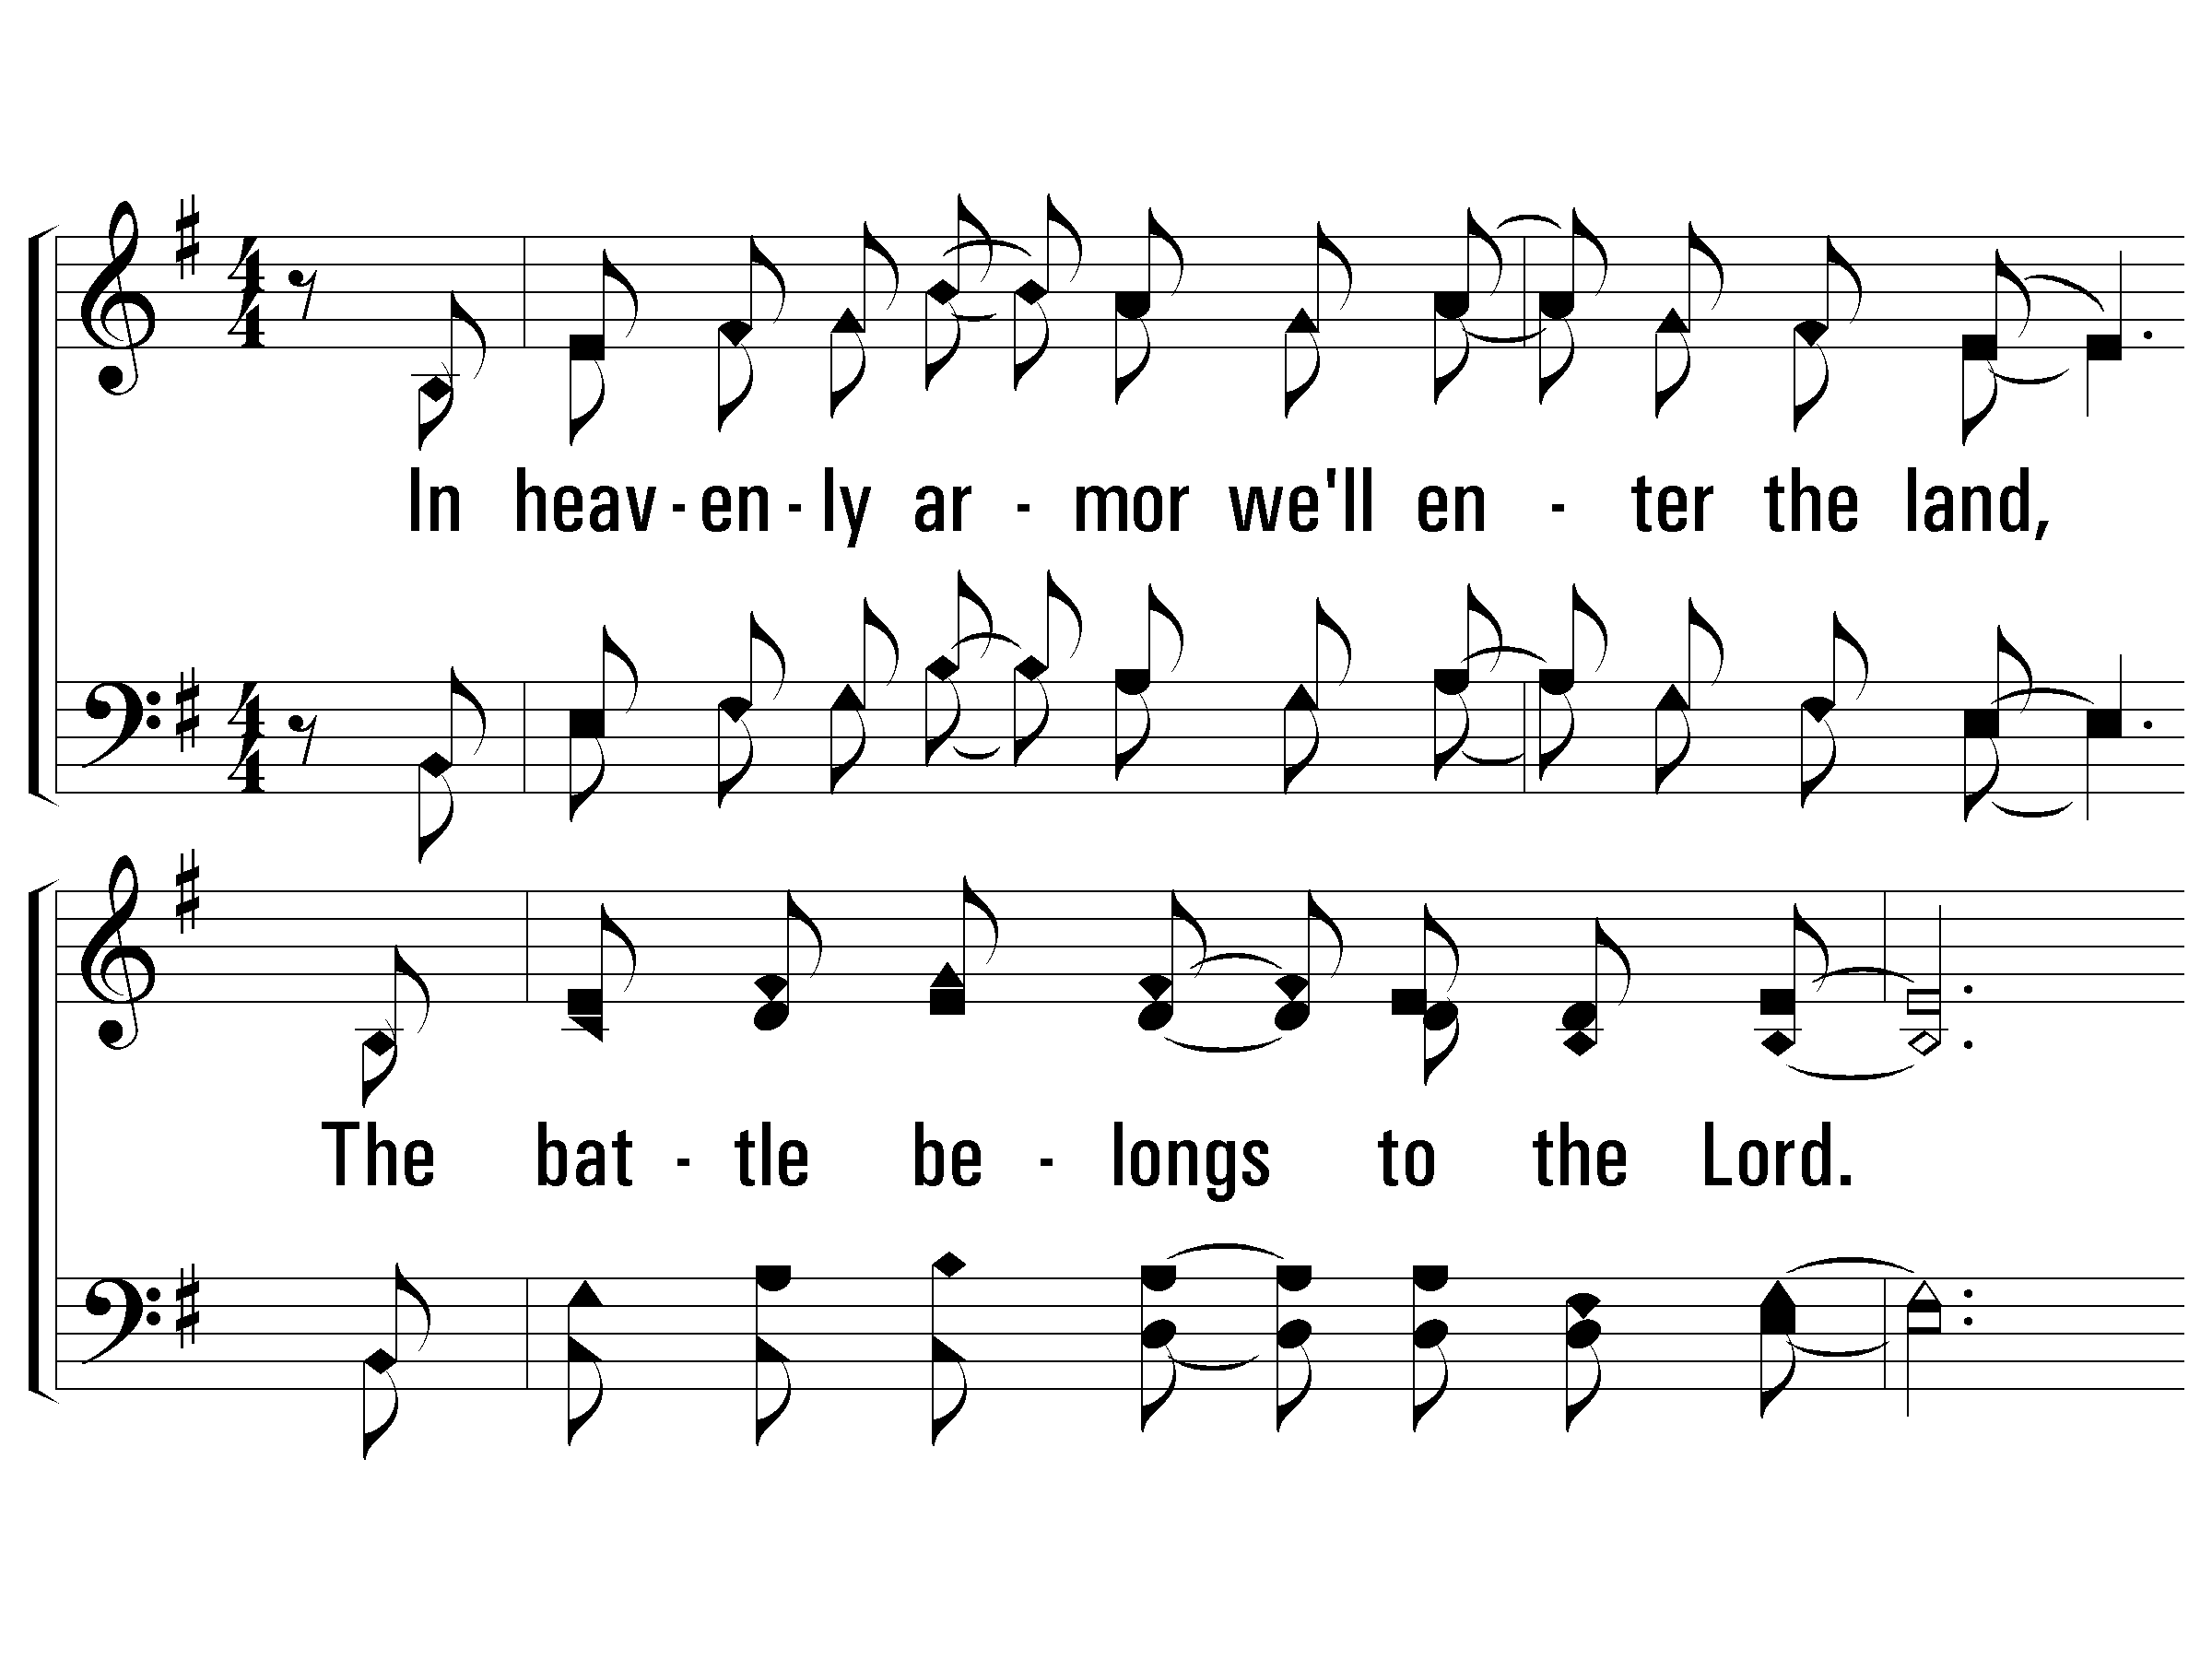
1 – The Battle Belongs to the Lord
1.
In heavenly armor we'll enter the land,
The battle belongs to the Lord.
No weapon that's fashioned against us will stand,
The battle belongs to the Lord.
Words & Music: Jamie Owens-Collins
Copyright © 1984 by Fairhill Music, Inc. (ASCAP)
© 2003 The Paperless Hymnal™

Slide 31
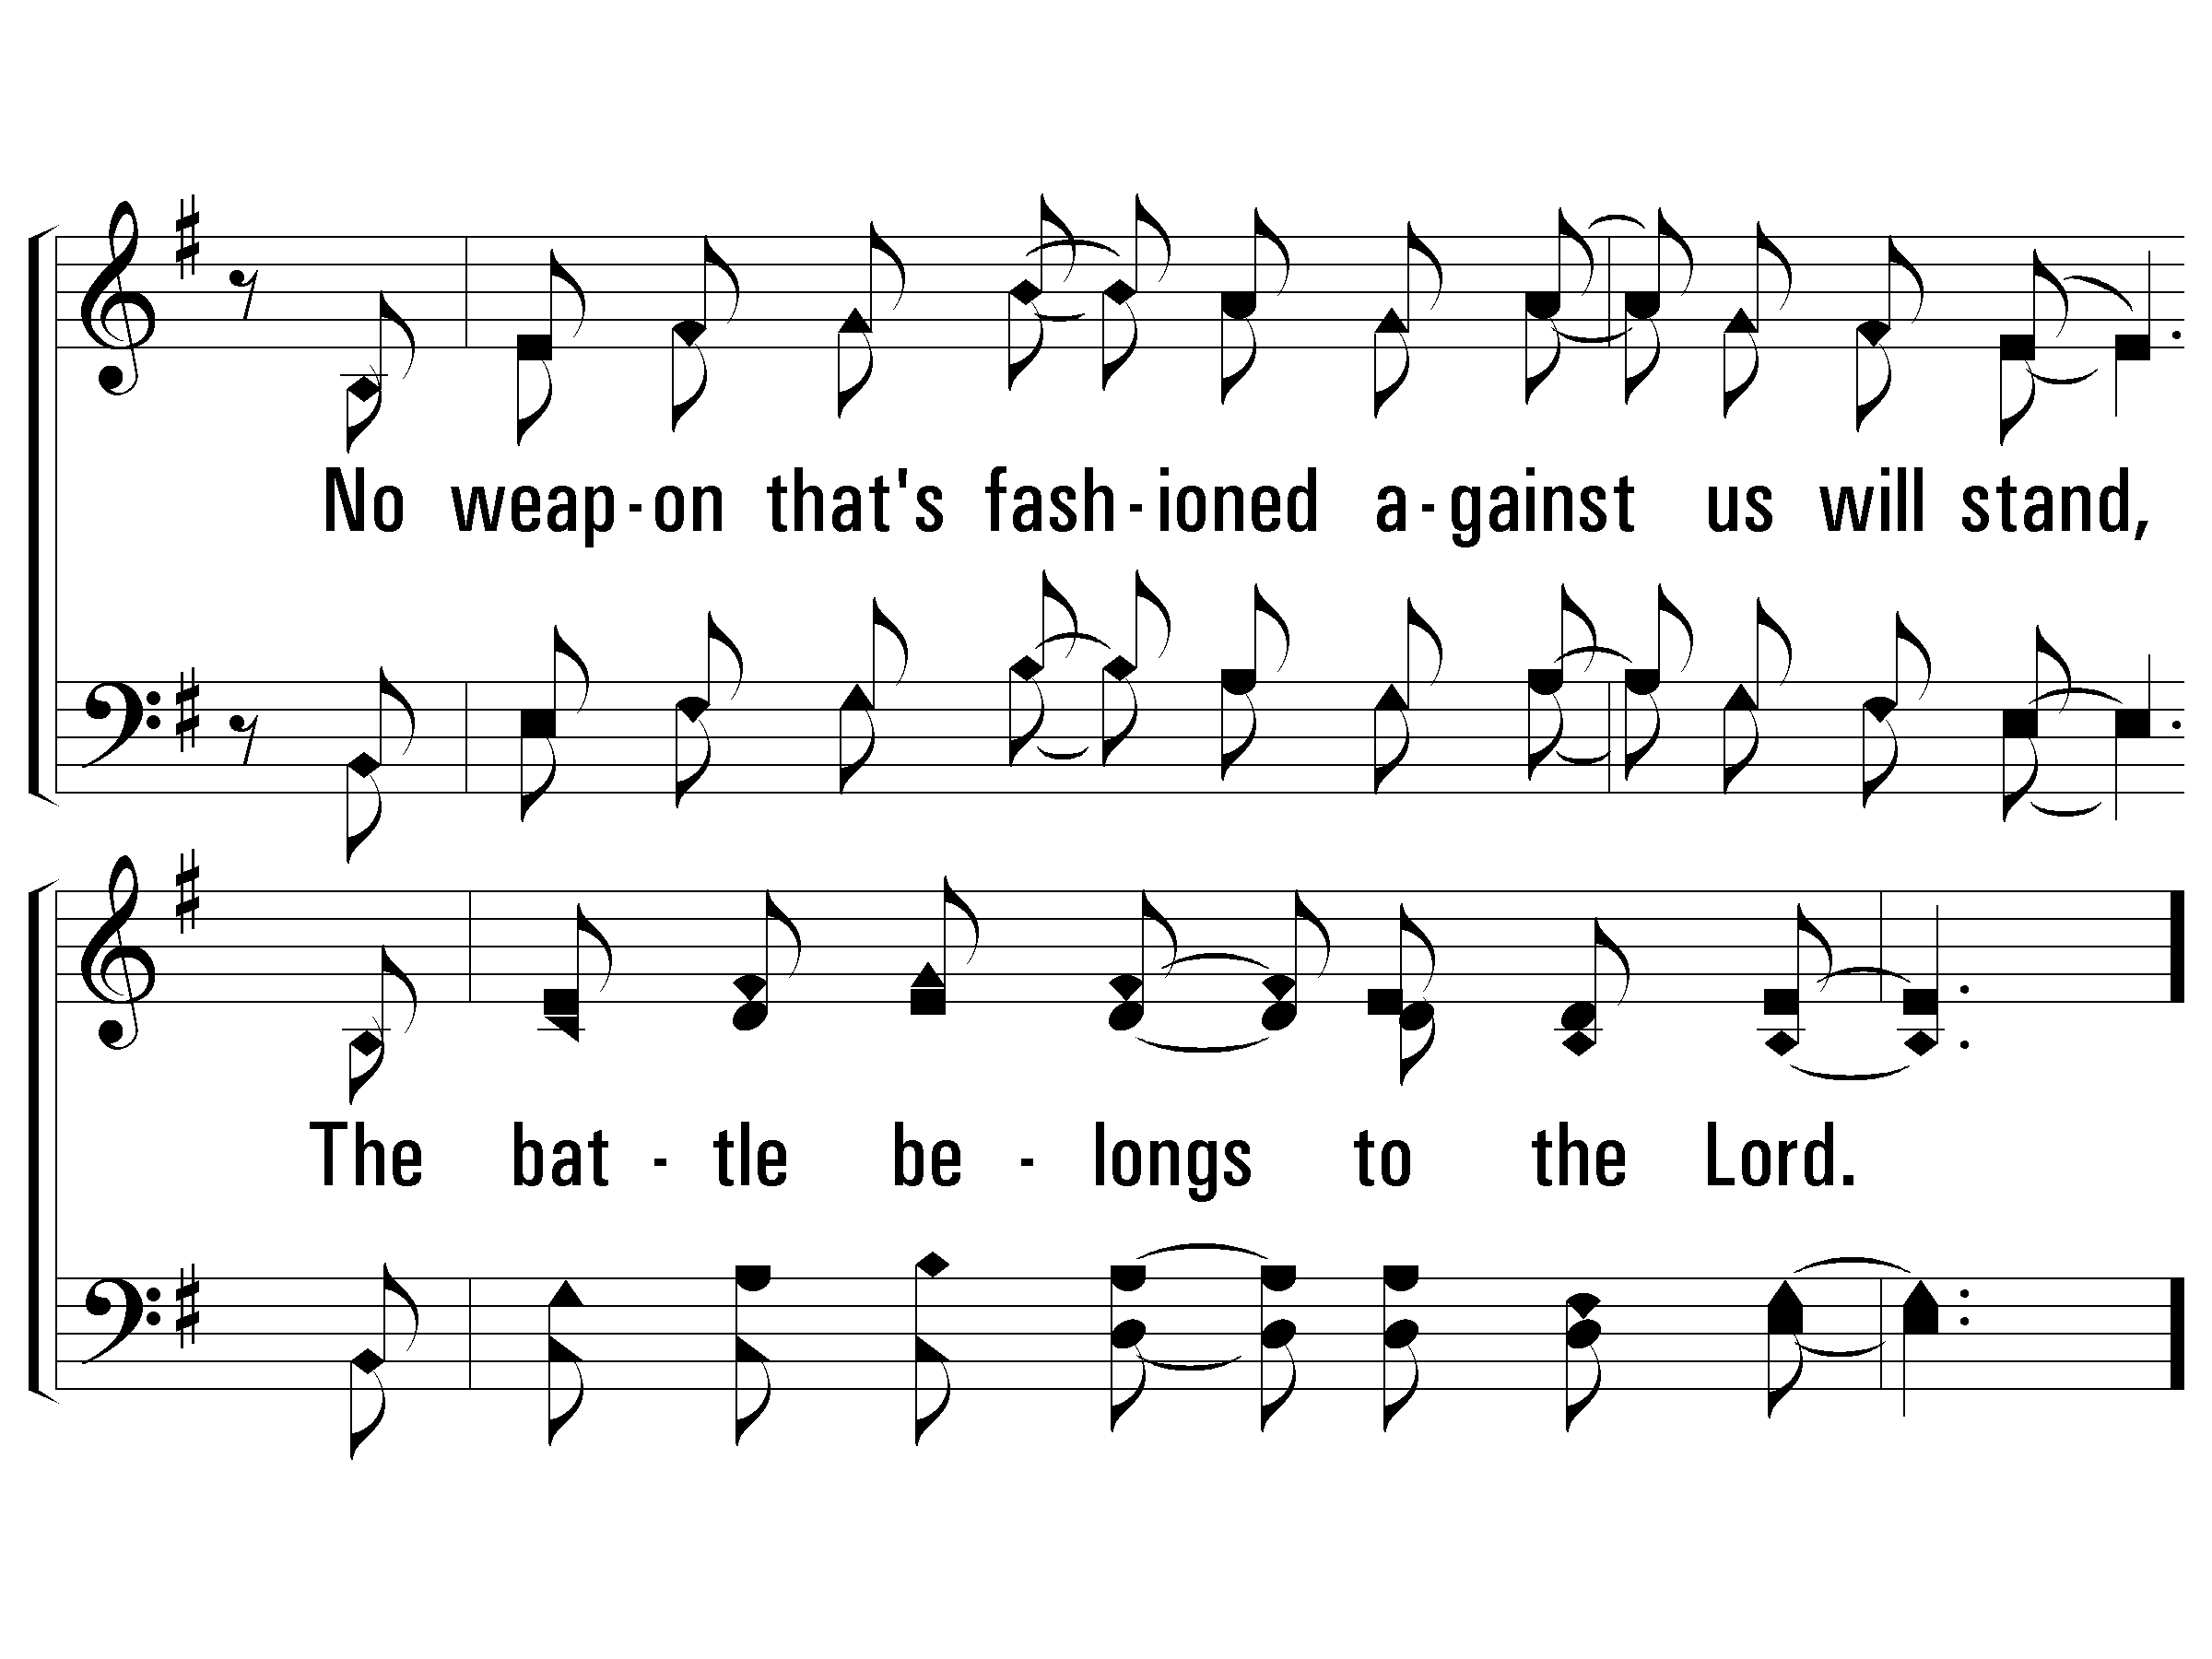
1 – The Battle Belongs to the Lord
© 2003 The Paperless Hymnal™

Slide 32
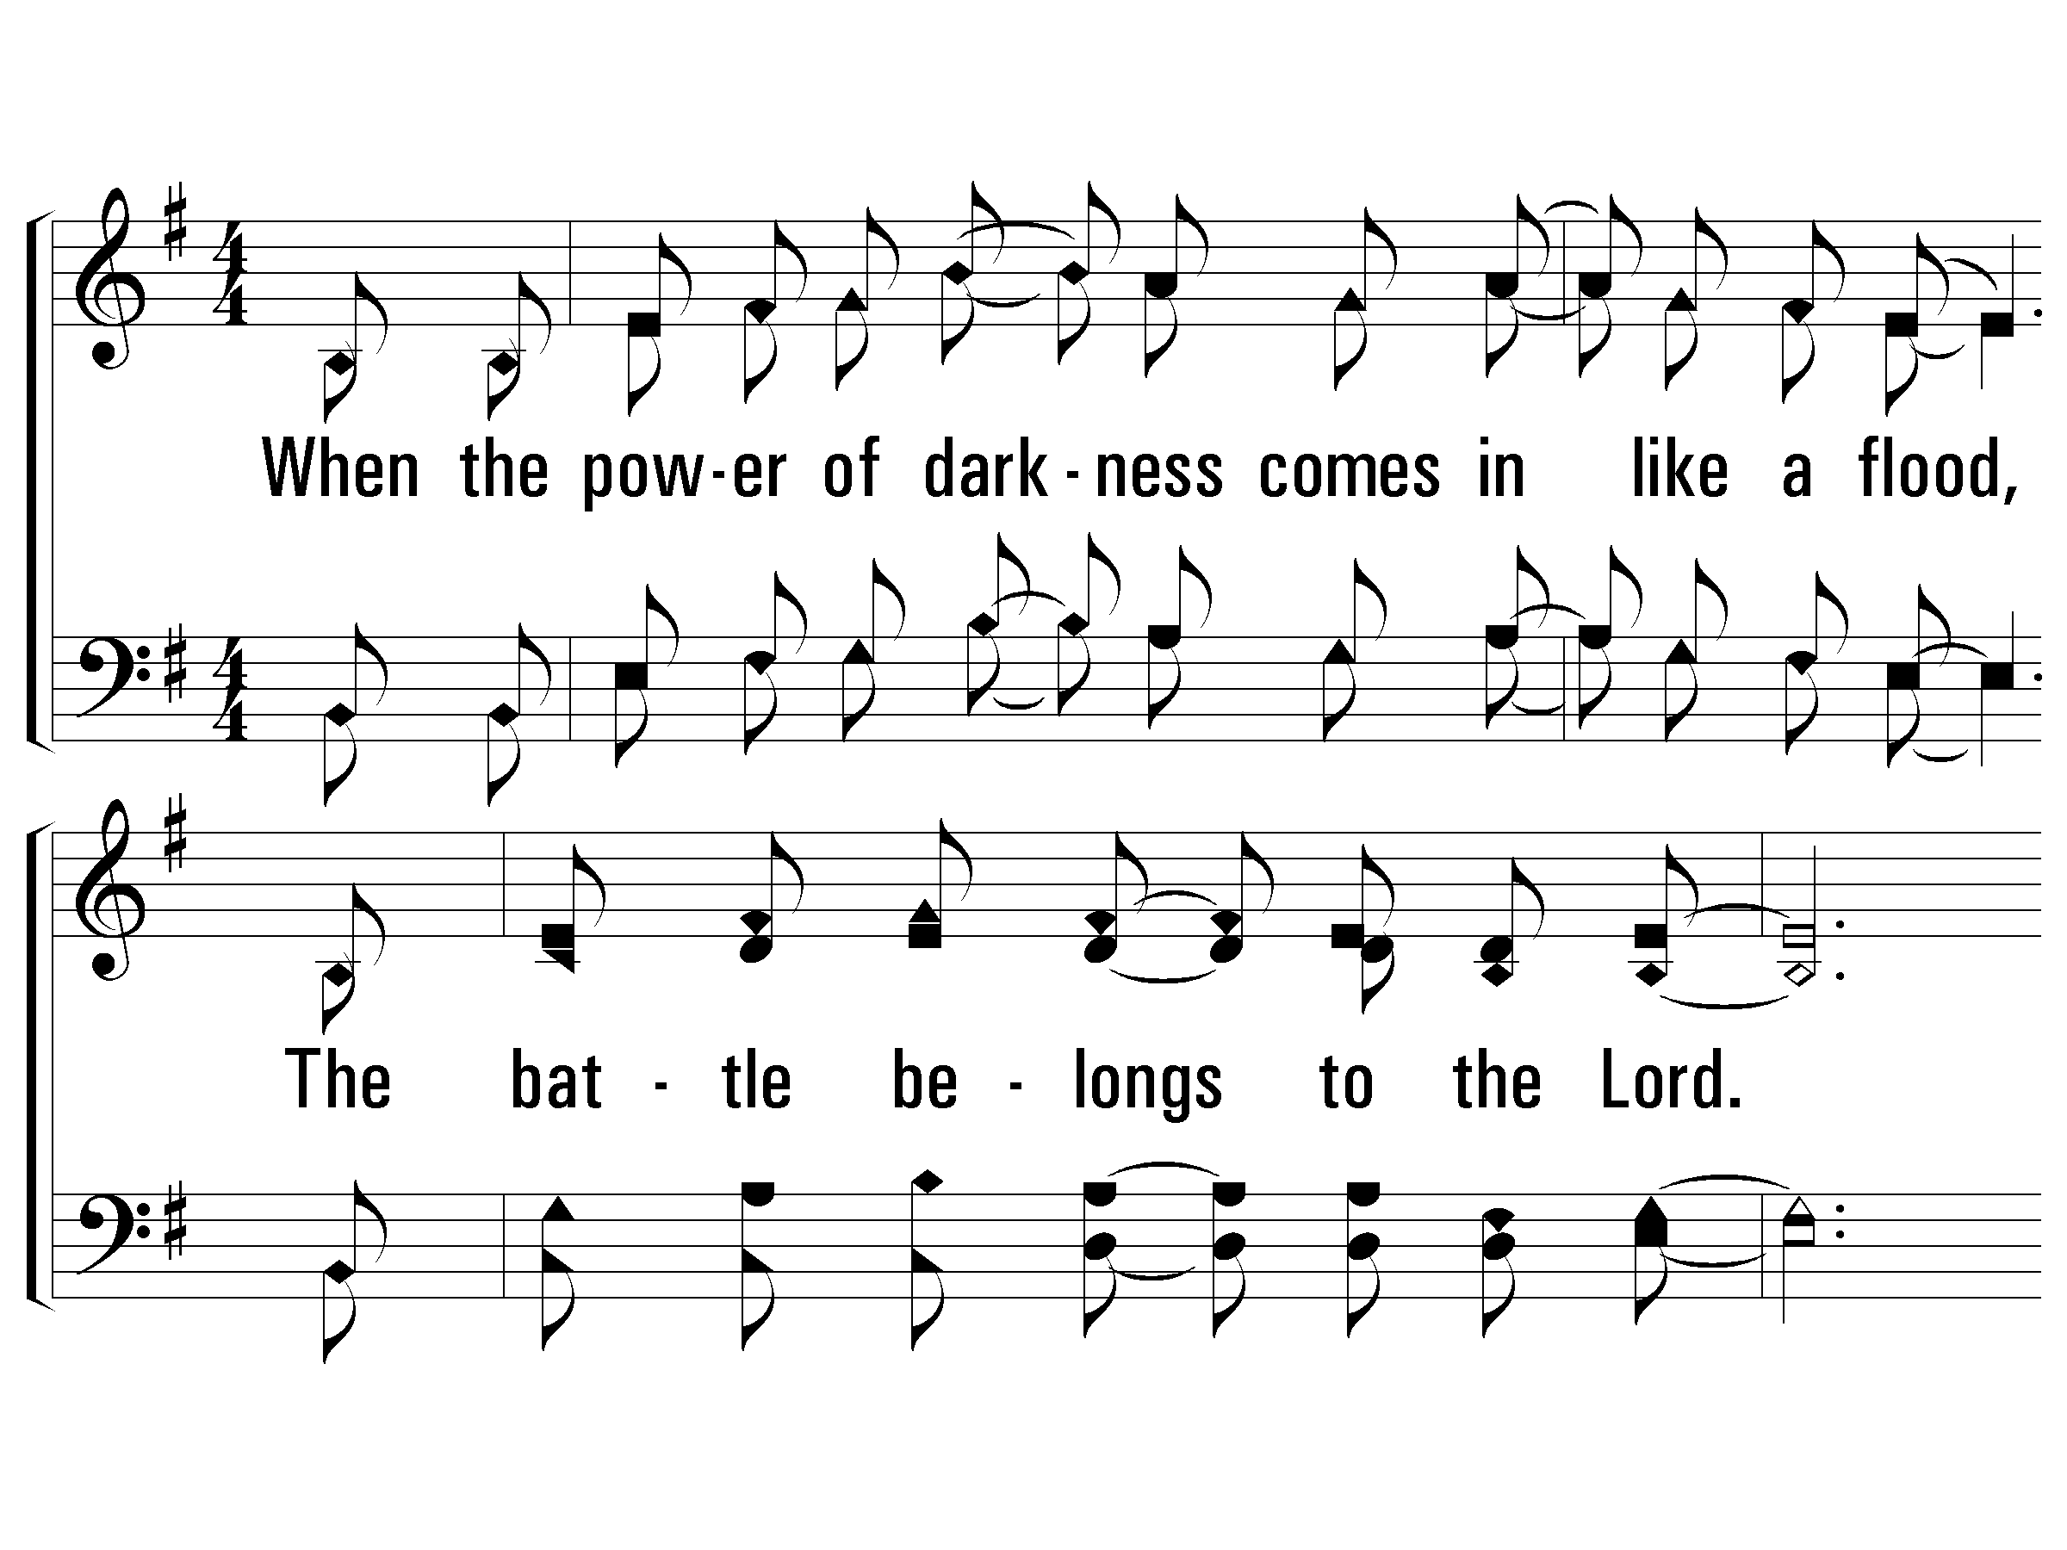
2 – The Battle Belongs to the Lord
2.
When the power of darkness comes in like a flood,
The battle be-longs to the Lord.
He's raised up a standard, the power of His blood,
The battle belongs to the Lord.
Words & Music: Jamie Owens-Collins
Copyright © 1984 by Fairhill Music, Inc. (ASCAP)
© 2003 The Paperless Hymnal™

Slide 33
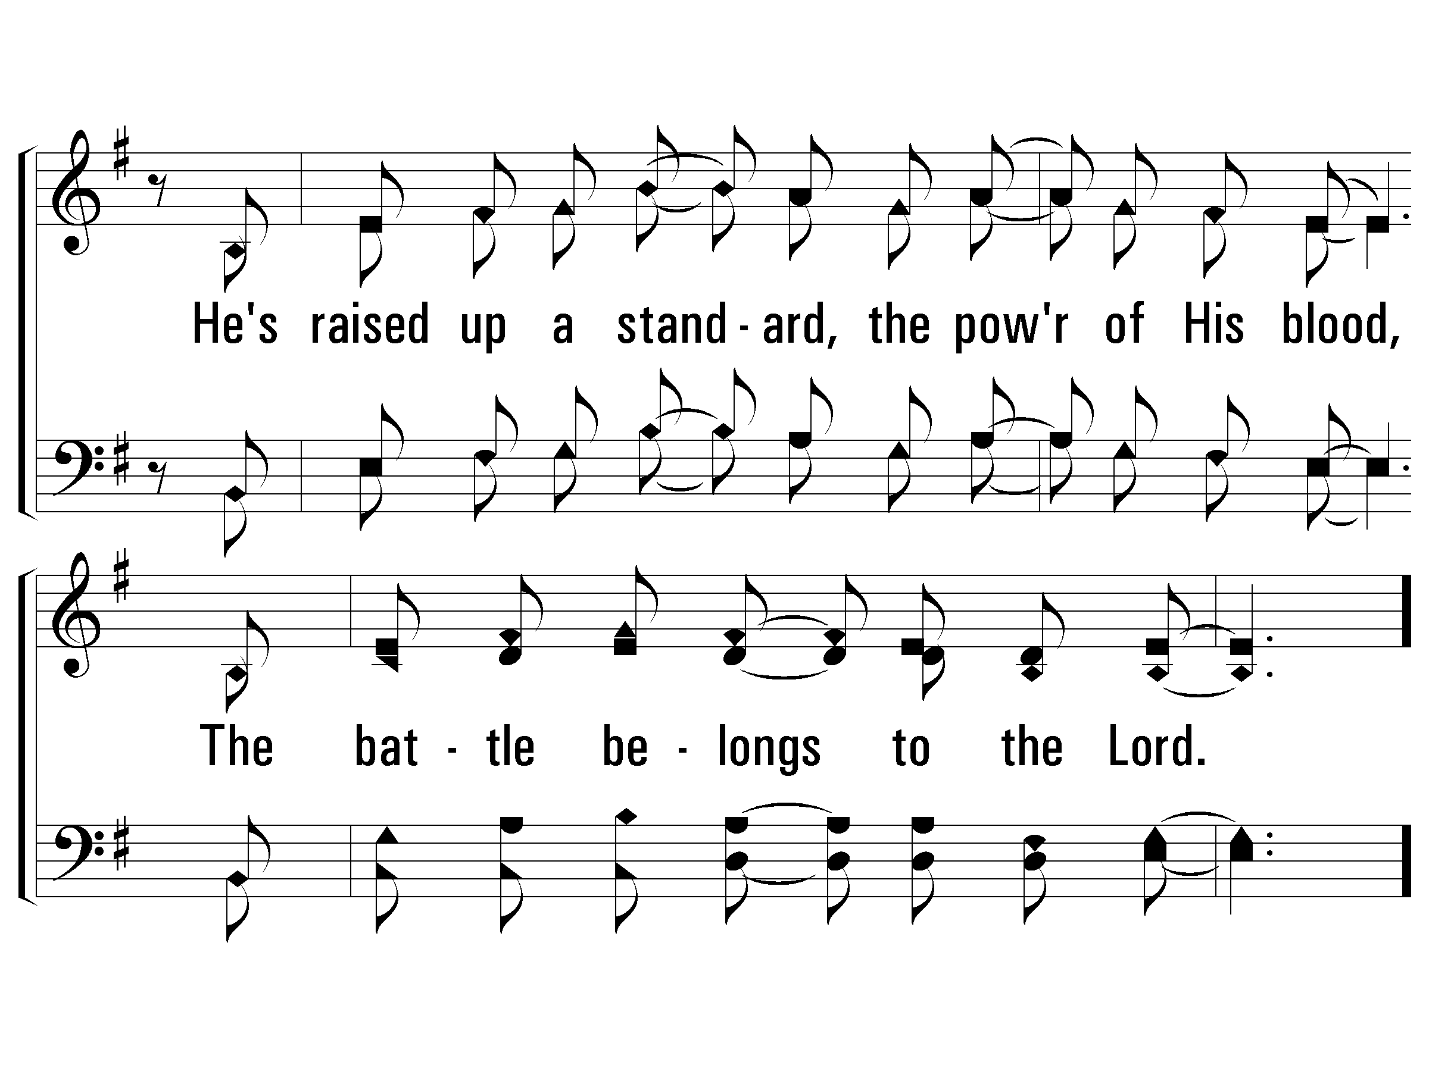
2 – The Battle Belongs to the Lord
© 2003 The Paperless Hymnal™

Slide 34
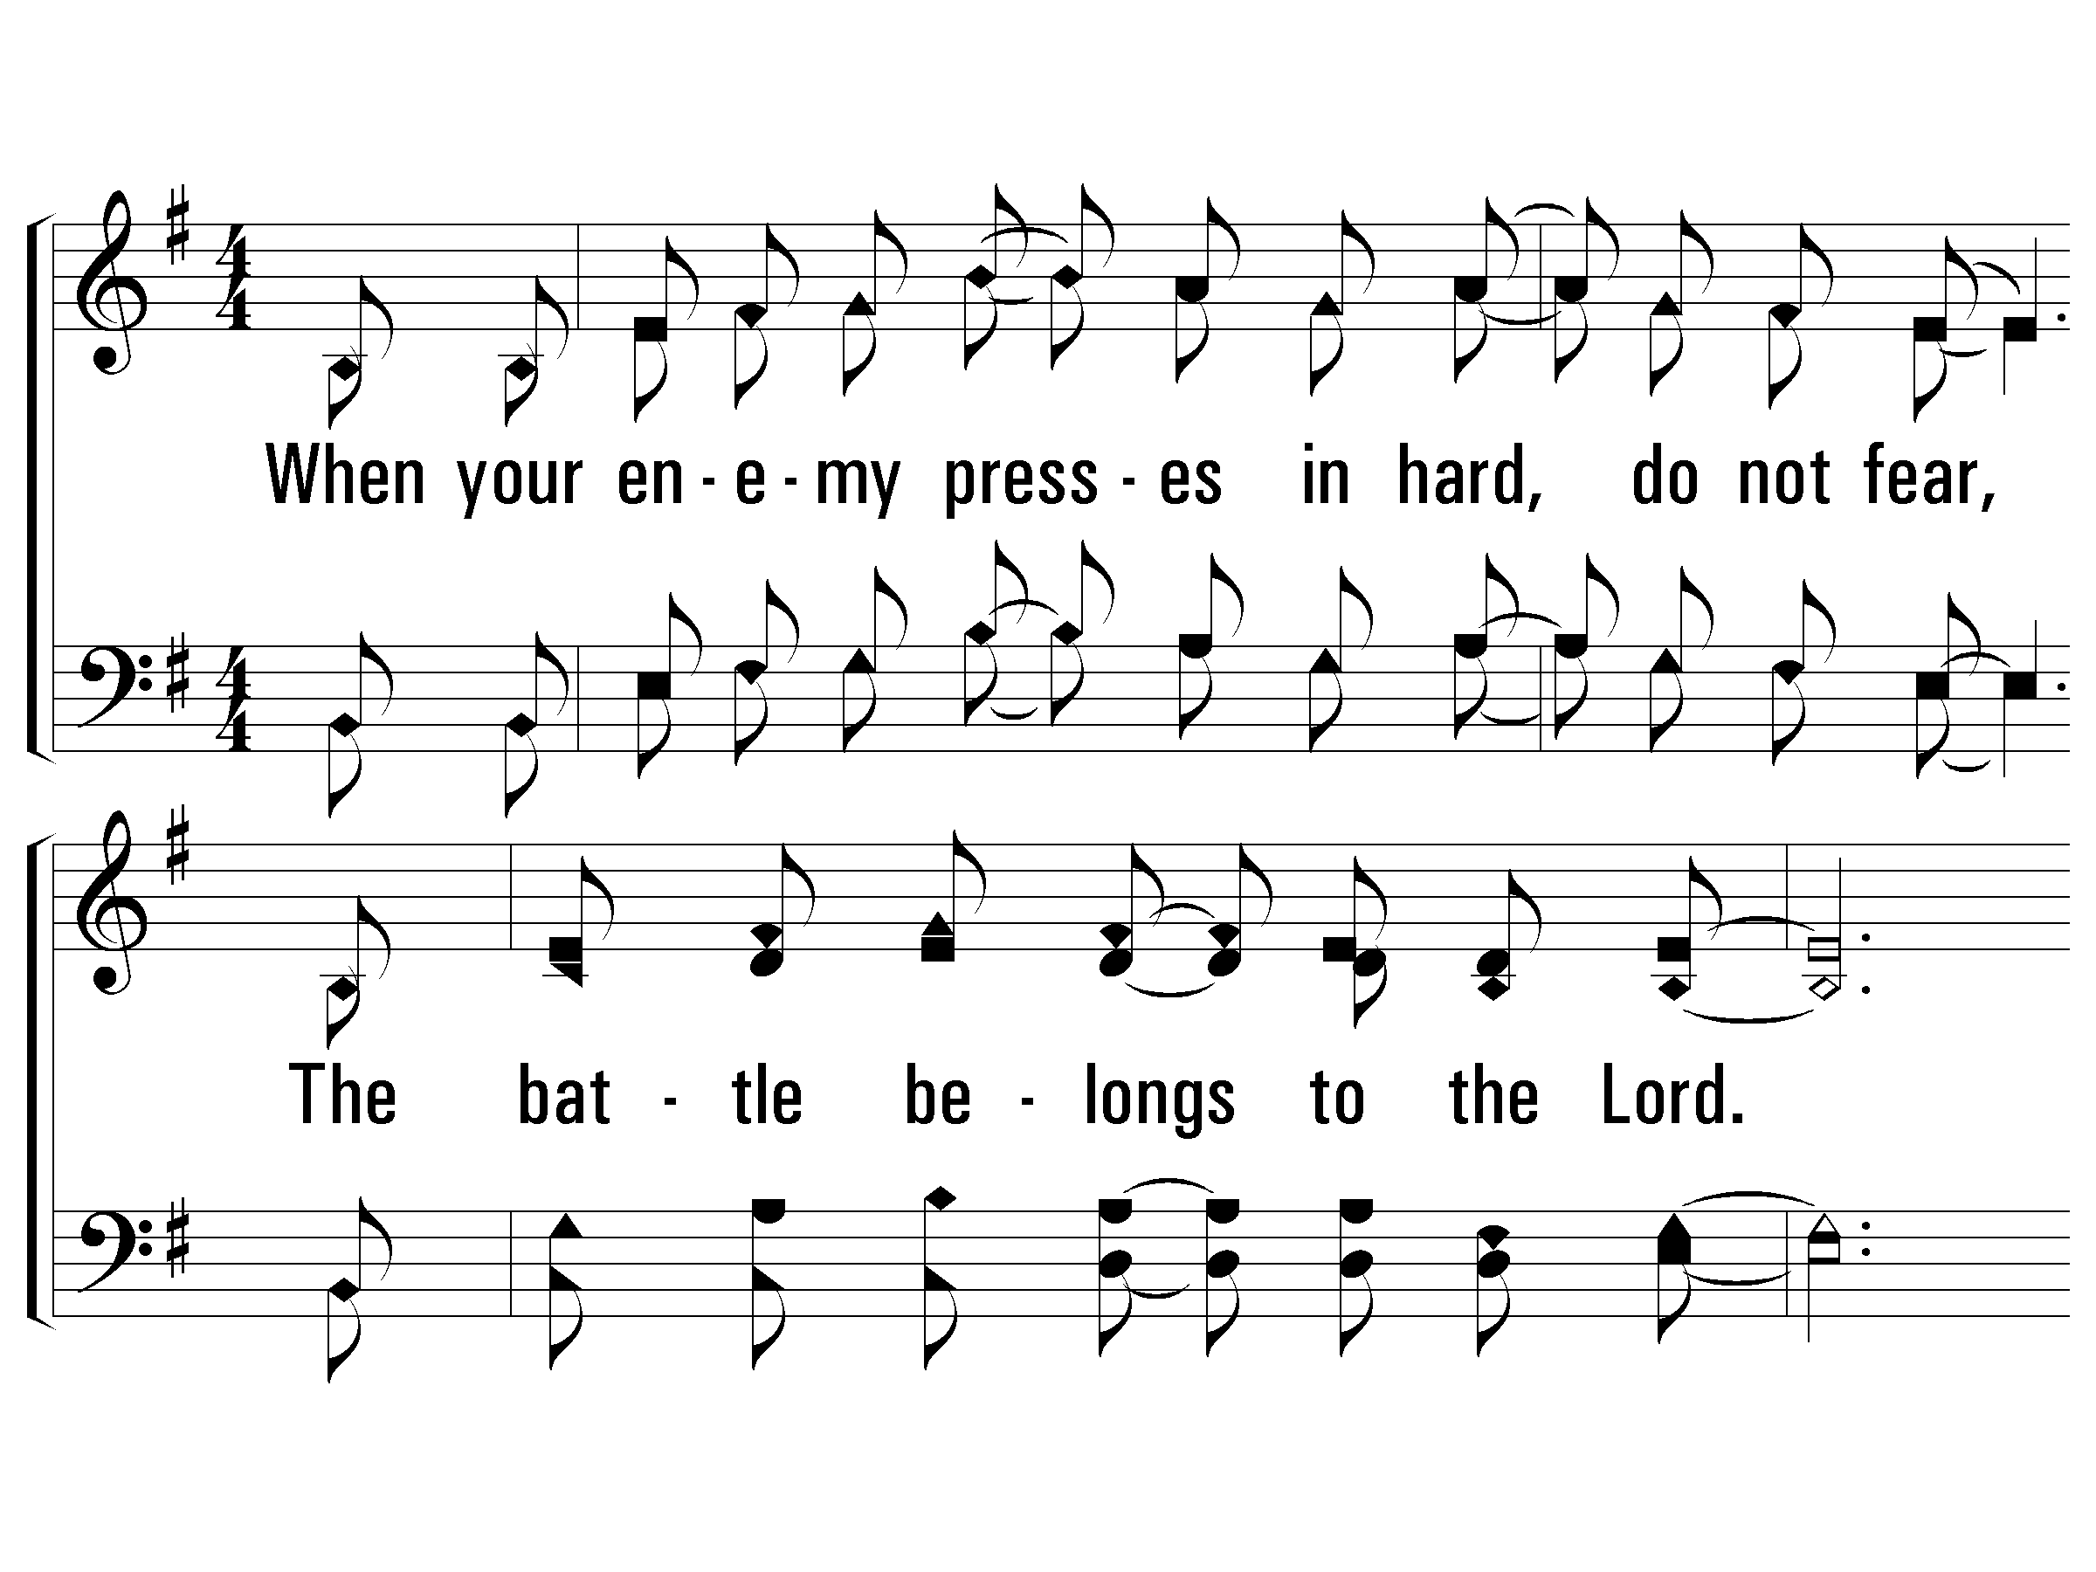
3 – The Battle Belongs to the Lord
3.
When your enemy presses in hard, do not fear,
The battle belongs to the Lord.
Take courage, my friend, your redemption is near,
The battle belongs to the Lord.
Words & Music: Jamie Owens-Collins
Copyright © 1984 by Fairhill Music, Inc. (ASCAP)
© 2003 The Paperless Hymnal™

Slide 35
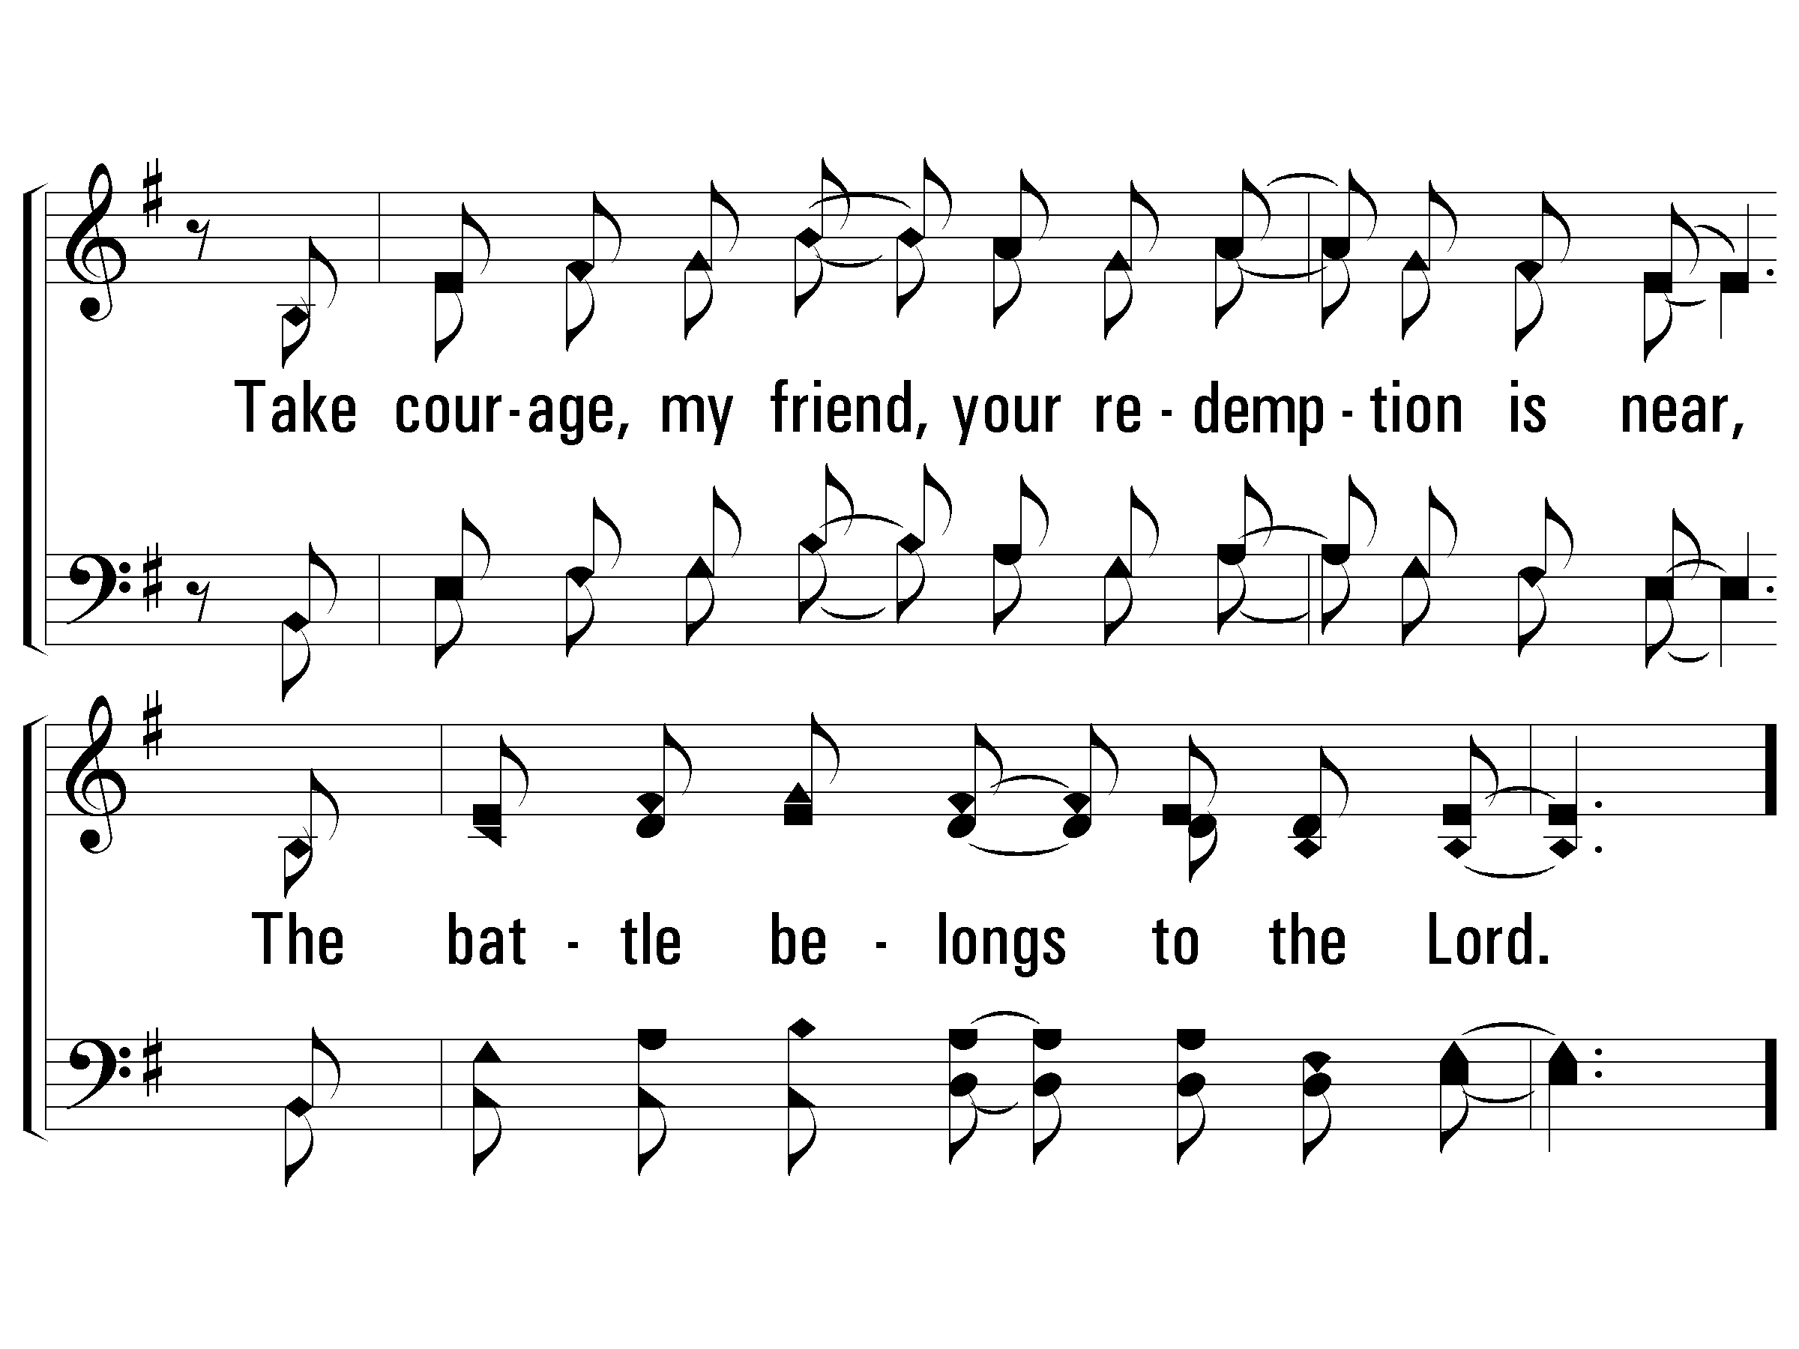
3 – The Battle Belongs to the Lord
© 2003 The Paperless Hymnal™

Slide 36
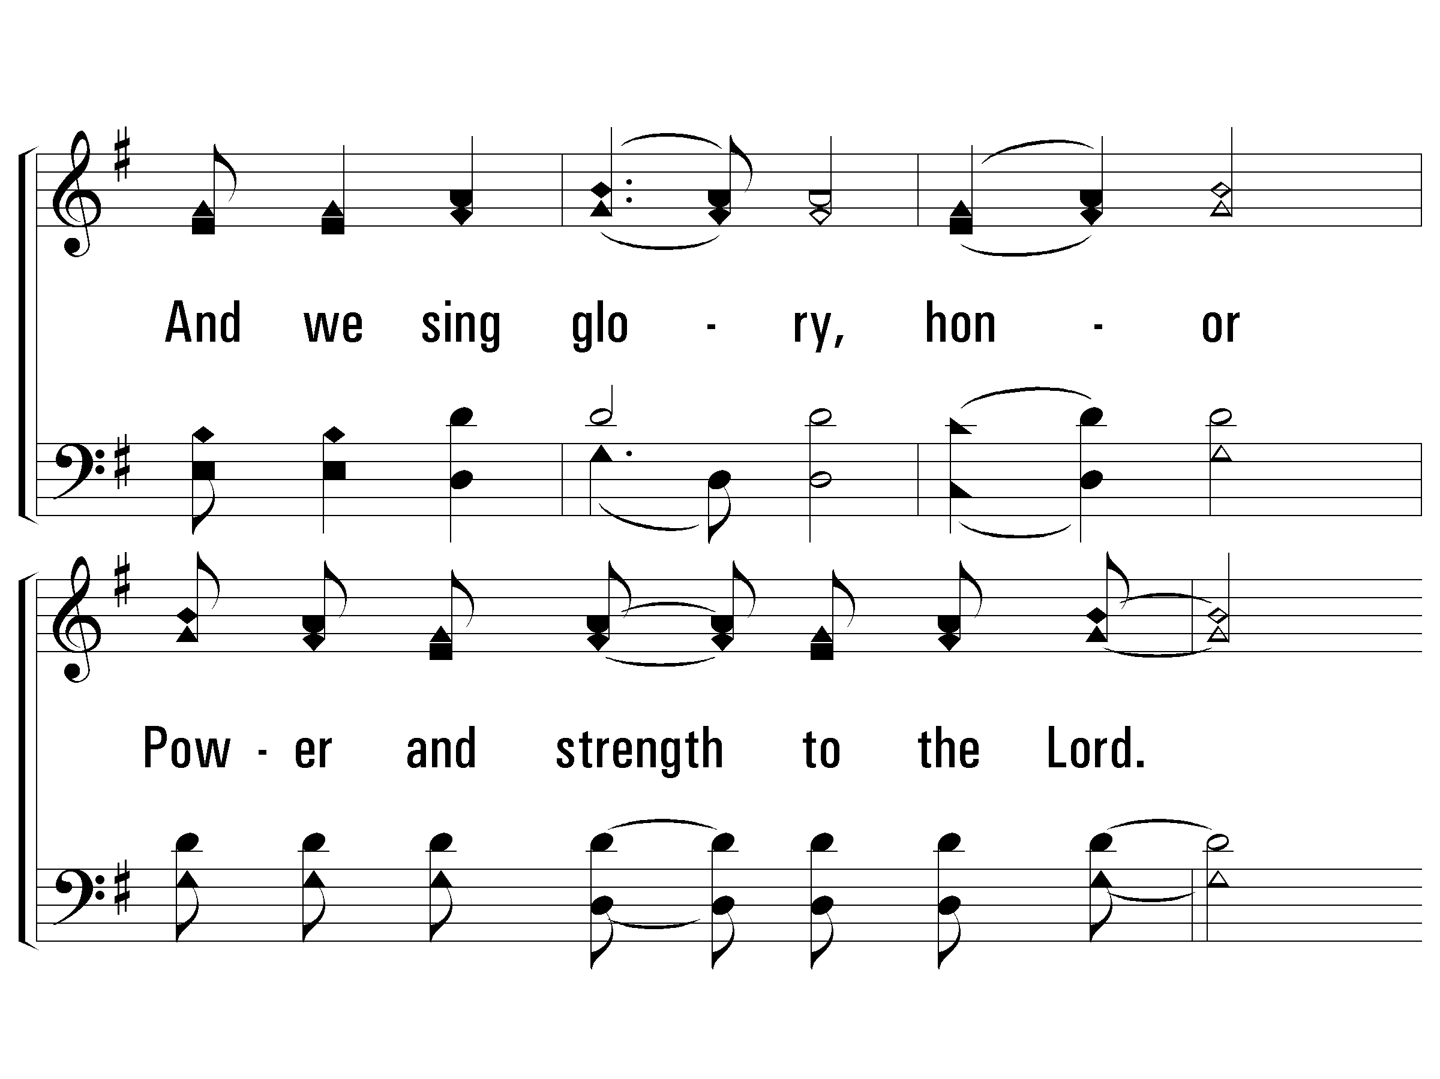
c – The Battle Belongs to the Lord
And we sing glory, honor
Power and strength to the Lord.
We sing glory, honor,
Power and strength to the Lord.
© 2003 The Paperless Hymnal™

