Slide 1
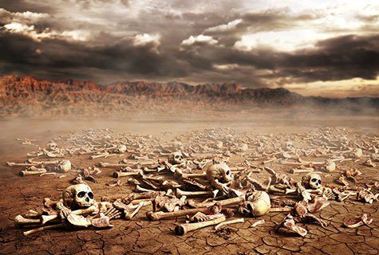
Ezekiel
“Ye Shall Know That I Am The Lord”

Slide 2
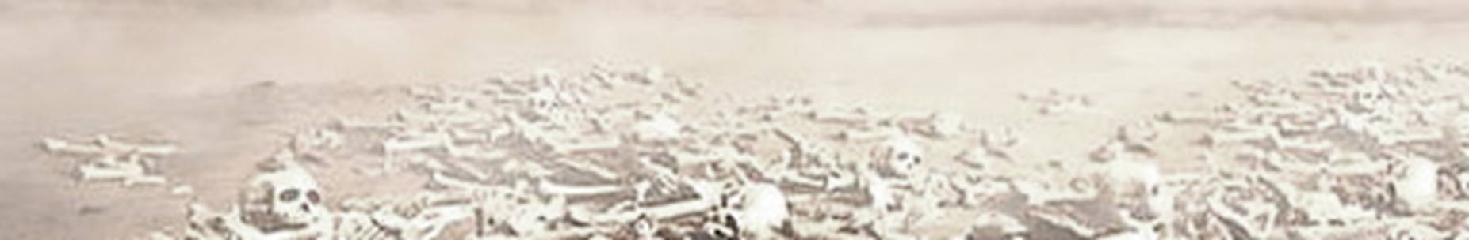
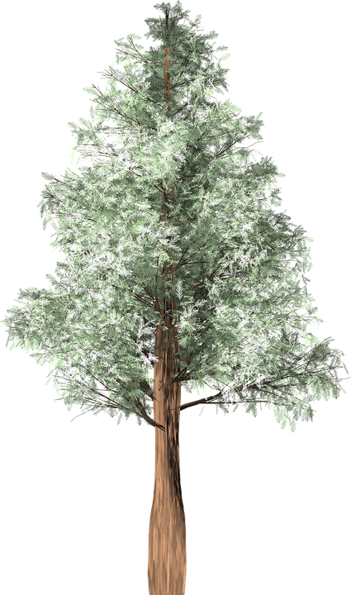
Ezekiel
Lessons 16 – Ezekiel 31-32
Egypt would fall like a great cedar – just as Assyria had (31:1-9)

Slide 3
Ezekiel
Lessons 16 – Ezekiel 31-32
Egypt would fall like a great cedar – just as Assyria had
Egypt, like Assyria -- is a great cedar (31:1-9)
Assyria fell when it was lifted up with pride [conquered by Babylon in 612 BC] (31:10-14; Isaiah 10:5-15, 33-34)
  The same principle is at work with proud individuals (Prov. 15:25; 16:5, 18; 18:12)
Nations were shaken by the fall of Assyria (31:15-17)
Egypt would be brought down as well, in much the same way (31:18)
Notes:
Isaiah 10:33-34 Behold, the Lord, The LORD of hosts, Will lop off the bough with terror; Those of high stature will be hewn down, And the haughty will be humbled. 34 He will cut down the thickets of the forest with iron, And Lebanon will fall by the Mighty One.
Proverbs 15:25 The LORD will destroy the house of the proud
Proverbs 16:5 Everyone proud in heart is an abomination to the LORD; Though they join forces, none will go unpunished.
Proverbs 16:18 Pride goes before destruction, And a haughty spirit before a fall.
Proverbs 18:12 Before destruction the heart of a man is haughty, And before honor is humility.

Slide 4
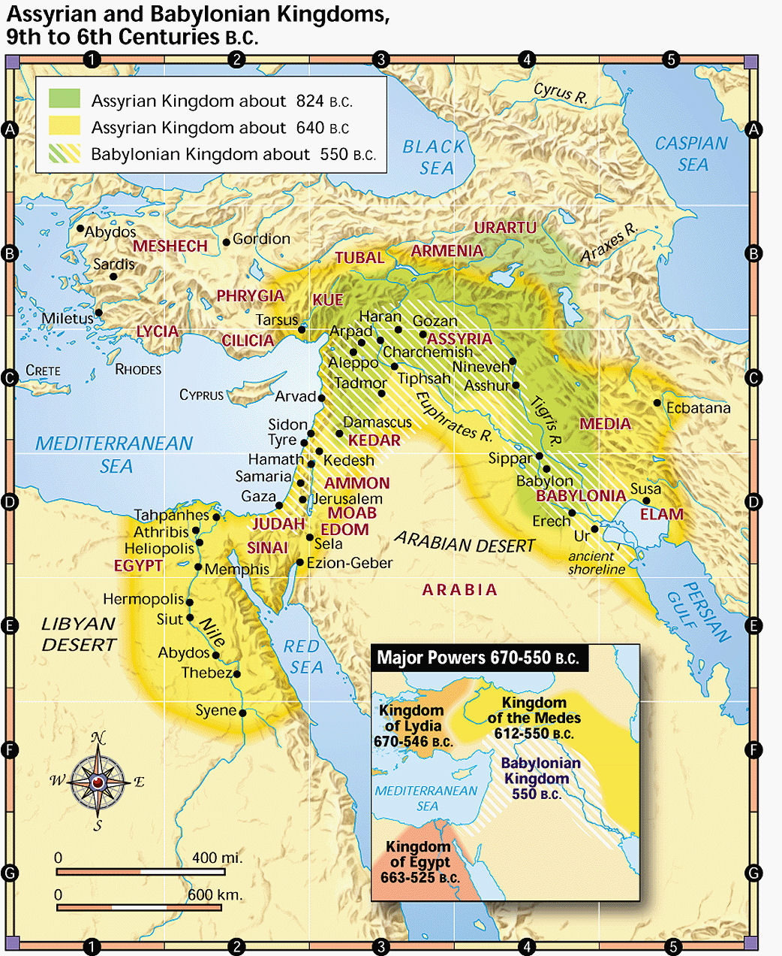

Slide 5
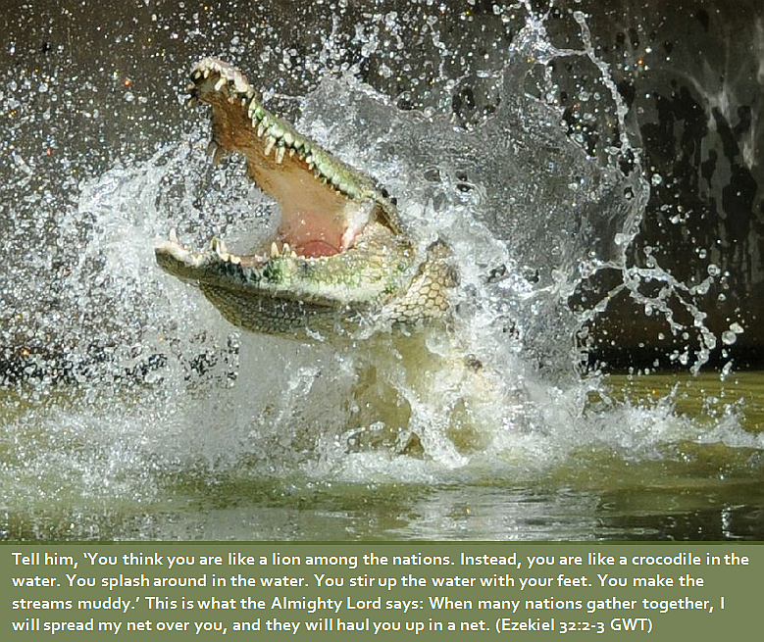
Lamentation for Pharaoh (32:1-16)
Like a crocodile* Egypt would be netted and scavenged by the nations (32:1-6) * “dragon” or “monster”

Slide 6
Ezekiel
Lessons 16 – Ezekiel 31-32
Lamentation for Pharaoh (32:1-16)
Like a crocodile, Egypt would be netted and scavenged by the nations (32:1-6)
Egypt’s fall would be like cosmic changes in the heavens (32:7-10, cf. Isaiah 13:10; 34:2-4; Jeremiah 4:28; Matthew 24:29)
The King of Babylon will execute God’s judgment (32:11-16)
Notes:
FALL OF BABYLON Isaiah 13:10 For the stars of heaven and their constellations Will not give their light; The sun will be darkened in its going forth, And the moon will not cause its light to shine.
FALL OF MANY NATIONS: Isaiah 34:2-4 For the indignation of the LORD is against all nations, And His fury against all their armies; He has utterly destroyed them, He has given them over to the slaughter. 3 Also their slain shall be thrown out; Their stench shall rise from their corpses, And the mountains shall be melted with their blood. 4 All the host of heaven shall be dissolved, And the heavens shall be rolled up like a scroll; All their host shall fall down As the leaf falls from the vine, And as fruit falling from a fig tree.
FALL OF JUDAH Jeremiah 4:28 For this shall the earth mourn, And the heavens above be black, Because I have spoken. I have purposed and will not relent, Nor will I turn back from it.
FALL OF JERUSALEM: Matthew 24:29 "Immediately after the tribulation of those days the sun will be darkened, and the moon will not give its light; the stars will fall from heaven, and the powers of the heavens will be shaken.

Slide 7
Ezekiel
Lessons 16 – Ezekiel 31-32
Lamentation for Egypt – slain like other nations (32:17-32)
Egypt will go down to the pit of destruction like other pagan nations (32:17-21)
  Assyria (32:22-23)
  Elam (32:24-25)
  Meshech and Tubal (32:26-28)
  Edom (32:29)
  Sidon (32:30)
Pharaoh could console himself in the knowledge that the same fate had come upon many other nations (32:31-32)

