Slide 1
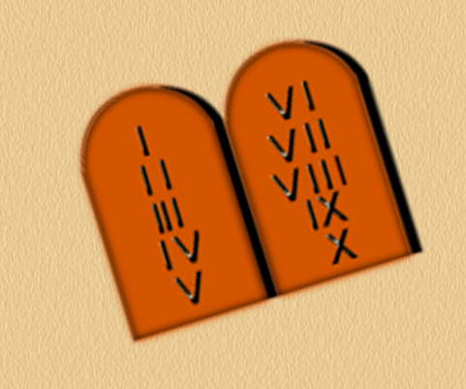
Exodus & Wandering in the Wilderness
Lesson 20
Deuteronomy 4:44- 26

Slide 2
Moses’ Second Speech
Introduction: 4:44-49
The law of God which Moses set before the people
Testimonies, statutes, judgements
Given to Israel after they came out of Egypt (see 5:3)

Slide 3
Moses’ Second Speech
Introduction:
Look for laws…
To bring them into proper relationship with God
To regulate their conduct toward orderly and beneficial living

Slide 4
Moses’ Second Speech
Ten Commandments Reviewed: 5:1-21
I am the Lord your God who brought you out of Egypt, out of slavery
I – You shall have no other gods before Me
II – You shall not make for yourself an idol
Any likeness of anything; in heaven, above or on the earth, or in the waters below
You shall not bow down and worship them for I am a jealous God

Slide 5
Moses’ Second Speech
Ten Commandments Reviewed (cont.)
II (cont.)
God punishes the children for the sins of their fathers to the 3rd and 4th generation; but show love to a 1000 generations of those that love Him and keep His commandments
III – You shall not take the name of the Lord your God in vain
For the Lord will not hold anyone guiltless who take His name in vain

Slide 6
Moses’ Second Speech
Ten Commandments Reviewed (cont.)
IV – Remember the Sabbath day, to keep it holy
Six days you shall labor and do your work; seventh day no work (for anyone in your household or servants)
V – Honor your father and your mother
So you may live long in the land the Lord your God is giving you
VI – You shall not murder

Slide 7
Moses’ Second Speech
Ten Commandments Reviewed (cont.)
VII – You shall not commit adultery
VIII – You shall not steal
IX – You shall not bear false witness against your neighbor
X – You shall not covet
Your neighbor’s house, wife, manservant, maidservant, ox, donkey, or anything

Slide 8
Moses’ Second Speech
Destroy the people and their idols that you find in the land 7:1-16
Offer sacrifices in the place God specifies 12:1-32
Put to death those who turn to idols 13:1-18
You are a holy people, so do not pollute yourselves 14:1-21

Slide 9
Moses’ Second Speech
Give your tithes to the Lord 14:22-29
The seventh year 15:1-18
Set apart the firstborn 15:19-23
Observe the feast days 16:1-17
Appoint judges in every town 16:18-20
Stone the one who turns to idols 16:21-17:7

Slide 10
Moses’ Second Speech
Bring difficult cases to priests 17:8-13
Instructions for kings 17:14-20
Offerings for priests and Levites 18:1-8
Do not engage in detestable practices 18:9-14
God will raise up a prophet 18:15-22
Cities of refuge 19:1-13

Slide 11
Moses’ Second Speech
Boundary markers 19:14
Witnesses 19:15-21
Rules for going to war 20:1-20
An unsolved murder 21:1-9
Marrying a captive woman 21:10-14
The right of the firstborn 21:15-17
A rebellious son 21:18-21

Slide 12
Moses’ Second Speech
Bury the criminal 21:22-23
Be considerate of your neighbor’s possessions 22:1-4
In appropriate conduct 22:5,9,10,11
Show consideration 22:6-8
Tassels 22:12
Accusation of unchastity 22:13-21

Slide 13
Moses’ Second Speech
Rules regarding adultery 22:22-30
Rules regarding who can be part of the assembly of Israel 23:1-8
Cleanness in the camp 23:9-14
A runaway slave 23:15-16
Temple prostitutes 23:17-18
Interest on loans 23:19-20

Slide 14
Moses’ Second Speech
Vows 23:21-23
Your rights in your neighbor’s field 23:24-25
Re-marrying a woman who is put away 24:1-4
Exempt from war 24:5
Securities for loans 24:6,10-13,17-18

Slide 15
Moses’ Second Speech
Kidnapping 24:7
Leprosy 24:8-9
A hired man 24:14-15
The guilty one dies 24:16
Leave the last for the poor 24:19-22
Beating for the guilty 25:1-3
Ox 25:4
Duty of a brother to a widow 25:5-10

Slide 16
Moses’ Second Speech
A woman who seizes the private parts of a man 25:11-12
Accurate weights and measures 25:13-16
Remember the Amalekites 25:17-19
Firstfruits and tithes as thanksgiving offerings to God 26:1-15
Mutual vows between Jehovah and Israel 26:16-19

