Slide 1
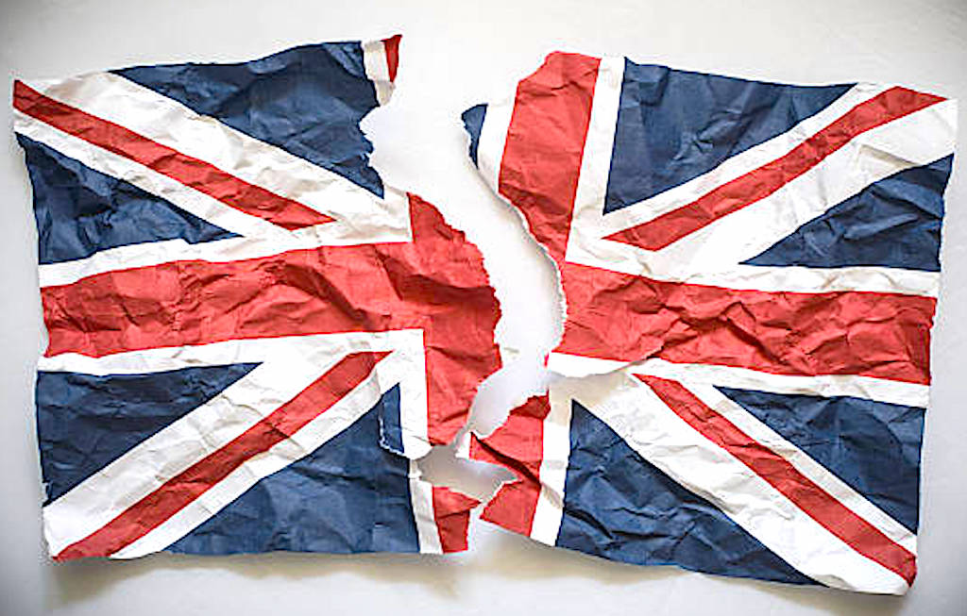
United Kingdom – Part 1

Slide 2
Today’s Material
Overview of the quarter
Review of the early years of Amaziah
Amaziah’s Death
Uzziah’s early reign

Slide 3
Quarter Overview
Approximately 84 of the last years of Israel
Approximately 220 of the last years of Judah
10 Prophets
12 Kings of Judah
7 Kings of Israel

Slide 4
Quarter Overview
These Passages
2 Kings 14-25
2 Chron 25-36
Jonah Zephaniah
Amos Jeremiah
Hosea Nahum
Isaiah Habakkuk
Micah Daniel (Just a little)

Slide 5
Quarter Overview
There are more books from the prophets during this time period. Why do you think that is?
2 Chron 36:16 But they mocked the messengers of God, despised His words, and scoffed at His prophets, until the wrath of the Lord arose against His people, till there was no remedy.
Jer 25:4 And the Lord has sent to you all His servants the prophets, rising early and sending them, but you have not listened nor inclined your ear to hear.

Slide 6
Quarter Overview
Roughly 220 years of Judah because:
Starting with Amaziah, their reigns total ~ 252 years
Some of the kings had overlapping reigns
Israel is taken captive in 722 BC
Judah is taken captive in 586 BC

Slide 7
Did Evil / Did Good
Judges 2:11 Then the children of Israel did evil in the sight of the Lord
Judges 3:7 So the children of Israel did evil in the sight of the Lord
Judges 3:12 And the children of Israel again did evil in the sight of the Lord
Judges ….

Slide 8
Did Evil / Did Good
1 Kings 11:6 Solomon did evil in the sight of the Lord
I Kings 15:5 because David did what was right in the eyes of the Lord

Slide 9
Review
Amaziah was 25 when he became king over Judah
He reigned 29 years in Jerusalem
So he was approximately 54 when he died
He “did what was right in the sight of the Lord, yet…”
Not like his father David
He did everything as his father Joash had done (12:1-3)
The high places were not taken away
The people still sacrificed and burned incense on the high places

Slide 10
Review
Amaziah’s father (Joash/Jehoash) was killed by his servants (12:20)
Amaziah executed those servants who had murdered his father BUT not their children (14:5-6)

Slide 11
Review
Amaziah went to war with Edom:
Had 300,000 “choice men”
Hired 100,000 “mighty men” from Israel (but sent them back home – and they were angry!)
They killed 10,000 Edomites
He took Sela (Petra?) (both mean “rock”)
Took 10,000 Edomites to the top of the rock and cast them down!
Brought back the gods of the people of Seir and worshipped them!
“I know that God has determined to destroy you, because you have done this and have not heeded my advice.”

Slide 12
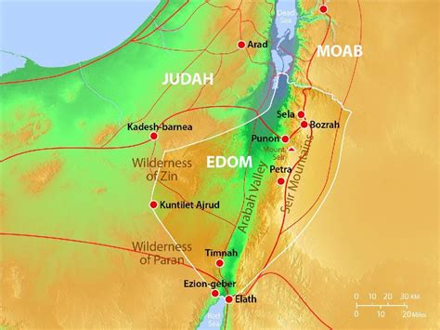
United Kingdom – Part 1

Slide 13
Review
Amaziah’s pride got the best of him after defeating the Edomites – so he called Jehoash (king of Israel) to war
Jehoash, to his credit, tried to get Amaziah to just be happy with defeating the Edomites. It didn’t work.

Slide 14
Review
Judah and Israel met in battle at Beth Shemesh (which belonged to Judah):
Judah was defeated
The men of Judah fled to their tents
Johoash captured Amaziah and took him to Jerusalem
He broke down the wall from the Gate of Ephraim to the Corner Gate (400 cubits ~ 600 feet)
Took all the gold, silver, and articles found in the temple and the king’s house
Took hostages

Slide 15
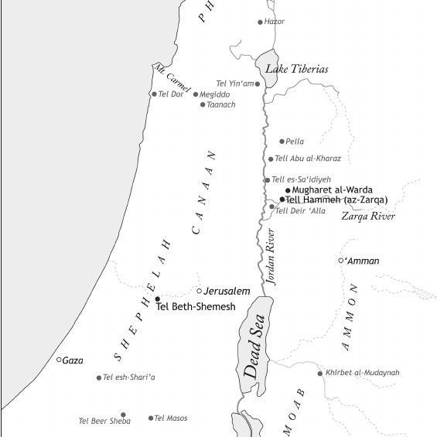
United Kingdom – Part 1

Slide 16
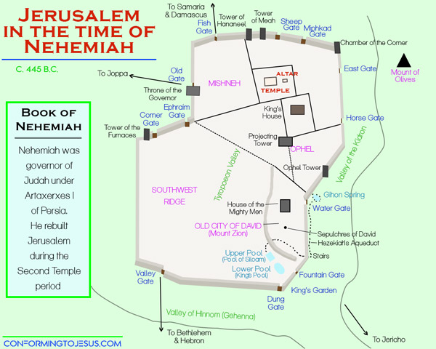
United Kingdom – Part 1

Slide 17
Today’s Lesson
Amaziah’s Death
Uzziah’s Reign
Introduction to Amos
2 Kings 14:15-15:4
2 Chron 25:26-26:15

Slide 18
Amaziah’s Death
Amazingly, Amaziah lived 15 years AFTER the death of Jehoash, king of Israel!
Could it be because his son (Uzziah) wasn’t ready to take over yet that God allowed this? (Matt 1:9 – in Jesus’ geneology through David)
After Amaziah turned away from the Lord, there was a conspiracy against him
He fled to Lachish but was caught and killed there
He was brought back to be buried “with his fathers” in the “City of David”

Slide 19
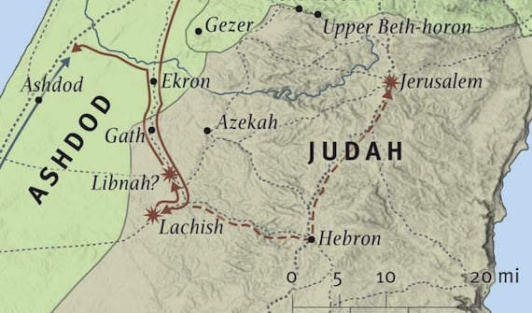
United Kingdom – Part 1

Slide 20
Azariah/Uzziah’s Reign
After Amaziah’s death, his son Azariah/Uzziah was made king and reigned for 52 years!
He was 16 years old
He did “what was right in the sight of the Lord”(as his father Amaziah had done) Except:
The high places were not removed
The people still sacrificed on the high places
Reigned approximately from 792/788 – 740/736 BC

Slide 21
Azariah/Uzziah’s Reign
Uzziah “built Elath and restored it to Judah”
He broke down the walls of the Philistine cities of Gath, Jabneh, and Ashdod
He rebuilt towns among the Philistines
God helped him against:
Philistines
Arabs who lived in Gur Baal
Meunites
Ammonites

Slide 22
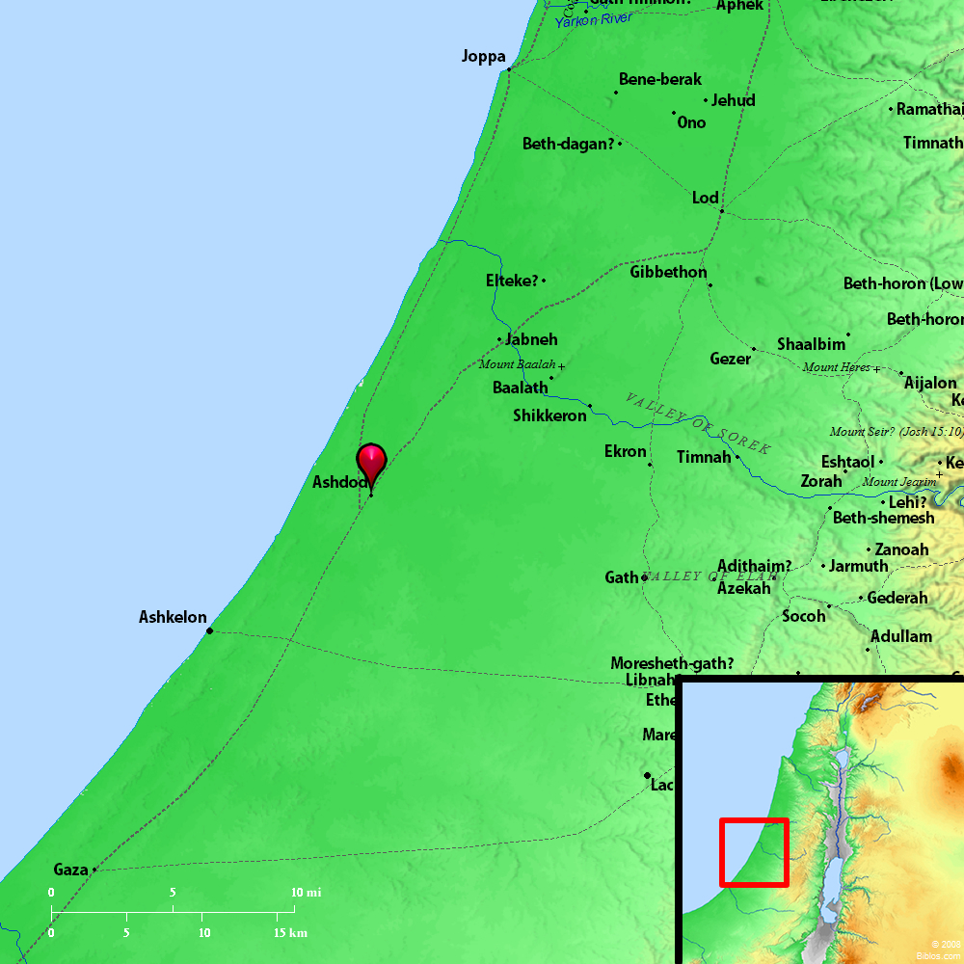
United Kingdom – Part 1
Notes:
Ashdod is almost due west of Jerusalem. Looks like Ashdod may be just a little north of due west.
Ash'dod. (a stronghold). Acts 8:40. One of the five confederate cities of the Philistines situated about 30 miles from the southern frontier of Palestine, three from the Mediterranean Sea, and nearly midway between Gaza and Joppa. It was assigned to the tribe of Judah, Joshua 15:47, but was never subdued by the Israelites. Its chief importance arose from its position on the high road from Palestine to Egypt. It is now an insignificant village, with no memorials of its ancient importance, but is still called Esdud.Smith's Bible Dictionary or International Standard Bible Encyclopedia
https://biblebento.com/maps/BL101.html

Slide 23
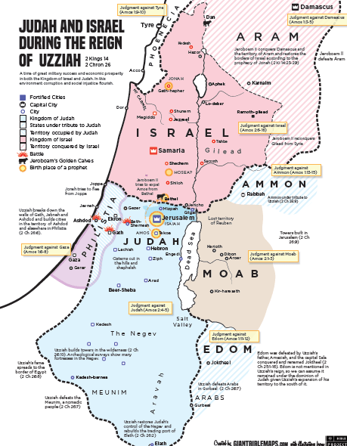
Notes:
Ashdod is almost due west of Jerusalem. Looks like Ashdod may be just a little north of due west.
Ash'dod. (a stronghold). Acts 8:40. One of the five confederate cities of the Philistines situated about 30 miles from the southern frontier of Palestine, three from the Mediterranean Sea, and nearly midway between Gaza and Joppa. It was assigned to the tribe of Judah, Joshua 15:47, but was never subdued by the Israelites. Its chief importance arose from its position on the high road from Palestine to Egypt. It is now an insignificant village, with no memorials of its ancient importance, but is still called Esdud.Smith's Bible Dictionary or International Standard Bible Encyclopedia
https://biblebento.com/maps/BL101.html

Slide 24
Azariah/Uzziah’s Reign
When had Elath been part of Judah?
2 Chron 8:17-18 Solomon had a port at Ezion Geber and Elath (That was in the land of Edom)
Who were the “Meunites”?
Lived in the area Simeon possessed – 1 Chron 4:24-43
Not much is known about them
Where was Gur Baal?
Bozrah (Near Petra in Jordan)?
Negev (South part of Israel)?

Slide 25
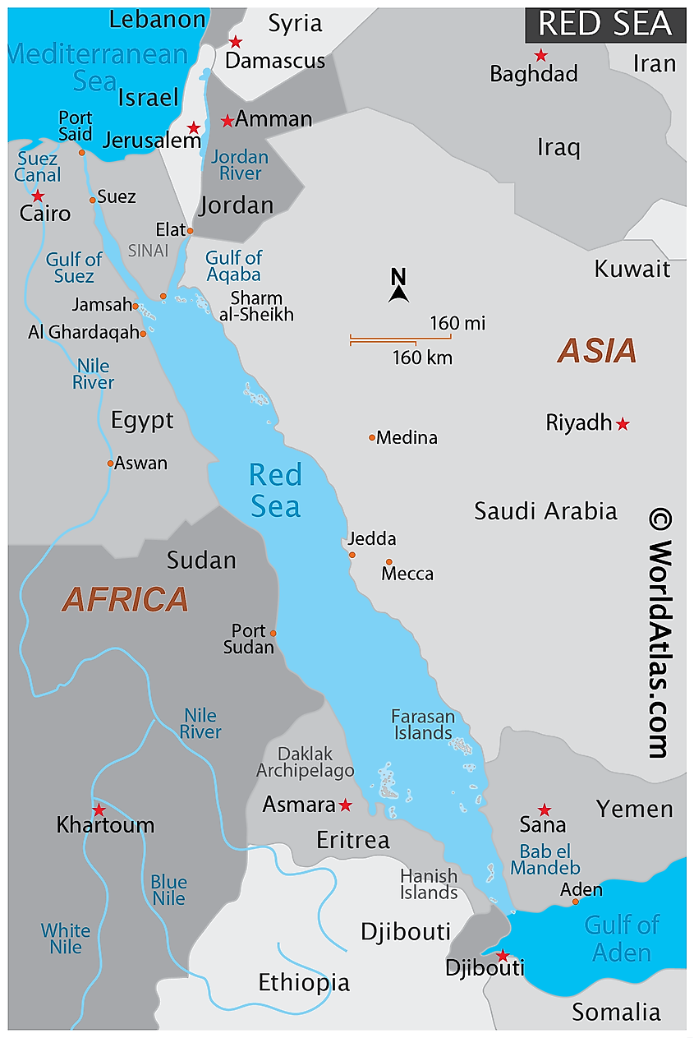
United Kingdom – Part 1

Slide 26
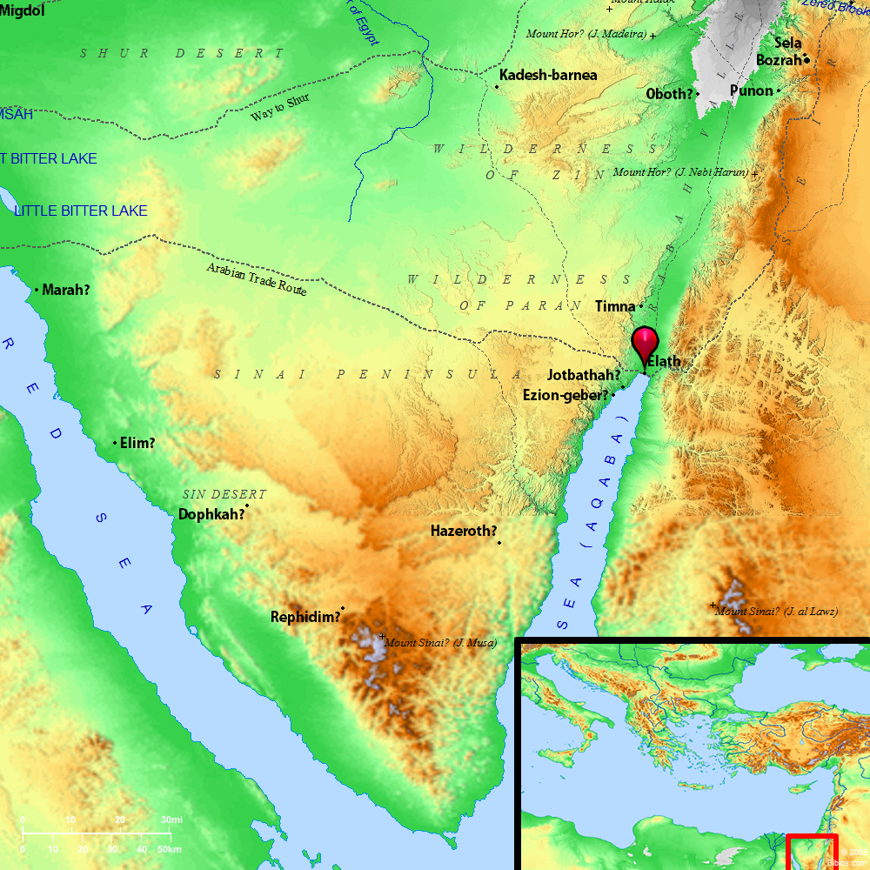
United Kingdom – Part 1

Slide 27
Azariah/Uzziah’s Reign
Uzziah built towers in Jerusalem at:
The Corner Gate
The Valley Gate
The angle of the wall
2 Kings 14:13, 2 Chron 25:23
Built towers in the wilderness
Dug many cisterns
Had a lot of livestock
He “loved the soil”

Slide 28
United Kingdom – Part 1

Slide 29
Azariah/Uzziah’s Reign
Uzziah’s army was well trained
There were 2600 leaders over the army
There were 307,500 in the army
“a powerful force”
Uzziah provided for the entire army:
Shields
Spears
Helmets
Coats of armor
Bows
Slingstones

Slide 30
Azariah/Uzziah’s Reign
In Jerusalem, Uzziah made devices on the towers to “shoot arrows and hurl large stones” (Lord of the Rings - catapults)
“His fame spread far and wide”
In short, Judah is rich and powerful!

Slide 31
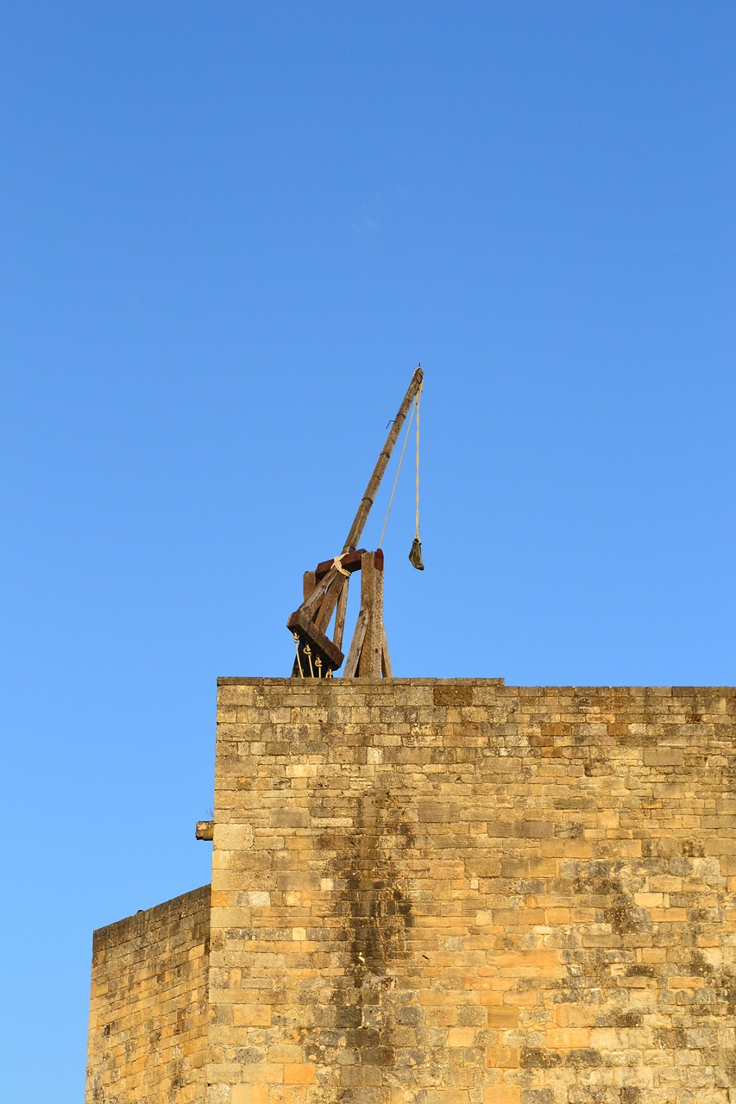

Slide 32
Azariah/Uzziah’s Reign
“He was greatly helped (by God) UNTIL he became powerful”
After Uzziah became powerful, his pride led to his downfall….

Slide 33
Jeroboam’s Reign In Israel
After Jehoash died, his son Jeroboam reigned for 41 years!
He did evil in the sight of the Lord
He “did not depart from all the sins of Jeroboam the son of Nebat”
He restored the territory of Israel from Hamath to the Sea of the Arabah
This had been spoken by Jonah!
“For the Lord saw that the affliction of Israel was very bitter”
The Lord “saved them by the hand of Jeroboam”

Slide 34
Jeroboam’s Reign In Israel
Jeroboam recaptured from Damascus and Hamath what had belong to Judah
When had those belonged to Judah/Israel?
David put garrisons in Damascus 2 Sam 8:5-6
Garrison:
A military post, especially one that is permanently established
The troops stationed at a military post
A body of troops stationed in a fort or fortified town
Solomon captured Hamath and put store cities there 2 Chron 8:3-4

Slide 35
Jeroboam’s Reign In Israel
In short, Israel is rich and powerful!

Slide 36
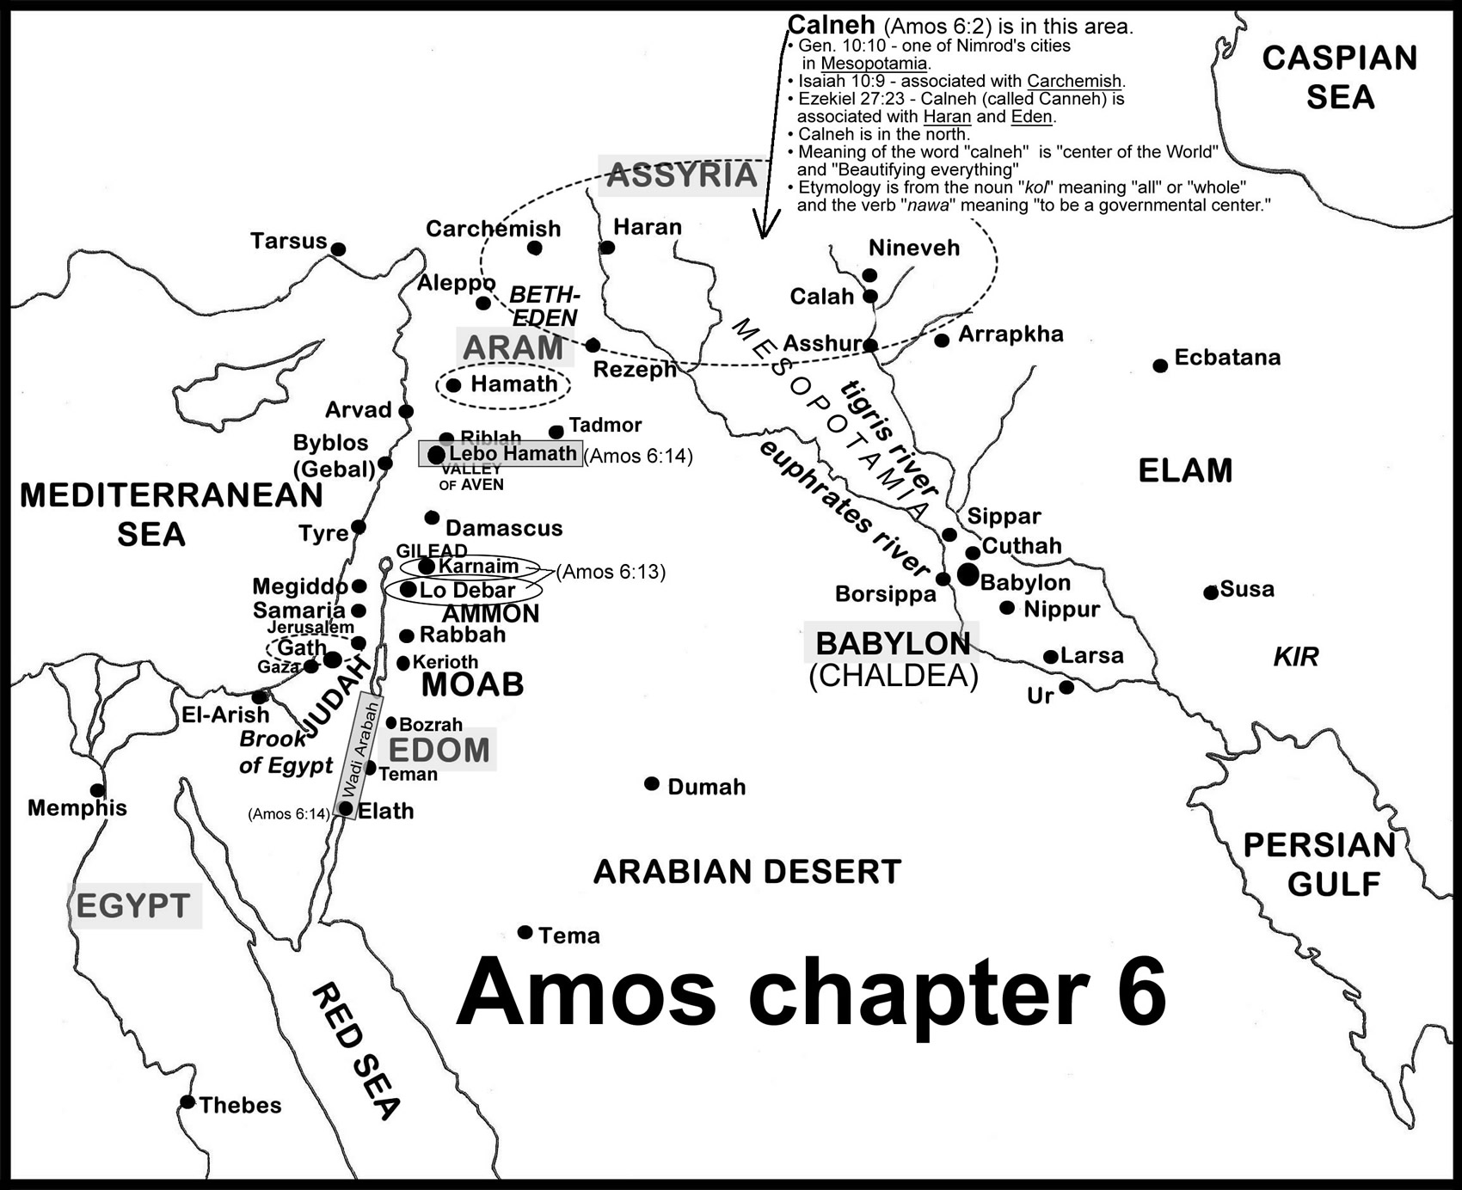
United Kingdom – Part 1

Slide 37
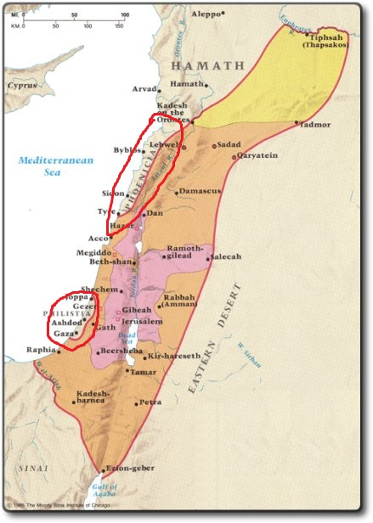
United Kingdom – Part 1

Slide 38
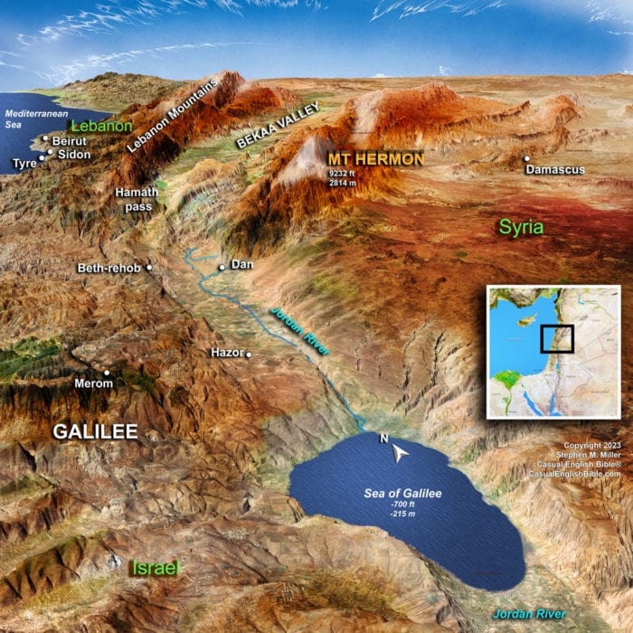
United Kingdom – Part 1

Slide 39
Amos - Introduction
God was blessing Judah as Uzziah was a good king
God was blessing Israel even though they had no good kings. He was trying to get them to repent. But they wouldn’t.
Amos was contemporary with Hosea and Isaiah
Amos – Uzziah in Judah, Jeroboam in Israel
Hosea – Uzziah, Jotham, Ahaz, and Hezekiah in Judah, Jeroboam in Israel
Isaiah – Uzziah, Jotham, Ahaz, and Hezekiah in Judah
Was a prophet from the South (Tekoa) and prophesied to the North (Israel)
Amos’ message to Israel – Judgement is coming

Slide 40
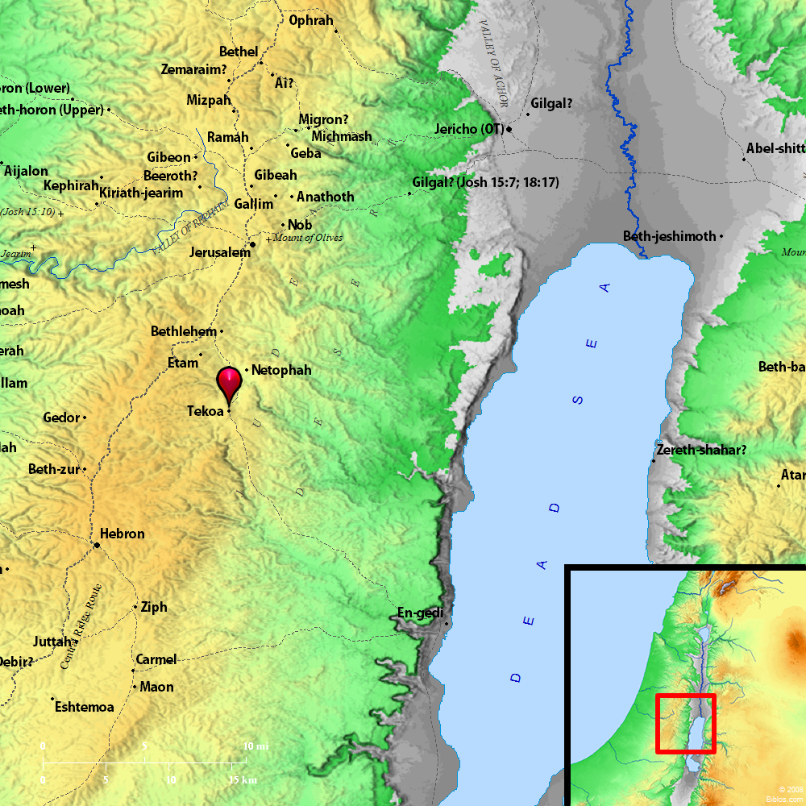
United Kingdom – Part 1

Slide 41
Common Themes
Judah’s Kings were doing “right” as much as their Fathers (but not any more than that?)
2 Kings 12:2-3 Jehoash did what was right in the sight of the Lord all the days in which Jehoiada the priest instructed him. But the high places were not taken away; the people still sacrificed and burned incense on the high places.
2 Kings 14:3-4 And he (Amaziah) did what was right in the sight of the Lord, yet not like his father David; he did everything as his father Joash had done. However the high places were not taken away, and the people still sacrificed and burned incense on the high places.
2 Kings 15:3-4 And he (Uzziah) did what was right in the sight of the Lord, according to all that his father Amaziah had done, except that the high places were not removed; the people still sacrificed and burned incense on the high places.

Slide 42
Common Themes
Israel’s Kings were Evil
2 Kings 13:11 And he (Jehoash) did evil in the sight of the Lord. He did not depart from all the sins of Jeroboam the son of Nebat, who made Israel sin, but walked in them.
2 Kings 14:24 And he (Jeroboam II) did evil in the sight of the Lord; he did not depart from all the sins of Jeroboam the son of Nebat, who had made Israel sin.

Slide 43
Lessons
Wealth does NOT necessarily correlate to right (Jeroboam was growing Israel but was an evil king)
It is hard to get past an evil leader (Jeroboam the son of Nebat)

Slide 44
Next Lesson
Amos

Slide 45
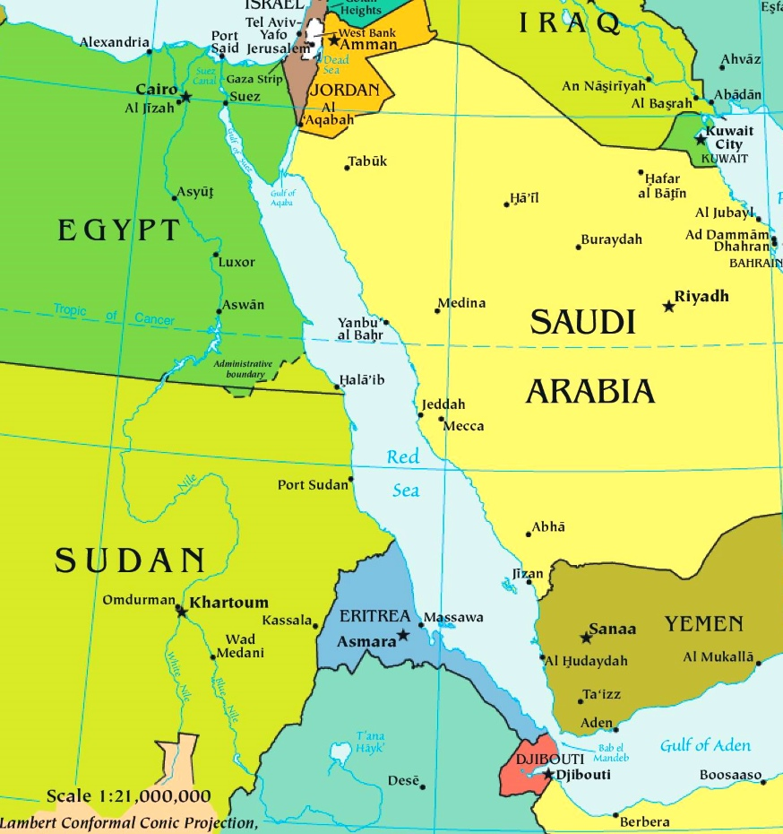
United Kingdom – Part 1

