Slide 1
1 Thessalonians 2:1-16
Auditorium Class Fall 2013

Slide 2
Setting
Audience: Thessalonian Christians
Location of writing: Corinth
Date of letter: A.D. 51 or 52
Historical Setting: Second Missionary Journey
Purpose: Encourage newly converted Christians

Slide 3
Thessalonica
Politically significant as a provincial capitol
Major seaport and center for trade
Socially and ethnically diverse
Prominence started around 315 BC
Designated as Macedonian capitol in 146 BC
Became a free city in 42 BC
Paul visited in 51 AD
Strong “Christian” presence through the centuries
Modern day city of Thessaloniki
Second most important city in Greece behind Athens

Slide 4
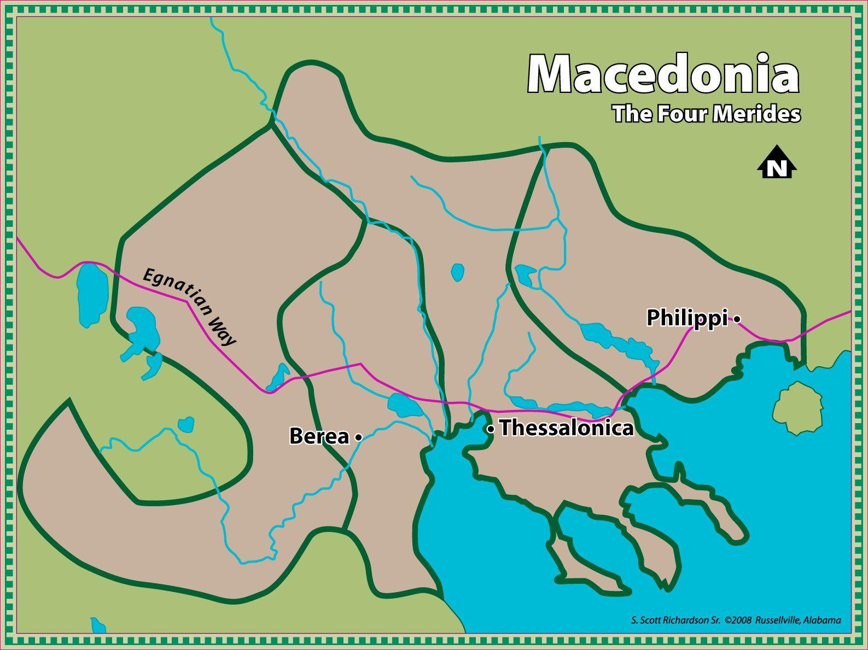
Thessalonica

Slide 5
I Thessalonians 1:1-10
Salutation thanking the Thessalonians for turning from idols
You were converted in spite of great affliction.
You now serve as examples for others.

Slide 6
1 Thessalonians 2:1-16
v1-2: A call to remembrance
v1: Paul brings to their remembrance the response to the gospel at Thessalonica
v2: Emphasizes the apostles were teaching in spite of personal sacrifice and risk as was shown at Philippi
Not teaching for their own benefit
Thought questions:
Are those that teach and preach for the praise of men following this example?
Are individuals that seek monetary wealth through the gospel following this example?
Are those that seek their own followers examples for good?

Slide 7
1 Thessalonians 2:1-16
v3-4: Paul’s motivation
v3: Paul’s exhortation was without deceit, uncleanness, or guile as a false teacher seeking personal gain would be. Acts 8:18-20, Acts 16:16
v4: Paul taught to please God and not men. God would judge their hearts.
Thought questions:
Who should we seek to please?
What should be our motive?

Slide 8
1 Thessalonians 2:1-16
v5-6: Paul’s method was pure
v5: No flattering words,
v5: No message of covetousness
v6: Did not seek personal glory or position
v6: Sought not to be a burden
Thought questions:
How can one examine a teacher’s method to determine the truthfulness of their message?

Slide 9
1 Thessalonians 2:1-16
v7-8: Paul’s method (continued)
v7: Gentle with the care of a nursing mother
v8: Developed a bond with and desire for those receiving the gospel
v8: Impart their own souls
2 Cor. 12:15 “And I will very gladly spend and be spent for you; though the more I love you, the less I be loved.”
v9: Paul labored to support himself so no one could claim he preached for his own physical gain.
Thought questions:
How do we impart our souls?
Do we allow ourselves to be this committed?
Must a preacher support himself to be effective?

Slide 10
1 Thessalonians 2:1-16
v10-12: Confirmation of the purity of the message
v10: Paul makes the point that they were witnesses to the purity of the message.
v11: Paul makes the point that they observed them teach as a father might his own children
v12: For the purpose of them walking worthily in God’s sight.
Thought questions:
How does Paul continue to emphasize the truthfulness of the message and the purity of his motives?

Slide 11
1 Thessalonians 2:1-16
V13-16: Thankful for their example
v13: Paul is thankful that they have received the word
V14-16: Thessalonians will have similar experiences at the hands of their own countrymen as those in Judea.
Persecution
Restrictions
Thought questions:
Would Paul be thankful for us?
Should we be deterred?

Slide 12
Schedule
Class | Day | Date | Teacher | Book | Text
3 | Wednesday | 9/11/2013 | Brent | 1 Thessalonians | 2:17-20, 3:1-13
4 | Sunday | 9/15/2013 | James | 1 Thessalonians | 4:1-18
5 | Wednesday | 9/18/2013 | Brent | 1 Thessalonians | 5:1-22
6 | Sunday | 9/22/2013 | James | 1, 2 Thessalonians | 5:23-28, Intro, 1:1-12
7 | Wednesday | 9/25/2013 | Brent | 2 Thessalonians | 2:1-16
8 | Sunday | 9/29/2013 | James | 2 Thessalonians | 3:1-18
 | Wednesday | 10/2/2013 |  | Singing
9 | Sunday | 10/6/2013 | James | 1 Timothy | Intro, 1:1-18
10 | Wednesday | 10/9/2013 | Brent | 1 Timothy | 2:1-15
11 | Sunday | 10/13/2013 | James | 1 Timothy | 3:1-18
12 | Wednesday | 10/16/2013 | Brent | 1 Timothy | 4:1-16
13 | Sunday | 10/20/2013 | James | 1 Timothy | 5:1-16
14 | Wednesday | 10/23/2013 | Brent | 1 Timothy | 5:17-25, 6:1-10
15 | Sunday | 10/27/2013 | James | 1, 2 Timothy | 6:11-20, Intro
16 | Wednesday | 10/30/2013 | Brent | 2 Timothy | 1:1-18
17 | Sunday | 11/3/2013 | James | 2 Timothy | 2:1-13
 | Wednesday | 11/6/2013 |  | Singing
18 | Sunday | 11/10/2013 | James | 2 Timothy | 2:14-26
19 | Wednesday | 11/13/2013 | Brent | 2 Timothy | 3:1-17
20 | Sunday | 11/17/2013 | Brent | 2 Timothy | 4:1-22
21 | Wednesday | 11/20/2013 | Brent | Titus | Intro, 1:1-16
22 | Sunday | 11/24/2013 | James | Titus | 2:1-15
23 | Wednesday | 11/27/2013 | Brent | Titus | 3:1-15

