Slide 1
Exodus & Wandering in the Wilderness
Exodus 3-7:13

Slide 2
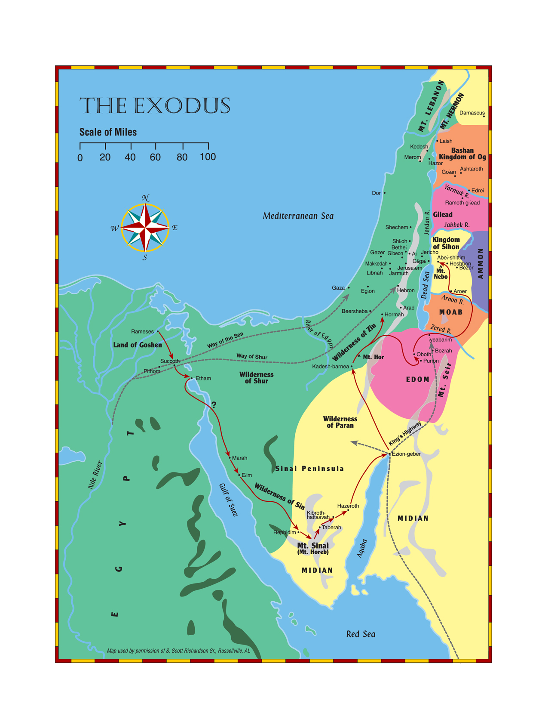

Slide 3
God said,
“I will be with you”
The Burning Bush 3:1-6
Moses shepherding for Jethro (aka Reuel)
Comes to Mt. Horeb (aka Sinai)
Angel appears in flames of fire within a bush
God calls to him, “Moses, Moses!”
Remove your sandals for you are on holy ground
Moses hid his face

Slide 4
God said,
“I will be with you”
God’s Plan Revealed 3:7-9
God has seen the misery of His people in Egypt
Heard them crying out because of the slave drivers
God has come down to rescue them
To bring them to a good and spacious land – flowing with milk and honey

Slide 5
God said,
“I will be with you”
Moses Reluctant to Serve 3:10-12
I am sending you (Moses) to Pharaoh to bring my people out of Egypt
Moses – “Who am I that I should go to Pharaoh…?”
“I will be with you…”
As a sign, Moses and the Israelites would worship God on that very mountain, Horeb

Slide 6
God said,
“I will be with you”
God the “I Am” 3:13-15
Moses – Suppose the Israelites ask your name?
God – “I Am Who I Am”, The God of your fathers, Abraham, Isaac, and Jacob
God’s name forever; the name to be remembered from generation to generation

Slide 7
God said,
“I will be with you”
Outline of Mission 3:16-22
Assemble the Israelite elders and tell the plan; they will listen
Then Moses and the elders are to go to Pharaoh and ask for a three day journey into the desert to offer sacrifices; but God knew how Pharaoh would reply.
Vv. 21-22 How Israel would plunder Egypt

Slide 8
God said,
“I will be with you”
God’s Power Demonstrated 4:1-9
Moses – What if they do not believe me or listen?
Moses’ staff becomes a snake!
Moses’ hand temporarily leprous
If these miraculous signs do not work, water from the Nile will turn to blood when poured upon the ground

Slide 9
God said,
“I will be with you”
Aaron to be Spokesman 4:10-17
Moses – I am not eloquent, but am slow of speech and tongue
God – Who gave man his mouth…?
Moses – Please send someone else
The Lord’s anger burned against Moses
God selects Aaron to speak for Moses

Slide 10
“I will harden his heart”
Moses Leaves for Egypt 4:18-20
Moses seeks Jethro’s permission to return to Egypt
The men in Egypt that wanted to kill Moses are dead (40 yrs. later)
Moses takes wife, sons, and staff of God back to Egypt

Slide 11
“I will harden his heart”
Prediction About Pharaoh 4:21-23
Moses is to do all the miracles God had given him power to do
But God will harden Pharaoh’s heart so that he will not let the people go
Pharaoh’s will forfeit his own firstborn son to deny freedom to God’s firstborn son, Israel

Slide 12
“I will harden his heart”
Moses’ Son Circumcised 4:24-26
Along the way God was going to kill Moses for not circumcising his son
Zipporah quickly took a flint and performed the rite
Zipporah called Moses a “bridegroom of blood” to her

Slide 13
“I will harden his heart”
Aaron Meets Moses 4:27,28
God tells Aaron to meet Moses in the desert
They meet at Mt Sinai where Moses tells of all that has happened

Slide 14
“I will harden his heart”
Israelites Told of Plan 4:29-31
Moses and Aaron bring together the elders of the Israelites
Aaron tells them of all the Lord had said to Moses
Aaron performs the signs before the people
The people believe and worship God

Slide 15
“I will harden his heart”
Pharaoh Refuses Plea 5:1-5
Moses and Aaron go to Pharaoh – “Let My people go…” for a feast to God in the desert
Pharaoh – Who is the Lord that I should obey
Moses and Aaron fear that God may afflict the people with pestilence or the sword if they do not get to worship
Pharaoh sends them back to work

Slide 16
“I will harden his heart”
Burdens Increased 5:6-14
Pharaoh orders Israelites must now gather their own straw to make bricks, and keep the same quota
They are lazy because they want to go worship, so they must work harder and not listen to lies

Slide 17
“I will harden his heart”
Foremen Blame Moses 5:15-6:1
Israelite foremen appeal to Pharaoh for relief, but Pharaoh calls them lazy and orders them back to work
Foremen find Moses and Aaron and blame them for their troubles
Moses entreats God

Slide 18
“I will harden his heart”
God to Fulfill Promises 6:2-8
God had appeared to Abraham, Isaac, and Jacob but by His name the Lord (I Am; Ex.3:15) did not make Himself known to them
God had heard the groaning of the Israelites and remembered His covenant
He will bring them out from under the yoke of the Egyptians

Slide 19
“I will harden his heart”
Moses Doubts Success 6:9-13 (6:28-30)
Moses reported this to the Israelites, but they did not listen because of their broken spirit and harsh slavery
Moses – If the Israelites will not listen to me, why would Pharaoh listen to one with faltering (uncircumcised) lips

Slide 20
“I will harden his heart”
God Reassures Moses 7:1-7
I have made you like God to Pharaoh, and your brother Aaron will be your prophet
You are to say everything I command you
But God will harden Pharaoh’s heart and he will not listen even though there will be many signs
Moses 80; Aaron 83 when they spoke to Pharaoh

Slide 21
“I will harden his heart”
Rods Become Snakes 7:8-13
God directs Moses and Aaron to throw down their staff when Pharaoh asks for a miracle. It will become a snake
They did just that, but Pharaoh summons his wise men and sorcerers to do the same by secret arts
Aaron’s staff (snake) swallowed up theirs
Yet Pharaoh’s heart became hard and he would not listen

Slide 22
Lineage of Moses and Aaron
Exodus 6:14-27
Reuben’s family
Simeon’s family
Levi
  Gershom – Libni, Shimi
  Kohath – Amram, Izhar, Hebron, Uzziel
  Merari – Mahli, Mushi
  (Jochebed)

Slide 23
Lineage of Moses and Aaron
Exodus 6:14-27
Amram m. (Jochebed – aunt)
  (Miriam)
  Aaron m. (Elisheba) – Nadab, Abihu, Eleazar, Ithamar
  Moses m. (Zipporah) – Gershom, Eliezer

