Slide 1
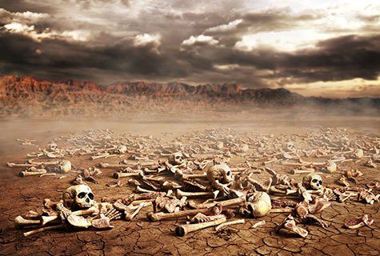
Ezekiel
“Ye Shall Know That I Am The Lord”

Slide 2

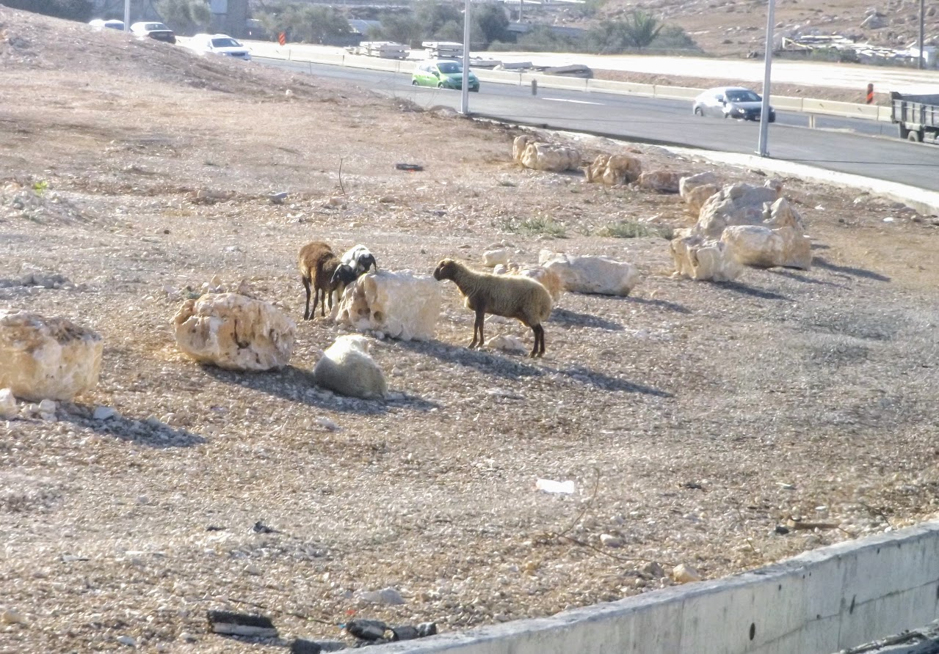
Ezekiel
Lessons 17 – Ezekiel 34
Woe to the Shepherds of Israel (34:1-10)
They preyed upon the flock (34:2-3)
They did not care for the flock (34:4)
They allowed the flock to be scattered (34:5-6)
God will judge the shepherds and deliver His flock (34:7-10)
Sheep left unattended and in danger in Israel

Slide 3
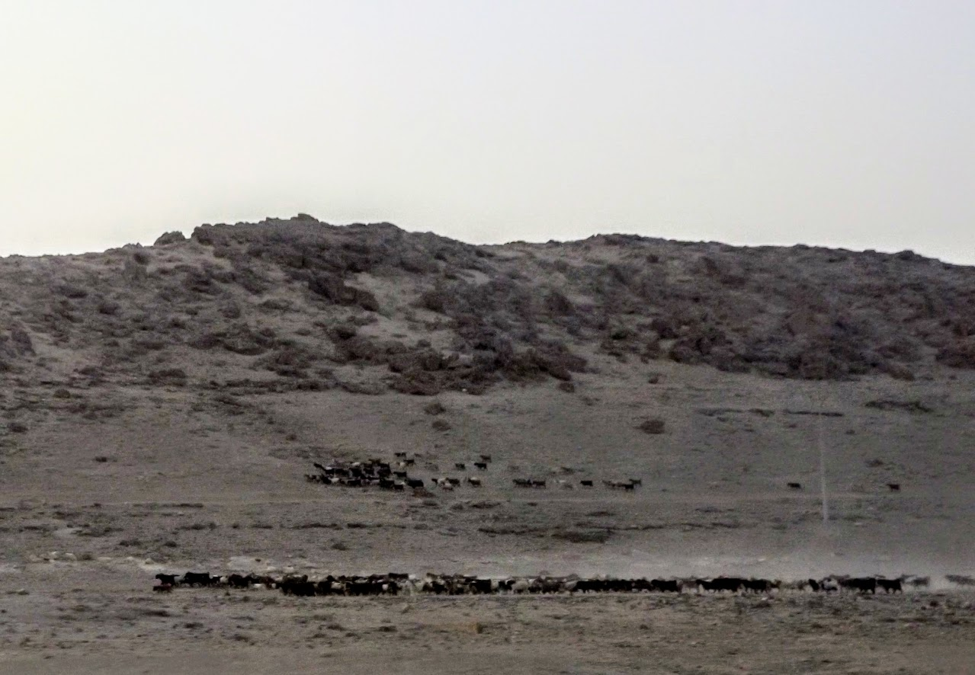
Ezekiel
Lessons 17 – Ezekiel 34
The Lord will seek His flock (34:11-16)
He will seek them in all the places they were scattered (34:11-12)
He will bring them to their own land, feed them, and give them rest (34:13-15; Ps. 23)
He will tend the injured and the sick (34:16)
Flocks in the Judean wilderness

Slide 4
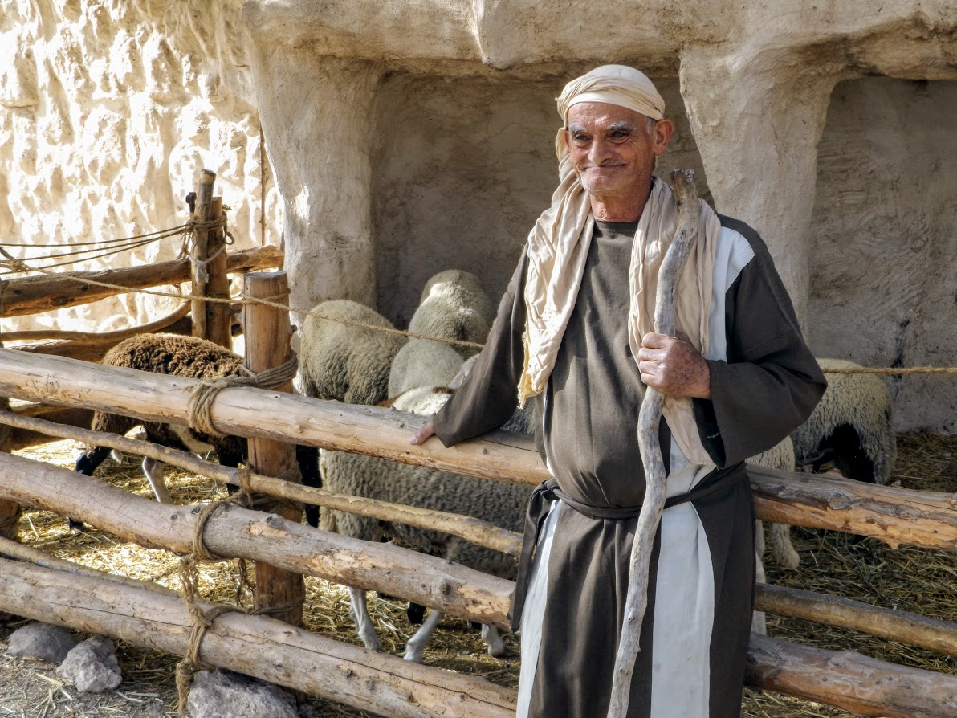
Ezekiel
Lessons 17 – Ezekiel 34
The Lord will judge the sheep (34:17-24)
Some were guilty of fouling the water and food with their feet (34:17-19)
God will judge between sheep and sheep (34:20-22)
He will establish one Shepherd-Prince over them (34:23-24; John 10)
A shepherd at Nazareth Village watches over his sheep

Slide 5
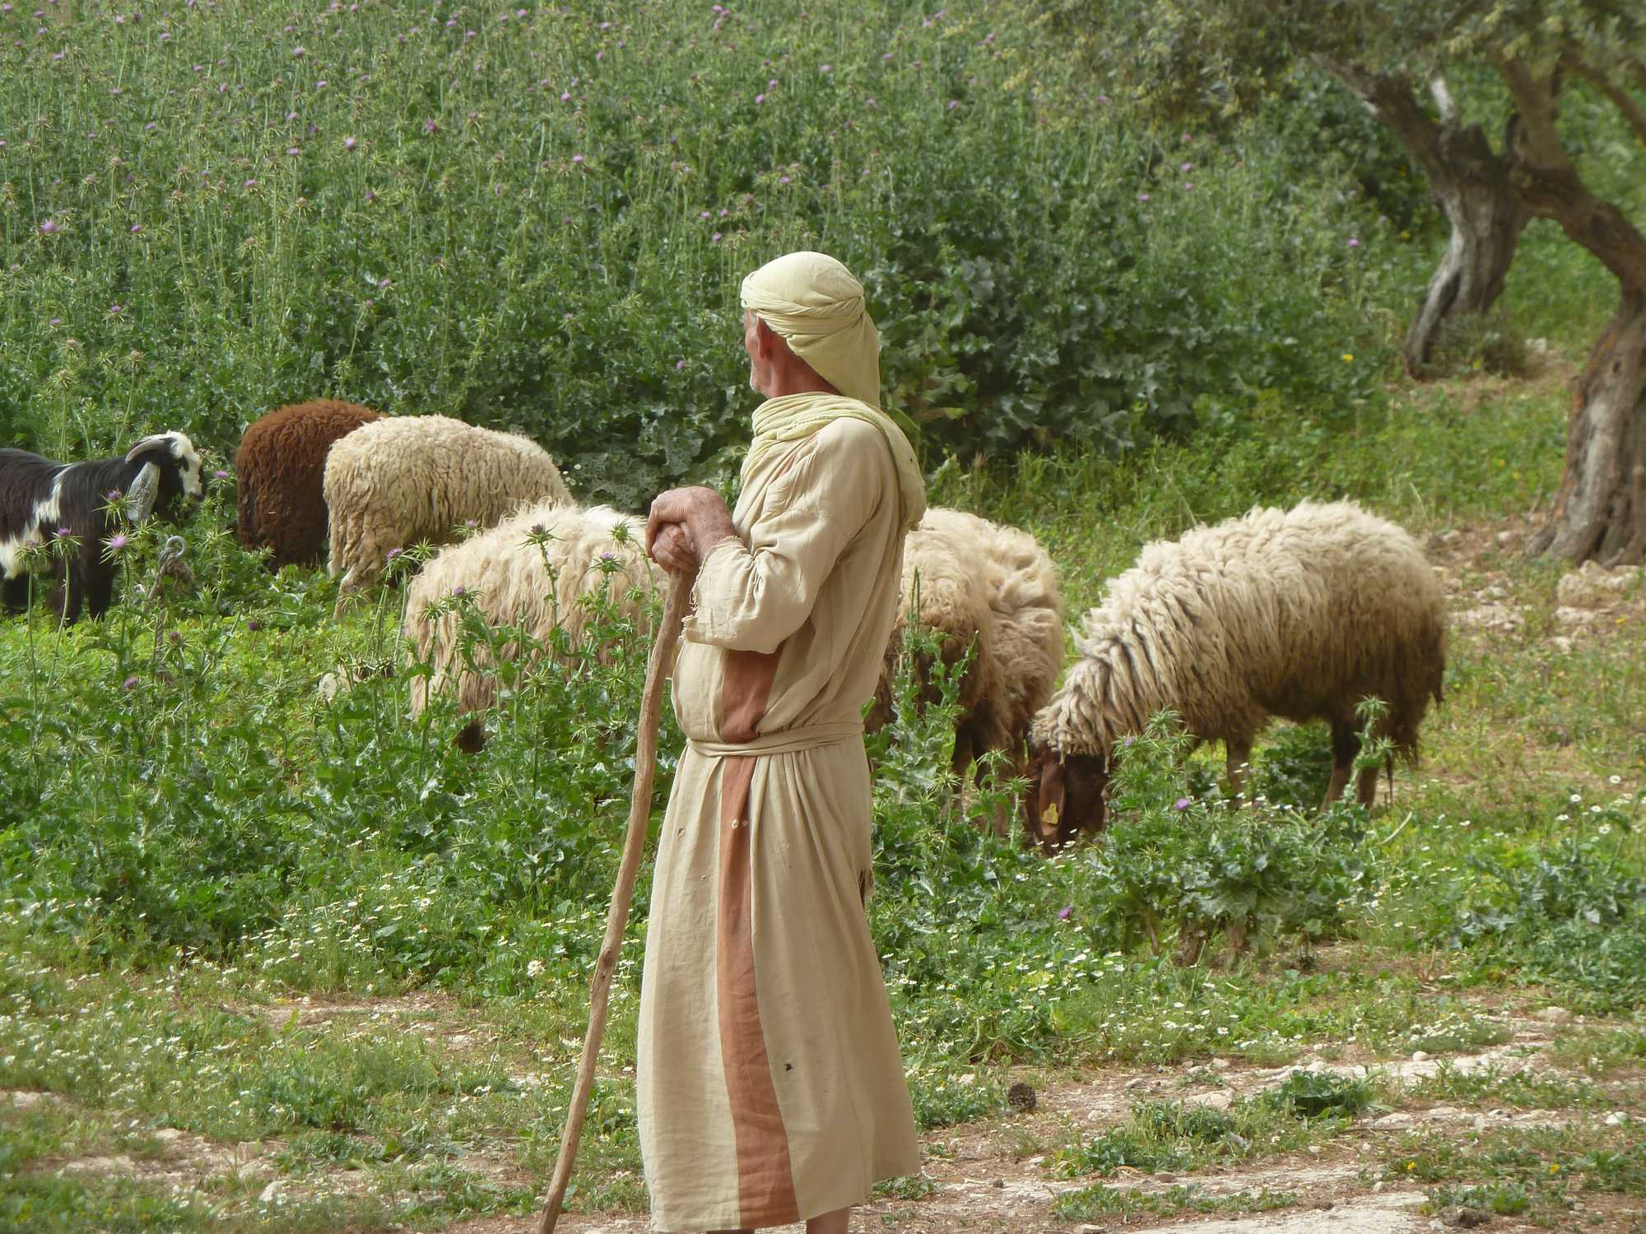
Ezekiel
Lessons 17 – Ezekiel 34
The Lord will make a covenant of peace (34:25-31)
His flock will dwell in blessed safety (34:25-28)
They will no longer bear shame among the Gentiles (34:29)
They will know that they are God’s people, and He is their God (34:30-31; 2 Cor. 6:16; Heb. 13:20-21; Gal. 6:16)
Sheep at peace in Israel
Notes:
2 Cor. 6:16 And what agreement has the temple of God with idols? For you are the temple of the living God. As God has said: "I WILL DWELL IN THEM AND WALK AMONG THEM. I WILL BE THEIR GOD, AND THEY SHALL BE MY PEOPLE."
Hebrews 13:20-21 Now may the God of peace who brought up our Lord Jesus from the dead, that great Shepherd of the sheep, through the blood of the everlasting covenant, 21 make you complete in every good work to do His will, working in you what is well pleasing in His sight, through Jesus Christ, to whom be glory forever and ever. Amen.
Galatians 6:16 And as many as walk according to this rule, peace and mercy be upon them, and upon the Israel of God.

