Slide 1
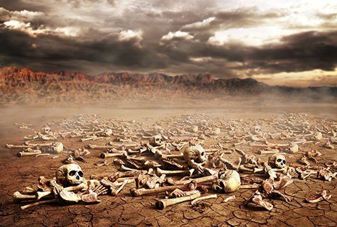
Ezekiel
“Ye Shall Know That I Am The Lord”

Slide 2

Ezekiel
Lessons 21 – Ezekiel 38-39
The Final Effort of the Enemies of God (38:1-16)
God will be against Gog and his allies who will come up against Israel after it has been resettled safely in the land (38:1-9)
  Meshech and Tubal dwelt in the region later known as Asia Minor (Anatolia, modern Turkey).
  “…the prince of Rosh, Meshech”may be better translated “the chief prince of Meshech” (ESV, NIV, HCSV)
    “Rosh” means “chief”
    There is little to no evidence that “Rosh” refers to modern Russia.
  Nations from all around will join Gog’s assault (38:5-6)

Slide 3
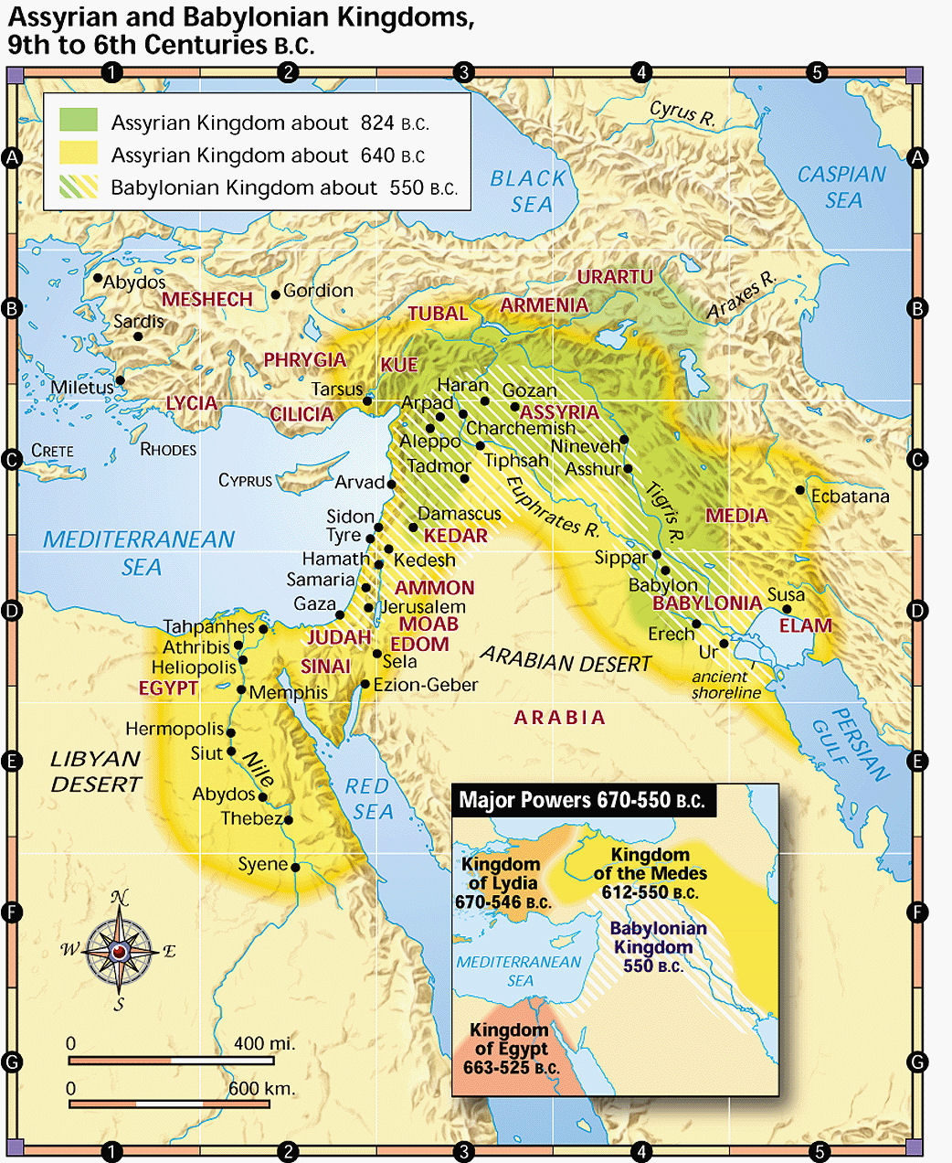

Slide 4
Ezekiel
Lessons 21 – Ezekiel 38-39
The Final Effort of the Enemies of God (38:1-16)
Gog will come against Israel to plunder her in a time when she is at peace and without strong defenses (38:10-16)
  Note that modern Israel is one of the most strife-ridden, heavily defended nations on earth. Walls, bars, and gates are found throughout, unlike the situation in 38:11.

Slide 5
Ezekiel
Lessons 21 – Ezekiel 38-39
Gog will be overthrown (38:17-23)
Gog had not been mentioned by earlier prophets who had described victories of foreign nations against Israel (38:17)
God’s wrath will be aroused against Gog on the day he comes against Israel (38:18)
  God would powerfully destroy Gog and the hordes who accompany him (38:19-23)
  The same scene is depicted in Revelation 20:7-9.
Gog’s destruction is certain (39:1-7)
God will lead him straight to his demise on the mountains of Israel (39:1-6)
God will not allow His Holy name to be profaned anymore (39:7)

Slide 6
Ezekiel
Lessons 21 – Ezekiel 38-39
Gog’s is utterly & completely destroyed
It will take seven years to burn the weapons and seven months to bury the bodies of the vanquished in order to cleanse the land (39:8-16)
The birds and the beasts will be called to feast upon the fallen, as if it were a sacrificial feast (39:17-20)
The nations would see God’s glory, power, and justice (39:21-24)
The Lord will restore Jacob, have mercy on the whole house of Israel, and vindicate His holy name
Having shown His ultimate intention to protect His people from the forces of evil for His name’s sake, the Lord again points the captives to their future restoration (39:25-29)

Slide 7
Ezekiel
Lessons 21 – Ezekiel 38-39
Premillennial Problems:
When do Gog and Magog come? At the beginning or end of the thousand years? (Revelation 20:1-10)
What kind of weapons do they use? Horses, shields, swords, bows and arrows! (38:4, 39:3)
Why isn’t Israel at “rest (38:11) if the attack is imminent?
What modern army would use weapons of wood that take seven years to burn?
How many people would have to die for it to take seven months for “all the people of the land” to bury the dead?
  There are currently 6.5 million Jews in modern Israel. If each one worked for seven months burying the dead, the number of dead could easily surpass the population of the earth!
Since a literal physical fulfillment is impossible, the events described must have a spiritual fulfillment!

