Slide 1
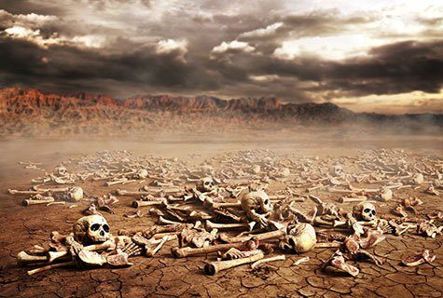
Ezekiel
“Ye Shall Know That I Am The Lord”

Slide 2

Ezekiel
Lessons 24 – Ezekiel 40-43
The Vision of the Temple
Cannot be describing Solomon’s temple because the details and dimensions are different (1 Kings 6-7)
Cannot be describing Zerubbabel’s temple (Ezekiel’s plan was not followed by Zerubbabel)
Cannot be describing a future literal temple in Jerusalem as Premillennialists claim
  Animal sacrifices have been abolished (Heb. 10:1-10)
  The Law of Moses was nailed to the cross – no more feasts, etc. (Colossians 2:14-17; Hebrews 7:18)
  The church is the temple! (Ephesians 2:19-22; Hebrews 8:1-2; 1 Peter 2:5)

Slide 3
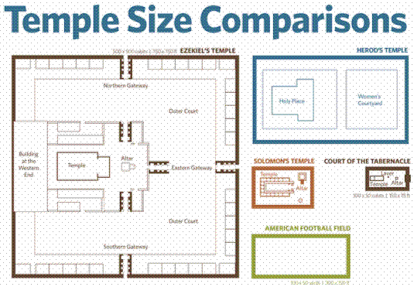

Slide 4
Ezekiel
Lessons 24 – Ezekiel 40-43
The Vision of the Temple
14 years after the destruction of the temple in Jerusalem, Ezekiel is taken in a vision of God to Israel and shown a city. (40:1-4)
  A bronze man tells him to carefully note everything he is shown in order to “Declare to the house of Israel everything you see.”
  Ezekiel is about to be shown the measurements of the temple (compare Revelation 11:1)
He is shown the boundary walls, gateway & outer court (40:5-27)
  The reed used to measure is about 10 feet long (40:5)
He is shown the inner court and its gateways (40:28-47)

Slide 5
Ezekiel
Lessons 24 – Ezekiel 40-43
The Vision of the Temple
He is shown the temple with its porch & chambers (40:48-41:26)
He is shown the priests chambers in the temple yard (42:1-20)
  Note the chambers in which the priests eat the offerings (42:13)
  The priests are to serve the Lord in holy garments (42:14)
  The wall around separated holy areas from the common (42:20)

Slide 6
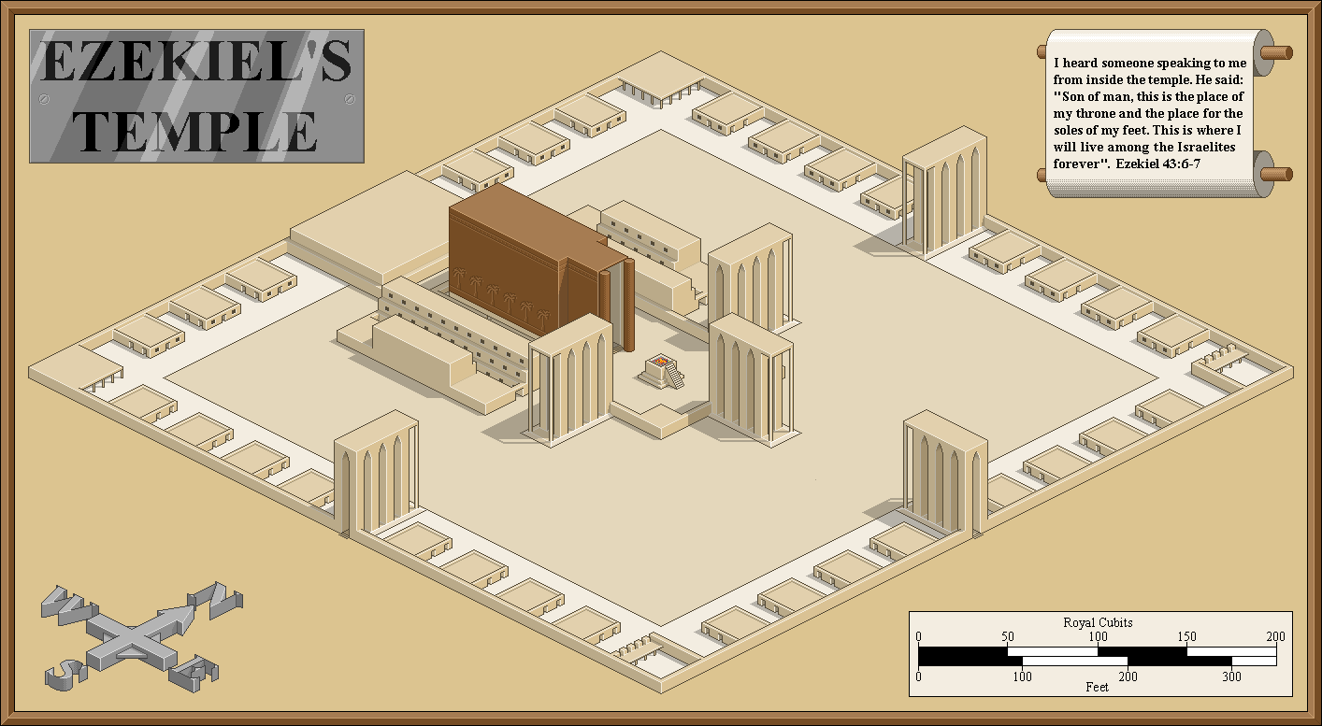

Slide 7
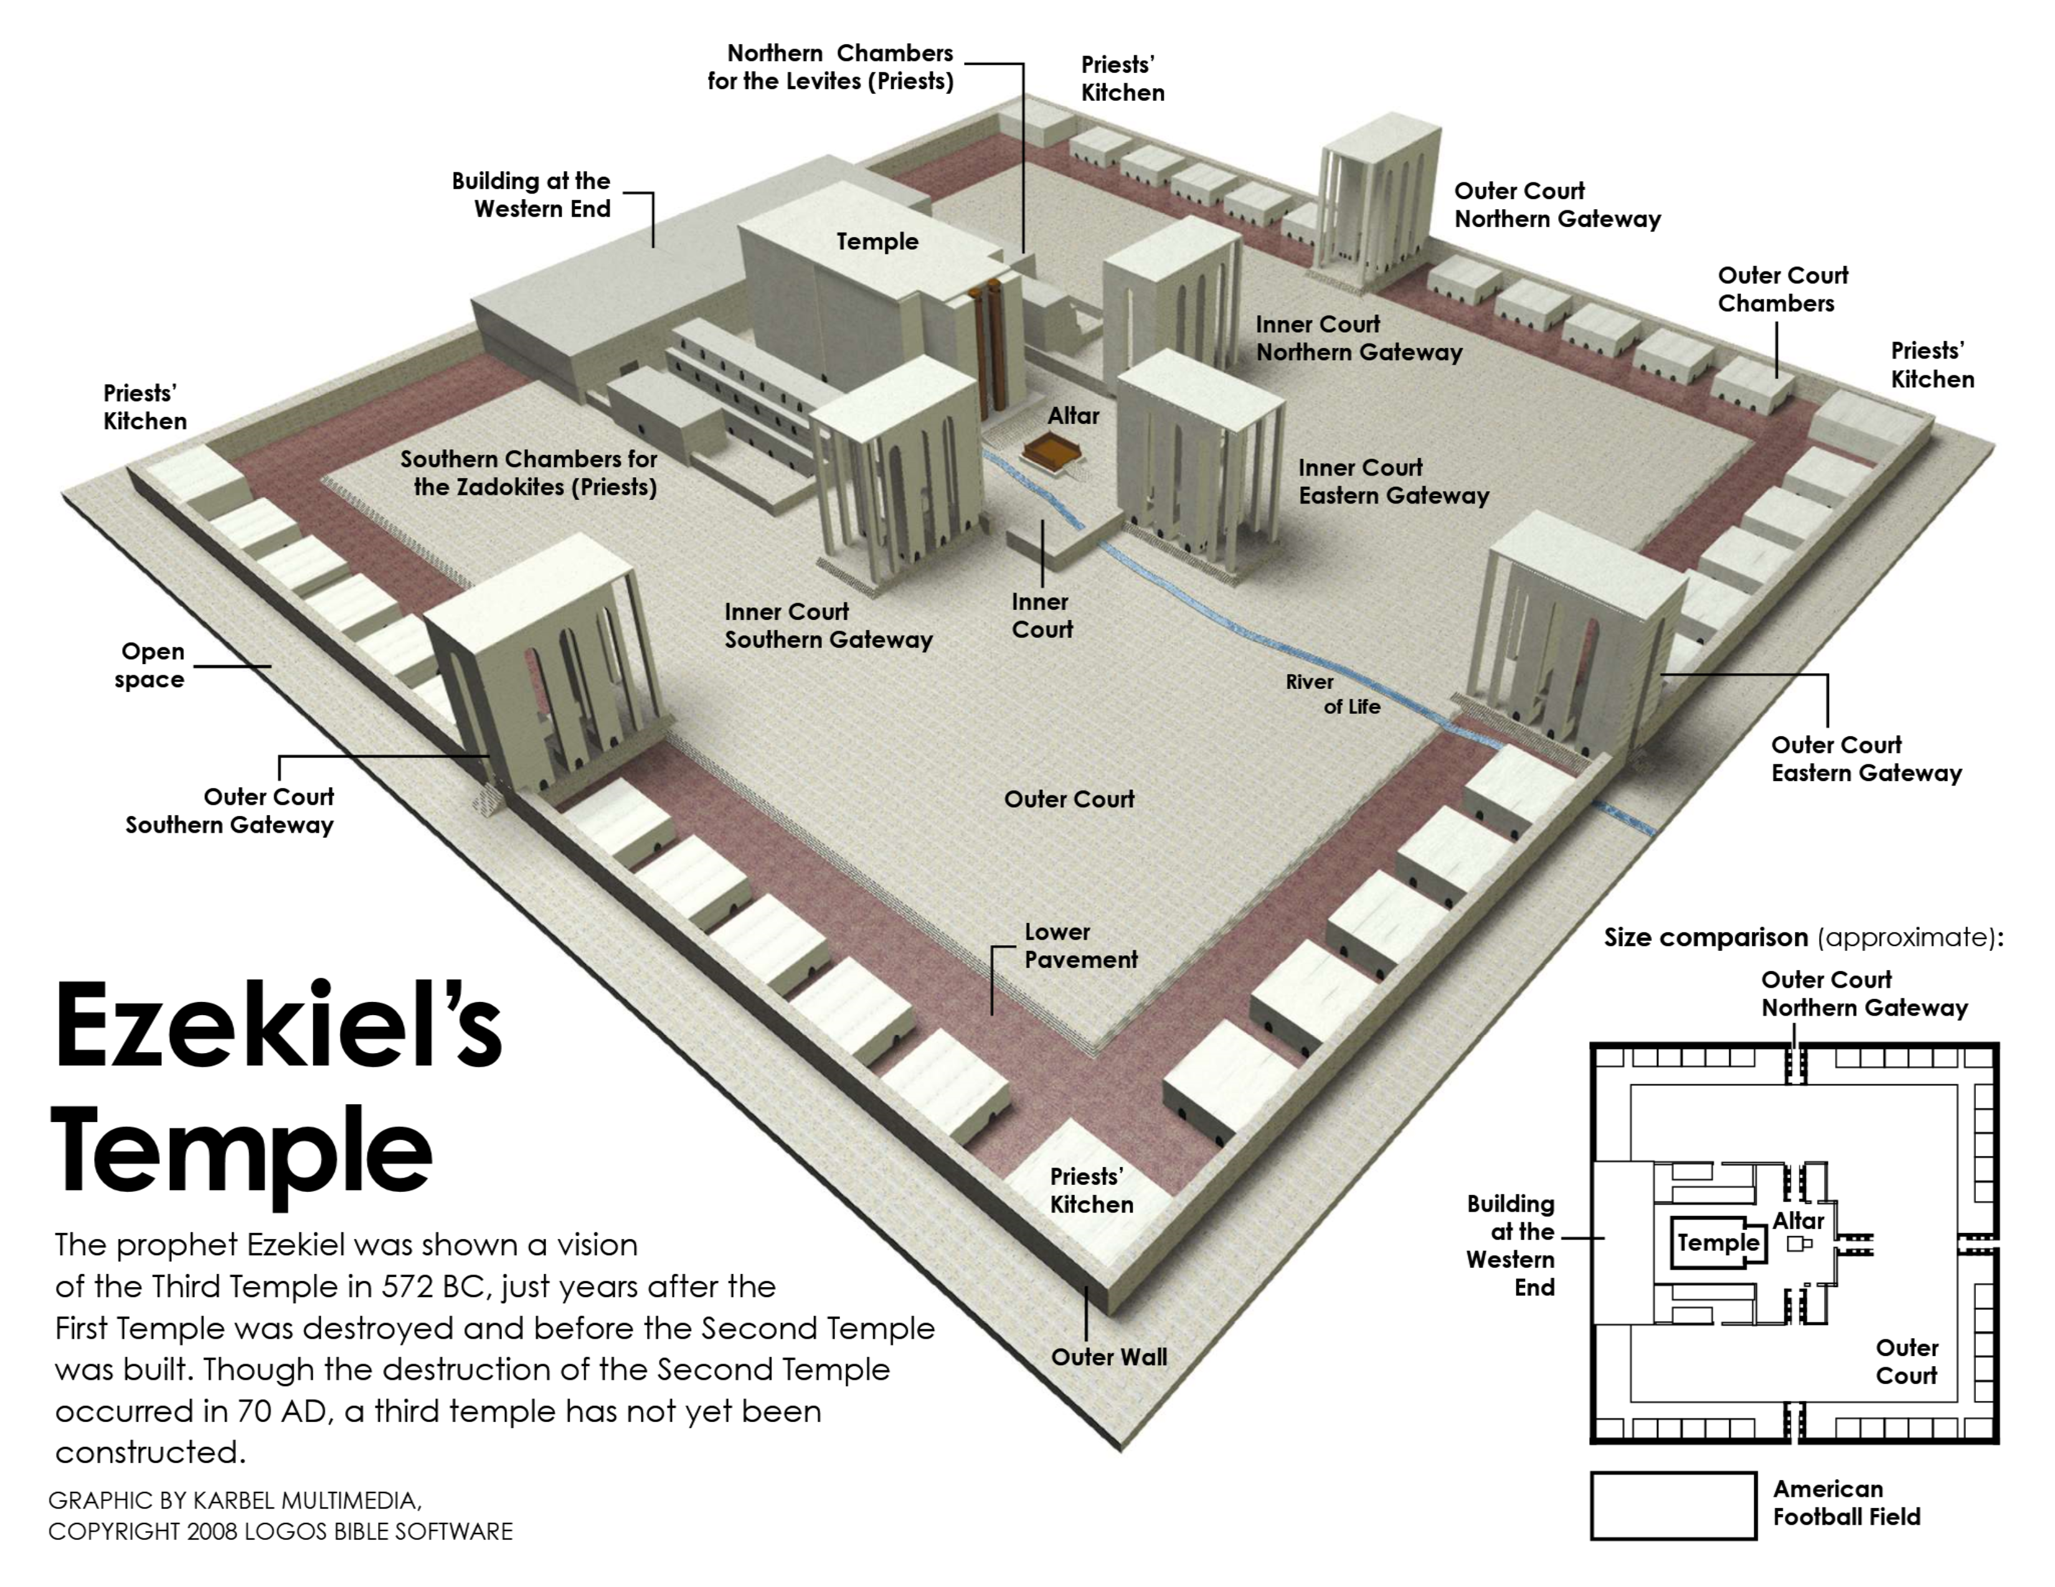

Slide 8
Ezekiel
Lessons 24 – Ezekiel 40-43
The Vision of the Temple
The glory of the Lord returns to the temple (43:1-12)
  Just as it had earlier entered the tabernacle and the temple (Exodus 40:34-35; 1 Kings 8:10-11)
  Holiness characterizes the new temple and its worshipers (43:7-9, 12; 1 Corinthians 3:16-17; 2 Corinthians 6:16—7:1)
  Ezekiel is commanded to describe the pattern and every aspect of the temple to the Israelites “that they may keep its whole design and all its ordinances” (43:10-11)
Offerings on the altar make the worshiper acceptable to God (43:13-27; Isaiah 56:7-8)

