Slide 1
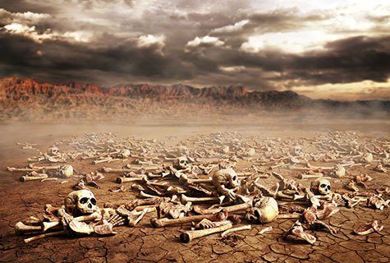
Ezekiel
“Ye Shall Know That I Am The Lord”

Slide 2
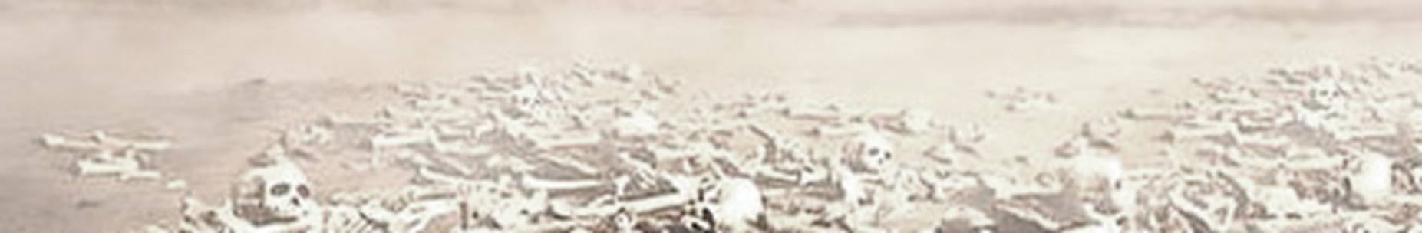
Ezekiel
Lessons 25 – Ezekiel 44-48
Regulations for Worship
Regulations concerning who could enter the temple and where they were to be positioned (44:1-14)
  Foreigners in “heart” or “flesh” would be excluded (44:4-9)
  Levites who had participated in idolatry could not minister to the Lord, but could serve as gatekeepers, etc. (44:10-14)
Regulations for the priests of the Lord who will serve (44:15-31)
  The sons of Zadok who had been faithful (44:15-16; 2 Samuel 8:17; 15:24ff)
  Their attire and conduct (44:17-22)
  Their function of teaching and judging (44:23-27)
  Their inheritance and portion (44:28-31)

Slide 3
Ezekiel
Lessons 25 – Ezekiel 44-48
Regulations for Worship
Holy land for holy leaders (45:1-12)
  The need for the princes to deal righteously and fairly (45:9-12)
Regulations for sacrifices and sacred days (45:13-46:24)
  The people’s offering for the prince (45:13-17)
  The sin offerings (45:18-20)
  Sacrifices for feasts and holy days (45:21—46:8)
  Entrance and exit for the worshippers (46:9-15)
  The inheritance of the prince (46:16-18)
  Sacrificial kitchens for the priests and the people (46:19-24)

Slide 4
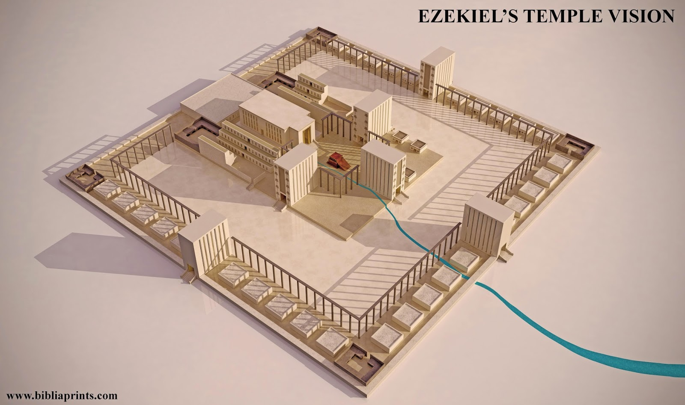
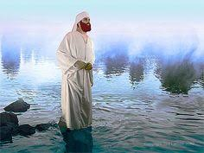
Ezekiel
Lessons 25 – Ezekiel 44-48
A Description of the Future Land
The river of the water of life (47:1-12; Rev. 22:1-2)

Slide 5
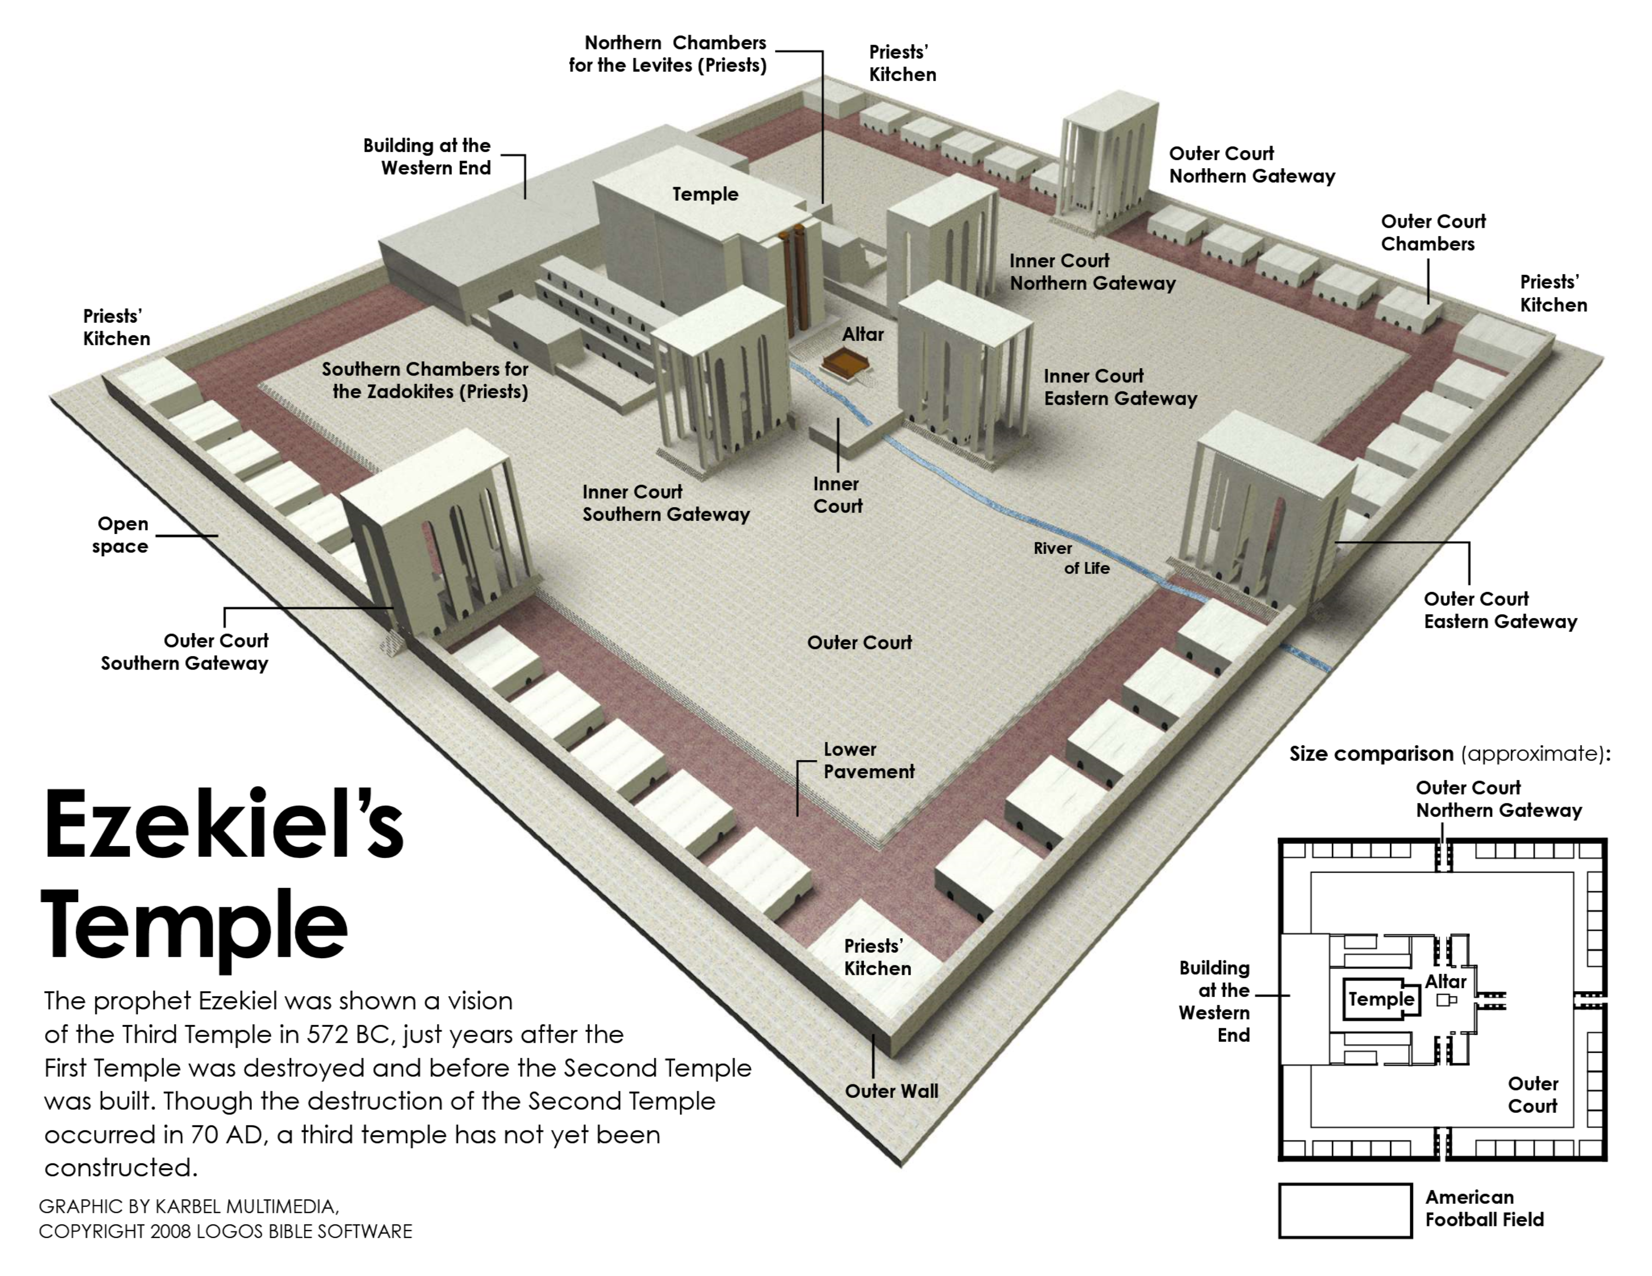

Slide 6
Ezekiel
Lessons 25 – Ezekiel 44-48
A Description of the Future Land
The river of the water of life (47:1-12; Rev. 22:1-2)
The land and its boundaries (47:13-23, cf. Hebrews 4)
  Foreigners would inherit land (47:22-23)
An allotment for every tribe, with the holy city in the midst of God’s holy people (48:1-35)
  The land portion for the seven northern tribes (48:1-7)
  The portion for the Lord, the sanctuary, and the priests (48:8-22). Note the use of the words “holy” and “set apart” (esp. 48:12)
  The portion for the southern tribes (48:23-29)

Slide 7
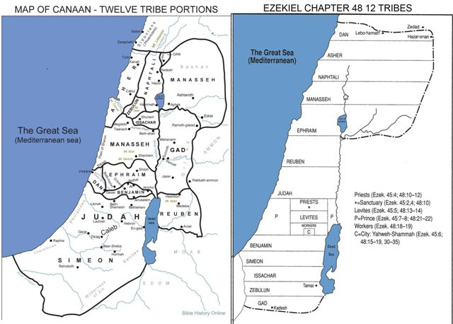

Slide 8
Ezekiel
Lessons 25 – Ezekiel 44-48
A Description of the Future Land
The river of the water of life (47:1-12; Rev. 22:1-2)
The land and its boundaries (47:13-33, cf. Hebrews 4)
An allotment for every tribe, with the holy city in the midst of God’s holy people (48:1-35)
  The portion assigned to the seven northern tribes (48:1-7)
  The portion for the Lord, the sanctuary, and the priests (48:8-22) Note the use of the words “holy” and “set apart” (esp. 48:12)
  The portion for the southern tribes (48:23-29)
The gates and the name of the city (48:30-35; cp. Revelation 21:12-14, 22)

Slide 9
Ezekiel
Lessons 25 – Ezekiel 44-48
Ezekiel’s Temple paralleled to the Church
Only those who meet God’s qualifications would be allowed to serve:
Circumcision (44:9; Rom. 2:28-29; Col. 2:11-13)
Qualifications for special servants (44:10, 15, 1 Timothy 3:1-13)
What they teach (44:23)
How they worship (46:1-9)
Notes:
Romans 2:28-29 For he is not a Jew who is one outwardly, nor is circumcision that which is outward in the flesh; 29 but he is a Jew who is one inwardly; and circumcision is that of the heart, in the Spirit, not in the letter; whose praise is not from men but from God.
Colossians 2:11-12 In Him you were also circumcised with the circumcision made without hands, by putting off the body of the sins of the flesh, by the circumcision of Christ, 12 buried with Him in baptism, in which you also were raised with Him through faith in the working of God, who raised Him from the dead.

