Slide 1
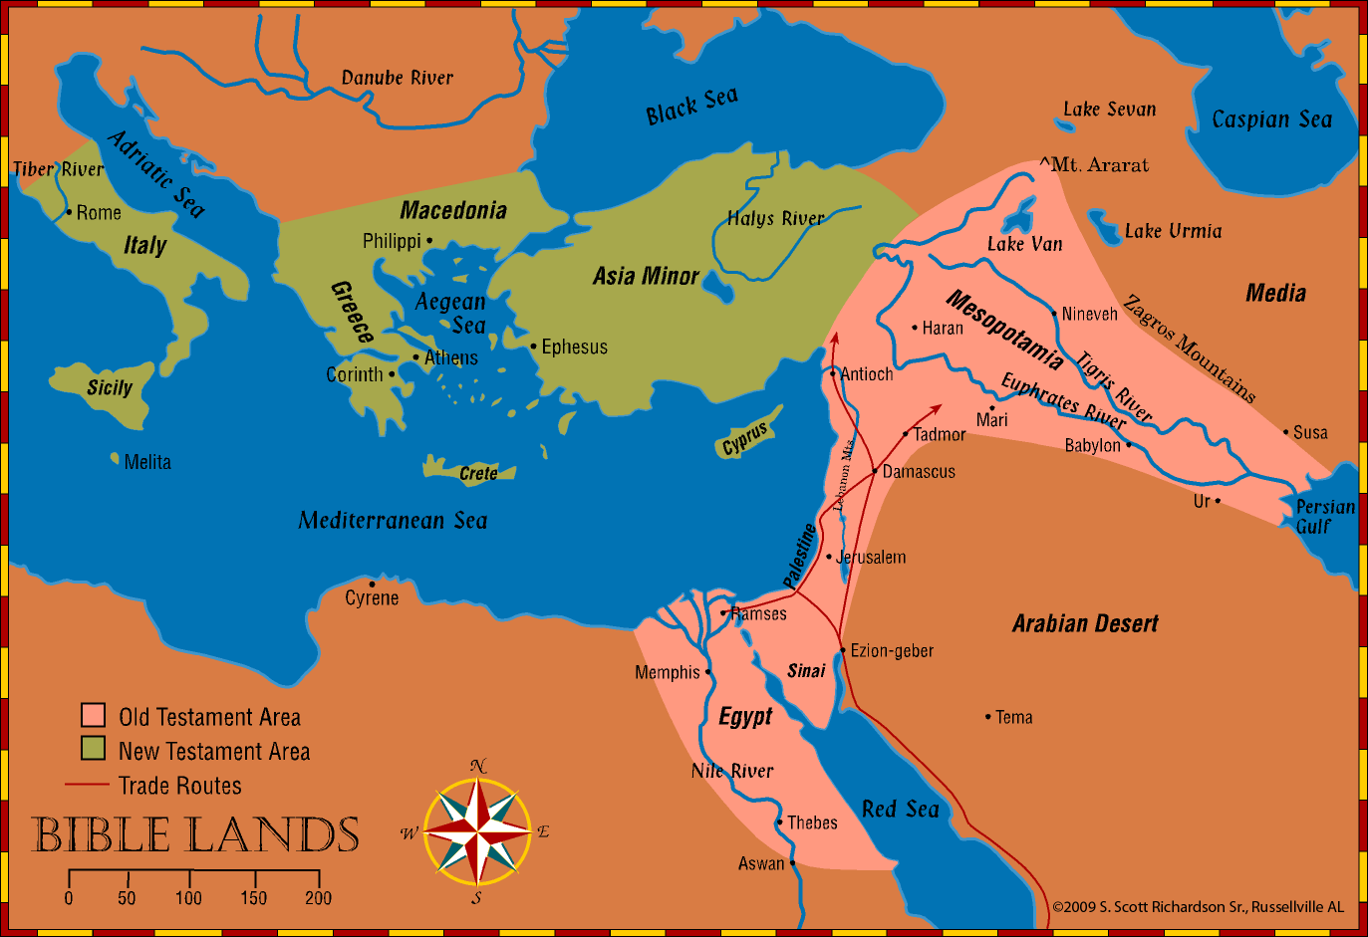
History and Geography of Bible Lands
Fall of Israel and Judah, and the Captivity - Lessons 30-33
Notes:
© 2009 S. Scott Richardson Sr., Russellville AL

Slide 2
Class Syllabus
Where we have been
  Cycles (or layers) 1, 2, and 3 of the narrative outline
  History and Geography of Bible Lands
    Two classes on Geography
    One class on Timeline and Geography
    Genesis and the Patriarchs
    Exodus and Wandering
    Conquest and Judges
    United Kingdom
    Divided Kingdom
    Cycle Review
Remaining classes
  Biblical silence and New Testament

Slide 3
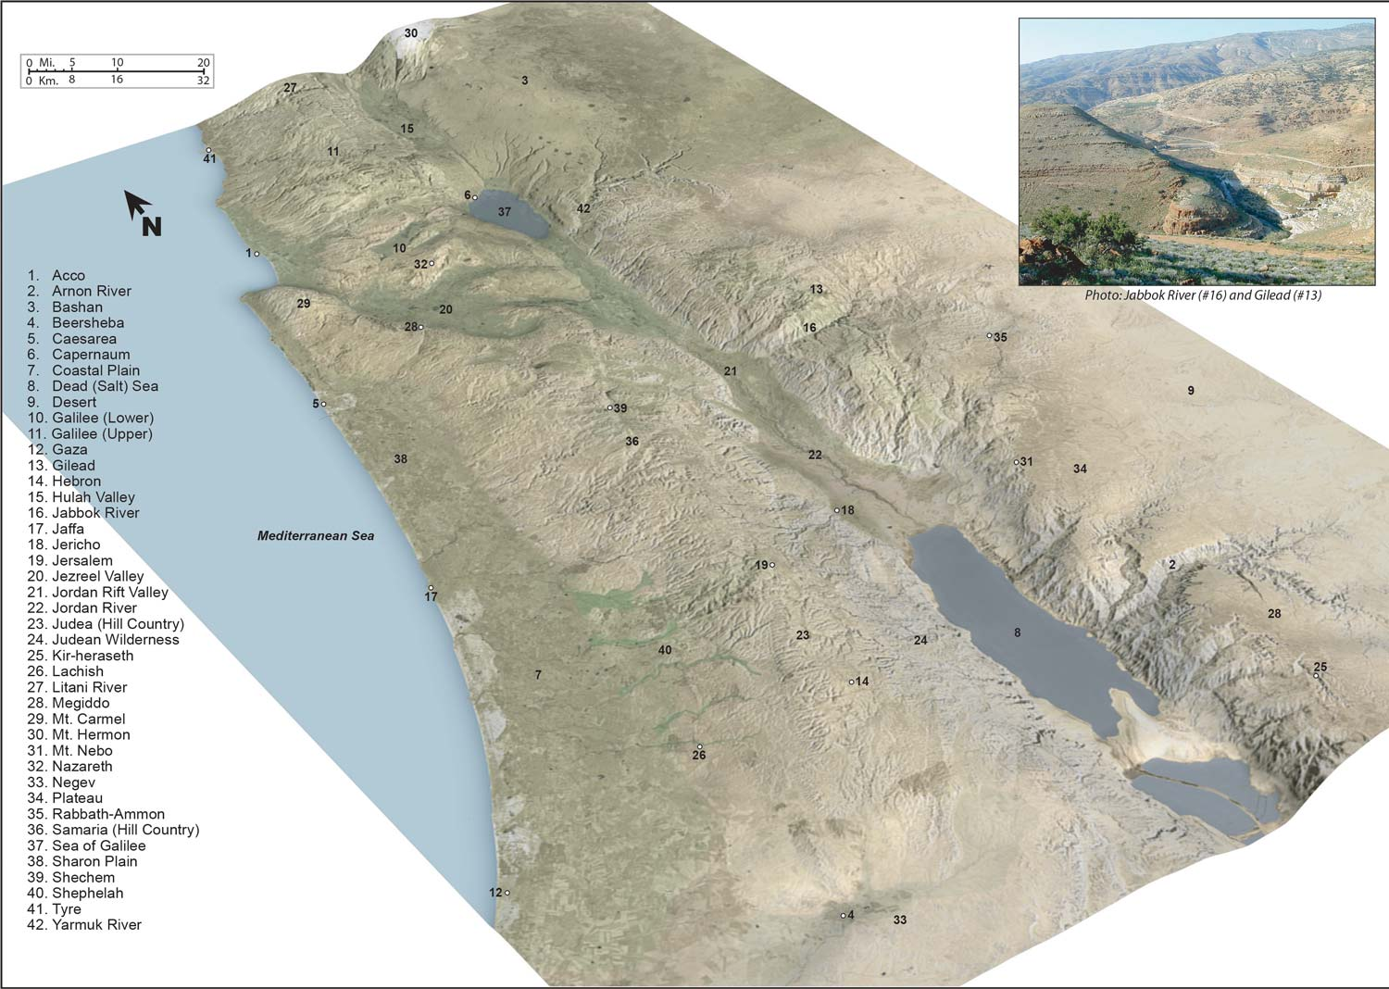
Map 1-16 – Schlegel, W. (2013). Satellite bible atlas: Historical geography of the Bible.
Notes:
Schlegel, W. (2013). Satellite bible atlas: Historical geography of the Bible. s.n.

Slide 4
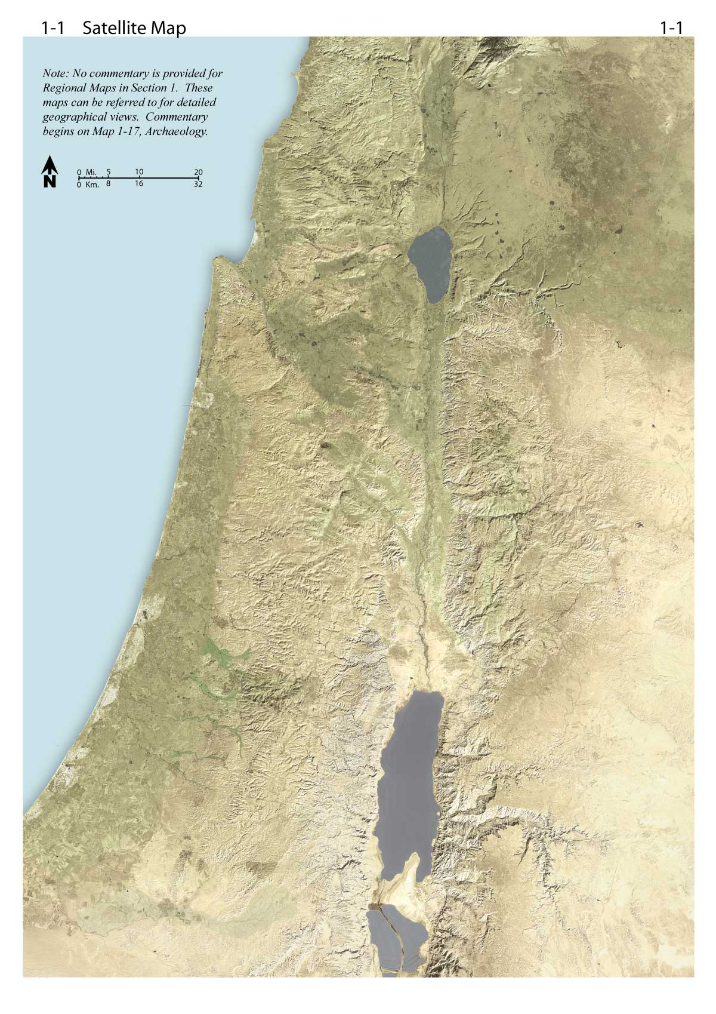
Map 1-1– Schlegel, W. (2013). Satellite bible atlas: Historical geography of the Bible.
Notes:
Schlegel, W. (2013). Satellite bible atlas: Historical geography of the Bible. s.n.

Slide 5
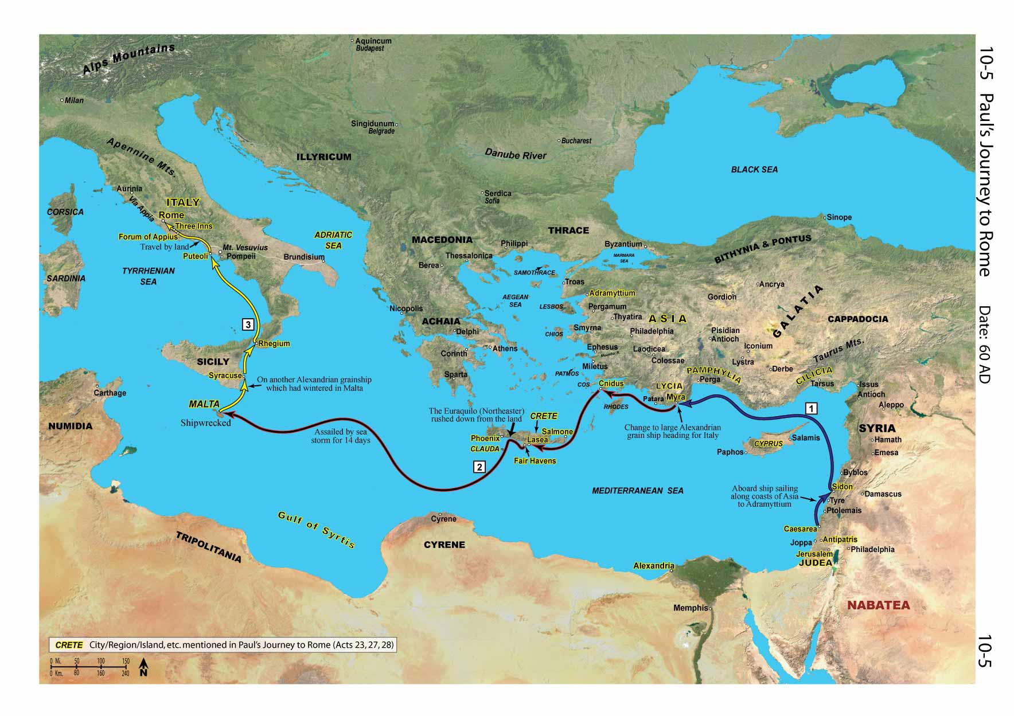
Map 10-5– Schlegel, W. (2013). Satellite bible atlas: Historical geography of the Bible.
Notes:
Schlegel, W. (2013). Satellite bible atlas: Historical geography of the Bible. s.n.

Slide 6
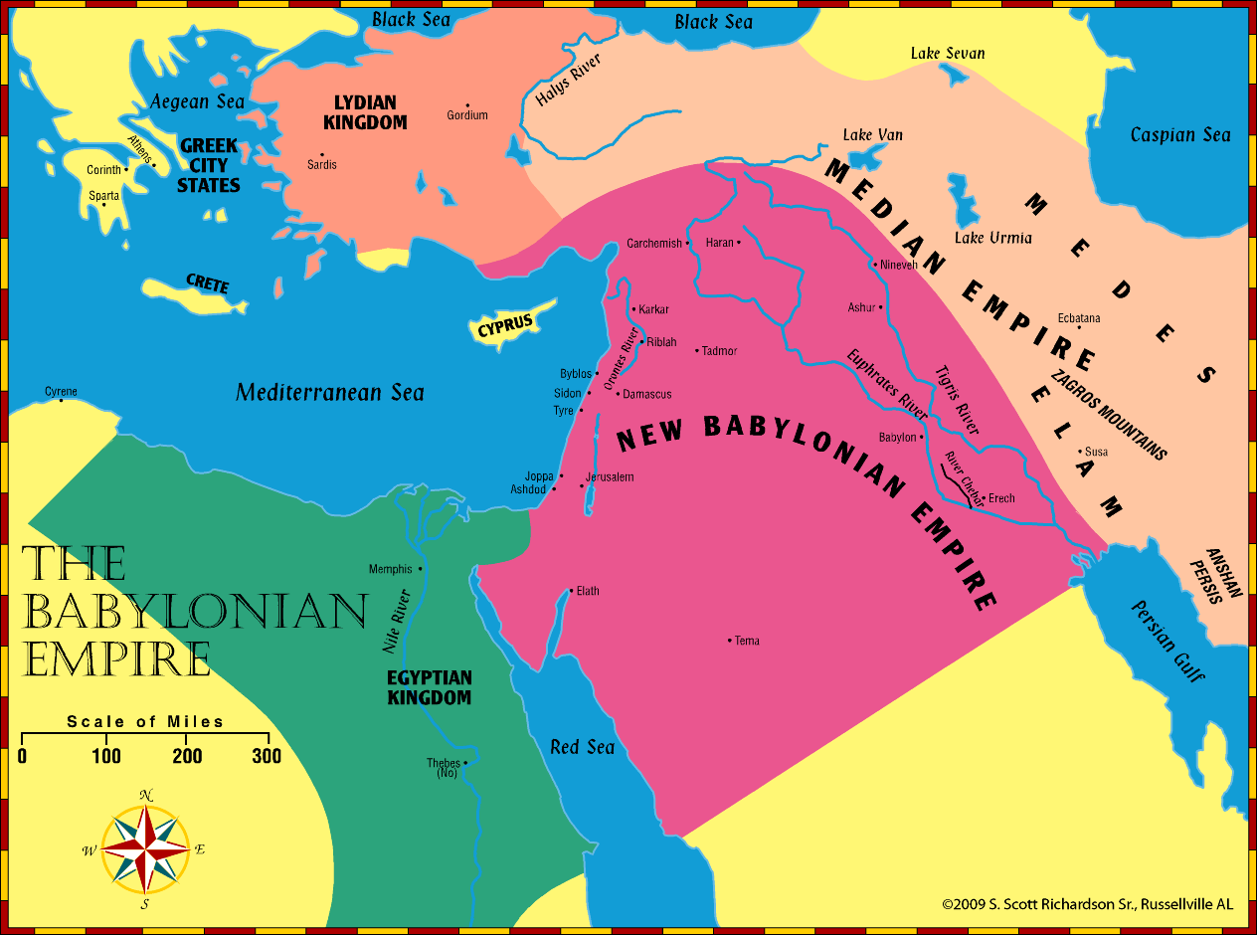
Date(s) –
721 – 586 B.C.
Bible Event(s):
Samaria falls to Assyria
Babylon via Nebuchadnezzar invades
Jerusalem falls to Babylon in 586
World Event(s):
Same as above
Mesopotamia/Persia – Sennacherib, Esarhaddon, Ashurbanipal, Nabopolassar, Nineveh falls
Greek and Roman foundations continue
Notes:
© 2009 S. Scott Richardson Sr., Russellville AL

Slide 7
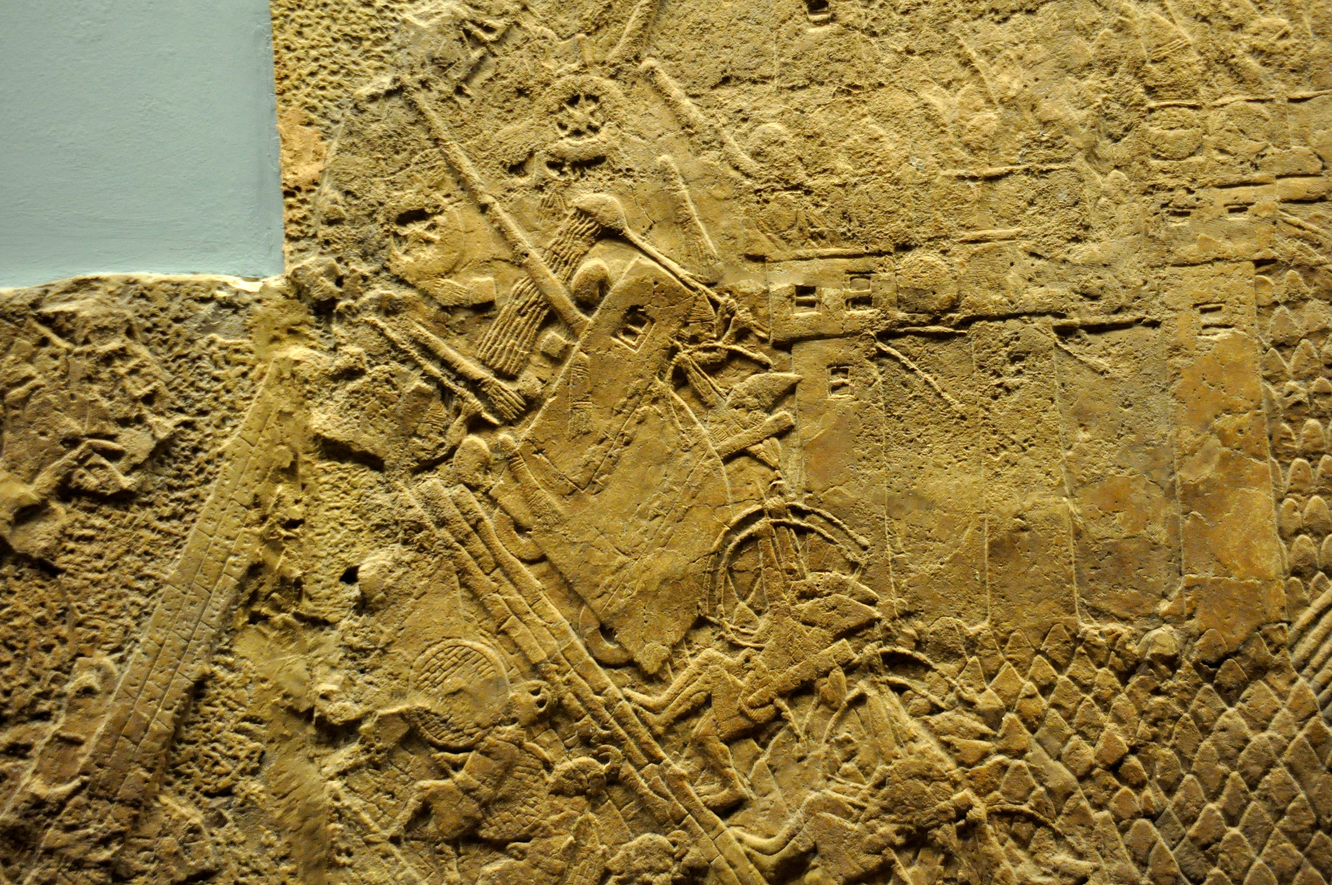
Date(s) –
721 – 586 B.C.
Bible Event(s):
Samaria falls to Assyria
Babylon via Nebuchadnezzar invades
Jerusalem falls to Babylon in 586
World Event(s):
Same as above
Mesopotamia/Persia – Sennacherib, Esarhaddon, Ashurbanipal, Nabopolassar, Nineveh falls
Greek and Roman foundations continue
Assyrian siege-engine attacking the city wall of Lachish
https://en.wikipedia.org/wiki/File:Assyrian_siege-engine_attacking_the_city_wall_of_Lachish,_part_of_the_ascending_assaulting_wave._Detail_of_a_wall_relief_dating_back_to_the_reign_of_Sennacherib,_700-692_BCE._From_Nineveh,_Iraq,_currently_housed_in_the_British_Museum.jpg

Slide 8
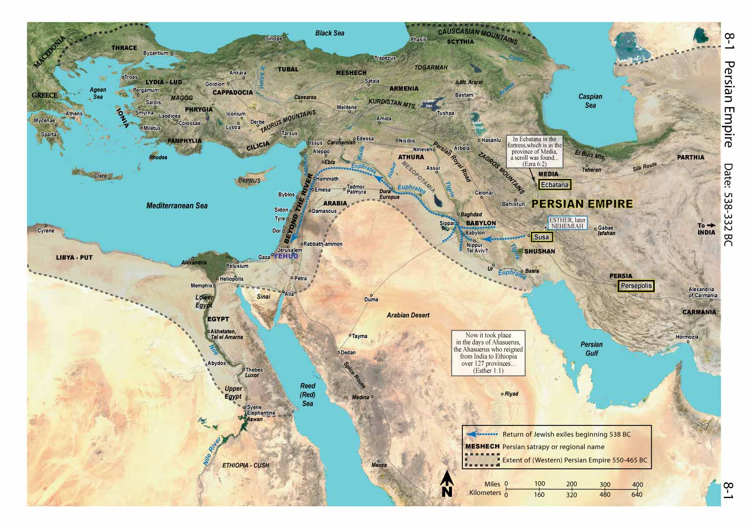
Date(s) –
606 – 400s B.C.
Bible Event(s):
Babylonian Captivity
Returns
  Zerubbabel - temple
  Nehemiah - walls
Temple completed
Last prophets - Malachi
World Event(s):
Persia returning people groups
Persian kings – Xerxes, Artaxerxes, Darius
Notes:
Schlegel, W. (2013). Satellite bible atlas: Historical geography of the Bible. s.n.

Slide 9
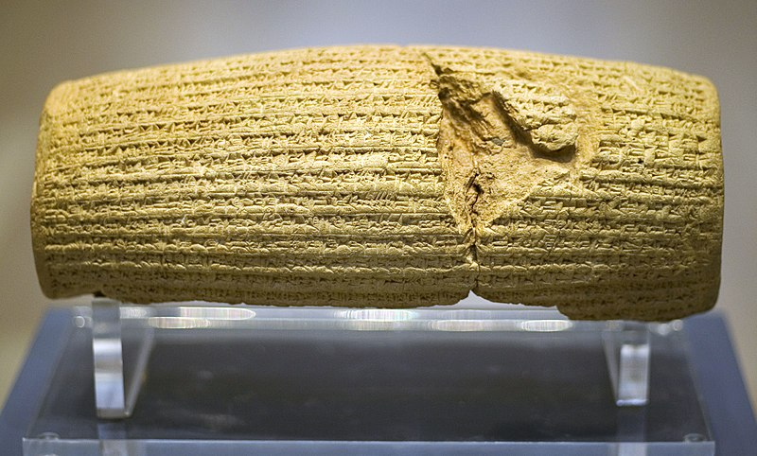
Date(s) –
606 – 400s B.C.
Bible Event(s):
Babylonian Captivity
Returns
  Zerubbabel - temple
  Nehemiah - walls
Temple completed
Last prophets - Malachi
World Event(s):
Persia returning people groups
Persian kings – Xerxes, Artaxerxes, Darius
A declaration in Akkadian cuneiform script in the name of Persia's Achaemenid king Cyrus the Great
https://en.wikipedia.org/wiki/File:Cyrus_Cylinder_front.jpg
Notes:
Sumerian artifacts: women’s gold and lapis lazuli headdress and necklaces, cuneiform tablets, gold and lapis statuette of a ram standing against a tree
These demonstrate the sophistication of southern Mesopotamian culture over a thousand years before Abraham’s time

Slide 10
Fall of Israel and Judah, and the Captivity
Fall of Israel and Judah, and the Captivity
  Concepts and messages
    Narratives about God’s people continuing to stray from the covenant and the consequences of that path
      Never a good king in Israel – they were taken first
      Judah did better, but still eventually fell
      The prophets brought messages of what was coming
      God follows through with his plan and promises
        He will restore a remnant
    Locational details for central Israel
      Samaria falls and Israel is taken away
      Jerusalem and it’s defending cities fall
      Geographic details from the prophets
        Where they are and where they are not

Slide 11
Fall of Israel, Judah, and Captivity
  Judah Alone (2 Kings 18-25 AND 2 Chronicles 30-36)
    Israel (Northern Kingdom) defeated and taken by Assyria
    Prophets
      Jonah
      Amos
      Hosea
  Captivity
    Captivity from 605-536 B.C.
    Prophets
      Jeremiah in Jerusalem
      Daniel taken captive in 605 B.C.
      Ezekiel taken captive in 597 B.C.
    Judah taken captive and Jerusalem destroyed in 586 B.C.
    Captivity for 70 years

Slide 12
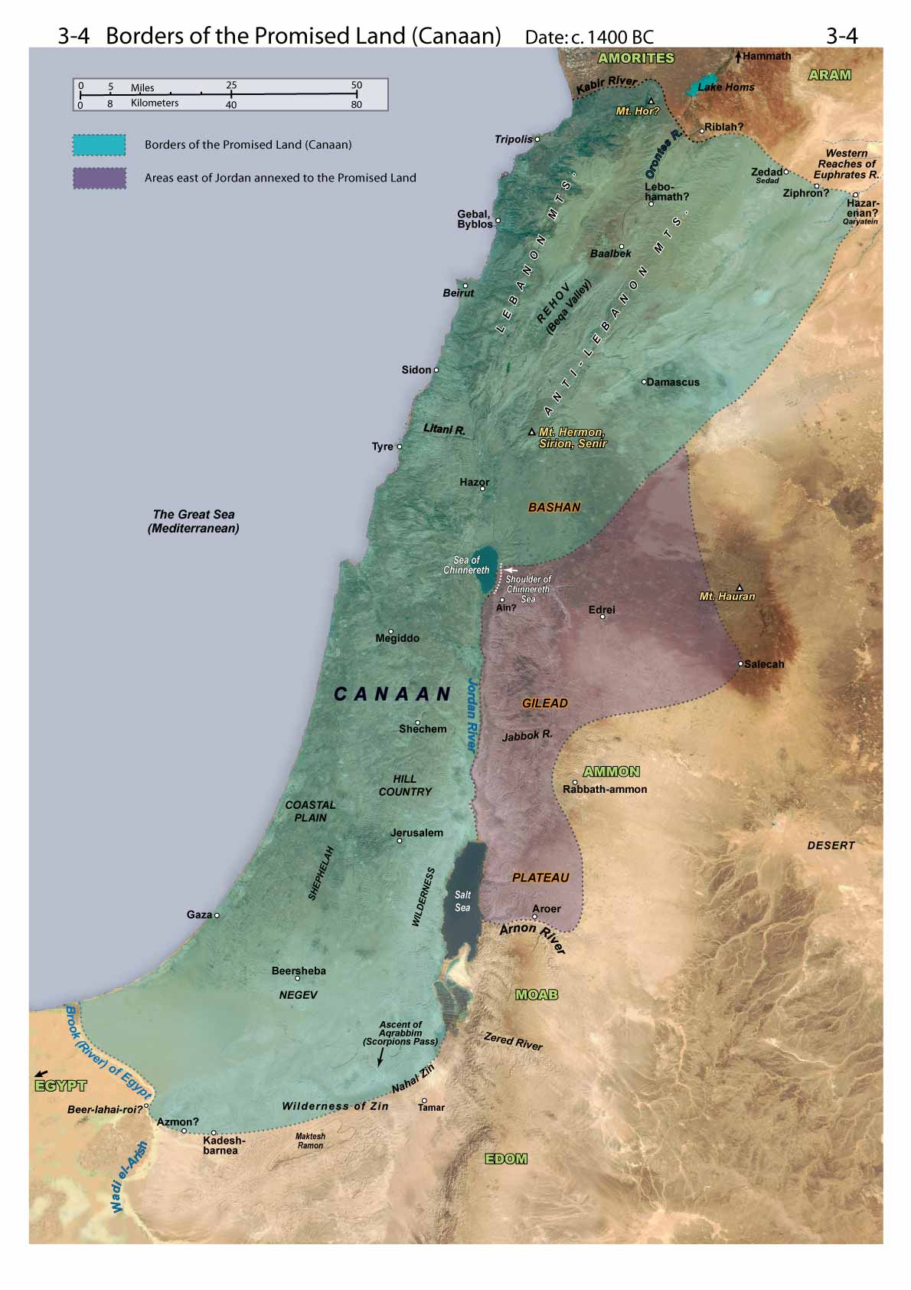
Map 3-4– Schlegel, W. (2013). Satellite bible atlas: Historical geography of the Bible.
Notes:
Schlegel, W. (2013). Satellite bible atlas: Historical geography of the Bible. s.n.

Slide 13
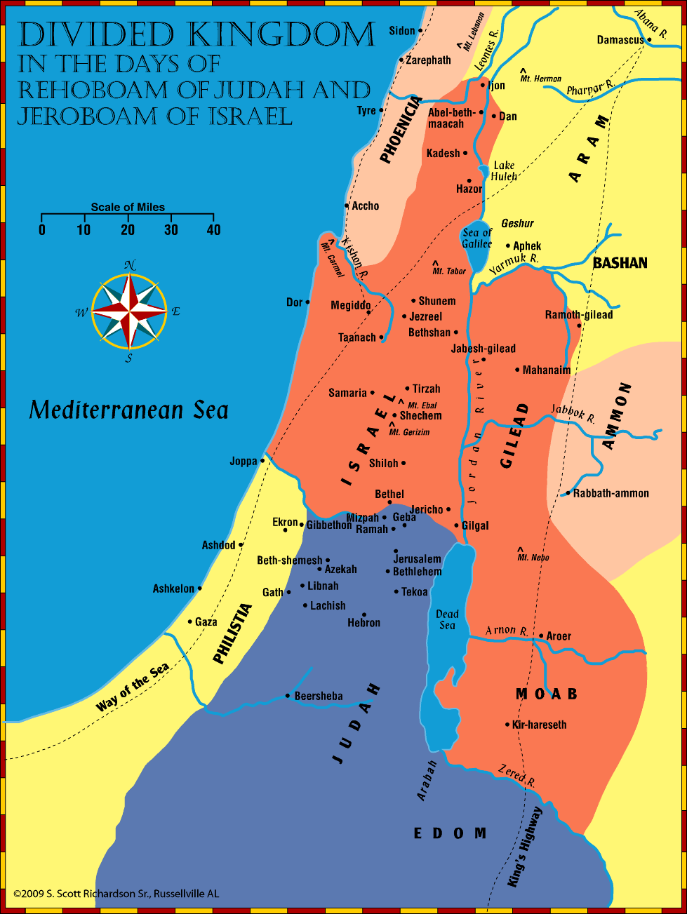
Notes:
© 2009 S. Scott Richardson Sr., Russellville AL

Slide 14
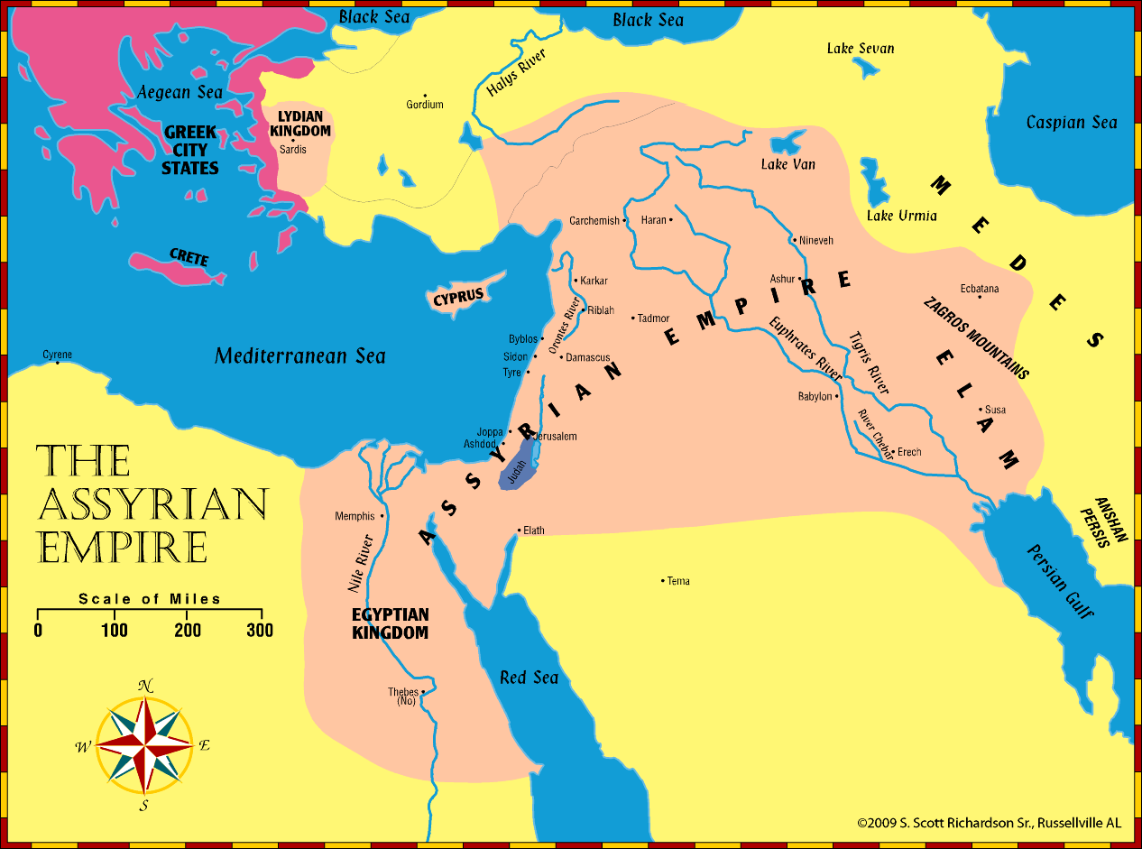
Date(s) – 9th – 7th centuries B.C.
Notes:
© 2009 S. Scott Richardson Sr., Russellville AL

Slide 15
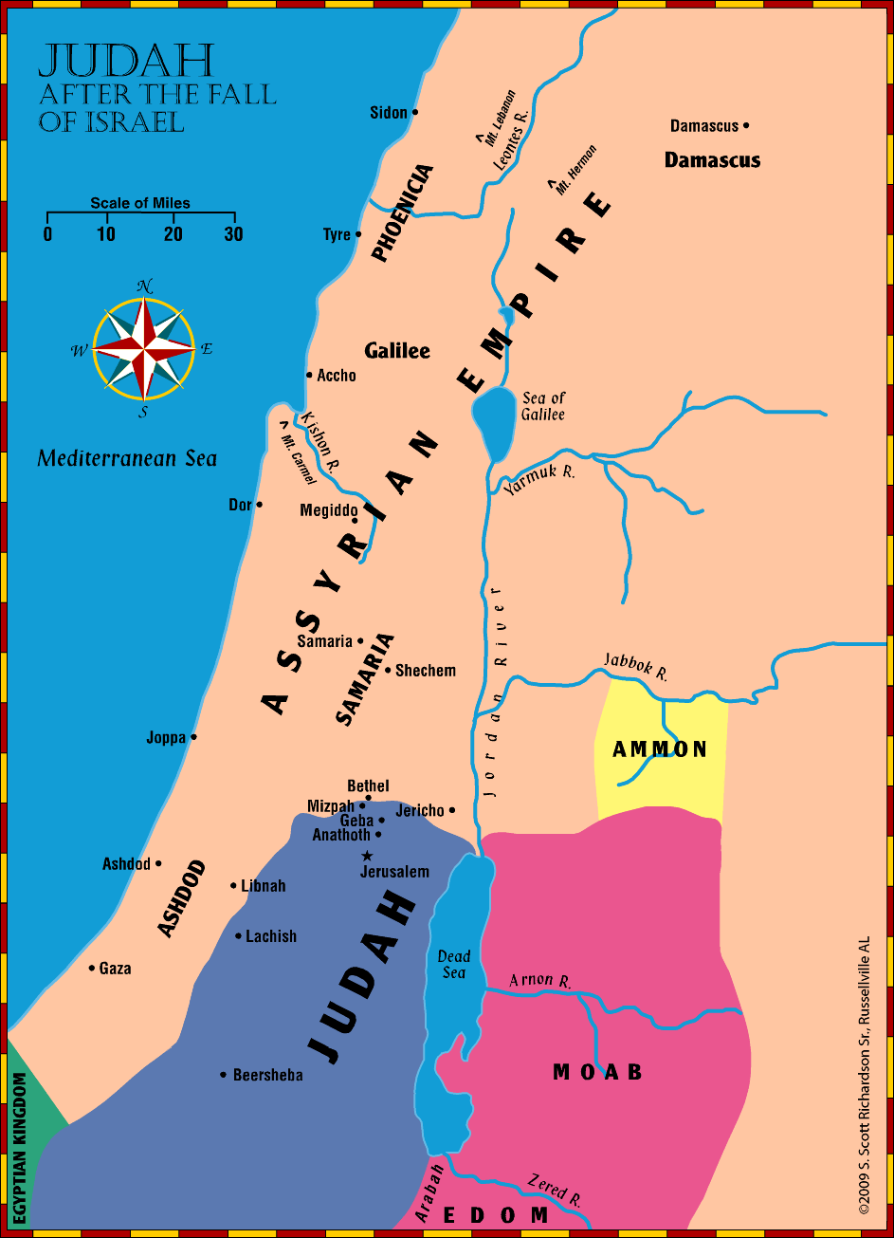
Notes:
© 2009 S. Scott Richardson Sr., Russellville AL

Slide 16
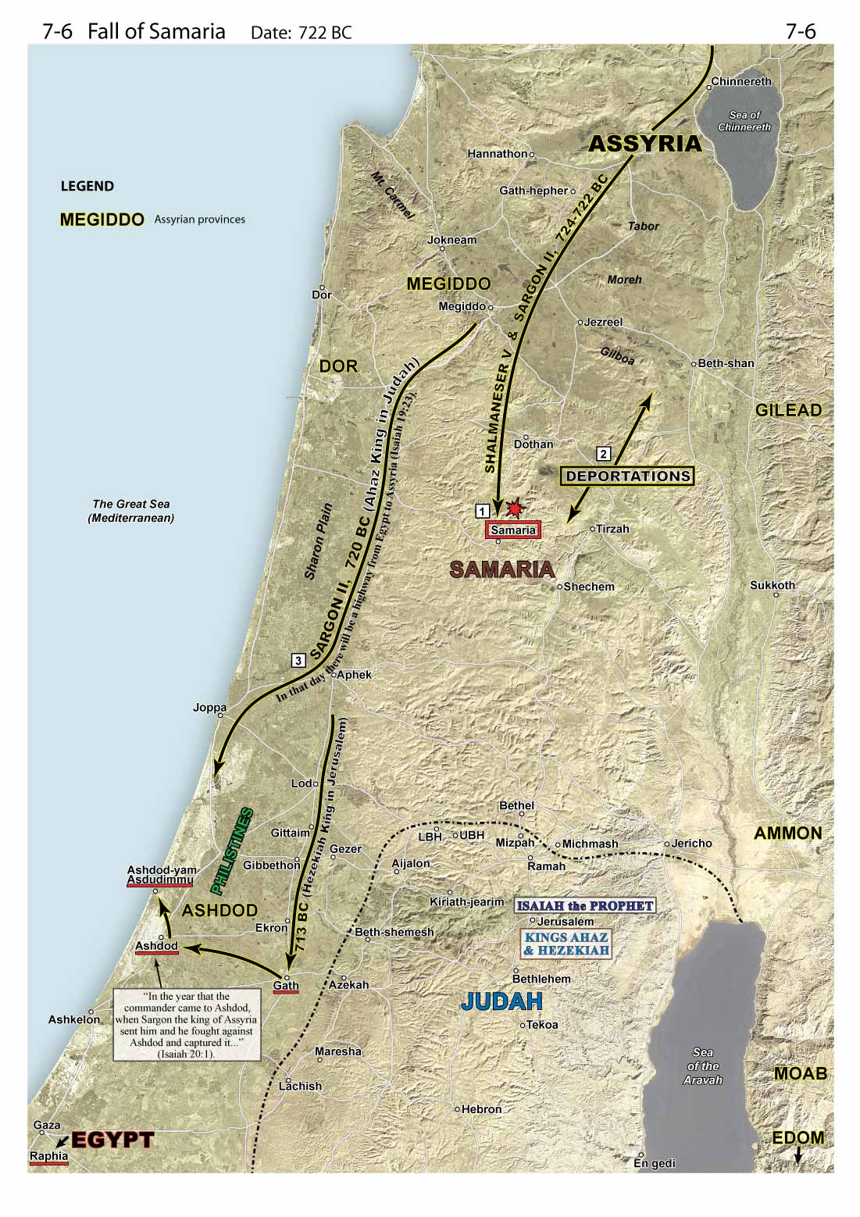
Map 7-6– Schlegel, W. (2013). Satellite bible atlas: Historical geography of the Bible.
Notes:
Schlegel, W. (2013). Satellite bible atlas: Historical geography of the Bible. s.n.

Slide 17
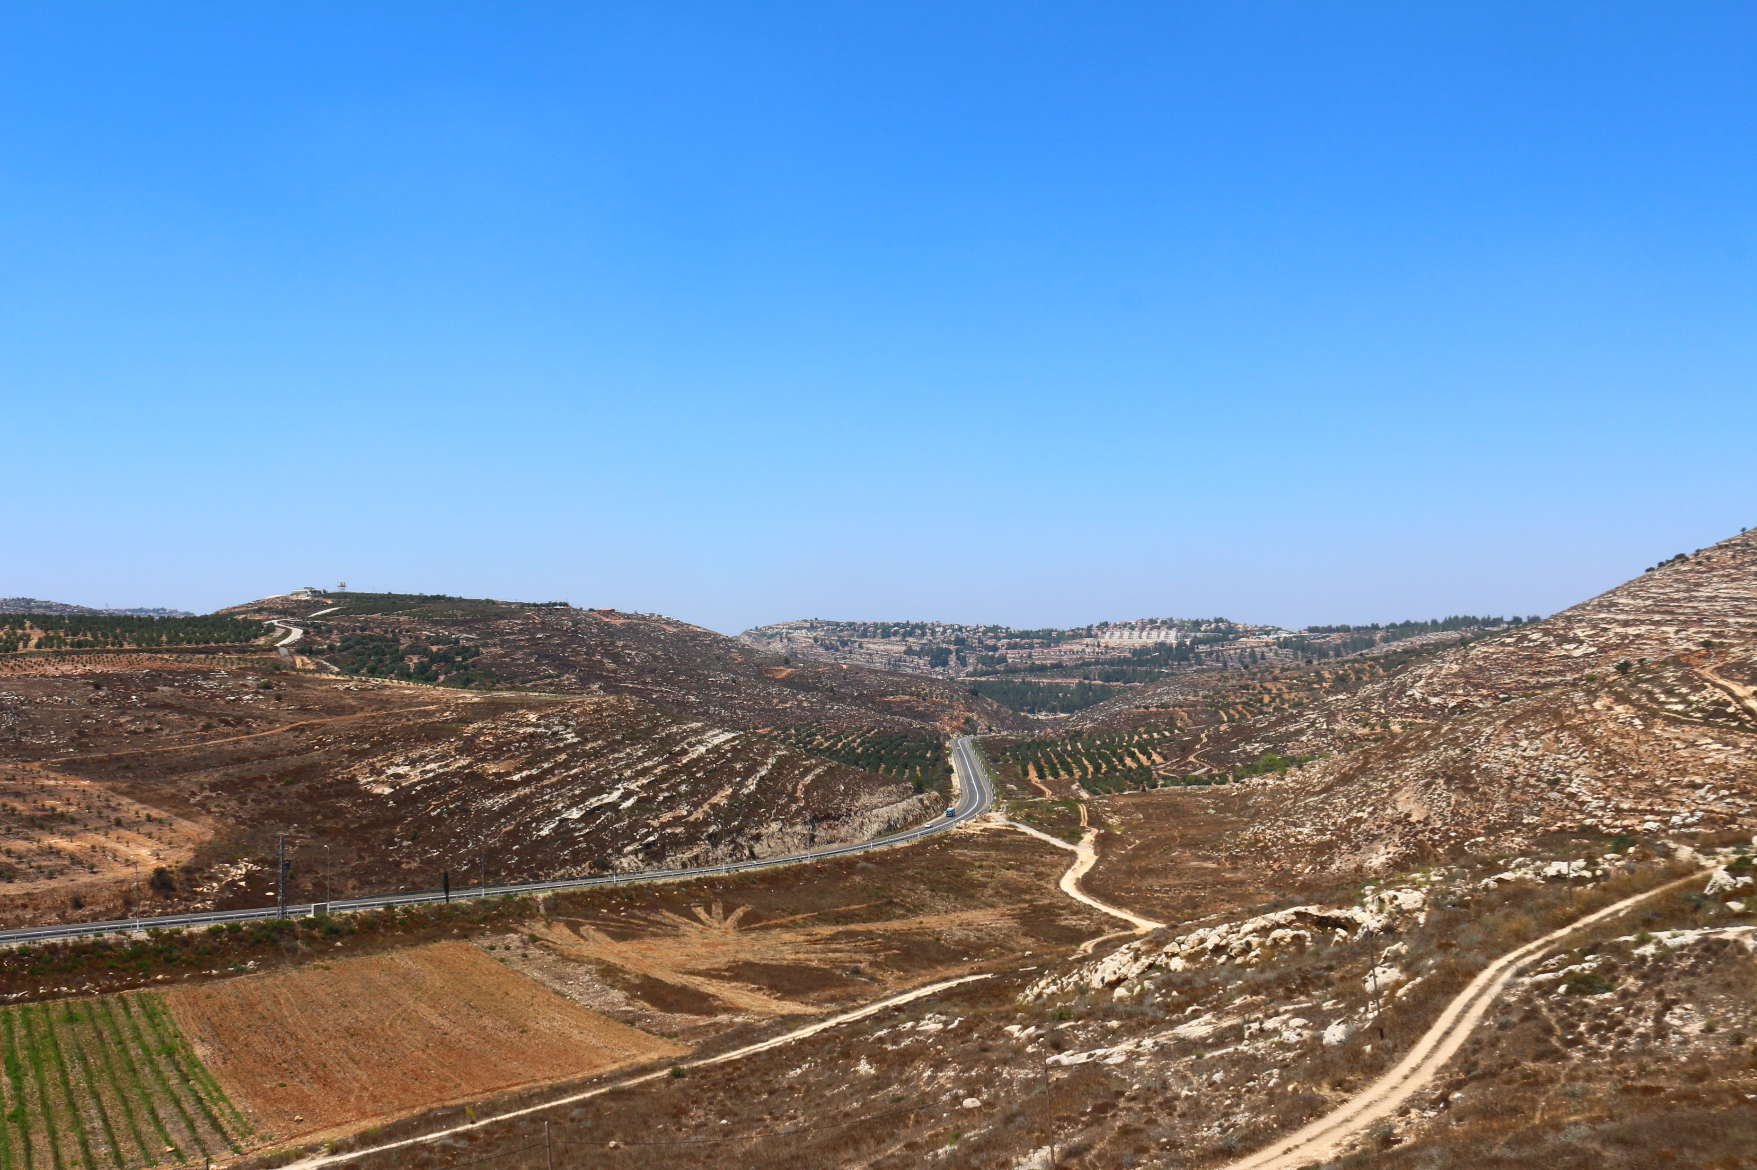
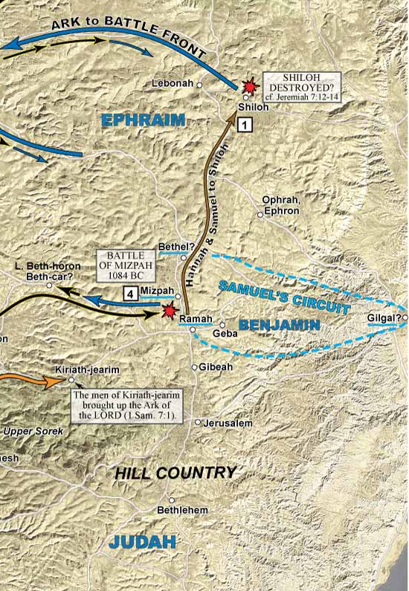
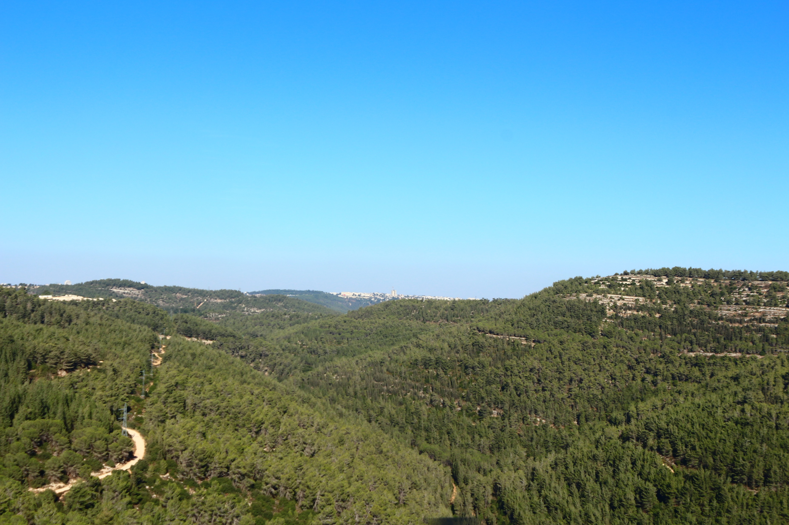
Map 5-1– Schlegel, W. (2013). Satellite bible atlas: Historical geography of the Bible.
Notes:
Schlegel, W. (2013). Satellite bible atlas: Historical geography of the Bible. s.n.

Slide 18
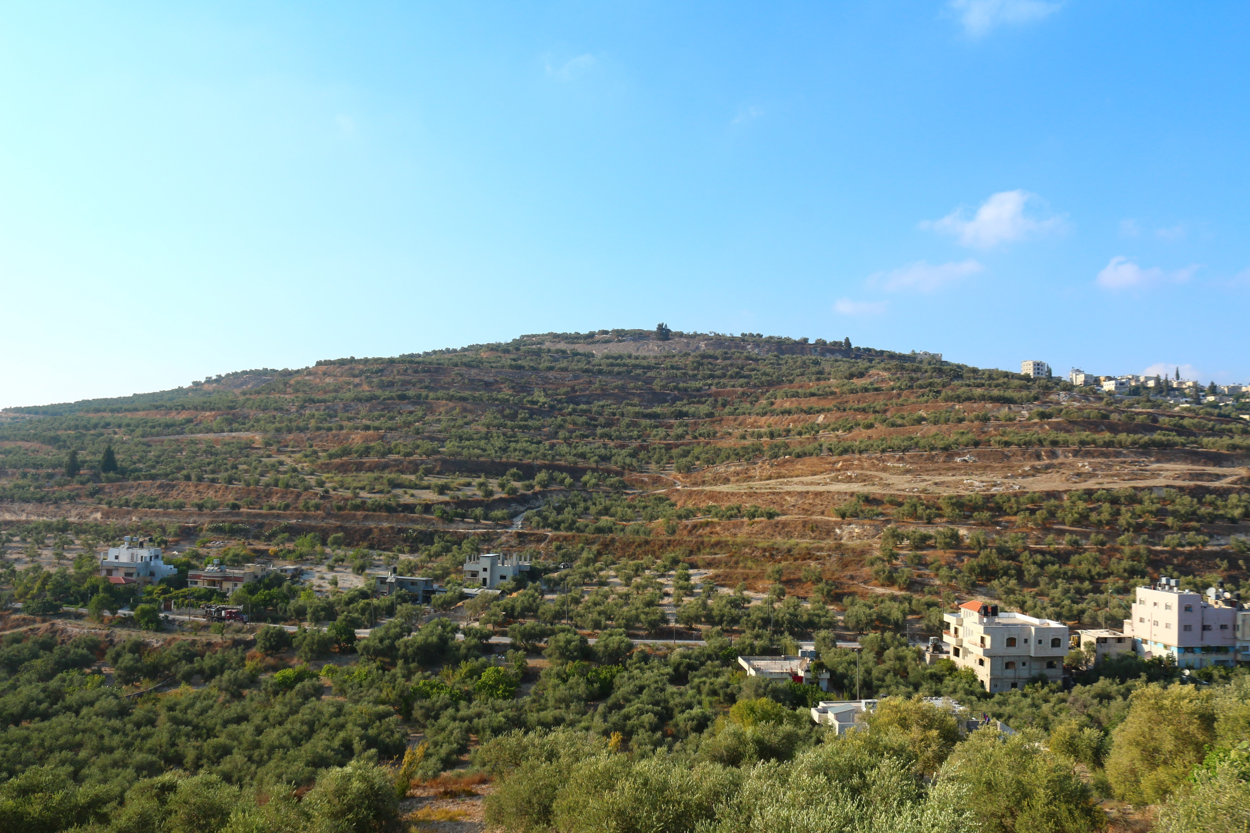
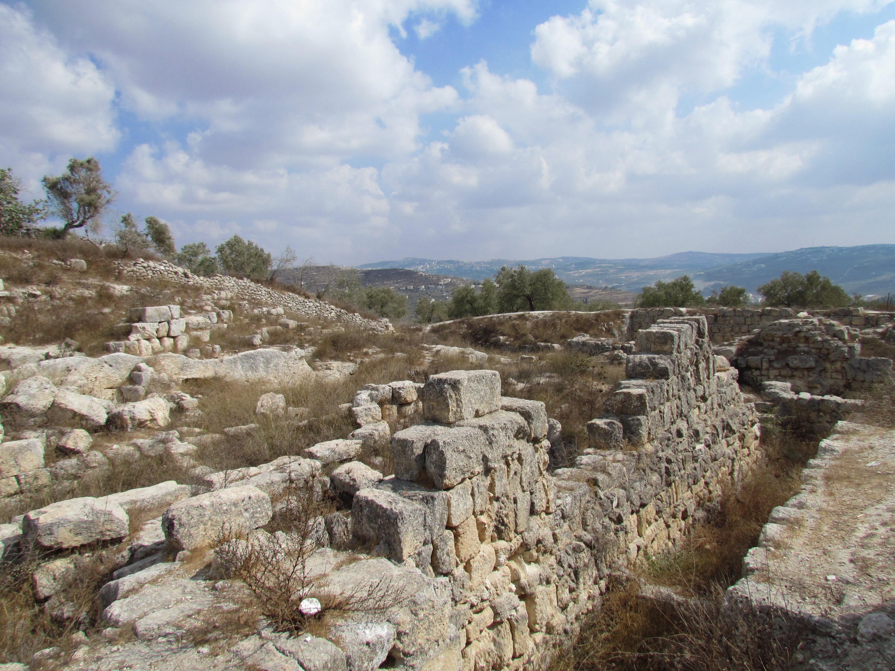
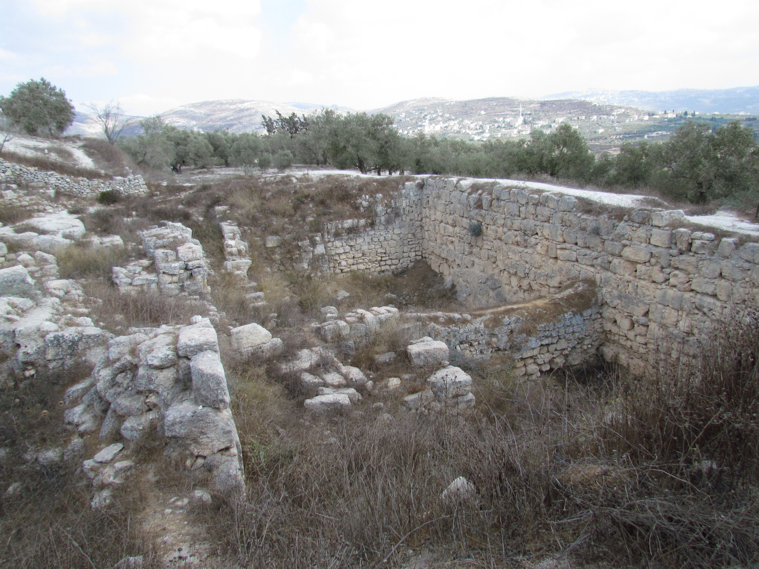
Map 7-6– Schlegel, W. (2013). Satellite bible atlas: Historical geography of the Bible.
Notes:
Schlegel, W. (2013). Satellite bible atlas: Historical geography of the Bible. s.n.

Slide 19
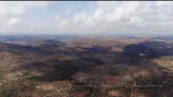
Notes:
Hills around Jerusalem

Slide 20
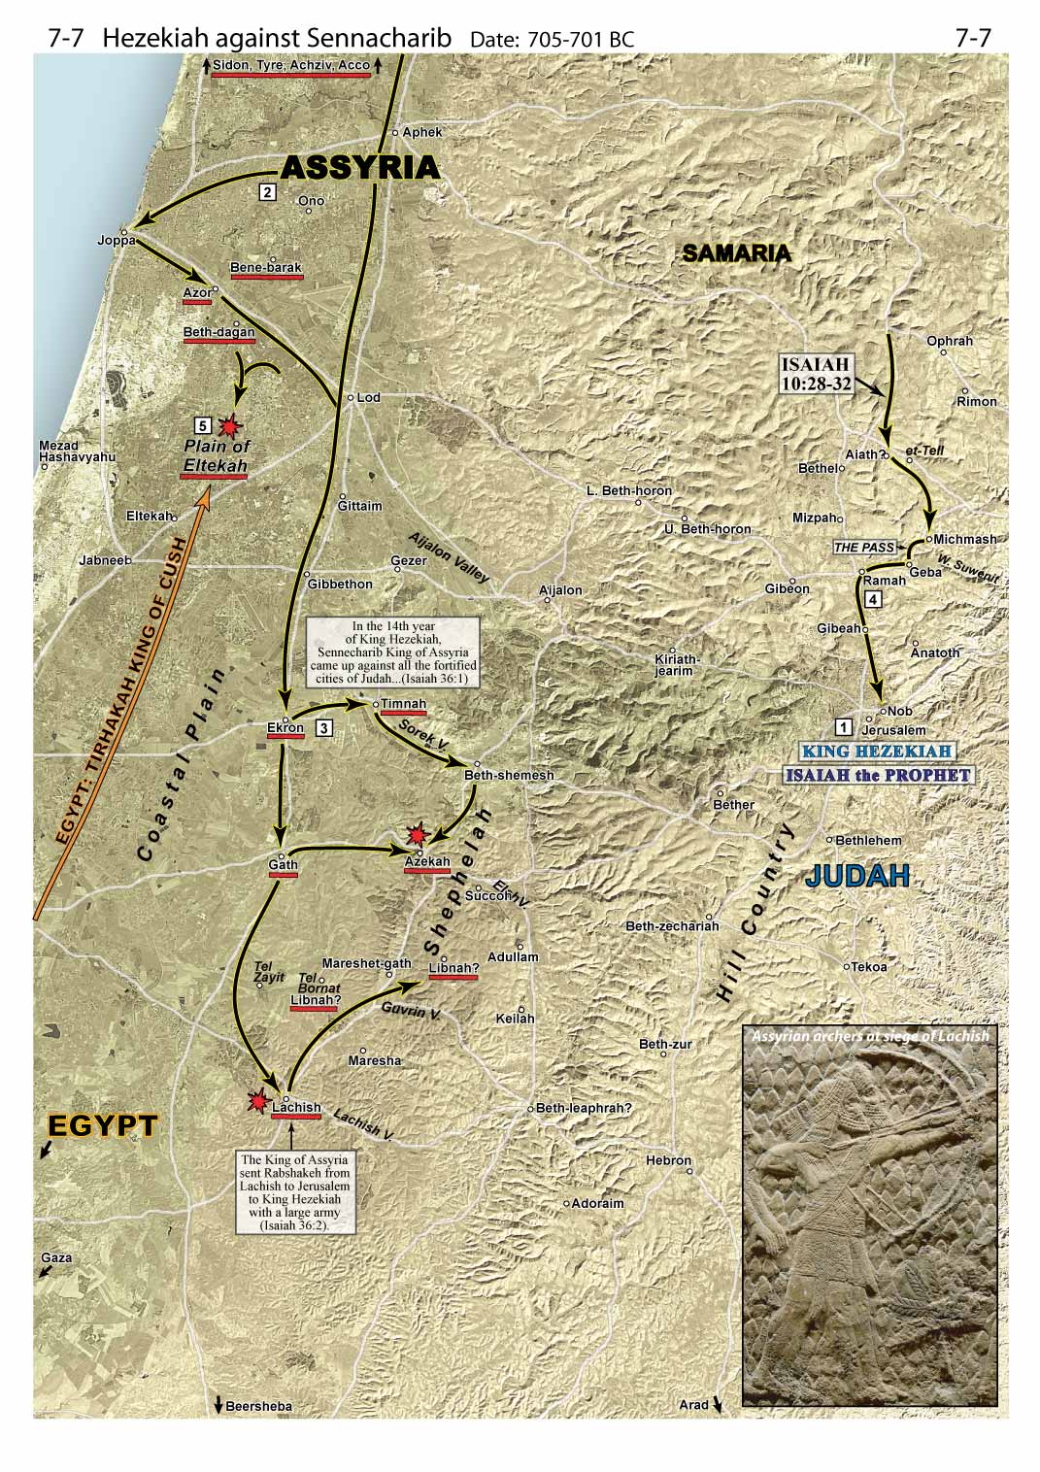
Map 7-7– Schlegel, W. (2013). Satellite bible atlas: Historical geography of the Bible.
Notes:
Schlegel, W. (2013). Satellite bible atlas: Historical geography of the Bible. s.n.

Slide 21
Date(s) – 7th – 6th centuries B.C.
Notes:
© 2009 S. Scott Richardson Sr., Russellville AL

Slide 22
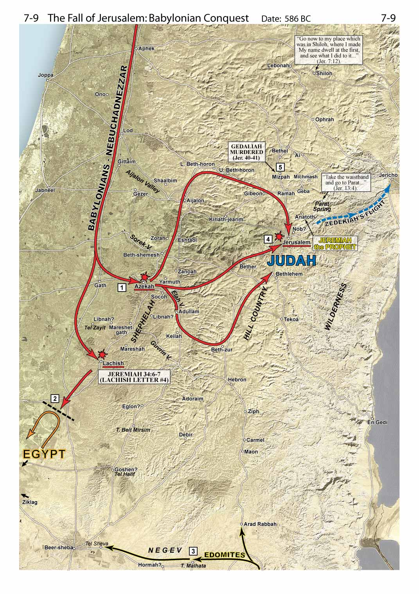
Map 7-9– Schlegel, W. (2013). Satellite bible atlas: Historical geography of the Bible.
Notes:
Schlegel, W. (2013). Satellite bible atlas: Historical geography of the Bible. s.n.

Slide 23
Captivity
  Prophets of the Captivity
    Captivity from 605-536 B.C.
    Prophets
      Jeremiah in Jerusalem
      Daniel taken captive in 605 B.C.
      Ezekiel taken captive in 597 B.C.
    Judah taken captive and Jerusalem destroyed in 586 B.C.
    Captivity for 70 years

Slide 24
Captivity
  Prophets of the Captivity - Jeremiah
    Jeremiah in Jerusalem
      Prophecies of Judah and the kingdom of God
      Judgment against the nations
        Egypt
        Philistines
        Moab
        Ammon
        Edom
        Damascus
        Kedar and Hazor
        Babylon
      Captivity of Judah

Slide 25
Captivity
  Prophets of the Captivity – Daniel
    Daniel taken captive in 605 B.C.
      Daniel’s Faithfulness
      Nebuchadnezzar’s Dream
      Nebuchadnezzar’s Golden Image
      Nebuchadnezzar’s Second Dream
      Handwriting on the Wall
      Daniel and the Lion’s Den
      Daniel’s Vision of the Four Beasts
      Daniel’s Vision of the Ram and Goat
      Daniel’s Prayer for His People
      Daniel’s Vision of a Man
      The Kings of the South and North
      The End Times

Slide 26
Map 10-5– Schlegel, W. (2013). Satellite bible atlas: Historical geography of the Bible.
Notes:
Schlegel, W. (2013). Satellite bible atlas: Historical geography of the Bible. s.n.

Slide 27
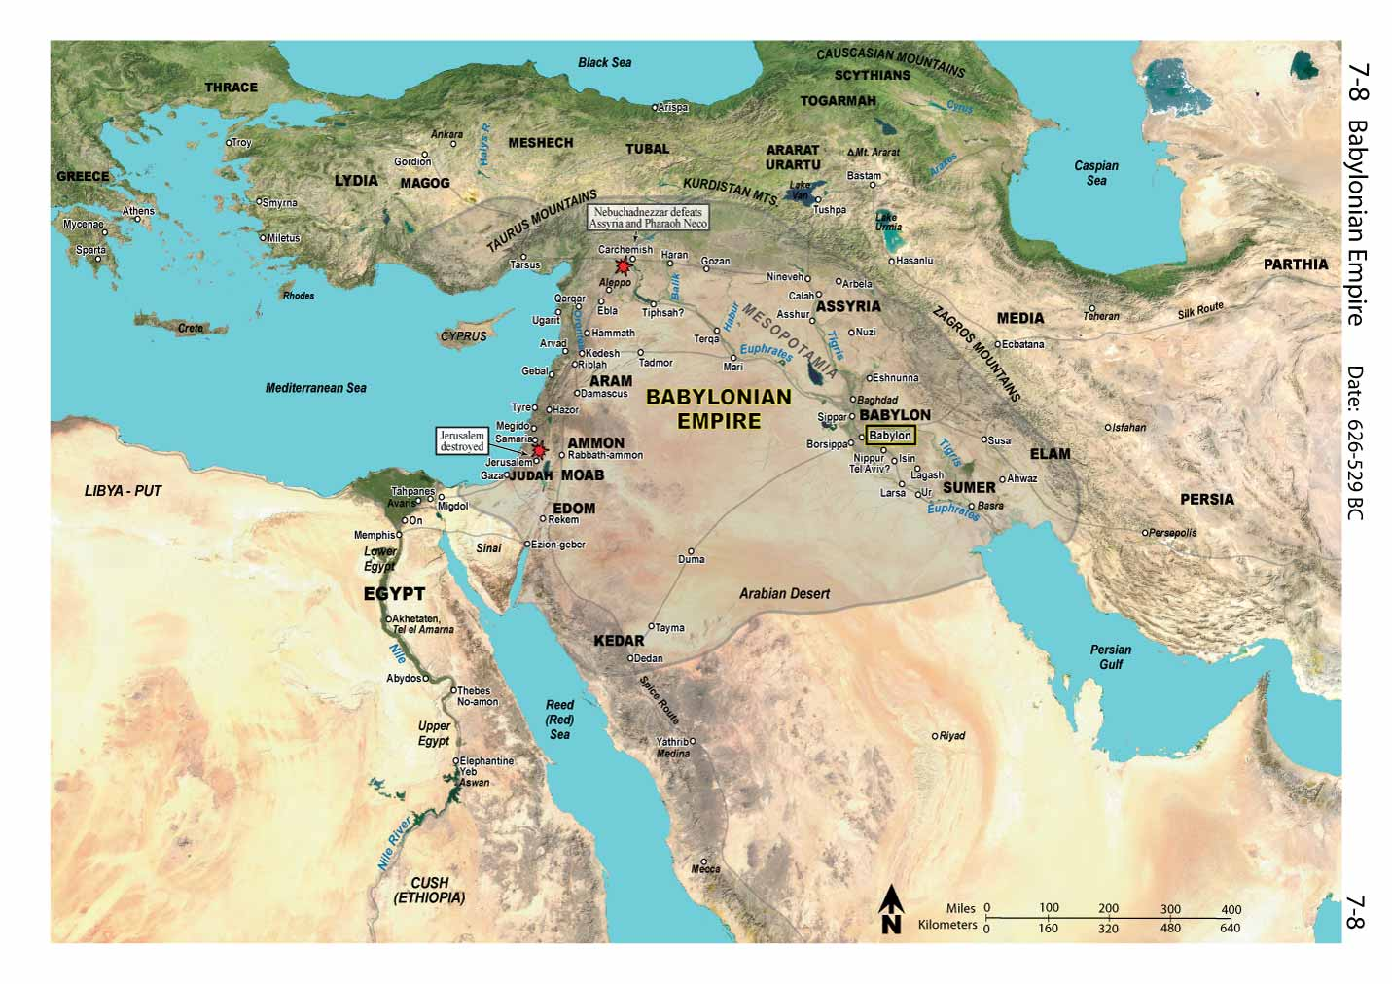
Map 7-8– Schlegel, W. (2013). Satellite bible atlas: Historical geography of the Bible.
Notes:
Schlegel, W. (2013). Satellite bible atlas: Historical geography of the Bible. s.n.

Slide 28
Captivity
  Prophets of the Captivity - Ezekiel
    Ezekiel taken captive in 597 B.C.
      1-24 – Judgements against Judah and Jerusalem
      25-32 – Judgments against the nations
      33-48 – God’s proclamations of restoration and salvation

Slide 29
Captivity
  Prophets of the Captivity - Ezekiel
    Ezekiel taken captive in 597 B.C.
      1-24 – Judgements against Judah and Jerusalem
        Ezekiel 8:1-6
        Ezekiel 10
        Ezekiel 11:1a, 11:22-25

Slide 30
Captivity
  The mountain to the east
    Joshua 2:5-7 – Rahab and the spies
    Joshua 2:7, Judges 3:28, Judges 12:5, Judges 12:6
    2 Kings 25:1-6 – Zedekiah
    **Ezekiel 11:22-25
    Matthew 23:37-24:3
    Matthew 26

Slide 31
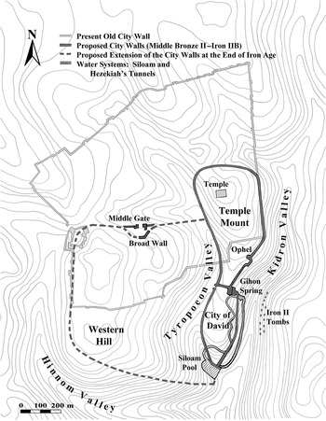
N
Jerusalem: capital city created in stone and in imagination (Chapter 20) - The Cambridge World History
Notes:
Jerusalem: capital city created in stone and in imagination (Chapter 20) - The Cambridge World History

Slide 32
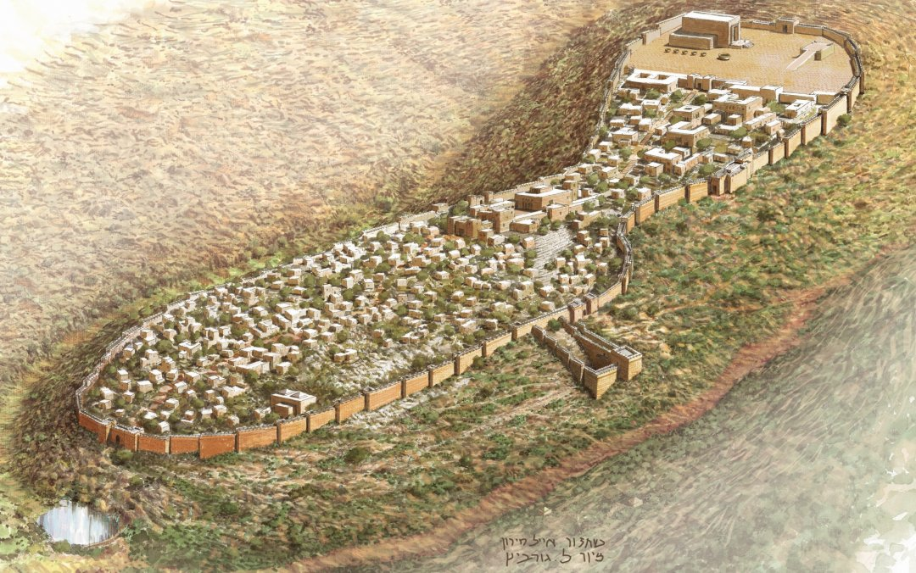
Reconstruction of Jerusalem in the late 10th century BCE, by Eyal Meiron. [9] (Drawing by Leonardo Gurevich. Courtesy of the Elad Foundation and Megalim Institute.) Meiron, E., 2009
https://bibleinterp.arizona.edu/articles/2018/04/gur428005#sdfootnote9sym
Notes:
Jerusalem: capital city created in stone and in imagination (Chapter 20) - The Cambridge World History

Slide 33
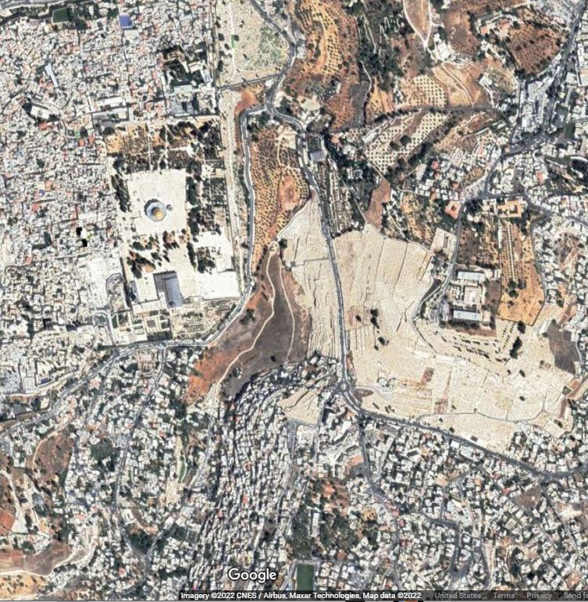
N
??????
Notes:
Jerusalem: capital city created in stone and in imagination (Chapter 20) - The Cambridge World History

Slide 34
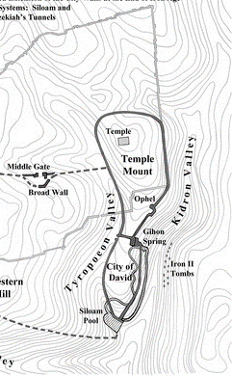
N
??????
Notes:
Jerusalem: capital city created in stone and in imagination (Chapter 20) - The Cambridge World History

Slide 35

N
??????
Notes:
Jerusalem: capital city created in stone and in imagination (Chapter 20) - The Cambridge World History

Slide 36
N
??????
Notes:
Jerusalem: capital city created in stone and in imagination (Chapter 20) - The Cambridge World History

Slide 37
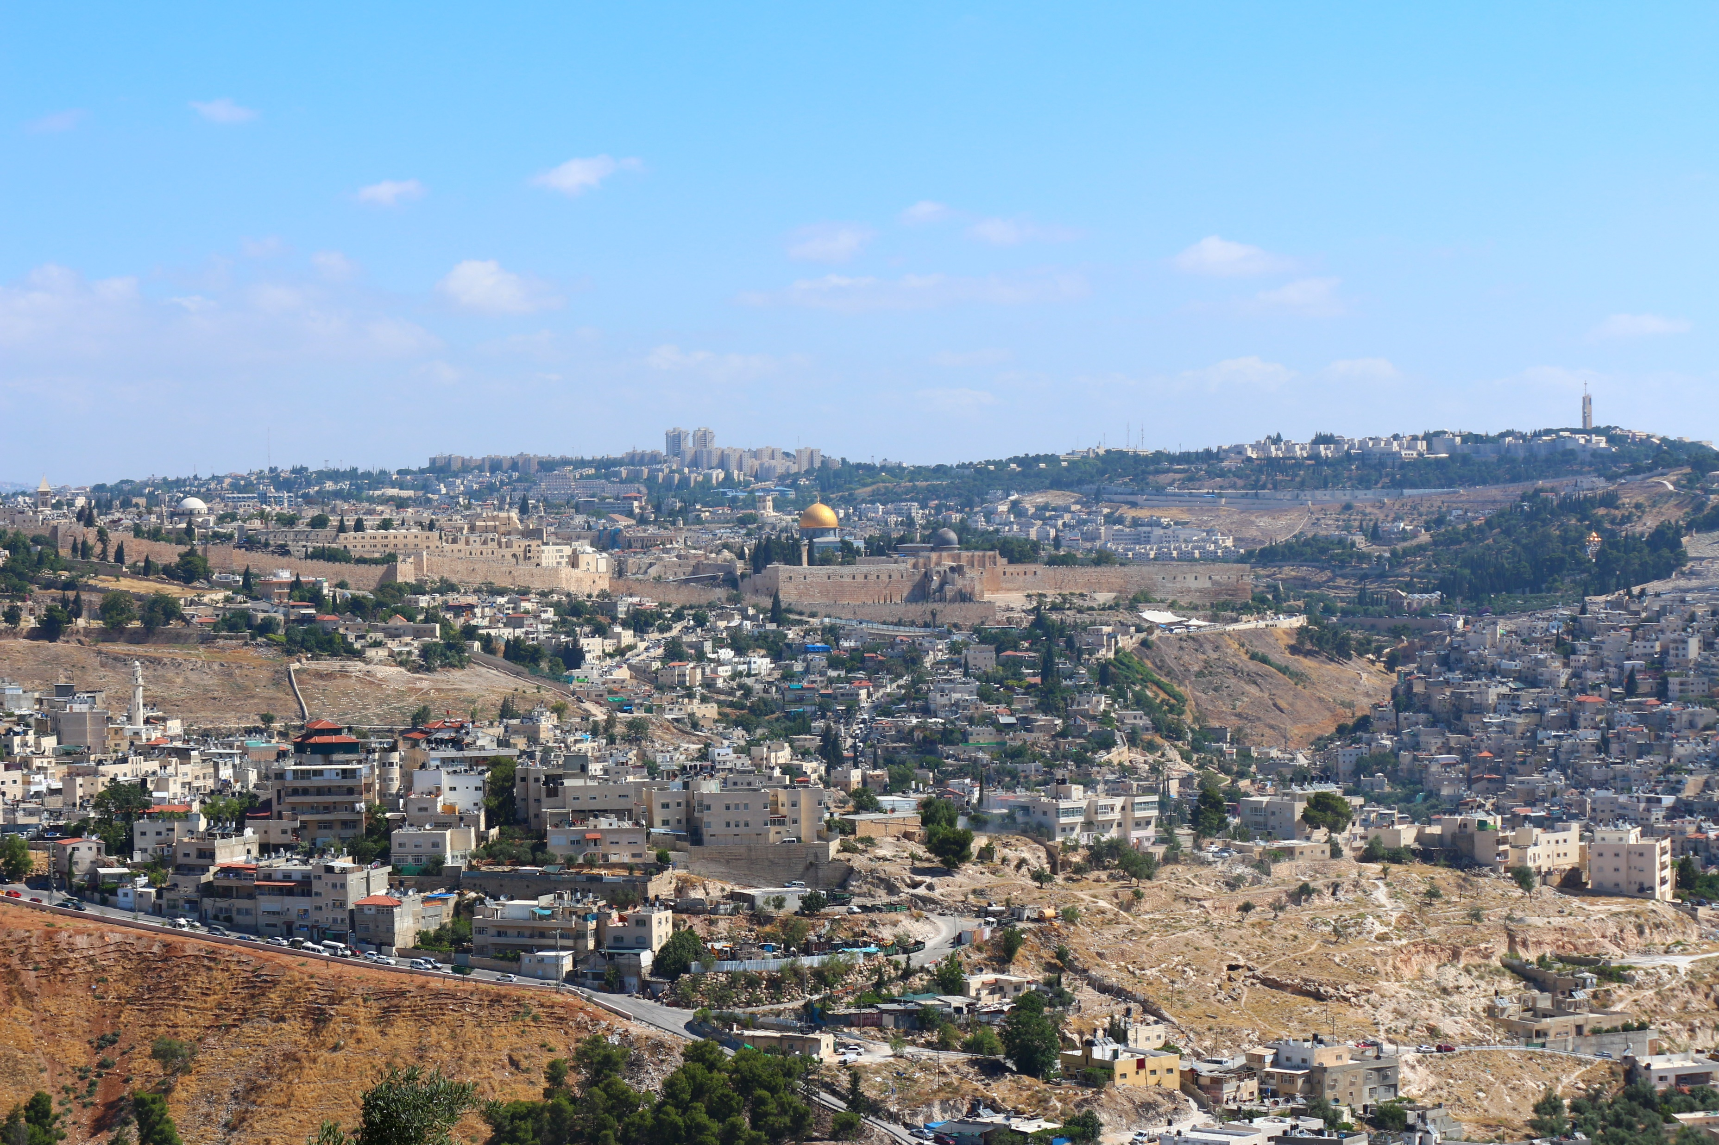
Jerusalem: capital city created in stone and in imagination (Chapter 20) - The Cambridge World History
Notes:
Jerusalem: capital city created in stone and in imagination (Chapter 20) - The Cambridge World History

Slide 38
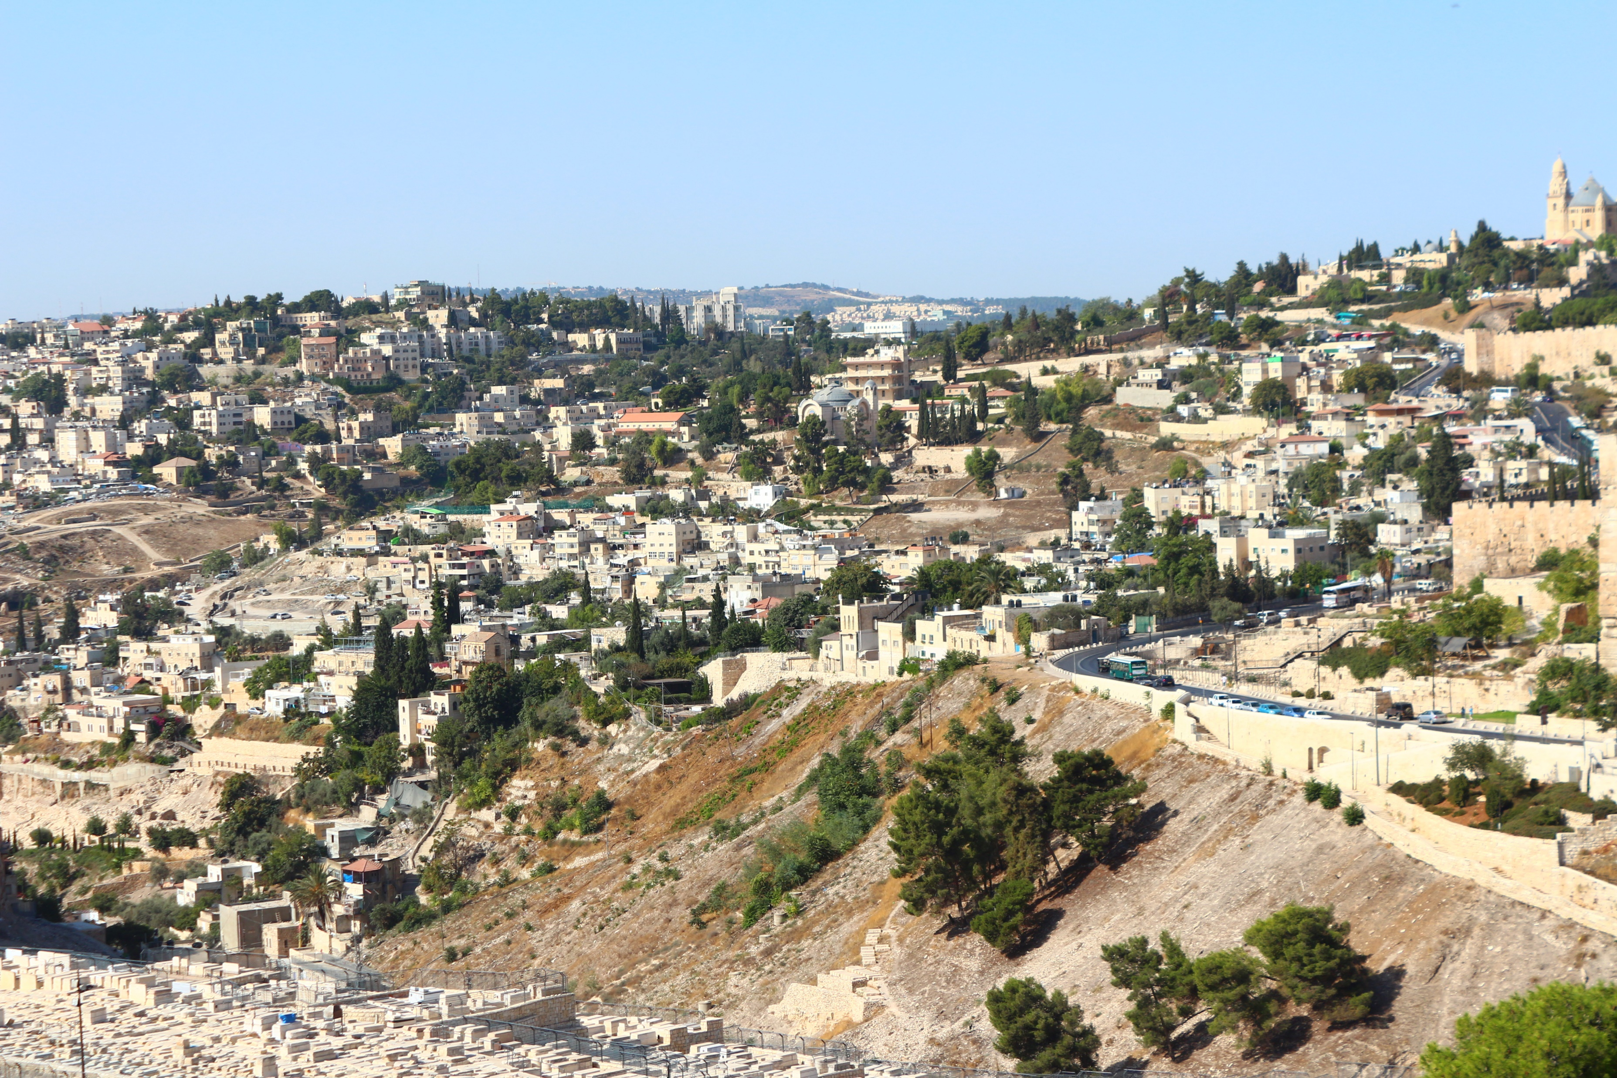
??????
Notes:
Jerusalem: capital city created in stone and in imagination (Chapter 20) - The Cambridge World History

Slide 39
N
??????
Notes:
Jerusalem: capital city created in stone and in imagination (Chapter 20) - The Cambridge World History

Slide 40

??????
Notes:
Jerusalem: capital city created in stone and in imagination (Chapter 20) - The Cambridge World History

Slide 41
N
??????
Notes:
Jerusalem: capital city created in stone and in imagination (Chapter 20) - The Cambridge World History

Slide 42
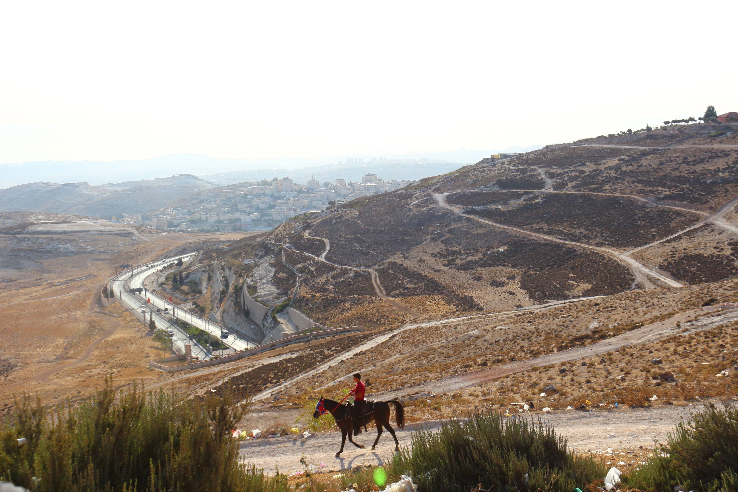
??????
Notes:
Jerusalem: capital city created in stone and in imagination (Chapter 20) - The Cambridge World History

Slide 43
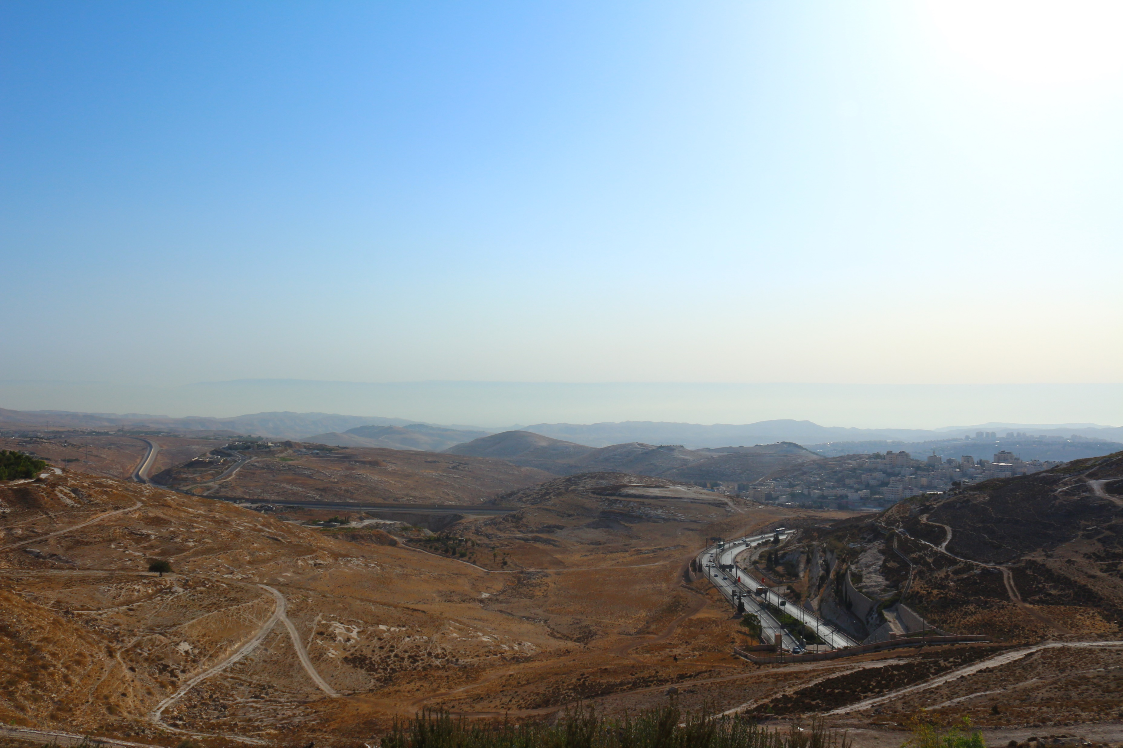
??????
Notes:
Jerusalem: capital city created in stone and in imagination (Chapter 20) - The Cambridge World History

Slide 44
Captivity
  The mountain to the east
    Joshua 2:5-7 – Rahab and the spies
    Joshua 2:7, Judges 3:28, Judges 12:5, Judges 12:6
    2 Kings 25:1-6 – Zedekiah
    **Ezekiel 11:22-25
    Matthew 23:37-24:3
    Matthew 26

Slide 45
Captivity
  Prophets of the Captivity
    Captivity from 605-536 B.C.
    Prophets
      Jeremiah in Jerusalem
      Daniel taken captive in 605 B.C.
      Ezekiel taken captive in 597 B.C.
    Judah taken captive and Jerusalem destroyed in 586 B.C.
    Captivity for 70 years
    The glory of the Lord has left the temple, we are in captivity…the return is next

Slide 46
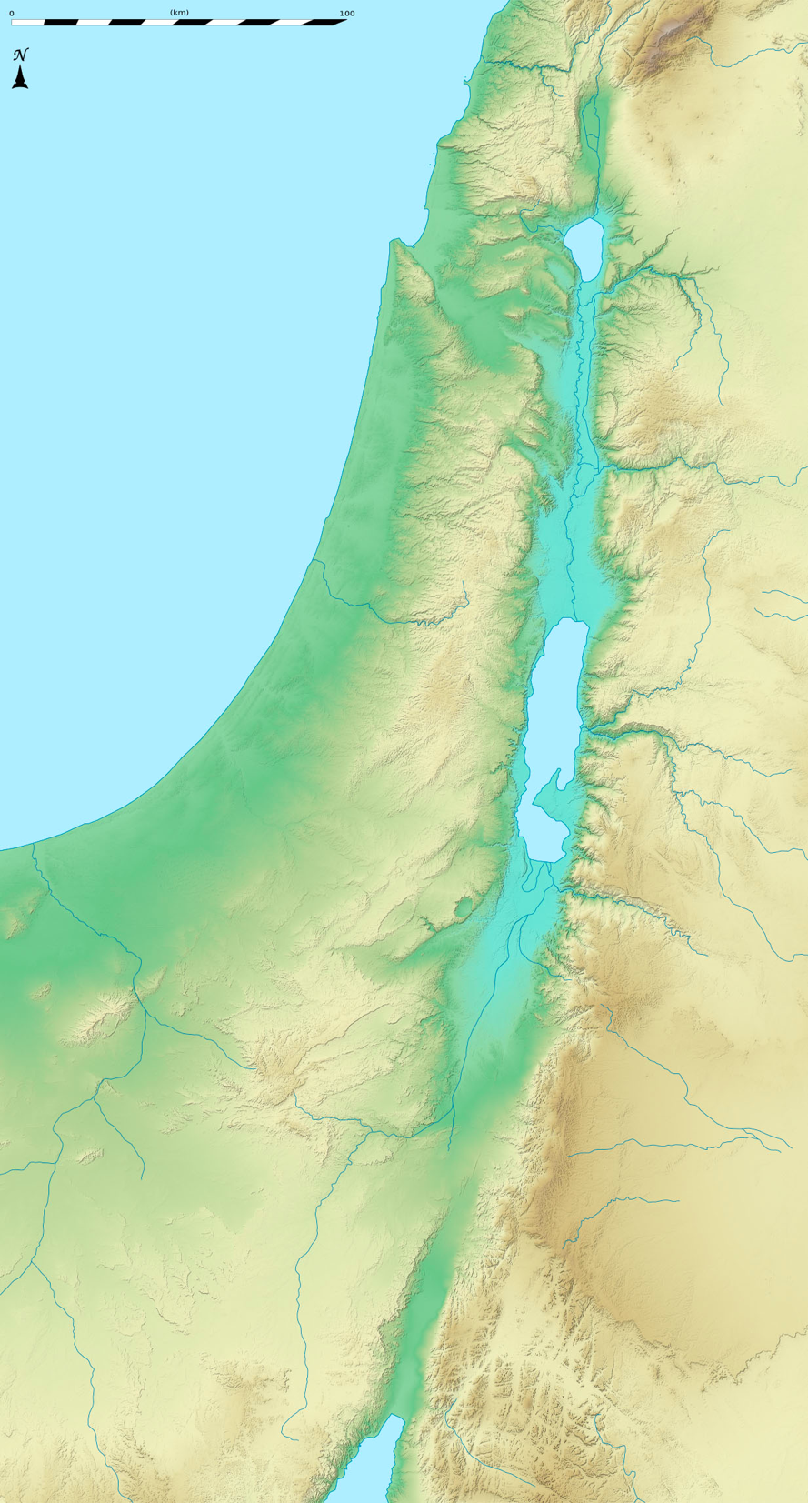
Geographic Regions
GALILEE
Geographic Regions of Israel
  Coastal Plain
  Shephelah
  Hill Country
  Galilee
  Judean Wilderness
  Jordan Valley
  Negev
  Trans-Jordanian Plateau
  Arabian Desert
JORDAN VALLEY
TRANS-JORDANIAN PLATEAU
COASTAL PLAIN
ARABIAN DESERT
HILL COUNTRY
SHEPHELAH
JUDAEAN WILDERNESS
NEGEV

Slide 47
Geographic Features
GOLAN HEIGHTS
CARMEL RANGE
SEA OF GALILEE
  Mountains
    Golan Heights
    Carmel Range
    Judaean Hills
  Valley
    Jezreel Valley
  Water
    Mediterranean Sea
    Sea of Galilee
    Jordan River
    Yarmuk, Jabbok, Arnon, Zered Rivers
    Dead Sea
    Gulf of Aqaba
YARMUK RIVER
JEZREEL
MEDITERRANEAN
SEA
JORDAN RIVER
JABBOK RIVER
JUDAEAN HILLS
ARNON RIVER
DEAD SEA
ZERED RIVER
GULF OF AQABA

Slide 48
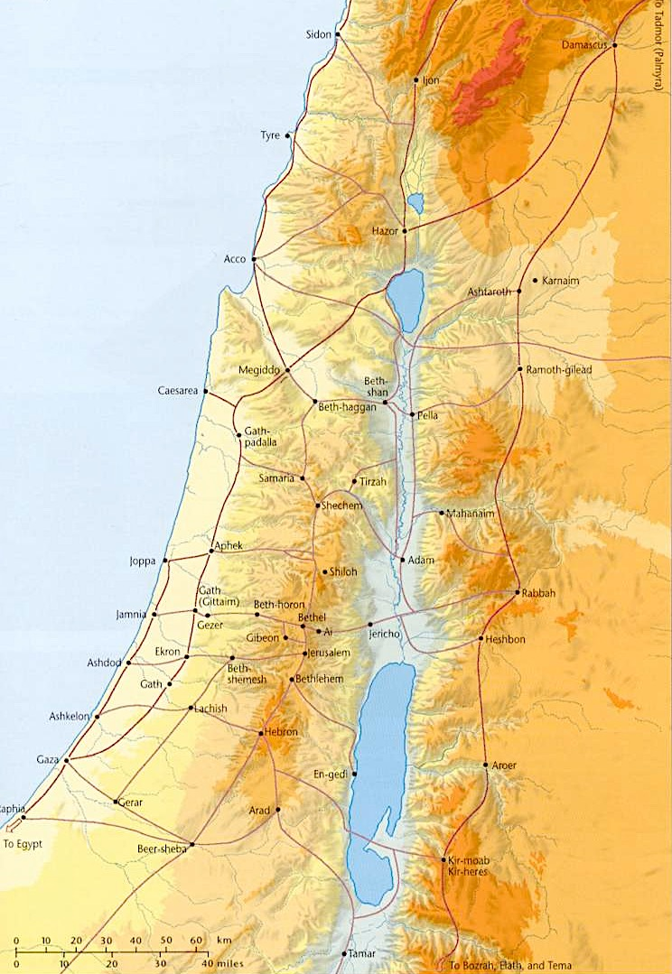
Trade & Travel Routes
  Sea Routes
  Way of the Sea
  King’s Highway
  Patriarchs’ Highway
  Way of Shur
  Bozrah to Gaza Spice Route
  Connections & Crossings

