Slide 1
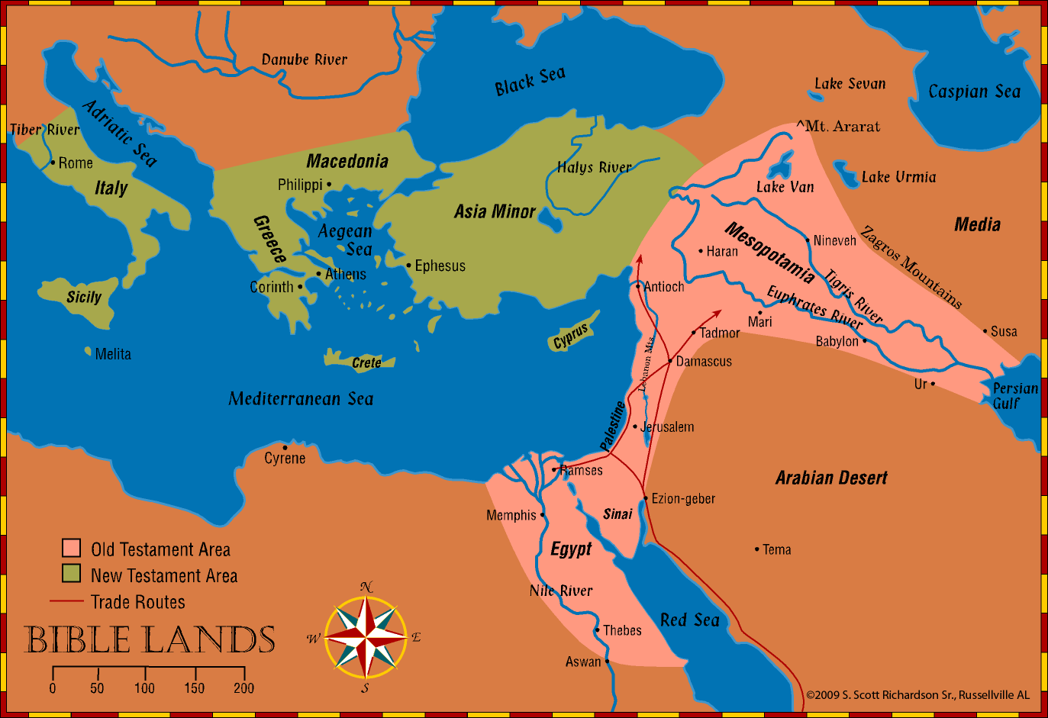
History and Geography of Bible Lands
Old Testament Empires & Biblical Silence - Lessons 34-37
Notes:
© 2009 S. Scott Richardson Sr., Russellville AL

Slide 2
The Bible Presents One Complete, Unified Story
Before the Flood
Flood
Scattering of the People
Patriarchs
Exodus
Wandering in the Wilderness
Invasion and Conquest
Judges
United Kingdom
Divided Kingdom
Judah Alone
Captivity
Return from Captivity
Years of Silence
Life of Christ
Early Church
Letters to Christians
We organize the story into 17 periods
Old Testament
Between OT & NT
New Testament

Slide 3
Jewish/World Affairs during Biblical Silence
Rise of the Grecian Empire as predicted in Daniel fulfilled. Alexander, 4 Generals. Seleucid (Syrian) and Ptolemaic (Egypt) empires emerge,
Greek culture, language and philosophy became a way of life throughout the empire
Syrian empire eventually becomes dominant.
Antiochus Epiphanes, King of Syria forbids Jewish religion, desecrates the temple with worship of Zeus (which he declared himself to be) and swine.
Maccabean Revolt leads to Jewish control of Jerusalem, cleansing of Temple, independence of Judah.
Notes:
© 2009 S. Scott Richardson Sr., Russellville AL

Slide 4
Jewish/World Affairs during Biblical Silence
Jewish Sects: Pharisees, Sadducees, Essenes, Zealots.
Pharisee traditions aimed at careful observance of the OT Law come to have the force of law themselves.
Septuagint (Greek Translation of the OT). Jesus, NT writers quoted from it.
Jewish Synagogues established in many cities.
Essenes collected writings, many found in 20th century, helped prove the OT has not been corrupted.
Idolatry now abhorred by Jews.
Roman Empire conquers Syria and expands to control much of the Mediterranean world.
Herod family named authorities over Judea.
Notes:
© 2009 S. Scott Richardson Sr., Russellville AL

Slide 5
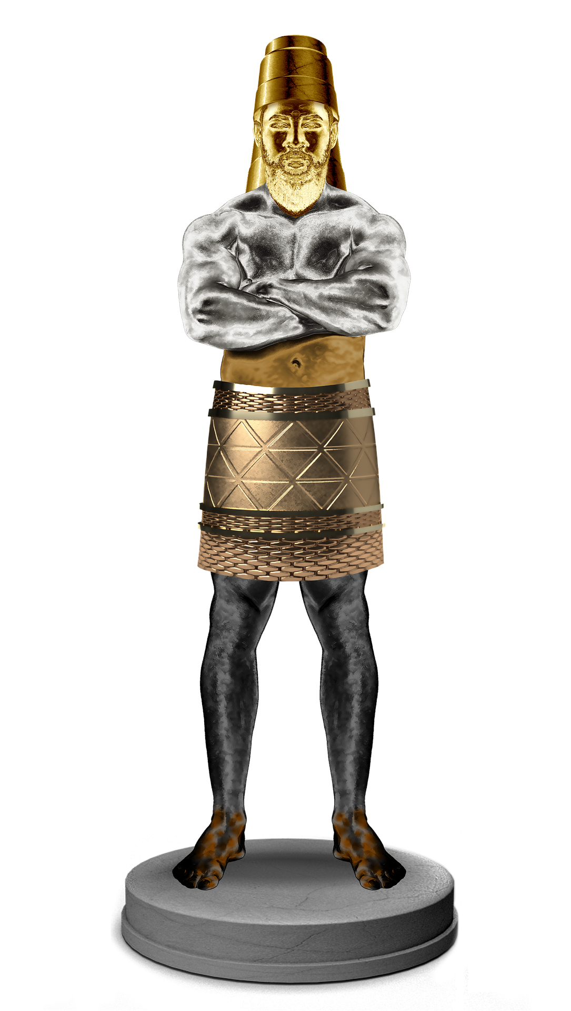
Recall the Dream of Nebuchadnezzar in Daniel 2
Four World Empires Prophesied
Head of Gold:
Babylonian Empire
Chest of Silver:
Medo-Persia Empire
Belly and Thighs of Bronze:
Grecian Empire
Feet and Toes of Iron and Clay:
Roman Empire
Babylon
Medo-Persia
Grecian
Rome
Notes:
© 2009 S. Scott Richardson Sr., Russellville AL

Slide 6
Roman Empire-The Time Draws Near
Years of Silence end when Gabriel announces the birth of John the Baptist to Zacharias (Luke 1:5-25).
Herod the Great. Reigned over Judea at the time Christ was born. Tyrannical. Paranoid that someone would end his dynasty. Killed members of his own family.
Herod died in 4 BC not long after Jesus was born.
Notes:
© 2009 S. Scott Richardson Sr., Russellville AL

Slide 7
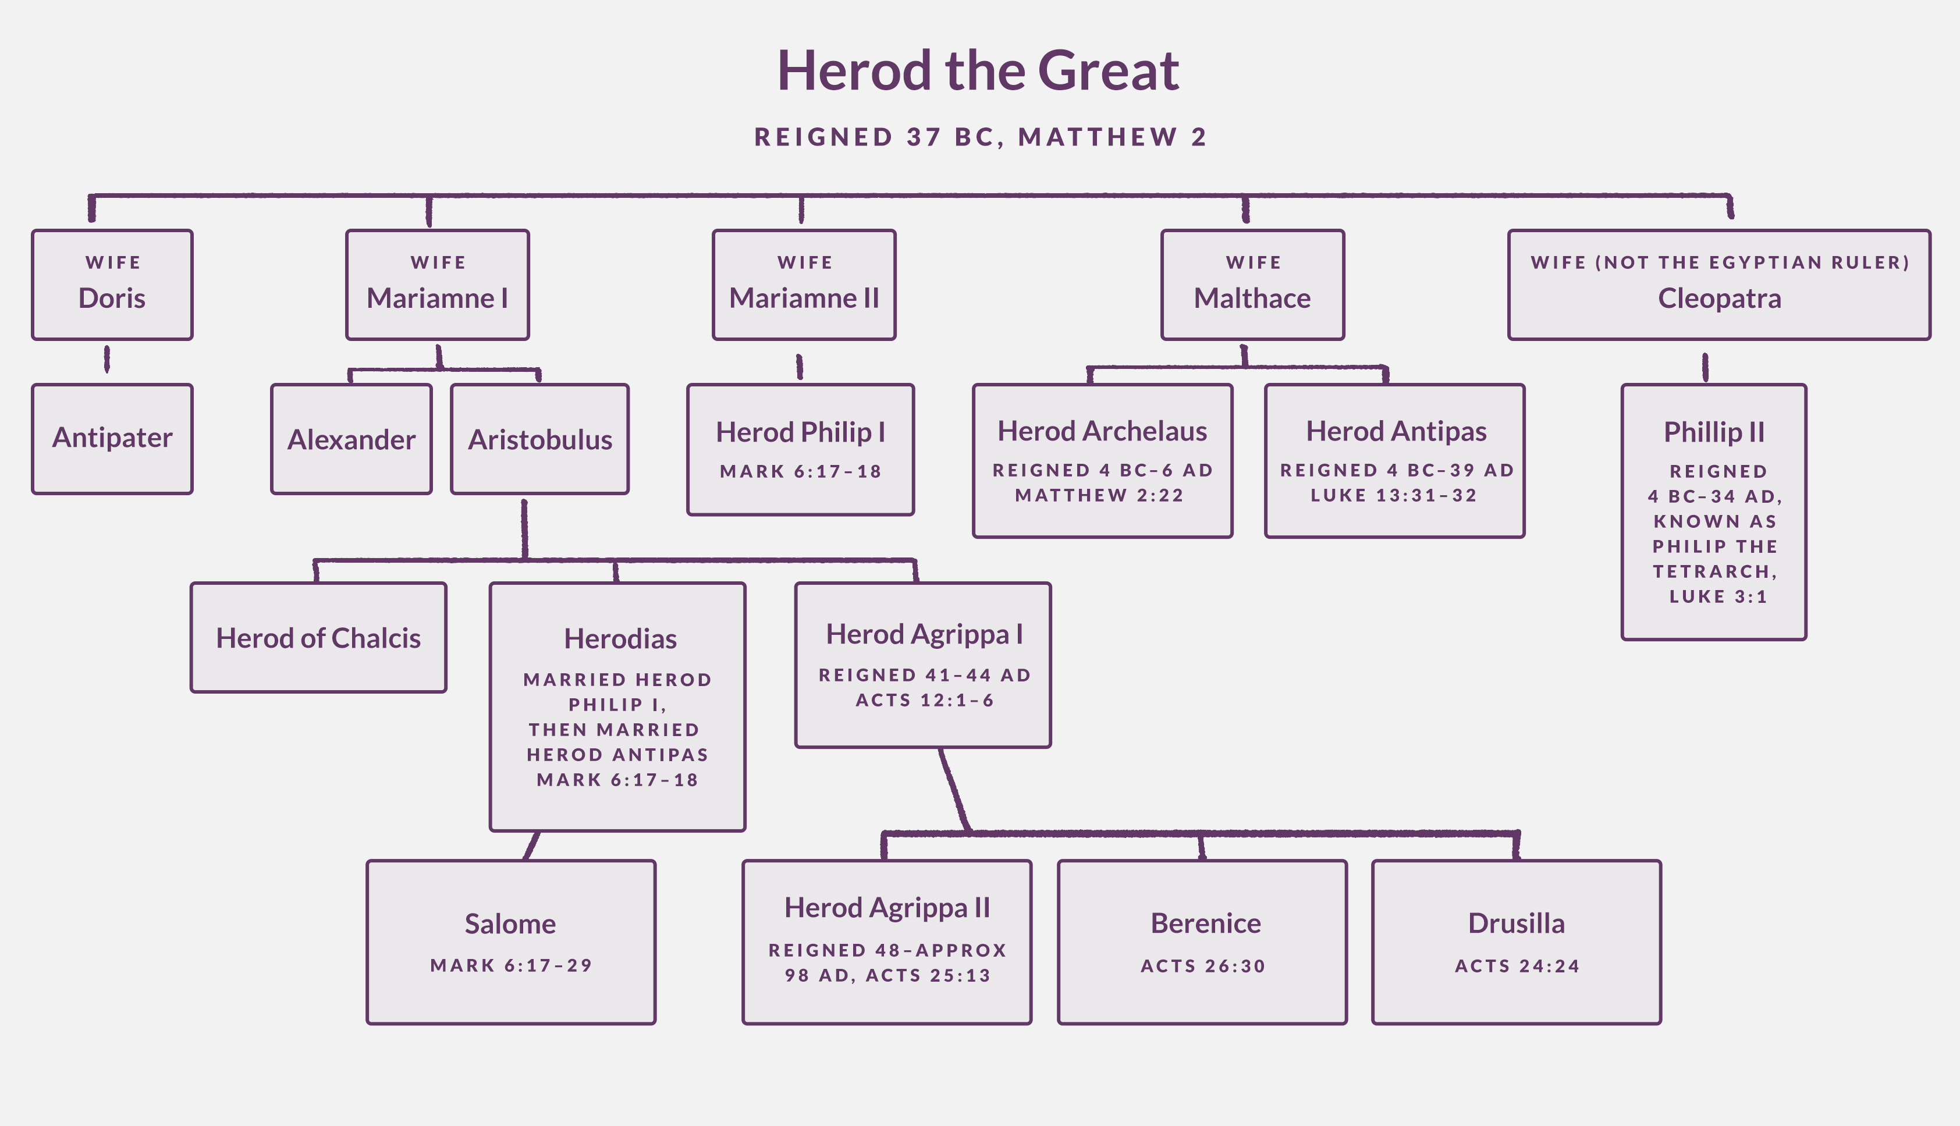
The Herod Family
.
Notes:
© 2009 S. Scott Richardson Sr., Russellville AL

Slide 8
“Fullness of Time”
God’s plan, in place before the world was created, reached the point that it was time for Him to bring Jesus into the world. Galatians 4:4-7, Ephesians 1:10.
The Roman Empire controlled lands surrounding the Mediterranean Sea and beyond.
Good roads allowed for travel and communication.
Greek Language dominated the empire.
Pax Romana “Roman Peace” 27BC to 180 AD.
Romans/Herod family allowed Jews some political/religious independence. Improved cities, started reconstruction of the Temple.
Notes:
© 2009 S. Scott Richardson Sr., Russellville AL

Slide 9
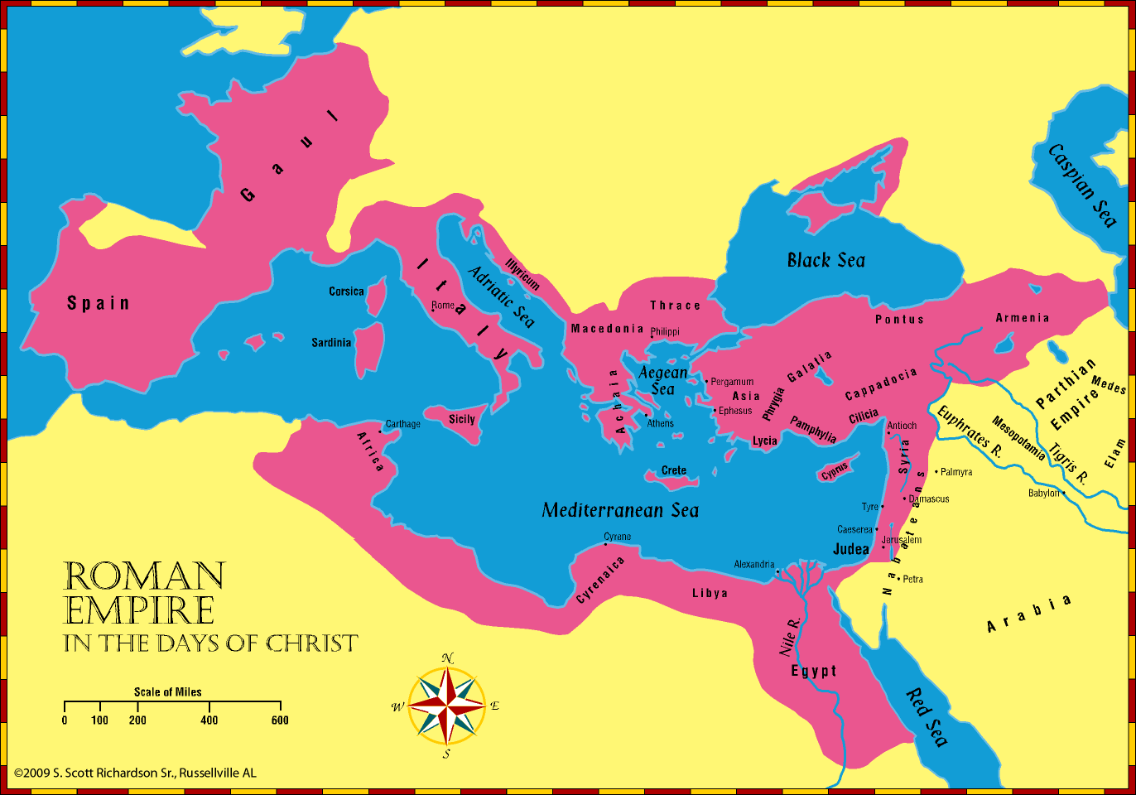
Roman Empire In the Days of Christ
Notes:
© 2009 S. Scott Richardson Sr., Russellville AL

Slide 10
Palestine during the Life of Christ
Jesus born in Bethlehem (about 5 miles from Jerusalem), just prior to the death of Herod the Great.
Herod sought to kill Jesus, ordered slaughter of babies.
Joseph, Mary, and baby Jesus flee to Egypt, return to Nazareth in Galilee, where Jesus grows up.
Jerusalem remained the cultural and religious center of Judea. Jews traveled there to attend Passover, Pentecost, Feast of Purim (from Esther’s day), Feast of Dedication (from the Maccabean deliverance).
Rabbinical schools in Jerusalem educated wealthy males.
Notes:
© 2009 S. Scott Richardson Sr., Russellville AL

Slide 11
Palestine during the Life of Christ
John the Baptist begins preaching in the Wilderness of Judea.
Much of Jesus’ work takes place in Galilee. Capernaum prominent in Jesus’ work. It was located on two important trade routes and had a Roman Garrison.
Jesus does many works in Cana, Nain, Bethsaida, and Chorazin. He also went into Samaria. Jacob’s well is still there today.
Decapolis was a region primarily east of the Jordan, that was comprised of 10 Model Greek Cities.
Tyre and Sidon were the two main cities in Phoenicia.
Notes:
© 2009 S. Scott Richardson Sr., Russellville AL

Slide 12
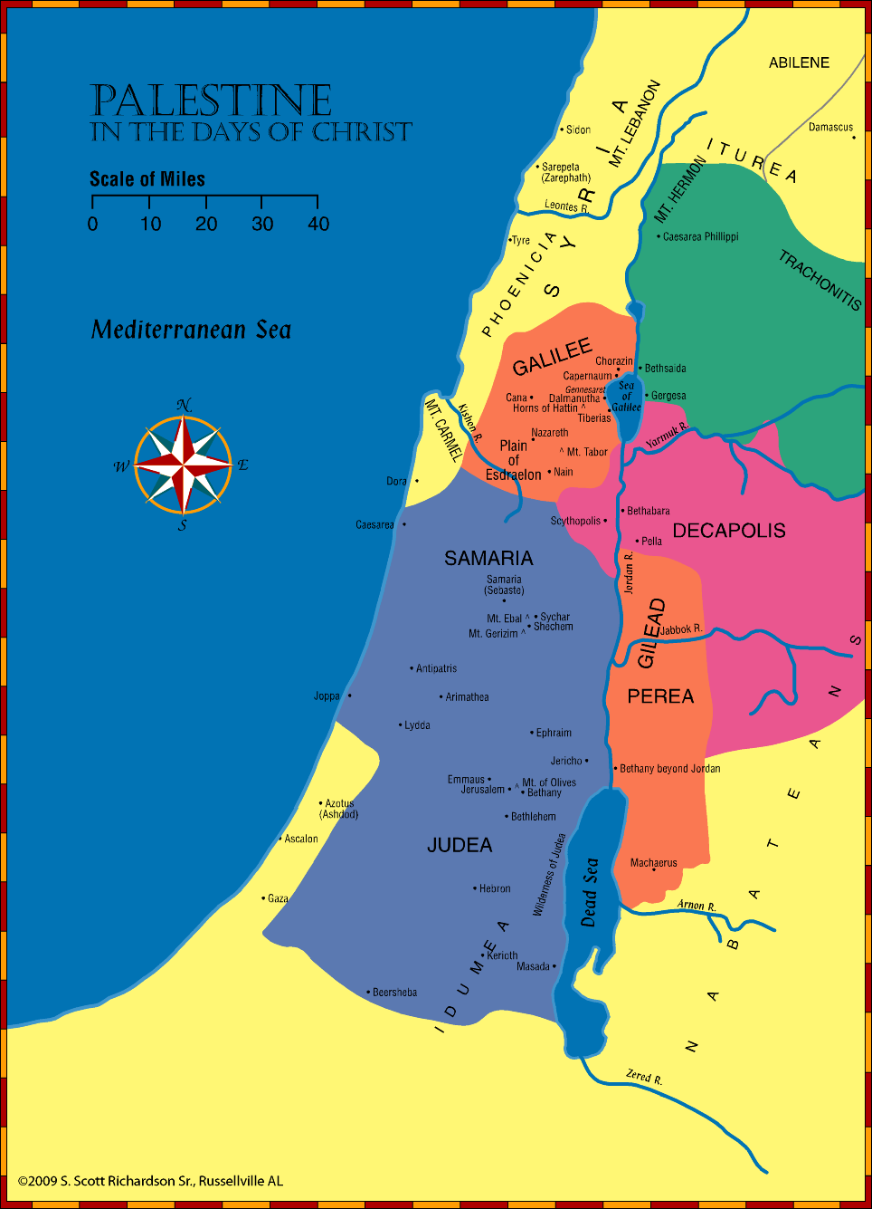
Palestine during the Days of Christ
Notes:
© 2009 S. Scott Richardson Sr., Russellville AL

Slide 13
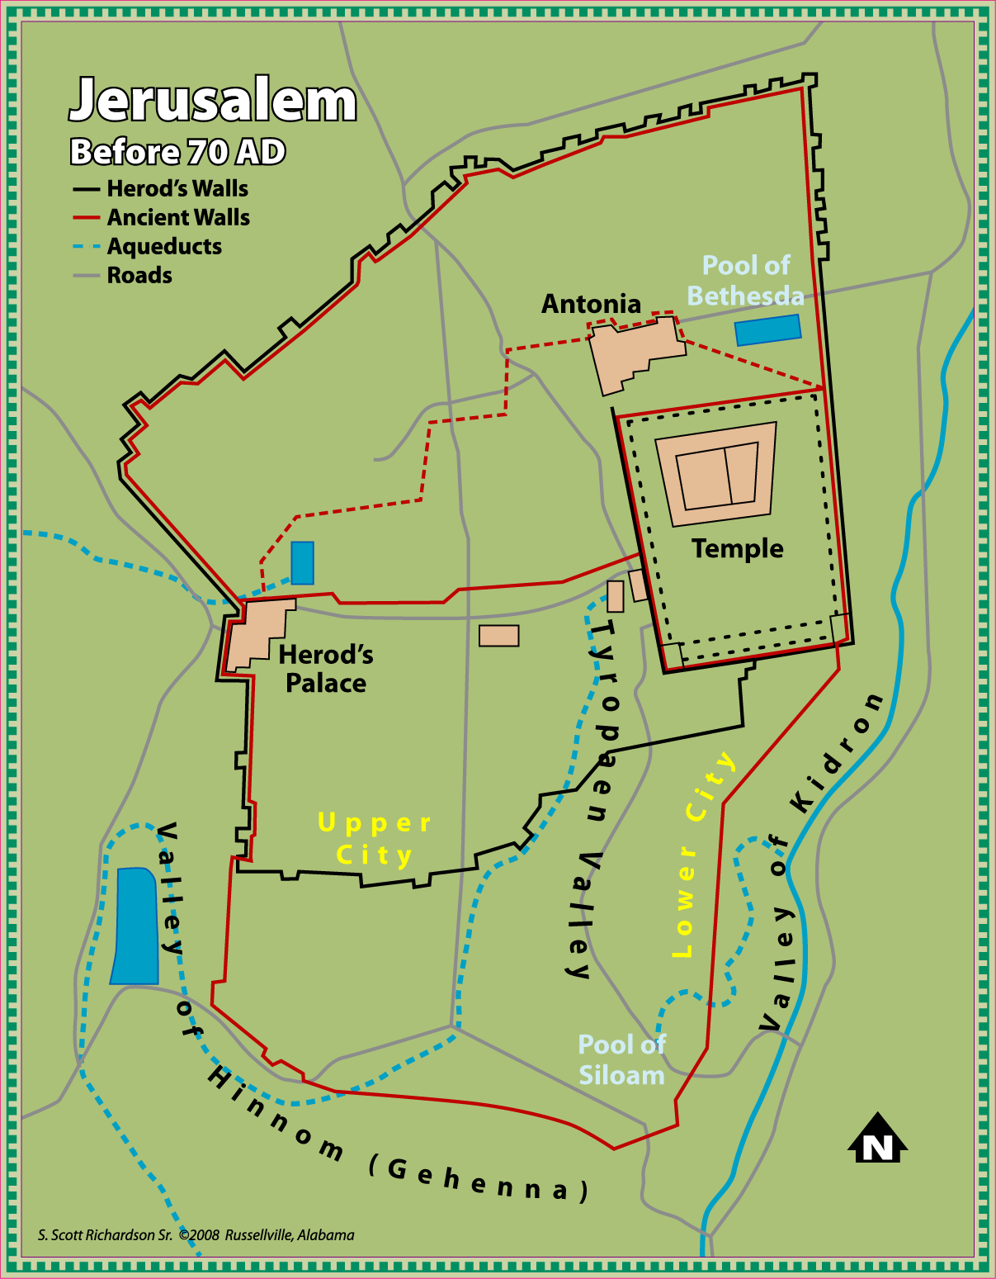
Jerusalem during the Life of Christ
Notes:
© 2009 S. Scott Richardson Sr., Russellville AL

Slide 14
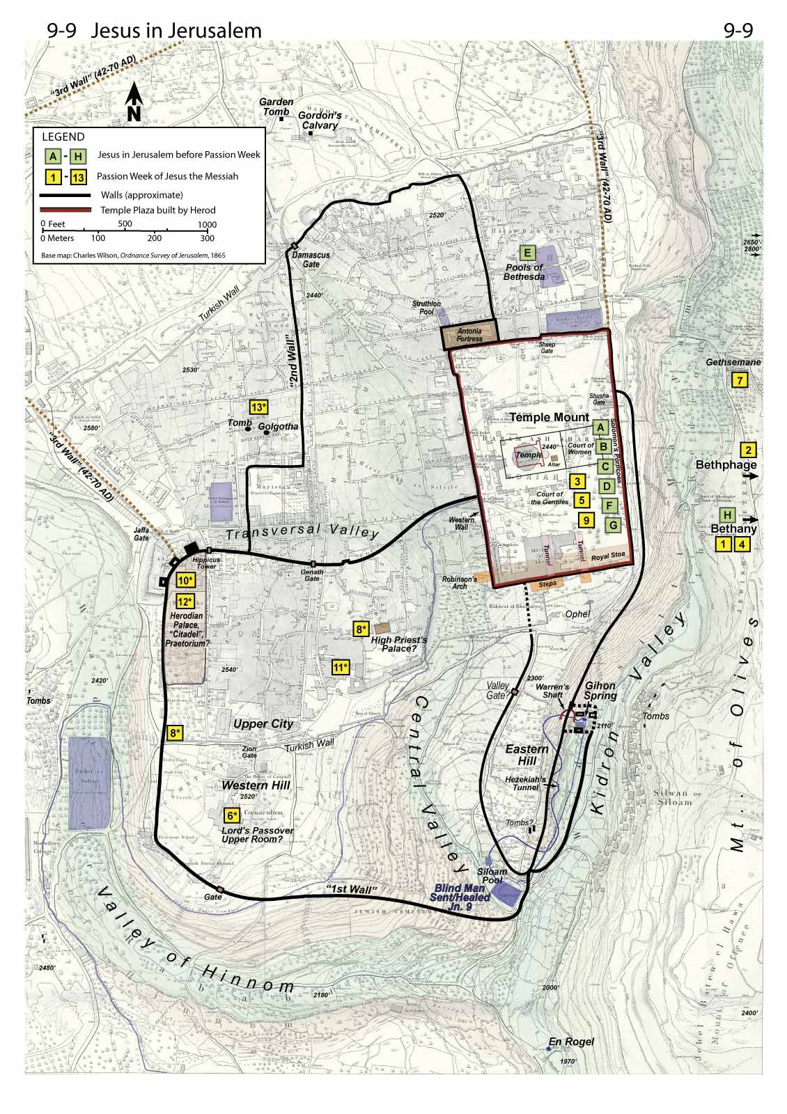
Plan View of Jerusalem
Notes:
© 2009 S. Scott Richardson Sr., Russellville AL

Slide 15
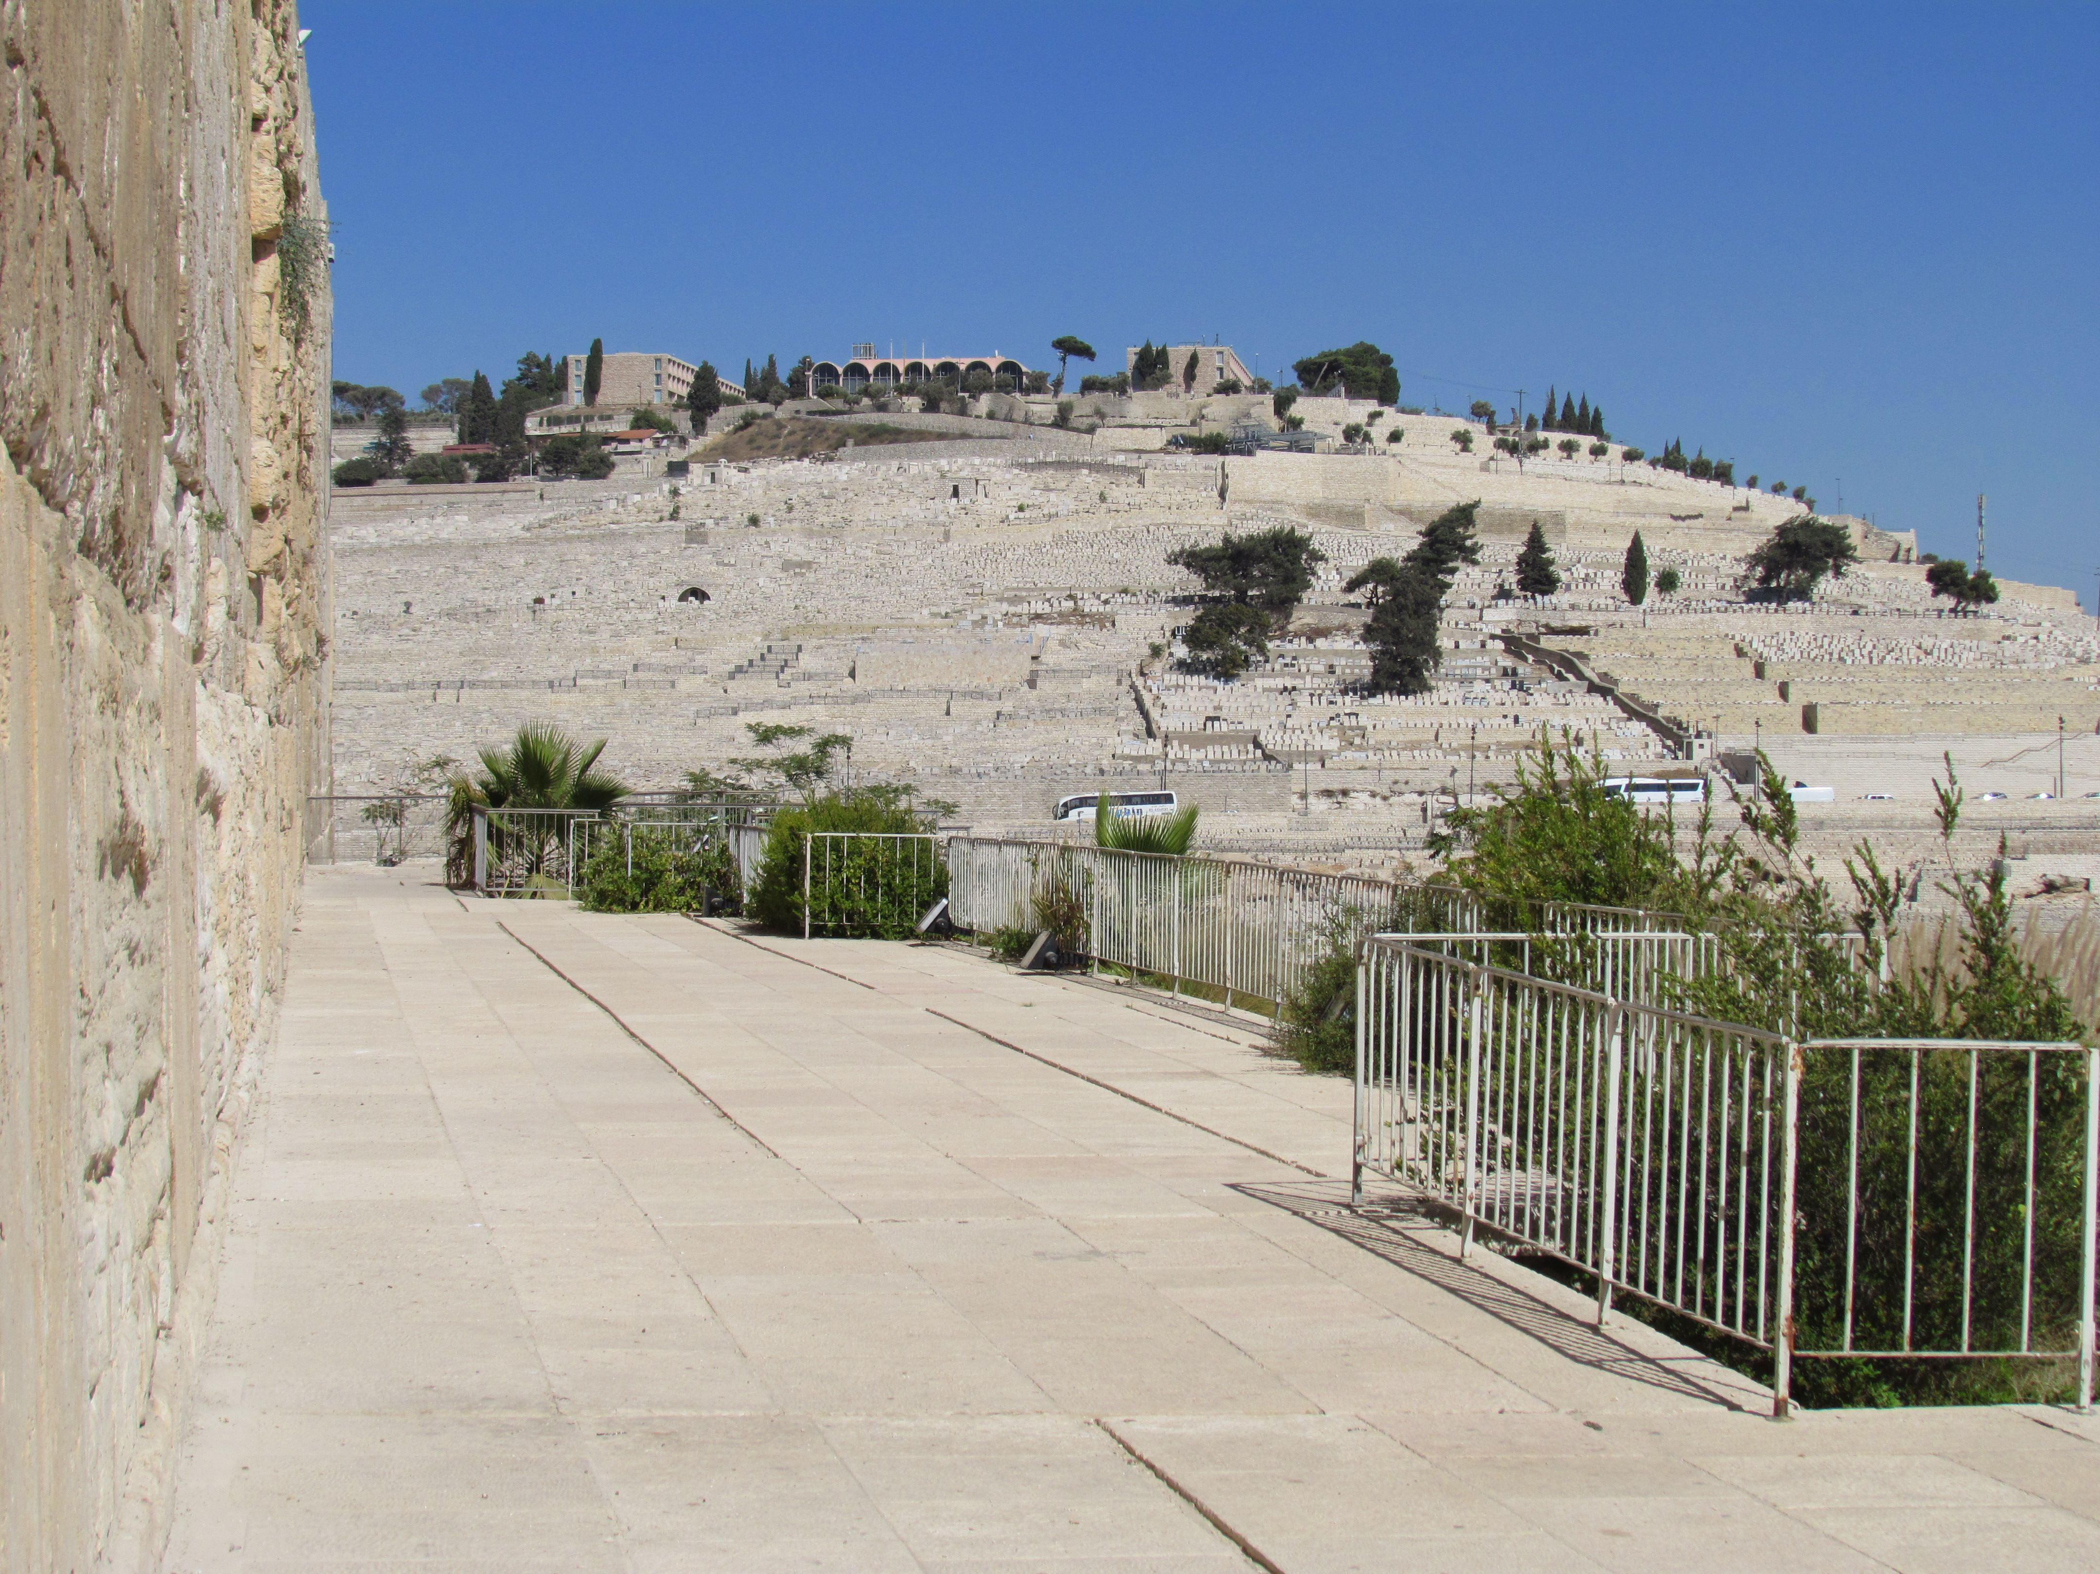
Looking Up at the Mount of Olives
Notes:
© 2009 S. Scott Richardson Sr., Russellville AL

Slide 16
Palestine during the Life of Christ
Nabateans: Arabian tribe that moved into the areas once occupied by Edom and Moab.
They had been a formidable foe to the Greeks, and weren’t conquered by Roman until after the close of the NT.
Jesus raised Lazarus from the dead in Bethany. Bethany was located on the eastern slope of the Mount of Olives.
Mount of Olives was directly east of Jerusalem. It was 250 feet higher than the temple.
Garden of Gethsemane was somewhere on the slopes of the Mount of Olives.
Notes:
© 2009 S. Scott Richardson Sr., Russellville AL

Slide 17
Kingdom of Heaven Established
Vision of Nebuchadnezzar, God showed that He would establish an eternal kingdom during the days of the 4th world kingdom (which we have learned is the Roman).
Jesus ascended into Heaven in AD 29.
On the day of Pentecost, just after Jesus ascended, the
Parthians and Medes and Elamites and residents of Mesopotamia, Judea and Cappadocia, Pontus and Asia, Phrygia and Pamphylia, Egypt and the parts of Libya belonging to Cyrene, and visitors from Rome, 11 both Jews and proselytes, Cretans and Arabians
Notes:
© 2009 S. Scott Richardson Sr., Russellville AL

Slide 18
Recall the Dream of Nebuchadnezzar in Daniel 2
Four World Empires Prophesied
Head of Gold:
Babylonian Empire
Chest of Silver:
Medo-Persia Empire
Belly and Thighs of Bronze:
Grecian Empire
Feet and Toes of Iron and Clay:
Roman Empire
Babylon
Medo-Persia
Grecian
Rome
Notes:
© 2009 S. Scott Richardson Sr., Russellville AL

Slide 19
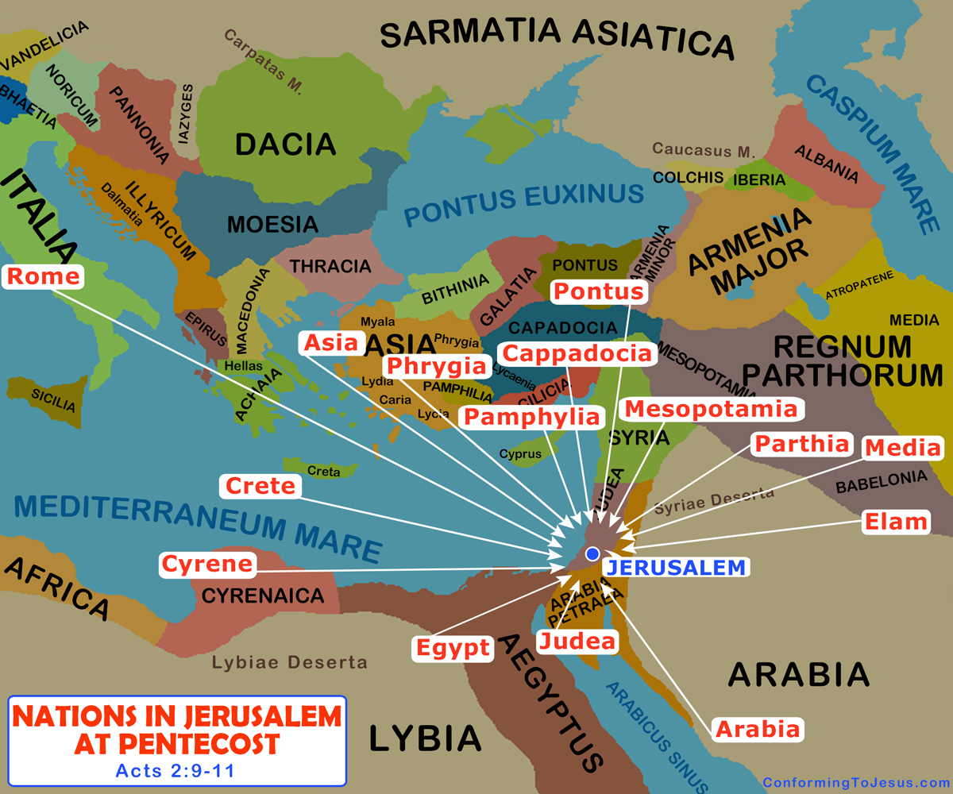
Acts: Nations in Jerusalem at Pentecost
Notes:
© 2009 S. Scott Richardson Sr., Russellville AL

