Slide 1
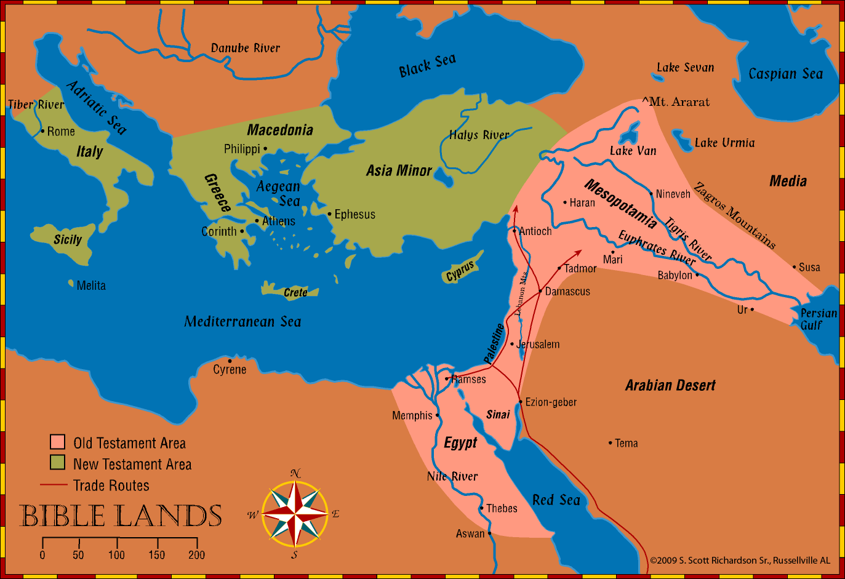
History and Geography of Bible Lands
Old Testament Empires & Biblical Silence - Lessons 46-50
Notes:
© 2009 S. Scott Richardson Sr., Russellville AL

Slide 2
The Bible Presents One Complete, Unified Story
Before the Flood
Flood
Scattering of the People
Patriarchs
Exodus
Wandering in the Wilderness
Invasion and Conquest
Judges
United Kingdom
Divided Kingdom
Judah Alone
Captivity
Return from Captivity
Years of Silence
Life of Christ
Early Church
Letters to Christians
We organize the story into 17 periods
Old Testament
Between OT & NT
New Testament

Slide 3
Jewish/World Affairs at the time of Christ’s Birth
Romans embraced the Greek language, culture, philosophy, arts, etc. that had spread over much of the world.
Led by Pompey, Rome had conquered Syria & much of the territory surrounding the Mediterranean, including Israel.
Caesar Octavian Augustus was emperor.
Herod the Great was King of Judea (included Samaria and Idumea). Three sons succeeded him upon his death in 4 BC.
Many Jews were scattered across the empire.
Notes:
© 2009 S. Scott Richardson Sr., Russellville AL

Slide 4
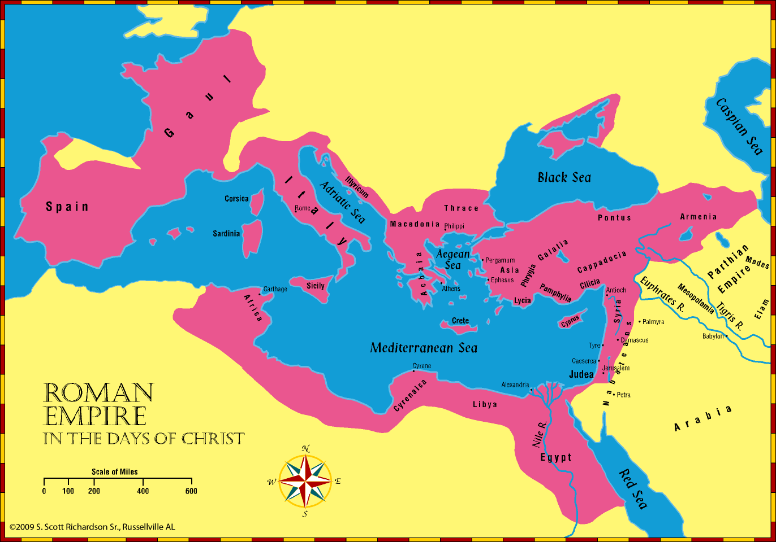
Roman Empire In the Days of Christ
Notes:
© 2009 S. Scott Richardson Sr., Russellville AL

Slide 5
“Fullness of Time”
Romans/Herod family allowed Jews some political/religious independence. Allowed Sanhedrin council. Improved cities, started reconstruction of the Temple.
400 years of silence end when Gabriel announces the birth of John to Zacharias.
God’s plan, in place before the world was created, reached the point that it was time for Him to bring Jesus into the world. Galatians 4:4-7, Ephesians 1:10.
Notes:
© 2009 S. Scott Richardson Sr., Russellville AL

Slide 6
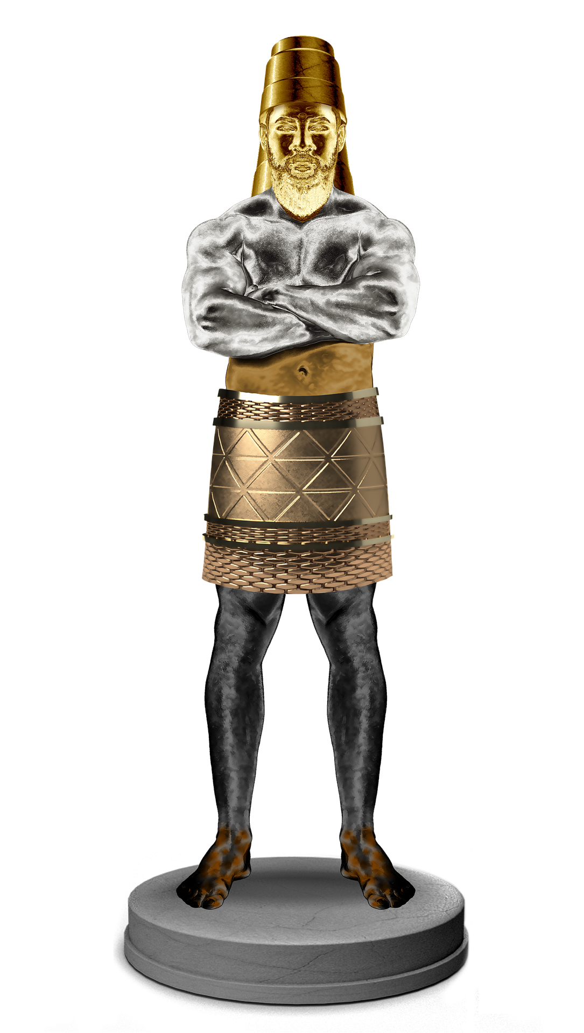
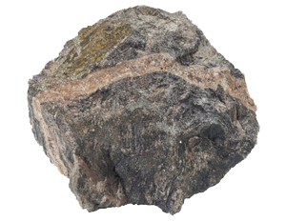
Recall the Dream of Nebuchadnezzar in Daniel 2
Four World Empires Prophesied
Head of Gold:
Babylonian Empire
Chest of Silver:
Medo-Persia Empire
Belly and Thighs of Bronze:
Grecian Empire
Feet and Toes of Iron and Clay:
Roman Empire
Babylon
Medo-Persia
In the days of those kings shall the God of heaven set up a kingdom which shall never be destroyed.
Grecian
Rome
Notes:
© 2009 S. Scott Richardson Sr., Russellville AL

Slide 7
Christ Comes to Earth
Jesus born in Bethlehem (about 5 miles from Jerusalem), just prior to the death of Herod the Great.
Herod sought to kill Jesus, ordered slaughter of male children 2 and under.
Joseph, Mary, and baby Jesus flee to Egypt, return and live in Nazareth in Galilee, where Jesus grows up.
Jerusalem remained the cultural and religious center of Judea. Jews traveled there to attend Passover, Pentecost, Feast of Purim (from Esther’s day), Feast of Dedication.
Notes:
© 2009 S. Scott Richardson Sr., Russellville AL

Slide 8
Christ Comes to Earth
John the Baptist begins preaching in the Wilderness of Judea.
Much of Jesus’ work takes place in Galilee. Capernaum prominent in Jesus’ work. It was located on two important trade routes and had a Roman Garrison.
Jesus does many works in Cana, Nain, Bethsaida, and Chorazin. He also went into Samaria. Jacob’s well is still there today.
Decapolis was a region primarily east of the Jordan, that was comprised of 10 Model Greek Cities.
Tyre and Sidon were the two main cities in Phoenicia.
Notes:
© 2009 S. Scott Richardson Sr., Russellville AL

Slide 9
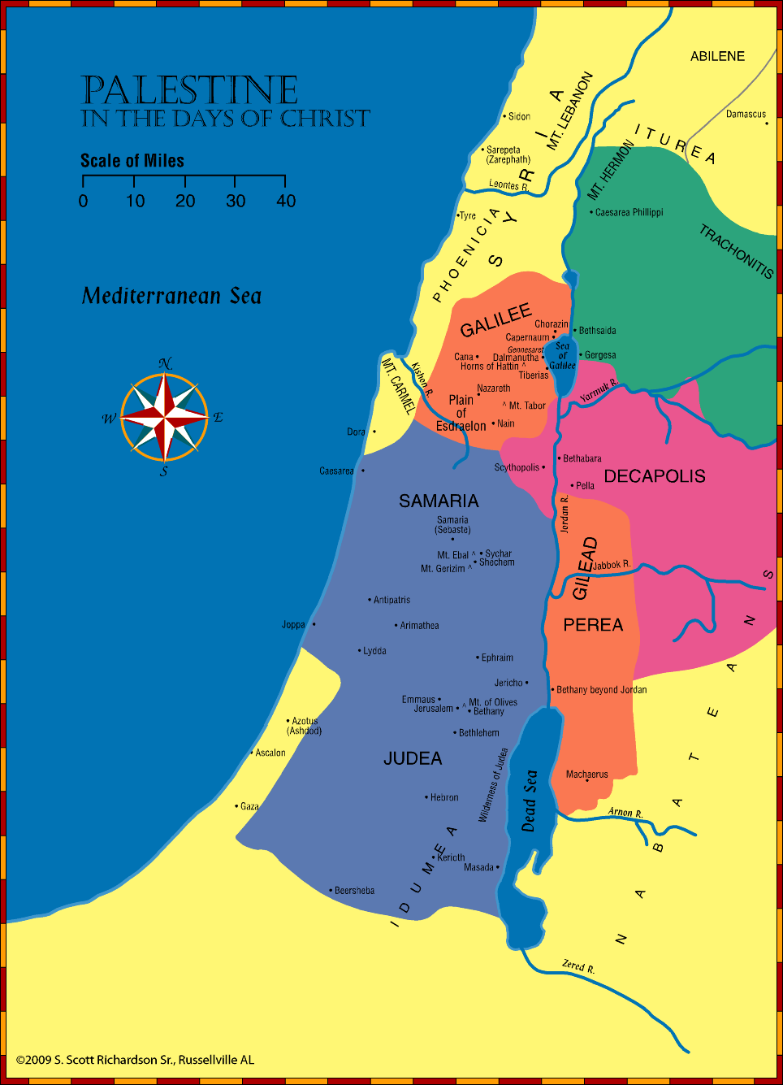
Palestine during the Days of Christ
Notes:
© 2009 S. Scott Richardson Sr., Russellville AL

Slide 10
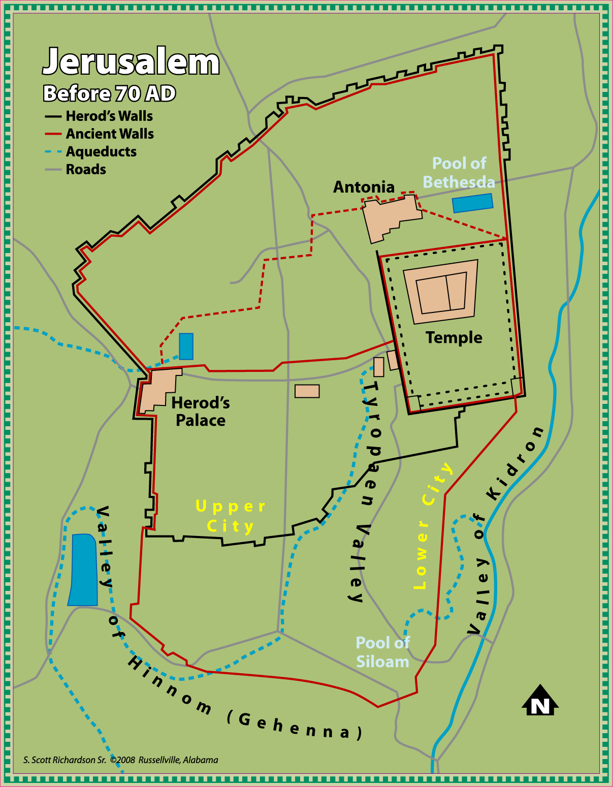
Jerusalem during the Life of Christ
Notes:
© 2009 S. Scott Richardson Sr., Russellville AL

Slide 11
Kingdom of Heaven Established
On the day of Pentecost, (10 days after Jesus ascended), the Apostles were gathered in Jerusalem.
Parthians and Medes and Elamites and residents of Mesopotamia, Judea and Cappadocia, Pontus and Asia, Phrygia and Pamphylia, Egypt and the parts of Libya belonging to Cyrene, and visitors from Rome, both Jews and proselytes, Cretans and Arabians.
Baptism of the Holy Spirit occurred, with tongues of fire upon each one. They were able to speak in languages they didn’t know. Those in the audience could hear the Apostles in their own native language.
Notes:
© 2009 S. Scott Richardson Sr., Russellville AL

Slide 12
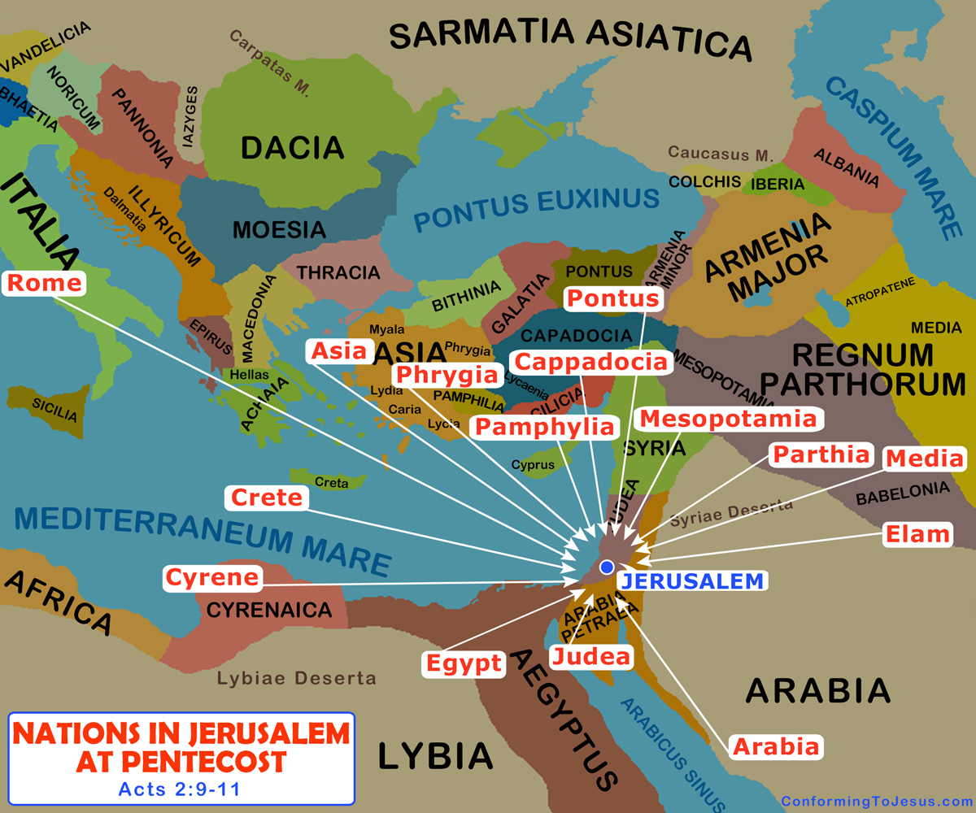
Acts: Nations in Jerusalem at Pentecost
Notes:
© 2009 S. Scott Richardson Sr., Russellville AL

Slide 13
Kingdom of Heaven Established
Peter addresses the assembly:
Relates baptism of Holy Spirit to Joel 2 prophecy
Jesus was attested by God with mighy works…
He was crucified him by lawless hands.
He was raised from the dead, ascended into heaven to sit at God’s right hand.
Jesus fulfills God’s promise to David to always have a descendant on the throne.
You crucified the Lord and Christ! “What shall we do?”
They were told to repent and be baptized for remission of sins (Acts 2:38).
Initially 3000 responded that day. Group of 5000 men later. More men and women added.
Notes:
© 2009 S. Scott Richardson Sr., Russellville AL

Slide 14
Kingdom of Heaven Established
Group initially stayed in Jerusalem, creating a financial crisis. Some sold possessions to support the group.
Jewish rulers opposed the gospel. Threatened, arrested Peter and John.
Stephen preaches Christ, is stoned. A wave of persecution against Christians ensues; house to house search occurs.
Christians were forced to flee Jerusalem and were scattered abroad. They go everywhere preaching the word!
The attempts to stop the spread of the Gospel resulted in it spreading even more, all over the world!
Phillip preaches in Samaria; Baptizes the Ethiopian Eunuch on the road from Jerusalem to Gaza, and in other towns to Caesarea.
Notes:
© 2009 S. Scott Richardson Sr., Russellville AL

Slide 15
Kingdom of Heaven Established
Christ appears to Saul (later Paul) on road to Damascus, baptized by Ananias. Once a persecutor of Christians, he starts preaching Christ!
Questions arise over whether Gentiles can be Christians:
In Joppa, Peter sees the vision of the great sheet with animals (including unclean). Kill and eat! House of Cornelius received Holy Spirit baptism. Gentiles acceptable! They are baptized.
Antioch (Syria) church: Jews and Gentiles. Antioch was a large city, with a river connecting to the Mediterranean.
More opposition/persecution, primarily from Jews.
Judaizing teachers try to force circumcision upon Gentiles.
Notes:
© 2009 S. Scott Richardson Sr., Russellville AL

Slide 16
The Work of Saul (Paul)
Saul began preaching Christ
Initially rejected by Christians in Jerusalem due to fear.
Barnabas explains Saul’s conversion; he is accepted.
Jewish leaders try to kill him; God tells him to leave; sent to the Gentiles. Saul and Barnabas go to Antioch.
Holy Spirit: “Set apart Barnabas and Saul for the work….”
John Mark accompanies them.
This become the first of four Journeys of Paul
Notes:
© 2009 S. Scott Richardson Sr., Russellville AL

Slide 17
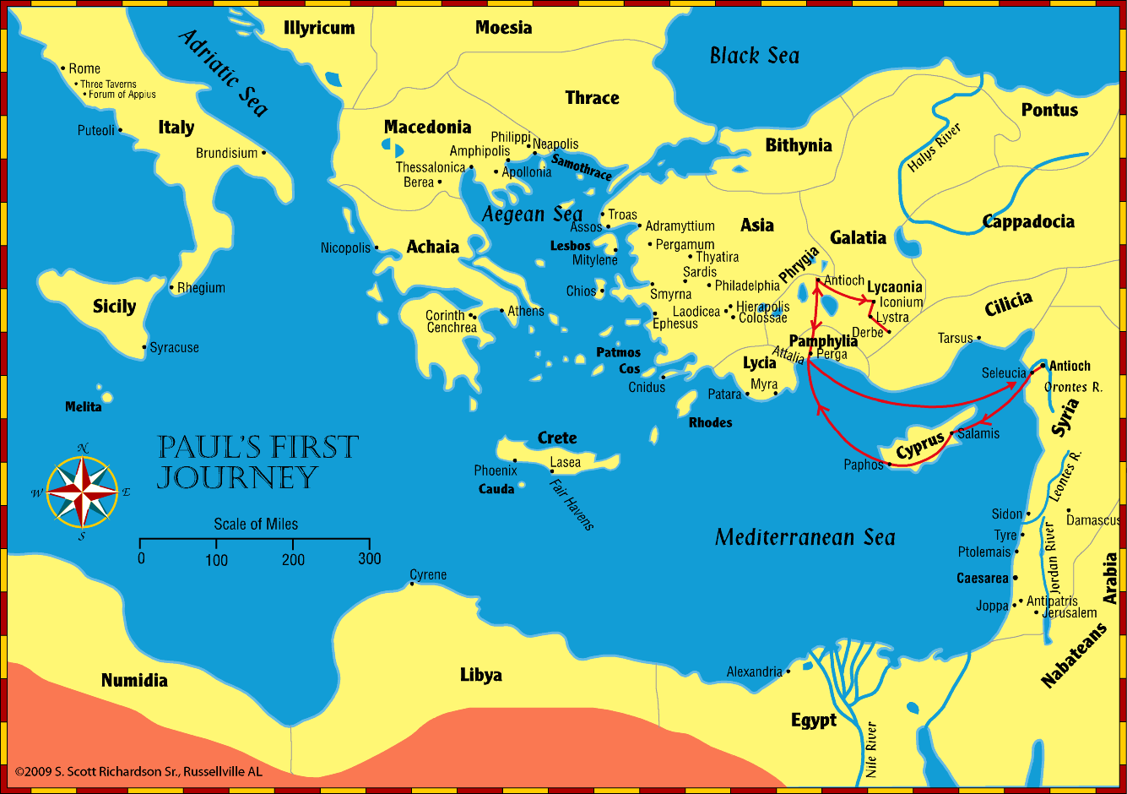
The Work of Saul (Paul)
Notes:
© 2009 S. Scott Richardson Sr., Russellville AL

Slide 18
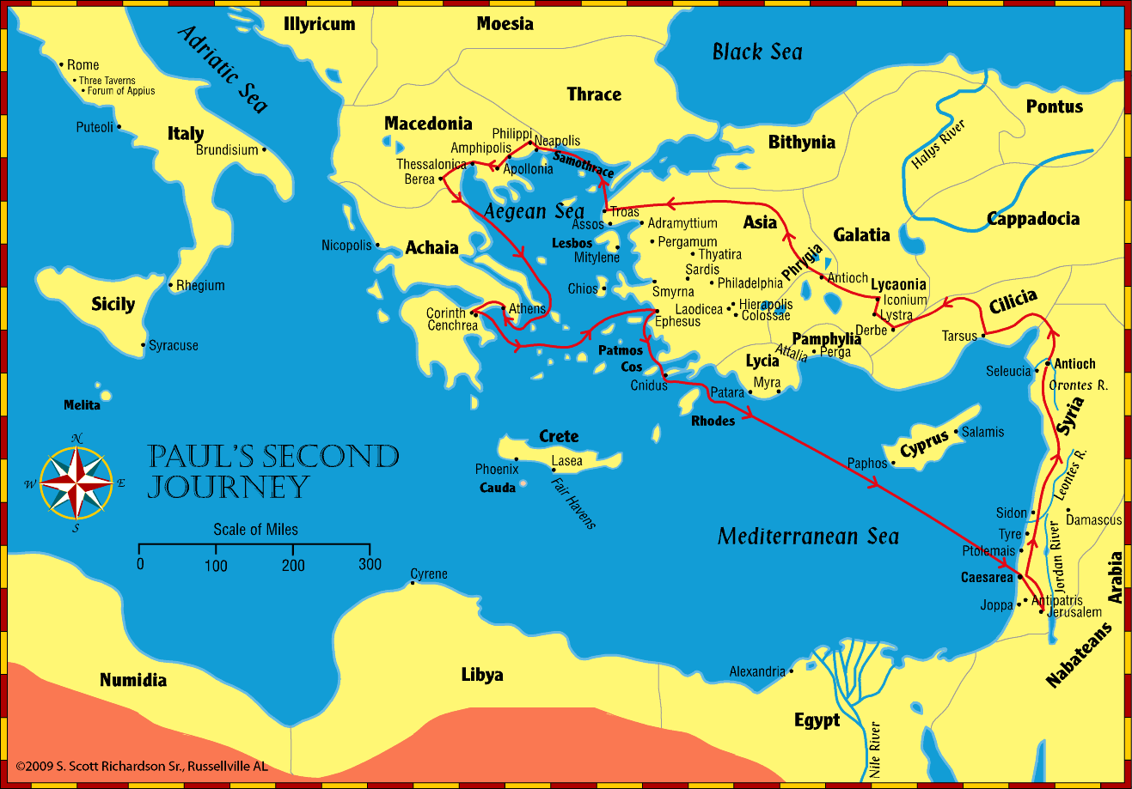
The Work of Saul (Paul)
Notes:
© 2009 S. Scott Richardson Sr., Russellville AL

Slide 19
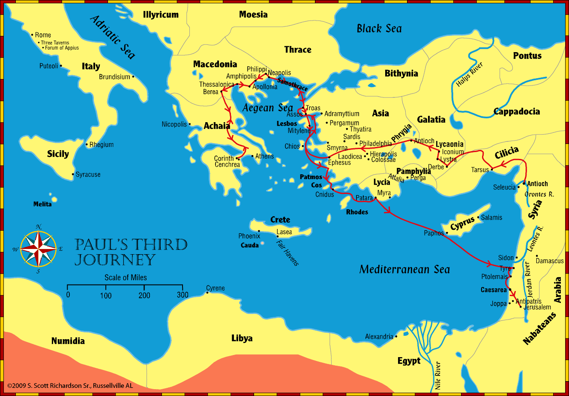
The Work of Saul (Paul)
Notes:
© 2009 S. Scott Richardson Sr., Russellville AL

Slide 20
The Work of Saul (Paul)
21: Jews accuse Paul of taking a Gentile into the Temple.
22: Paul makes a defense; mob tries to kill Paul; Romans intervene.
23: Taken to the Sanhedrin Council.
24: Defense before Felix;
25: Defense before Festus; Paul appeals to Caesar
26: Defense before Agrippa.
27: Depart Caesarea for Rome; storms, shipwreck
28: House Arrest for two years from AD 61 – 63. Nero was emperor.
Paul authors at least 13 epistles (not including Hebrews), several during his arrest in Rome.
Notes:
© 2009 S. Scott Richardson Sr., Russellville AL

Slide 21
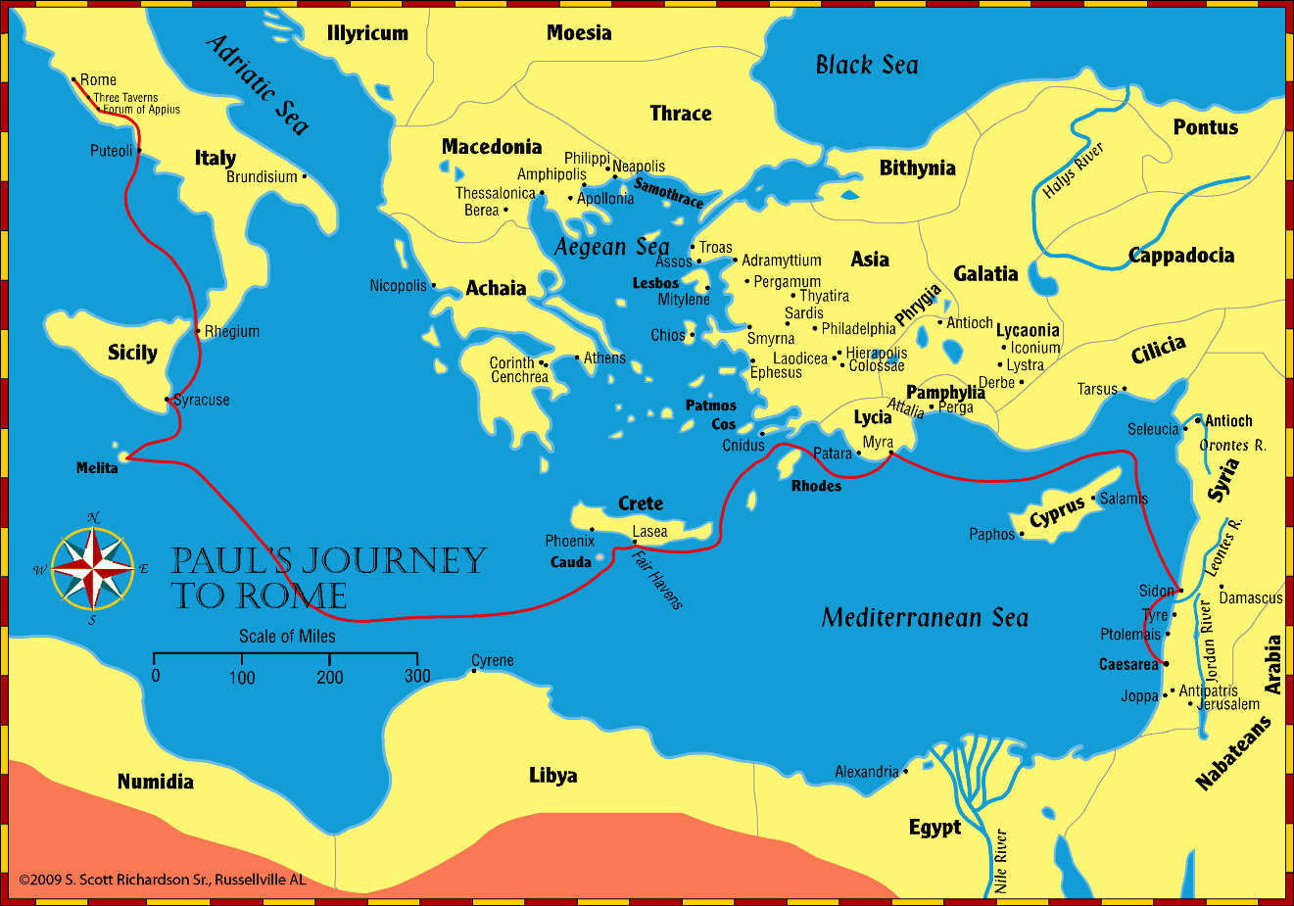
The Work of Saul (Paul)
Notes:
© 2009 S. Scott Richardson Sr., Russellville AL

Slide 22
Close of the Century
Other Apostles surely worked to spread the gospel, but little is known of their work.
Tradition says that every Apostle except John had a violent death.
Peter wrote an epistle to the Jews scattered in Asia Minor.
Paul appears to have released, then re-arrested.
Great fire of Rome: AD 64. Nero blamed Christians. Violent, horrific persecution ensued.
Tradition: Peter crucified upside down. Paul beheaded.
Groups of Jews violently resisted Roman rule. General Titus completed the destruction of Jerusalem in AD 70.
John writes The Revelation near the end of the century. The message: Christ is in control. God wins!
Notes:
© 2009 S. Scott Richardson Sr., Russellville AL

