Slide 1
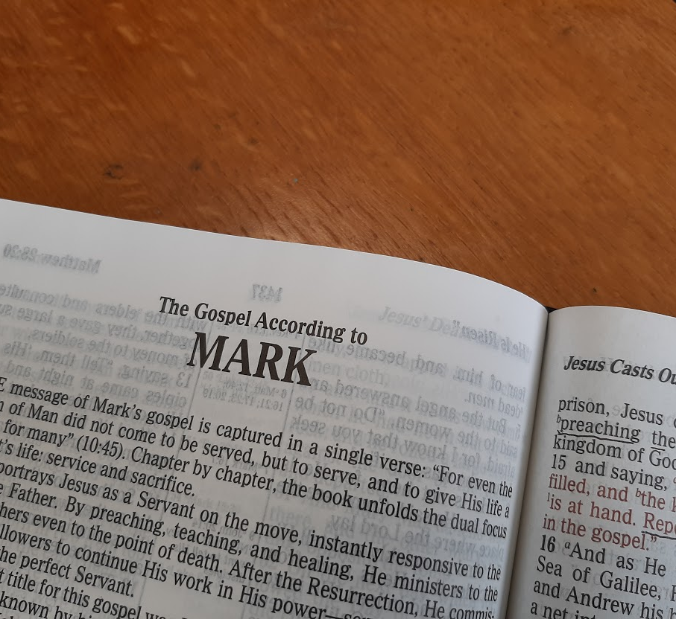
A Study of the Gospel of Mark
Leading the Lost to Belief and Obedience

Slide 2

Authorship of the Gospel of Mark
The Gospel of Mark is thought to be the earliest of the four Gospels.
While not signed by Mark, very early historical evidence attributes it to him.
  Eusebius (ca. 300 AD), Papias (ca. 150 AD), and Clement of Alexandria (ca. 200 AD) all attribute the book to Mark.
  Mark’s association with Peter is often cited as support for his authorship (1 Peter 5:13)
Notes:
1 Peter 5:13 She who is in Babylon, elect together with you, greets you; and so does Mark my son.

Slide 3
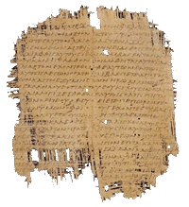
Ancient Mark Manuscript
The earliest text we have of the Gospel of Mark is in the Chester Beatty papyri and dates to about 250 A.D.

Slide 4
Who is Mark?
He is known as John whose surname was Mark (Acts 12:11-12, 25; 15:37)
His mother’s home was a place where disciples gathered for prayer (Acts 12:12)
He was a cousin of Barnabas (Col. 4:10)
He accompanied Paul and Barnabas on their first missionary journey, but left them at Perga to return to Jerusalem (Acts 13:5, 13)
Paul and Barnabas separated because they disagreed about taking Mark with them on their next journey (Acts 15:36-39)
Notes:
Colossians 4:10 Aristarchus my fellow prisoner greets you, with Mark the cousin of Barnabas (about whom you received instructions: if he comes to you, welcome him),

Slide 5
Who is Mark?
Mark and Barnabas journeyed to Cyprus to preach the gospel (Acts 15:39)
Mark is later with Paul at Rome and is regarded by Paul as a “fellow laborer” (Colossians 4:10; Philemon 23-24)
Paul desired Mark’s presence because “he is useful to me for ministry” (2 Timothy 4:11)
Mark was close to Peter and probably converted by him (1 Peter 5:13)
Notes:
Colossians 4:10 Aristarchus my fellow prisoner greets you, with Mark the cousin of Barnabas (about whom you received instructions: if he comes to you, welcome him),
Philemon 1:23-24 Epaphras, my fellow prisoner in Christ Jesus, greets you, 24 as do Mark, Aristarchus, Demas, Luke, my fellow laborers.
2 Timothy 4:11 Only Luke is with me. Get Mark and bring him with you, for he is useful to me for ministry.

Slide 6
The Purpose of Mark’s Gospel
Apparently written for Gentiles and Romans to provide a record of Jesus’ life.
  Few Old Testament quotations.
  Translation of common Hebrew words
  Presents Jesus as a man of action
    Focuses more on what Jesus did than what He said
    Uses the word “immediately” 36 times.
Draws the reader to two important conclusions about Jesus:
  “You are the Christ” (Mark 8:27-29)
  “Truly this Man was the Son of God” (Mark 15:39)
Notes:
Mark 8:27-29 Now Jesus and His disciples went out to the towns of Caesarea Philippi; and on the road He asked His disciples, saying to them, "Who do men say that I am?" 28 So they answered, "John the Baptist; but some say, Elijah; and others, one of the prophets." 29 He said to them, "But who do you say that I am?" Peter answered and said to Him, "You are the Christ.“
Mark 15:39 So when the centurion, who stood opposite Him, saw that He cried out like this and breathed His last, he said, "Truly this Man was the Son of God!"

Slide 7
The Deity of Christ in Mark
Mark 1:1, “The beginning of the good news about Jesus the Messiah, the Son of God…”
Mark 1:3, “a voice of one calling in the wilderness, ‘Prepare the way for the Lord, make straight paths for him.” (cf. Isaiah 40:3)
Mark 1:10-11, “And when he came up out of the water, immediately he saw the heavens being torn open and the Spirit descending on him like a dove. And a voice came from heaven, ‘You are my beloved Son; with you, I am well pleased.”

Slide 8
The Deity of Christ in Mark
Mark 1:23-24, “And immediately there was in their synagogue a man with an unclean spirit. And he cried out, ‘What have you to do with us, Jesus of Nazareth? Have you come to destroy us? I know who you are - the Holy One of God.”
Mark 2:5-10, [When Jesus forgives the sins of a lame man, the Jews ask,] “Who can forgive sins but God alone?” Jesus responds, “Which is easier: to say to this paralyzed man, ‘Your sins are forgiven,’ or to say, ‘Get up, take your mat and walk’?”

Slide 9
The Deity of Christ in Mark
Mark 9:2, 7 “And he was transfigured before them, and his clothes became radiant, intensely white, as no one on earth could bleach them.… And a cloud overshadowed them, and a voice came out of the cloud, “This is my beloved Son; listen to him.”
Mark 14:61-64, “…the high priest asked him, ‘Are you the Christ, the Son of the Blessed?’ And Jesus said, ‘I am, and you will see the Son of Man seated at the right hand of Power, and coming with the clouds of heaven.”

