Slide 1
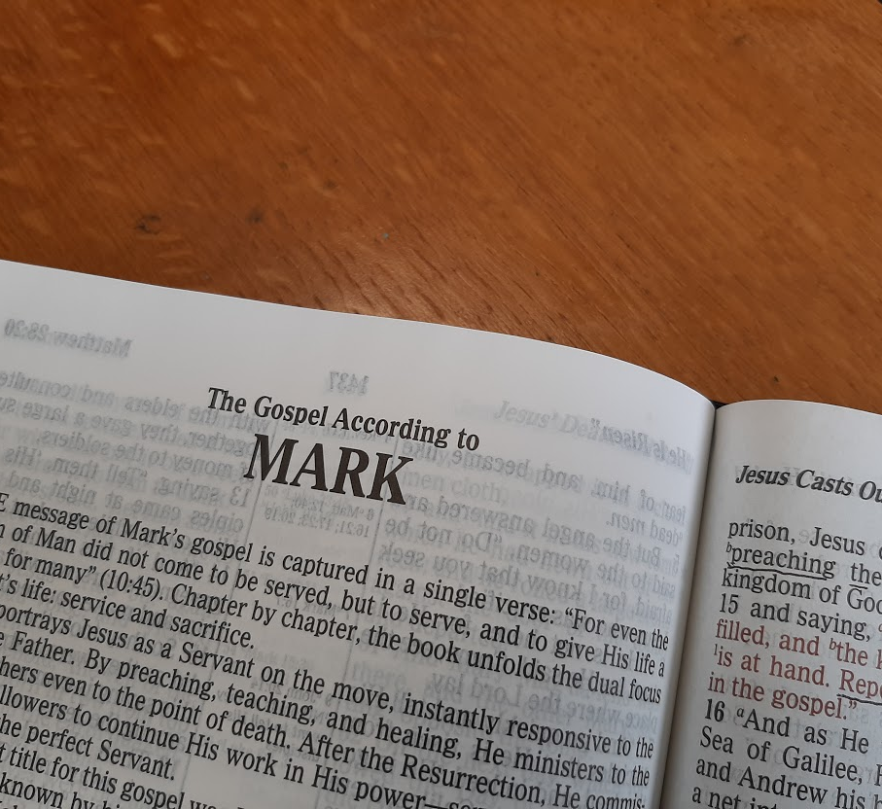
A Study of the Gospel of Mark
Leading the Lost to Belief and Obedience

Slide 2
A Study of the Gospel of Mark
Leading the Lost to Belief and Obedience

Slide 3
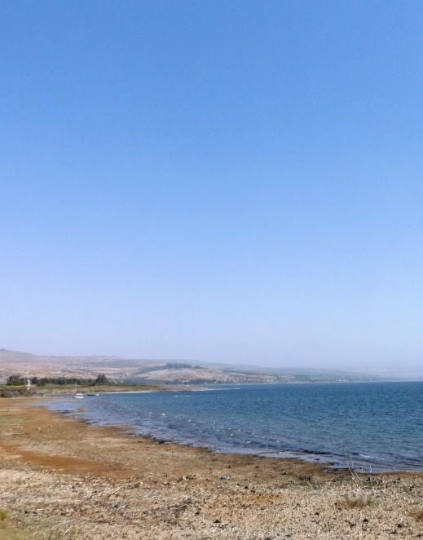
Jesus Teaches in Parables
Mark 4:1-34
Jesus enters a boat and teaches a large crowd as they stand on the shore facing Him (4:1).
Jesus taught “many things by parables” (4:2, 34).

Slide 4
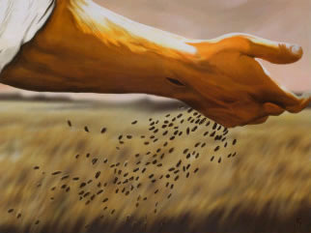
Jesus Teaches in Parables
The Parable of the Sower (4:3-20)
Begins and ends with exhortations to listen* (4:3, 9)
In the parable, a sower sows seed on four kinds of soil with varying results (4:3-8)
    The seed sown on the wayside soil was eaten by birds.
    The seed sown on the rocky ground soon withered because its roots were not deep.
    The seed that fell among the thorns was choked out by the thorns.
    The seed that fell on good ground yielded a crop.
When they are alone with Jesus, the disciples ask Him to explain about the parable (4:10)
Notes:
Some form of the word “hear” is found 13 times in Mark 4.

Slide 5
Jesus Teaches in Parables
Jesus explains that parables are designed to reveal truth to disciples while concealing it from those with hardened hearts (4:11-13, Isa. 6:9f.).
The parable of the sower shows the effect of God’s word on different kinds of hearts.
  The seed is the word (4:14).
  Satan takes the word out of the hearts of those symbolized by the wayside soil.
  The word does not take deep root in the rocky soil – these can’t take the heat of persecution and fall away.
  The word is choked by the cares, riches, and the desire for other things in the thorny soil.
  The good soil hears the word, accepts it and bears fruit in varying amounts.
Notes:
Isaiah 6:9-10 And He said, "Go, and tell this people: 'Keep on hearing, but do not understand; Keep on seeing, but do not perceive.' 10 "Make the heart of this people dull, And their ears heavy, And shut their eyes; Lest they see with their eyes, And hear with their ears, And understand with their heart, And return and be healed.“
HEAT of PERSECUTION: 2 Timothy 3:12 Yes, and all who desire to live godly in Christ Jesus will suffer persecution.
Heat makes those with deep roots grow even faster, produce even more!
CARES & Riches 1 Timothy 6:6-10 Now godliness with contentment is great gain. 7 For we brought nothing into this world, and it is certain we can carry nothing out. 8 And having food and clothing, with these we shall be content. 9 But those who desire to be rich fall into temptation and a snare, and into many foolish and harmful lusts which drown men in destruction and perdition. 10 For the love of money is a root of all kinds of evil, for which some have strayed from the faith in their greediness, and pierced themselves through with many sorrows.
Even daily needs can be distracting cares of the world if we let them be, Matthew 6:25-32

Slide 6

Jesus Teaches in Parables
The Parable of the Lamp (4:21-25)
The gospel light is designed to reveal, not conceal or be concealed.
Careful hearing is necessary.
  We must watch both “what” and “how” we hear (Luke 8:18, Acts 17:11)
The more we hear, receive, and understand the truth of God’ word, the more of God’s word we will be able to hear, receive, and understand.
Notes:
Luke 8:18 Take care then how you hear, for to the one who has, more will be given, and from the one who has not, even what he thinks that he has will be taken away.”
Acts 17:11 Now these Jews were more noble than those in Thessalonica; they received the word with all eagerness, examining the Scriptures daily to see if these things were so.

Slide 7

Jesus Teaches in Parables
The Parable of the Seed (4:26-29)
  The gospel has great power to grow and bear fruit on its own; it does not need to be altered, just sown.
  The seed sown in good ground will yield fruit “by itself.”
  When it is ripe, harvest comes!
Notes:
Seed produces after its kind!
(Gr. Automatos)
Romans 7:4 “…we should bear fruit to God.”

Slide 8
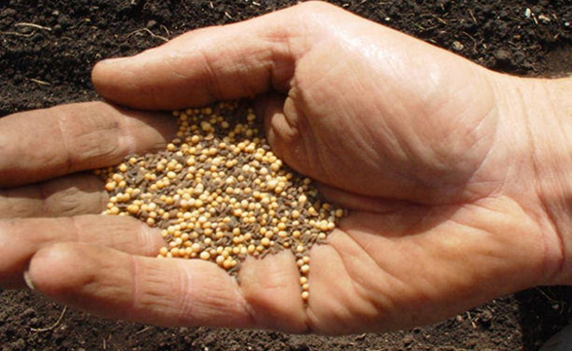
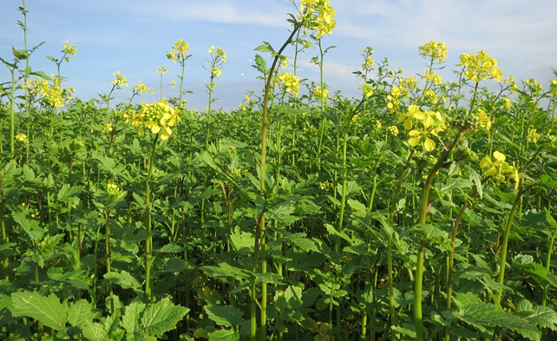
Jesus Teaches in Parables
The Parable of the mustard seed (4:30-32)
The kingdom may start small, but it would grow large and become a refuge for many.
Jesus consistently taught with parables and explained things in detail to His disciples (4:34-35)

Slide 9
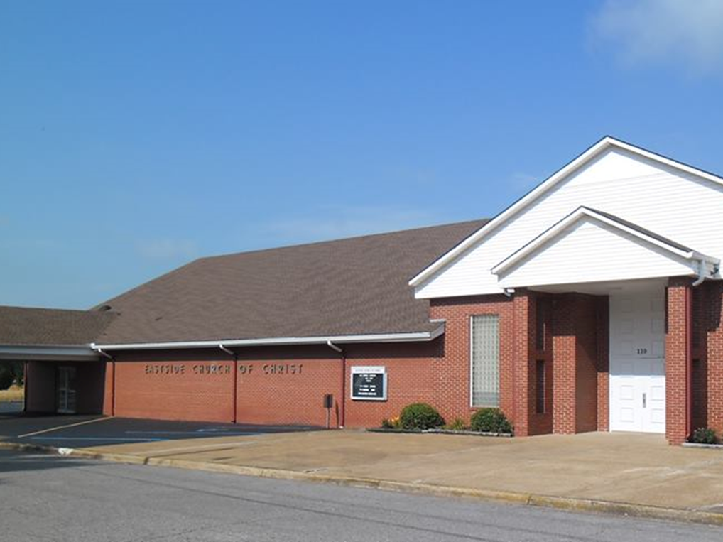
Eastside Church of Christ
Eastside-church.org

