Slide 1
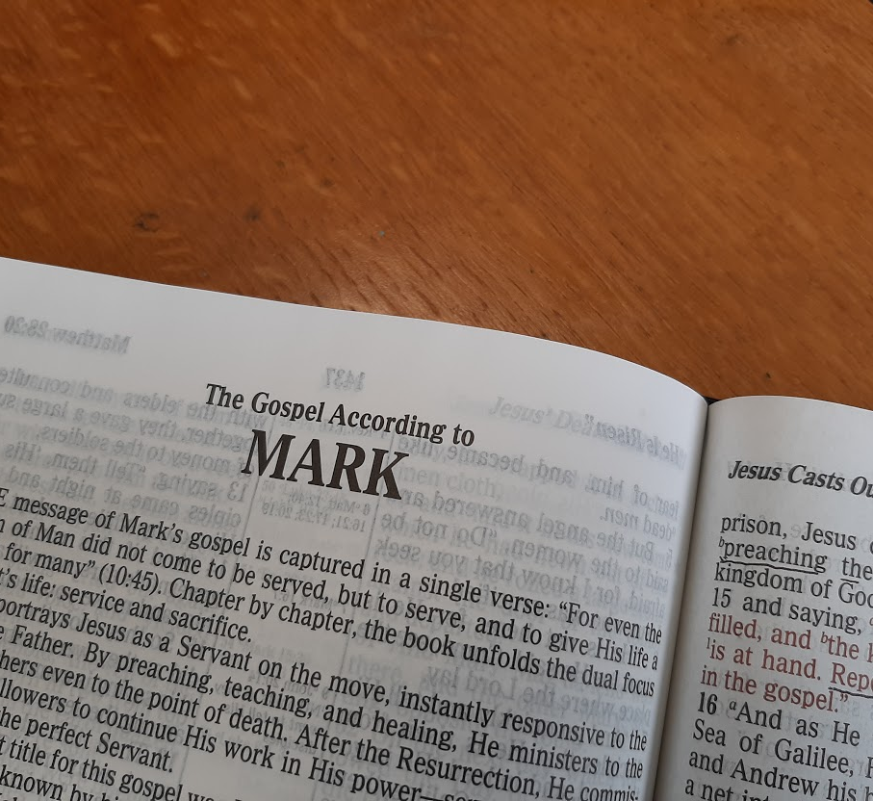
A Study of the Gospel of Mark
Leading the Lost to Belief and Obedience

Slide 2
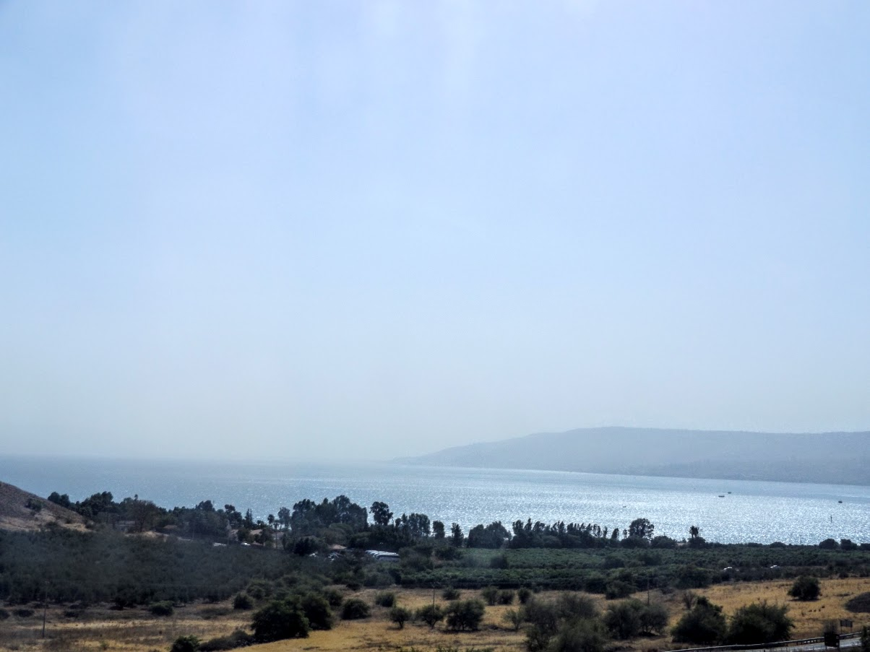
Defective Spiritual Vision Mark 8:1—9:29

Slide 3
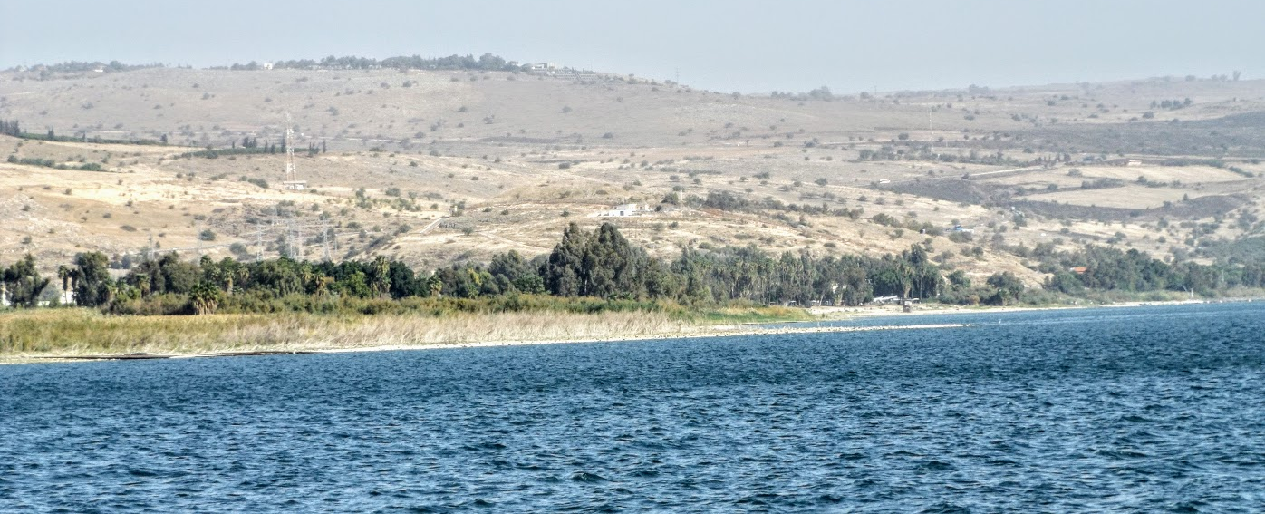
Jesus Feeds 4,000 Men (Mark 8:1-10)
Near the Sea of Galilee, a large multitude follows Jesus for three days with nothing to eat (8:1-3).
Jesus has compassion on them.
The disciples ask, “How can one satisfy these people with bread here in the wilderness?” (8:4)
They have 7 loaves and a few fish for which Jesus gives thanks; they set the food before the multitude (8:5-9)
The multitude ate and were filled.
Seven large baskets of leftovers were taken up.
Notes:
3

Slide 4
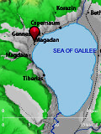
Warning About Leaven (Mark 8:10-21)
Jesus and His disciples travel to the region of Dalmanutha (8:10)
The Pharisees come out and dispute with Jesus, seeking a sign, testing Him (8:11)
Jesus “sighed deeply in His spirit, and said, ‘Why does this generation seek a sign? Assuredly, I say to you, no sign shall be given to this generation’” (8:12).
Matthew 16:3 indicates that no sign would be given because they could not discern signs anyway.
Jesus left them and departed in a boat to the other side of the sea (8:13).
Notes:
4

Slide 5
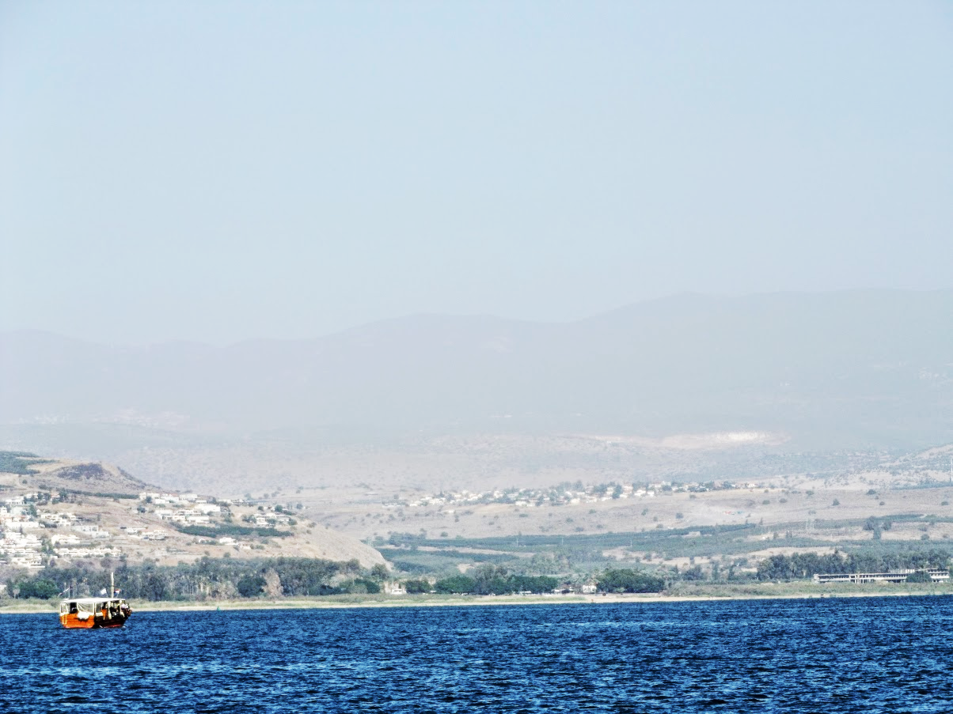
Warning About Leaven (Mark 8:14-21)
The disciples forget to take bread (8:14).
Jesus charges them to “beware of the leaven of the Pharisees and of Herod,” and the disciples wonder if it is because they have not brought bread (8:14-15).
Jesus chastises them for their lack of perception (8:16-21). They needed to remember what they had seen and heard, and understand its significance:
Jesus had fed the 5,000 and the 4,000 in their presence.
He could provide their every need.
Matthew 16:13 indicates that they eventually understood, “that He did not tell them to beware of the leaven of bread, but of the doctrine of the Pharisees and Sadducees.”
Notes:
5

Slide 6
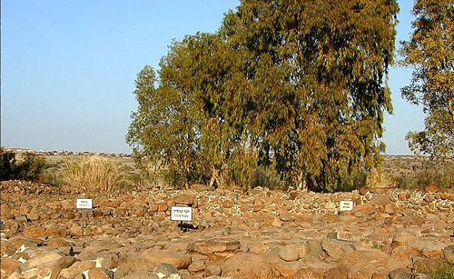
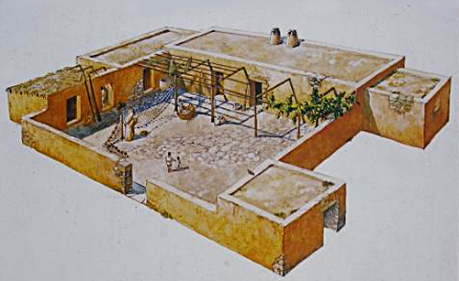
Jesus Heals a Blind man in Two Stages (Mark 8:22-26)
Jesus travels to Bethsaida, on Galilee’s north shore (8:22).
Bethsaida is the hometown of Peter, Andrew & Philip (Jn. 1:44)
Bethsaida means “House of the Fisherman.”
Archeologists have excavated a “House of the Fisherman“ there in which they found lead weights, anchors, needles, and fishhooks.
Notes:
6

Slide 7
Jesus Heals a Blind man in Two Stages (Mark 8:22-26)
The people bring a blind man to Jesus to be healed (8:22b-26)
Jesus took the man by the hand and led him out of town.
He spat in his eyes, touched him and asked him if he saw anything.
The man said, “I see men like trees walking.”
Jesus touched him again, made him look up, “and he was restored and saw everyone clearly.”
Jesus instructs the man not to go into the town or tell anyone in the town.

Slide 8
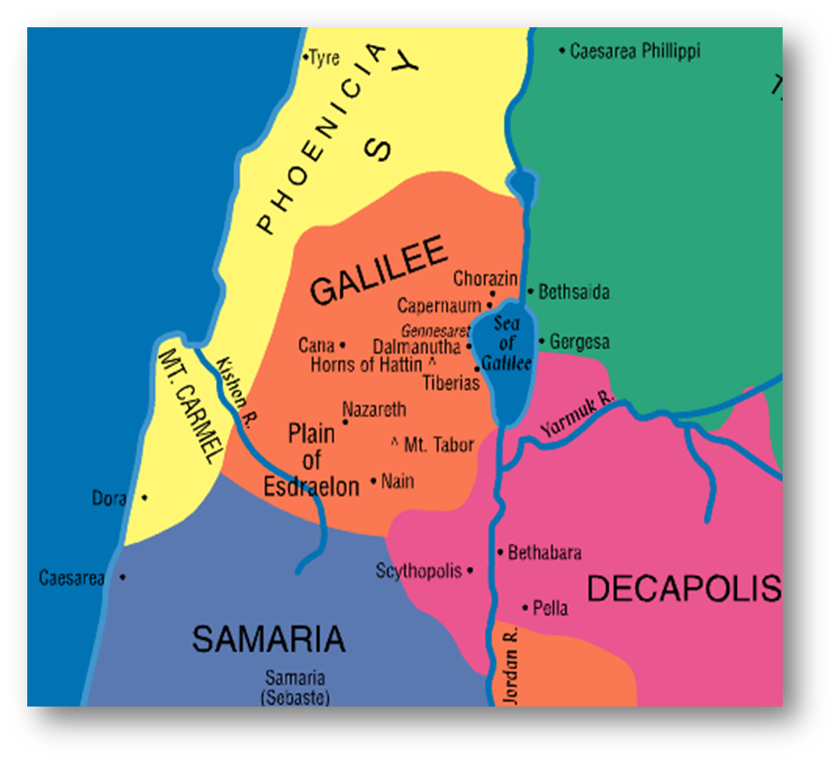

Jesus and His disciples travel to Caesarea Philippi (Mark 8:27)
Notes:
8

Slide 9
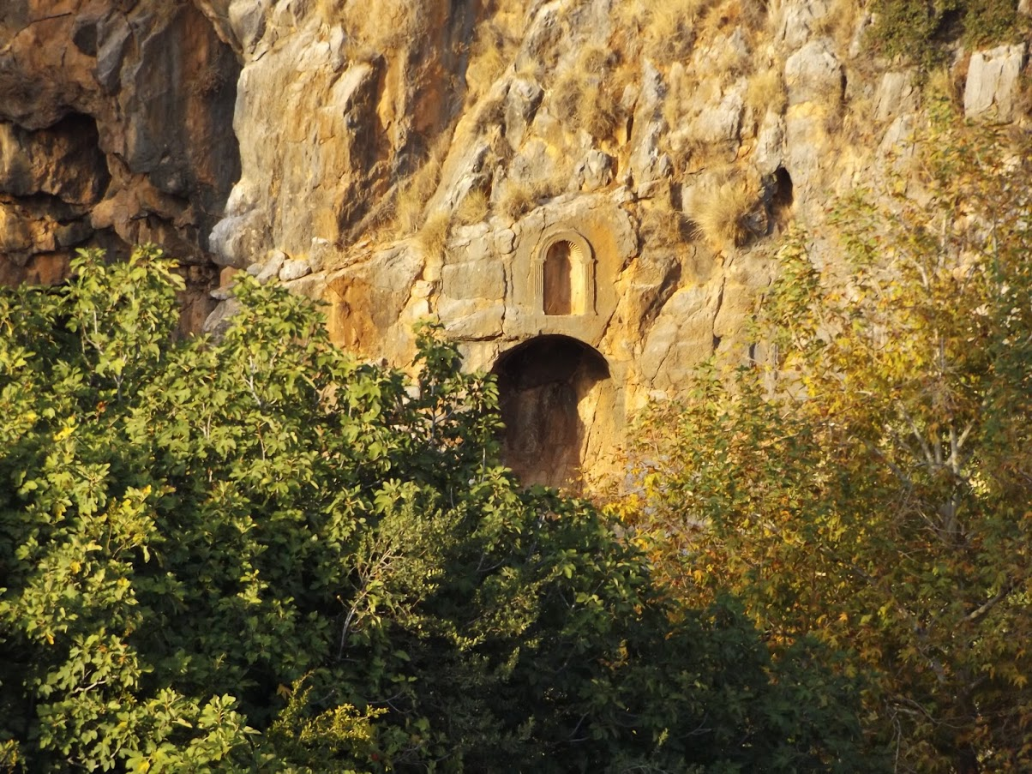
The Strength and Weakness of Peter (Mark 8:27-33)
Traveling in the region of Caesarea Philippi, Jesus asks His disciples, “Who do men say that I am?” (8:27)
They respond, “John the Baptist, Elijah or one of the prophets.” (8:28)
Notes:
9

Slide 10
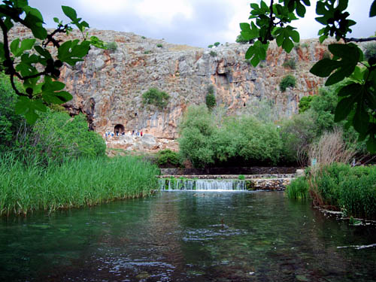
Notes:
10

Slide 11
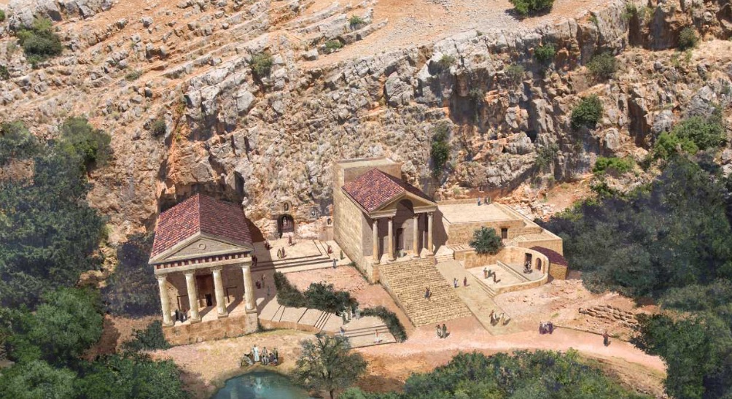
Caesarea Philippi As it would have looked in Jesus’ day

Slide 12
The Strength and Weakness of Peter (Mark 8:27-33)
Jesus asks, "But who do you say that I am?"
Peter responds, "You are the Christ." (8:29)
Jesus strictly warns them “that they should tell no one about Him.” (8:30)
Notes:
12

Slide 13
The Strength and Weakness of Peter (Mark 8:31 – 9:1)
Jesus begins to show the disciples that, since He is the Christ, He must suffer, be killed, and rise again (8:31).
Peter takes Him aside and rebukes Him (8:32).
Jesus turns and looks at His disciples and rebukes Peter, saying, “Get behind me Satan! For you are not mindful of the things of God, but the things of men” (8:33).

Slide 14
The Conditions of Discipleship (Mark 8:34 – 9:1)
Jesus proclaims that, “Whoever desires to come after me” should “deny himself, and take up His cross, and follow me” (8:34-35).
Only a follower who loses his life, will save it (8:36).
The value of the soul makes the decision to follow Jesus a wise choice (8:37).
Whoever is ashamed of Christ and His words will find that Christ is ashamed of him when He comes again (8:38).
Some there would see Kingdom of God “present with power” (9:1).

Slide 15
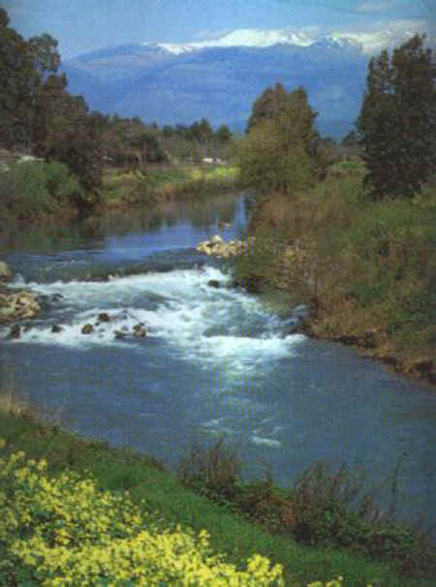
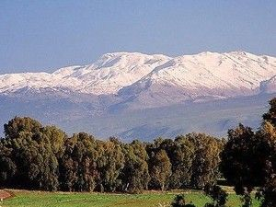
Jesus is Transfigured (Mark 9:2-13)
After six days Jesus led Peter, James and John to a “high mountain” (9:2).
Mount Hermon near Caesarea Philippi is the probable location
Notes:
15

Slide 16
Jesus is Transfigured (Mark 9:2-13)
After six days Jesus led Peter, James and John to a “high mountain” (9:2).
Jesus is Transfigured before them.
His clothes become shining and white (9:3).
Moses and Elijah appear and talk with Jesus (9:4)
They talk about Jesus’ impending decease (Lk. 9:31).
In fear and awe, Peter suggests building a tabernacle for each of the three (9:5-6).
A cloud overshadows them; a voice comes from the cloud saying, “This is My beloved Son. Hear Him!” (9:7)
Suddenly the disciples are alone with Jesus (9:8).
Notes:
We cannot build multiple tabernacles – one for Jesus and one for our parents, or our family religion, or our favorite activity.

Slide 17
Jesus is Transfigured (Mark 9:2-13)
He instructs them not to tell anyone what they had seen until He rises from the dead (9:9-10).
This event makes a lasting impression on the disciples which Peter shares in 2 Peter 1:14-17.
In response to a question from the three disciples Jesus…
Reveals that Elijah has come (9:11-13; Matthew 17:13).
Inquires of them why it is written that the Son of Man is to suffer and be treated with contempt.
Notes:
2 Peter 1:14-18 knowing that shortly I must put off my tent, just as our Lord Jesus Christ showed me. (15) Moreover I will be careful to ensure that you always have a reminder of these things after my decease. (16) For we did not follow cunningly devised fables when we made known to you the power and coming of our Lord Jesus Christ, but were eyewitnesses of His majesty. (17) For He received from God the Father honor and glory when such a voice came to Him from the Excellent Glory: "This is My beloved Son, in whom I am well pleased." (18) And we heard this voice which came from heaven when we were with Him on the holy mountain.

Slide 18
The Disciples Fail to Cast Out a Demon (Mark 9:14-29)
Jesus rejoins the other disciples and finds them disputing with the scribes in the midst of a great multitude (9:14-16).
Jesus asks the scribes what they are discussing.
A man explains that Jesus’ disciples had been unable to heal his possessed son (9:17-18).
Jesus laments their faithlessness and asks that the boy be brought to Him (9:19).
When the boy is brought, the evil spirit convulses him, causing him to fall to the ground and foam at the mouth (9:20-22).
Jesus is told that such has happened often from childhood.
The father begs Jesus to “have compassion on us and help us.”
Notes:
.

Slide 19
The Disciples Fail to Cast Out a Demon (Mark 9:14-29)
Jesus said to the father "If you can believe, all things are possible to him who believes" (9:23).
The father of the child cried out and said with tears, "Lord, I believe; help my unbelief!" (9:24).
Jesus commanded the unclean spirit to “come out of him and enter him no more!" (9:25)
The spirit cried out, convulsed him and came out.
The boy appeared to be dead (9:26).
But Jesus took him by the hand, and he arose (9:27).
Privately the disciples ask why they could not cast out the demon. Jesus tells them that “this kind” requires prayer and fasting (9:28-29)

Slide 20
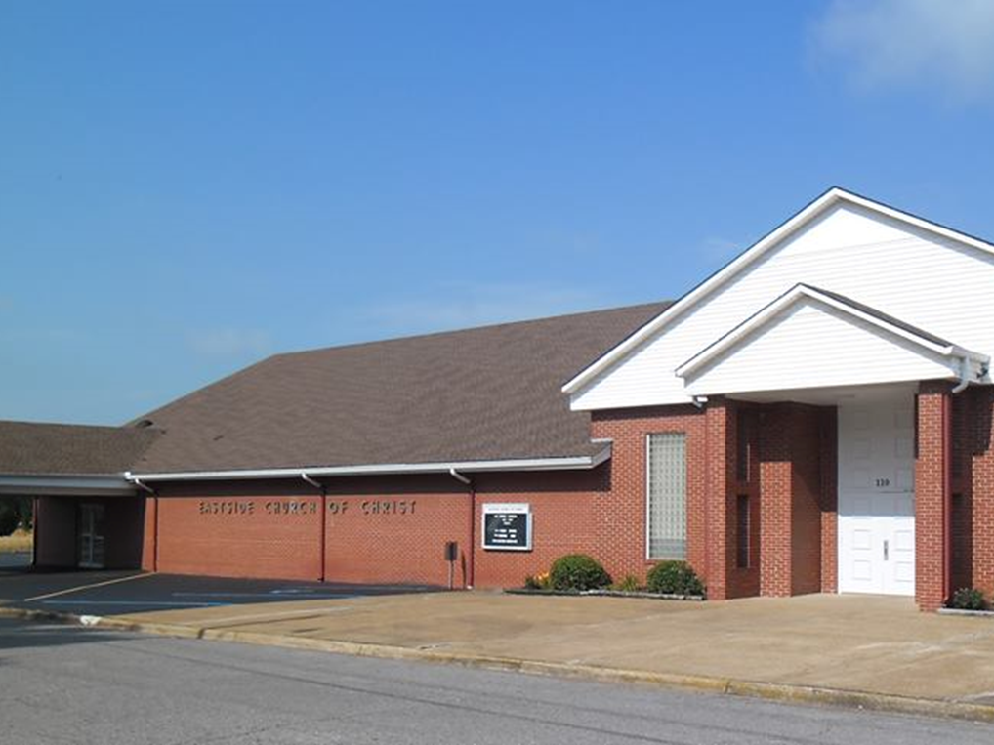
Eastside Church of Christ
Eastside-church.org

