Slide 1
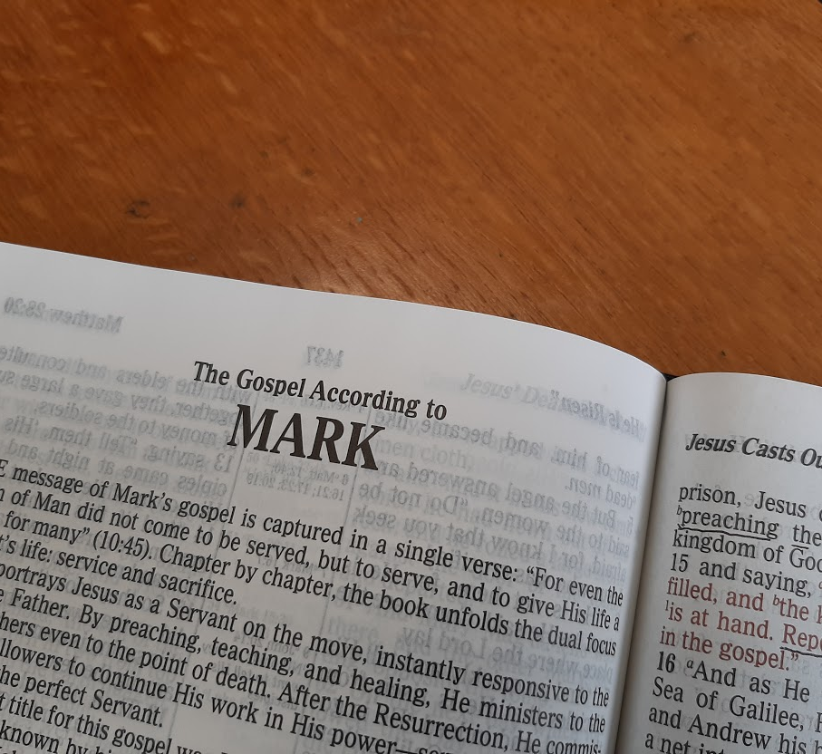
A Study of the Gospel of Mark
Leading the Lost to Belief and Obedience

Slide 2
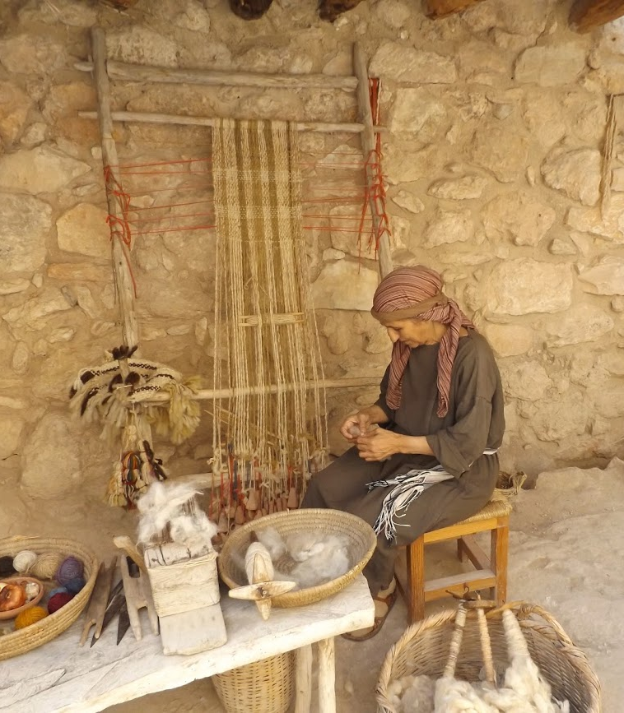
Jesus Accepts the Lowly
Mark 9:30—10:52

Slide 3
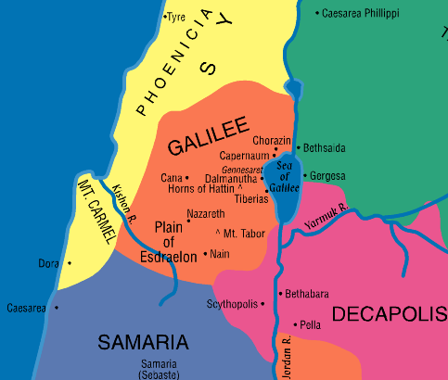
Jesus Announces His Death, Rebukes Pride (Mark 9:30-37)
Jesus and the disciples head south through Galilee, but Jesus does not want anyone to know it (9:30).
Jesus tells the disciples, “The Son of Man is being betrayed into the hands of men, and they will kill Him. And after He is killed, He will rise the third day” (9:31).
The disciples do not understand this and are afraid to ask (9:32).
Notes:
3

Slide 4
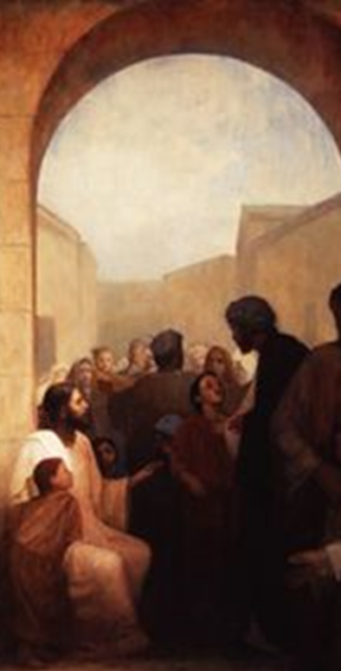
Jesus Rebukes Pride (Mark 9:33-37)
When they reach Capernaum, Jesus asks what the disciples had been discussing on the road (9:33).
They did not respond because they had disputed about who would be the greatest in the kingdom (9:34).
Jesus teaches them about true greatness (9:35-37).
Become a servant of all.
Those humble enough to receive children are humble enough to receive the Father and the Son.
Notes:
4

Slide 5
Jesus Warns of the Dangers of Stumbling (Mark 9:38-50)
John tells Jesus about encountering a man “casting out demons in Your name” and forbidding Him to do so because “he does not follow us” (9:38).
Jesus instructs them not to forbid such a one because…
Anyone who works miracles in Jesus’ name will not speak evil of Him (9:39).
“He who is not against us is on our side” (9:40, compare Matthew 12:30).
Whoever does good in Jesus name will be rewarded (9:41; Colossians 3:17).
Notes:
5
Matthew 12:30 He who is not with Me is against Me, and he who does not gather with Me scatters abroad.
Colossians 3:17 And whatever you do in word or deed, do all in the name of the Lord Jesus, giving thanks to God the Father through Him.

Slide 6
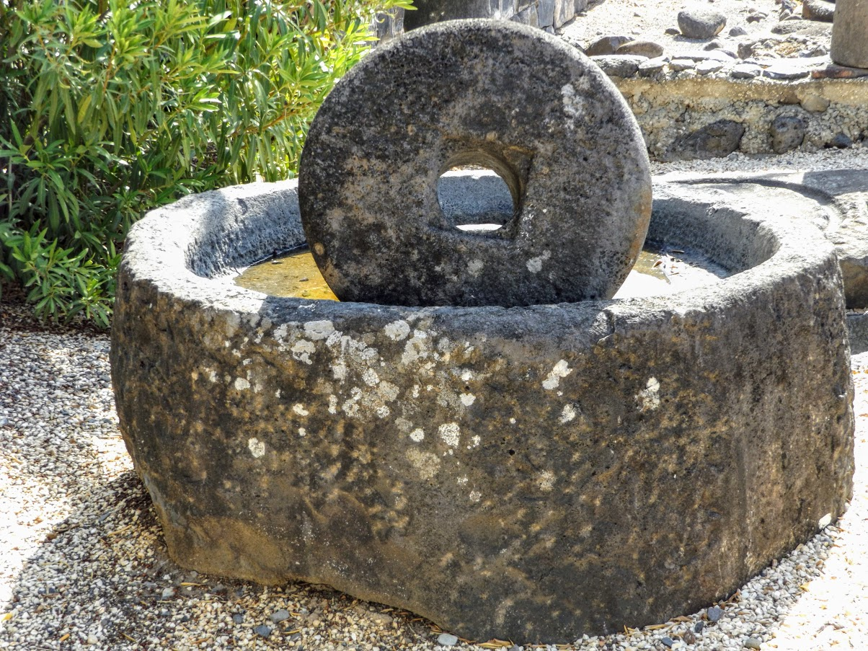
Jesus Warns of the Dangers of Stumbling (Mark 9:42-50)
Causing another to stumble dooms one to a fate worse than a horrible death (9:42)
It would be better to lose a hand, foot, or eye that is causing you to sin than to be cast into hell “where their worm does not die and the fire is not quenched” (9:43-48; cf. Jer. 7:31)
Notes:
6
Jeremiah 7:31 And they have built the high places of Tophet, which is in the Valley of the Son of Hinnom, to burn their sons and their daughters in the fire, which I did not command, nor did it come into My heart.
Thayer: Hell is the place of the future punishment call “Gehenna” or “Gehenna of fire”. This was originally the valley of Hinnom, south of Jerusalem, where the filth and dead animals of the city were cast out and burned; a fit symbol of the wicked and their future destruction.

Slide 7
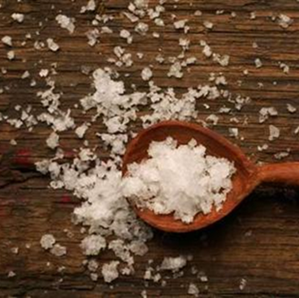
Jesus Warns of the Dangers of Stumbling (Mark 9:42-50)
Disciples are like the sacrifices of the Old Testament (9:49; Leviticus 2:13)
Offered in fire – symbolic of the self-denial and self-sacrifice of disciples that Jesus had just spoken of.
Disciples are to have salt in themselves and peace with one another (9:50)
“Salt” purifies, preserves, and makes palatable.
“Peace” relates to the disciples’ earlier quarrel (9:33)
Notes:
7
Leviticus 2:13 And every offering of your grain offering you shall season with salt; you shall not allow the salt of the covenant of your God to be lacking from your grain offering. With all your offerings you shall offer salt.

Slide 8
Questions About Divorce (Mark 10:1-12)
Jesus travels from Capernaum to Judea and Perea, where He again teaches the multitudes (10:1).
His new location may explain why He begins again to teach publicly and also why He refers to a woman’s right to divorce.
Notes:
8
Map created in using Build-a-map software form S. Scott Richardson

Slide 9
Questions About Divorce (Mark 10:1-12)
The Pharisees test Him by asking if it is “lawful for a man to divorce his wife” (10:2-9).
Jesus refers them to what Moses said (Deut. 24:1-4).
Jesus then explains that Moses’ Law was given because of the “hardness of your heart.”
God’s intention is seen “from the beginning of creation” where He made man and woman to be JOINED and become ONE (Genesis 2:24).
“Therefore what God has joined together, let not man separate.”
When the disciples ask Jesus privately about the matter, He explains that divorcing and remarrying constitute adultery (10:10-12).
NOTE: Mark’s account omits the exception to this and the related comments found in Matthew 19:9-12
Notes:
9
Deuteronomy 24:1-4 "When a man takes a wife and marries her, and it happens that she finds no favor in his eyes because he has found some uncleanness in her, and he writes her a certificate of divorce, puts it in her hand, and sends her out of his house, (2) when she has departed from his house, and goes and becomes another man's wife, (3) if the latter husband detests her and writes her a certificate of divorce, puts it in her hand, and sends her out of his house, or if the latter husband dies who took her as his wife, (4) then her former husband who divorced her must not take her back to be his wife after she has been defiled; for that is an abomination before the LORD, and you shall not bring sin on the land which the LORD your God is giving you as an inheritance.

Slide 10
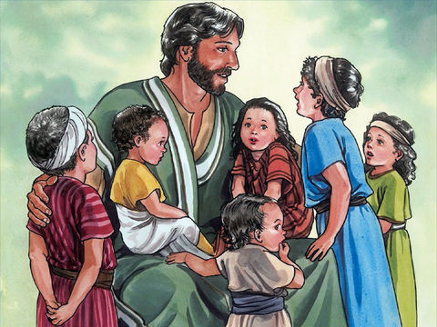
Jesus Blesses the Children (Mark 10:13-16)
The disciples rebuke some who brought little children to Jesus to be blessed by Him (10:13).
Note what Jesus had just told His disciples in Mark 9:36-37.
Jesus says, "Let the little children come to Me, and do not forbid them; for of such is the kingdom of heaven" (10:14-15).
In order to enter the kingdom of God, one must receive it “as a little child”.
Jesus blesses the children (10:16).
Notes:
10
Image courtesy of Good News Productions International and College Press Publishing.

Slide 11
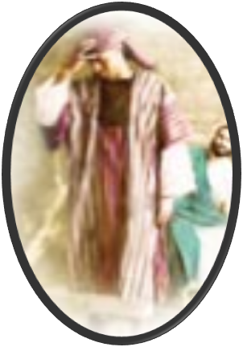
The Rich Man Considers Cost too High (Mark 10:17-31)
A man came to Jesus on the road, knelt before Him and asked, “Good Teacher, what shall I do that I may inherit eternal life?” (10:17)
Jesus responds (10:18-19).
“Why do you call me good?” Only God is good.
“You know the commandments.” Keep them.
The man answers that he has kept the commandments from his youth (10:20).
Jesus loves him and tells him that he still lacks one thing: He must sell what he has, give it the poor, take up the cross and follow Jesus (10:21).
The man “went away sorrowful, for he had great possessions” (10:22).
Notes:
11

Slide 12
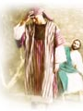
The Rich Man Considers Cost too High (Mark 10:17-31)
Jesus tells his disciples that it is hard for those who have riches to enter the kingdom (10:23-25).
The disciples are “greatly astonished” and ask, “Who then can be saved?” (10:26).
Jesus replies, “With men it is impossible… with God all things are possible" (10:27).
Peter points out that the disciples had “left all” to follow Jesus (10:28).
Jesus assures him that anyone who has sacrificed family and property for His sake will receive 100 times as much in this life AND eternal life; yet the first will be last (10:28-31).
Notes:
12

Slide 13
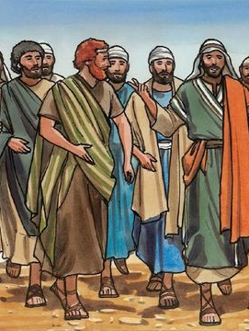
Greatness in God’s Kingdom (Mark 10:32-34)
Jesus leads His disciples up the road toward Jerusalem (10:32).
The disciples were amazed and afraid (see John 11:7-8, 16).
NOTE: Mark has not mentioned Jesus going to Jerusalem until now; the other Gospels inform us that Jesus had been there several times during His public ministry.
For the third time Jesus explains to His disciples what will happen to Him (10:33-34, 8:31; 9:31).
In this prophecy Jesus specifically mentions being betrayed to the chief priests and scribes, turned over to the Gentiles, mocked, scourged and spat on, killed, and raised the third day.
Notes:
13

Slide 14
Greatness in God’s Kingdom (Mark 10:35-45)
James & John ask that Jesus give them the top positions of honor in His kingdom (10:35-37).
Jesus responds (10:38-40).
They must be able to drink the cup that He would drink and be baptized with the baptism that He would endure.
It was not Jesus’ place to give the positions they requested.
The ten other disciples were upset with James and John (10:41).
Jesus teaches them the right attitude about attaining positions of authority (10:42-45).
The disciples must not be like the Gentiles in authority who “lord it over” their subjects. They must be servants. Jesus Himself sets the example.
Notes:
14

Slide 15
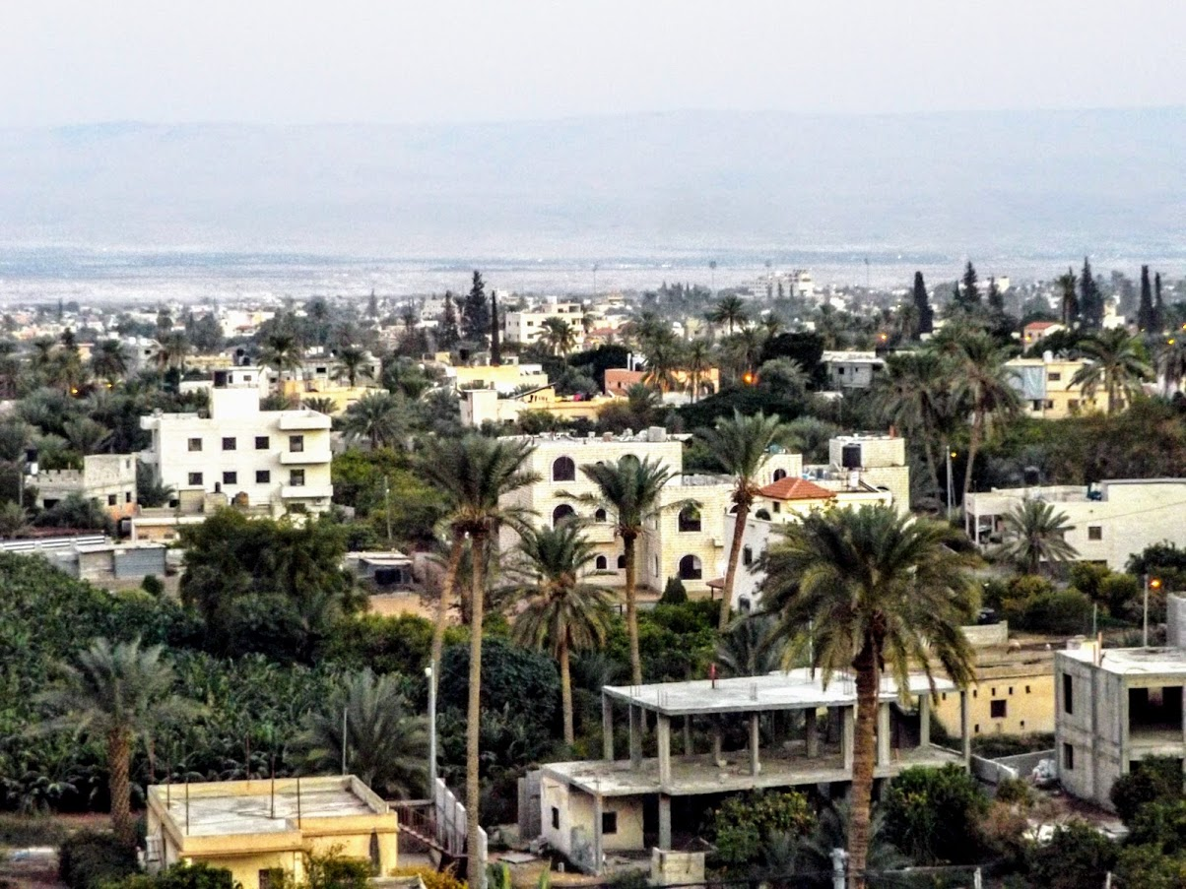
Jesus Heals Bartimaeus (Mark 10:46-52)
As Jesus and His disciples pass through Jericho a great multitude follow (10:46)
A blind man named Bartimaeus sat at the side of the road begging.
Notes:
15

Slide 16
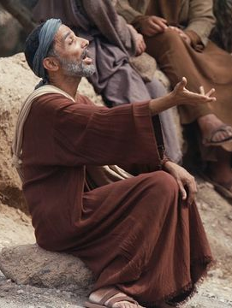
Jesus Heals Bartimaeus (Mark 10:46-52)
Bartimaeus cries out, “Jesus, Son of David, have mercy on me” (10:47-48).
When the crowd attempts to silence him, Bartimaeus cries out all the more.
Calling Jesus the “Son of David” amounts to confessing Him as the Christ (2 Samuel 7:12; Psalms 132:11; 89:29, 35-37; Isaiah 9:5-7).
Jesus calls for Bartimaeus to be brought to Him (10:49-50).
Bartimaeus asks to receive his sight (10:51).
Jesus tells him, “Go your way, your faith has made you well” (10:52).
Immediately he receives his sight and follows Jesus on the road.
Notes:
16
Psalms 132:11 The LORD has sworn in truth to David; He will not turn from it: "I will set upon your throne the fruit of your body.
Psalms 89:29 His seed also I will make to endure forever, And his throne as the days of heaven.
Psalms 89:35-37 Once I have sworn by My holiness; I will not lie to David: (36) His seed shall endure forever, And his throne as the sun before Me; (37) It shall be established forever like the moon, Even like the faithful witness in the sky." Selah
Isaiah 9:6-7 For unto us a Child is born, Unto us a Son is given; And the government will be upon His shoulder. And His name will be called Wonderful, Counselor, Mighty God, Everlasting Father, Prince of Peace. (7) Of the increase of His government and peace There will be no end, Upon the throne of David and over His kingdom, To order it and establish it with judgment and justice From that time forward, even forever. The zeal of the Lord of hosts will perform this.

Slide 17
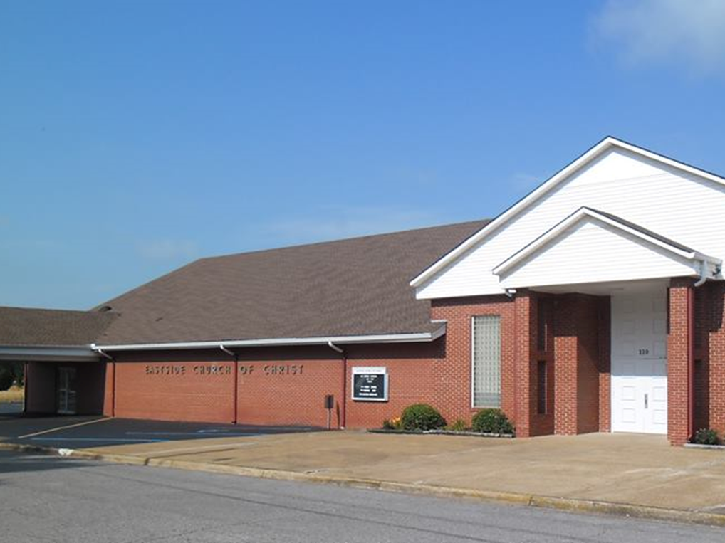
Eastside Church of Christ
Eastside-church.org

