Slide 1
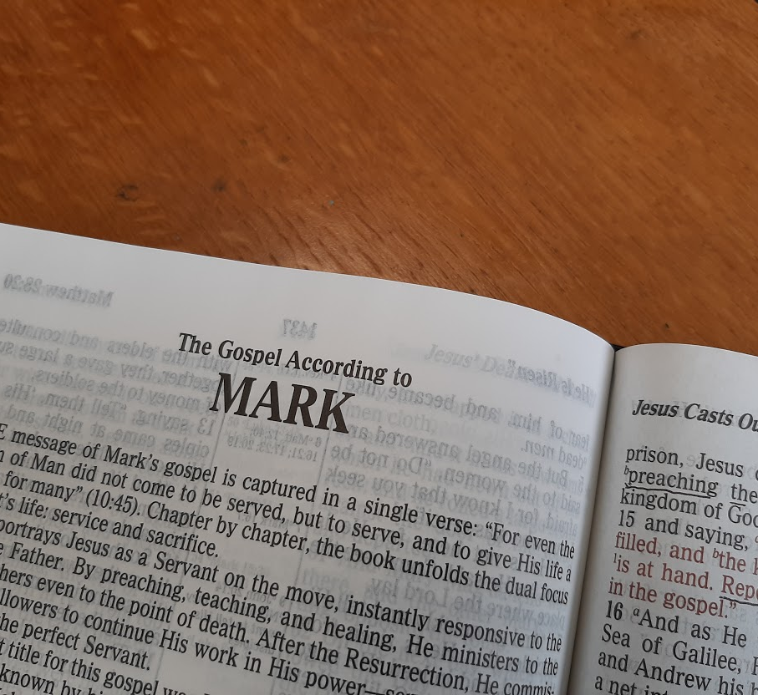
A Study of the Gospel of Mark
Leading the Lost to Belief and Obedience

Slide 2
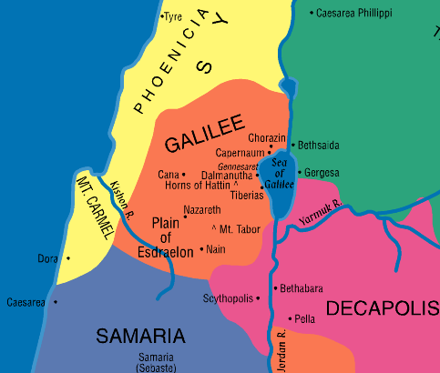
The Message Spreads Mark 6:7—7:37

Slide 3
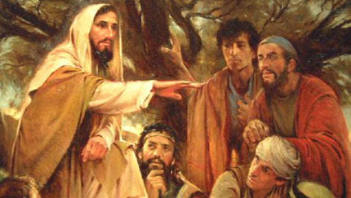
The Message Spreads
Jesus Sends out the Twelve (6:7-13)
Jesus taught around Galilee in a circuit.
He sends His apostles out two by two.
This is their first recorded evangelistic mission.
They were given power over unclean spirits.
He commands them to travel light.
Take no bag, bread, coins, or extra clothing. (These restrictions were lifted for later missions, cf. Luke 22:35-36)
Rely on the first offer of hospitality.
They are to leave any place their word is not received, shaking the dust from their feet (6:11).
They preach that people should repent, and they verify their message by performing miracles (6:12-13).

Slide 4
The Message Spreads (Mark 6:7—7:37)
Herod Fears Jesus (6:14-29)
Herod hears of Jesus, because His name had become well-known. Herod fears that Jesus is John the baptist raised from the dead (6:14-16).
Others say that Jesus is Elijah, the Prophet, or one of the other prophets.
Herod insists that He is John whom he had beheaded.

Slide 5
The Message Spreads (Mark 6:7—7:37)
Herod Fears Jesus (6:14-29)
Herod’s dealings with John the Baptist (16:17-20)
Herod had married Herodias, his brother Philip’s wife.
John had said to Herod, “It is not lawful for you to have your brother’s wife.”
John’s work was to prepare people to obey the Law of Christ. More on unscriptural marriages in Mark 10
Herod had imprisoned John for the sake of Herodias.
Herodias wanted to kill John, but she could not because Herod protected him.
Herod respected John and listened to his teaching.

Slide 6
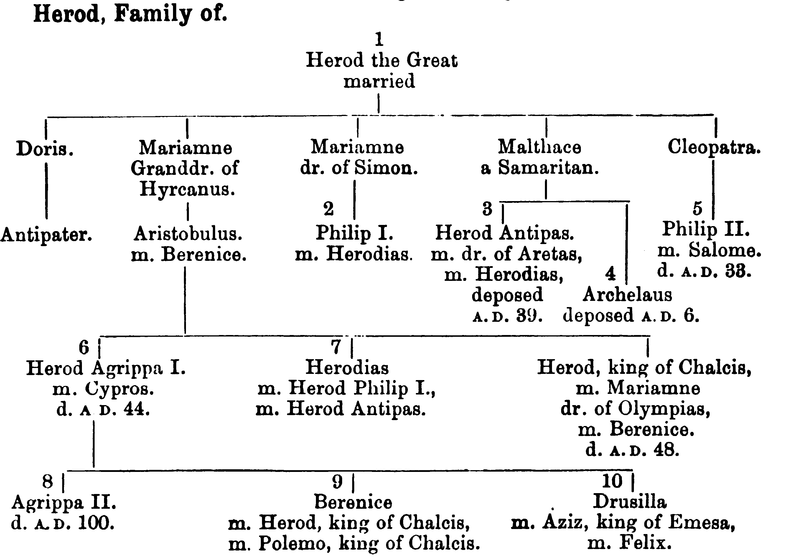

Slide 7
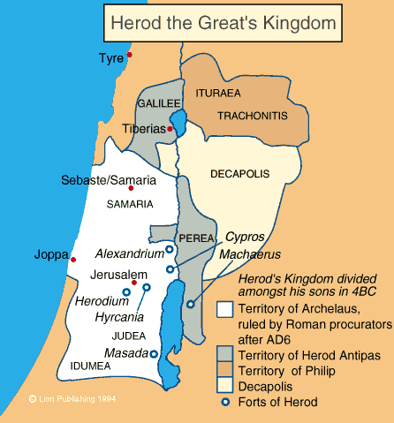
Herod's Kingdom

Slide 8
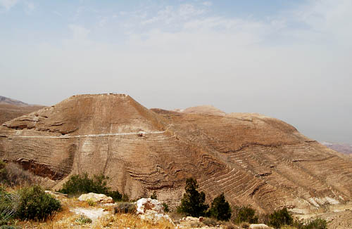
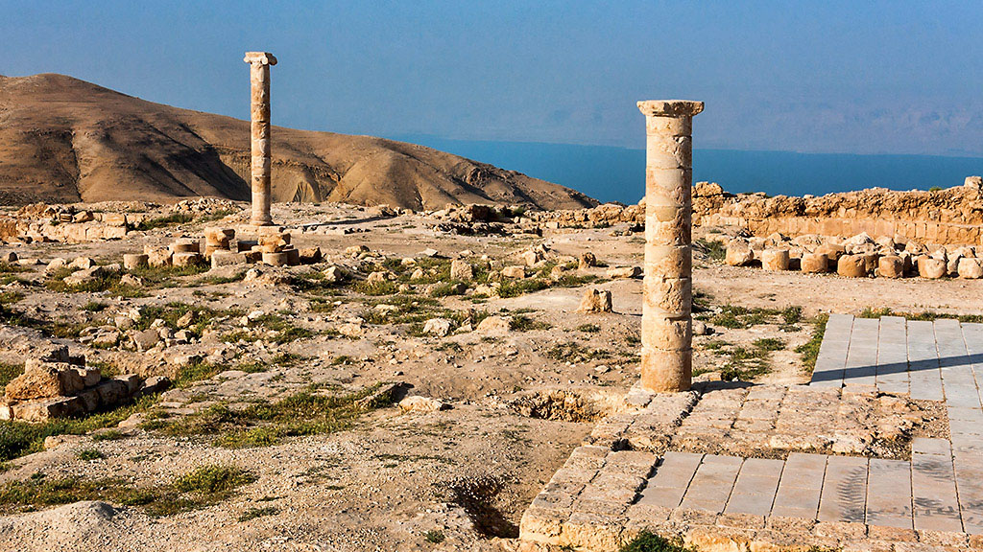
Machaerus
Josephus records that Herod sent John to Machaerus where he was imprisoned and put to death. (Antiquities 18:116-119)
“Machaerus has an impressive location overlooking the Dead Sea from the east. The citadel is located about 2300 feet above sea level. This would make it about 3600 feet above the Dead Sea.” (Quote & photos by Ferrell Jenkins).

Slide 9
The Message Spreads (Mark 6:7—7:37)
Herod Fears Jesus (6:14-29)
Herod’s birthday feast occasions an opportunity for Herodias to have John killed (6:21-29).
The daughter of Herodias dances and pleases Herod.
He promises her whatever she wants up to half his kingdom.
Herodias instructs her to ask for the head of John.
Herod is sorry, but fulfills her request “because of the oaths and because of those who sat with him.”
The executioner beheads John in prison and brings the head to the girl who then presents it to Herodias.
John’s disciples take the corpse and bury it.

Slide 10
The Message Spreads (Mark 6:7—7:37)
Herod Fears Jesus (6:14-29)
Sins that led to John’s death:
An unlawful marriage.
Resentment and bitterness (on the part of Herodias).
A presumably lustful dance.
A rash and prideful promise.
Prideful unwillingness to reverse a sinful promise.

Slide 11
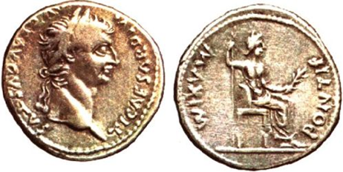
An Unsuccessful Attempt at Rest (Mark 6:30-44)
The apostles return to Jesus and report on their deeds and their preaching (6:30)
Jesus encourages them to come away for some solitude and rest (6:31-32).
Multitudes watch them go and take off after them; they arrive before Jesus and the apostles (6:33).
Jesus has compassion on the multitudes; He teaches them “many things” (6:34).
At evening, the disciples want to send the multitudes away to local villages to buy food (6:35-36).
Jesus challenges His disciples to give them something to eat, but they object that it would take 200 denarii to buy enough food (6:37).
Notes:
11

Slide 12
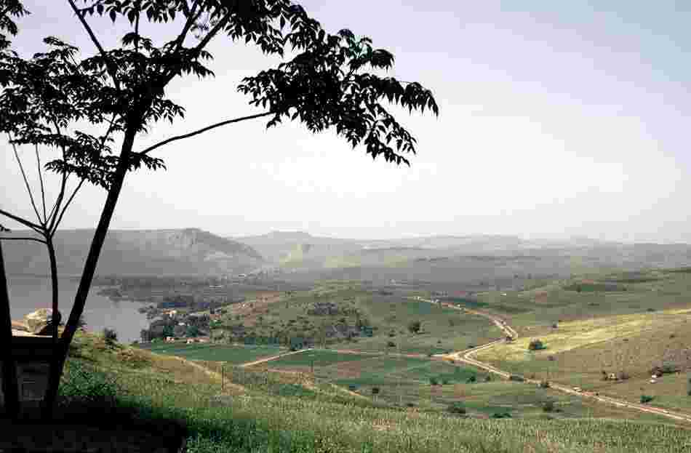
An Unsuccessful Attempt at Rest - Feeding the 5,000 (Mark 6:30-44)
This miracle occurred in the Spring, near the time of the Passover, on the North shore of the Sea of Galilee. It is the only miracle recorded in all four Gospels.
Notes:
12

Slide 13
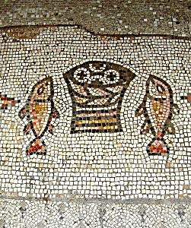
Feeding the 5,000 (Mark 6:38-43)
The disciples could only produce 5 loaves and 2 fish (6:38).
Jesus instructs the disciples to seat the multitudes (5,000 men, plus women and children) on the green grass in groups of 100’s and 50’s (6:39-40).
He blesses the food and gives it to His disciples to give to the multitudes (6:41).
When everyone had eaten their fill, they gathered up 12 baskets of fragments (6:42-43).
Mosaic at Tabgha
Notes:
13

Slide 14
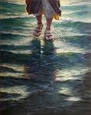
The Trip Back Across the Sea (Mark 6:45-52)
Jesus sends His disciples to the boat to go ahead of Him to the other side, and He sends the multitude away (6:45).
Jesus departs to a mountain to pray (6:46).
At evening, Jesus is alone on land, while the boat is in the midst of the sea (6:47).
Jesus walks on water (6:48-50).
He sees His disciples straining to row against the wind.
About the fourth watch of the night, He walks to them on the sea and “would have passed them by.”
Notes:
14

Slide 15
Jesus Walks on Water (Mark 6:45-52)
The disciples see him and cry out in fear.
Jesus says, “Be of good cheer! It is I. Do not be afraid.”
When Jesus gets in the boat the winds cease.
The disciples marvel and are greatly amazed, because they had not understood the significance of the miracle with the loaves and fish (6:51-52).
Notes:
15

Slide 16
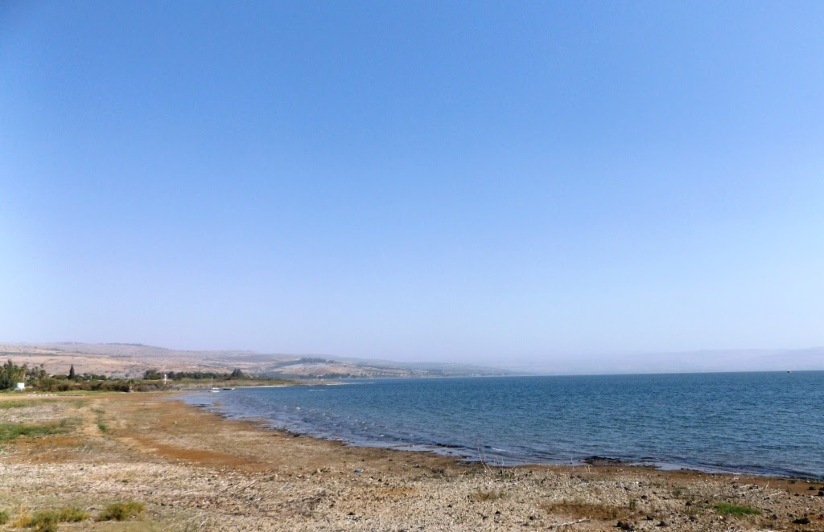
Healing the Sick in Gennesaret (Mark 6:53-56)
Jesus and His disciples anchor the boat at Gennesaret.
They are recognized immediately, and people go throughout the region bringing their sick to Jesus’ location.
People begged to touch the hem of His garment to be made well.
Notes:
16

Slide 17
Jesus VS. Traditions (Mark 7:1-13)
Pharisees and scribes from Jerusalem come to Galilee; they find fault when they observe Jesus’ disciples eat with unwashed hands (7:1-2).
They held to the tradition of the Jewish elders concerning ceremonial washing and purification (7:3-4).
They ask Jesus, “Why do Your disciples not walk according to the tradition of the elders, but eat bread with unwashed hands?” (7:5).

Slide 18
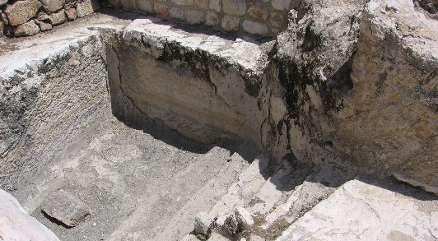
A Mikveh for Ceremonial Washing Near the Temple Site in Jerusalem

Slide 19
Jesus VS. Traditions (Mark 7:1-13)
Jesus responds…
Isaiah had foretold of their hypocrisy (7:6-7; Isa. 29:13).
They teach the commandments and traditions of men while laying aside the commandment of God (7:8-9).
As an example, Jesus refers to their practice of vowing to dedicate funds to God that should have been used to honor indigent parents (7:10-13).

Slide 20
Emphasis on the Heart (Mark 7:14-23)
Jesus explains the true source of uncleanness (7:14-16).
Defilement does not originate from the outside in, but from the inside out.
All need to hear and understand this teaching.
Jesus’ disciples ask Him privately about the teaching and He further clarifies (7:17-23).
Food is processed by the digestive system and does not enter the heart or spiritual center of man; it cannot defile.
The condition of the heart and what comes from it determines whether a man is pure or defiled (cf. Proverbs 4:23).

Slide 21
Jesus Heals a Gentile Woman’s Daughter (Mark 7:24-30)
Jesus withdrew from Galilee to the region of Tyre seeking seclusion, “but He could not be hidden”(7:24)
Notes:
21

Slide 22
Jesus Heals a Gentile Woman’s Daughter (Mark 7:24-30)
A woman whose daughter is demon possessed begs Jesus to heal her daughter (7:25-26).
The woman was Greek (of non-Jewish culture) and of Syrophoenician ancestry.
Jesus responds, “Let the children be filled first, for it is not good to take the children's bread and throw it to the little dogs” (7:27).
The woman says, “even the little dogs under the table eat from the children's crumbs” (7:28).
Jesus tells her that “for this saying” the demon was out of her daughter (7:29).
The woman went home and found her daughter healed (7:30).
Notes:
22

Slide 23
Jesus Heals a Deaf Man (Mark 7:31-37)
Jesus travels through the middle of the Decapolis. and then returns to the Sea of Galilee (7:31).
They brought a deaf man to Him to be healed (7:32).
Jesus took him aside, put His fingers in his ears, spat and touched his tongue and said “Be opened.”
Immediately the man’s ears were opened and his tongue was loosed; he spoke plainly.
Jesus commanded that they tell no one, “but the more He commanded them the more widely they proclaimed it” (7:36).
They were “astonished beyond measure” (7:37)
Witnessing the thoroughness of this miracle, they observe, “He has done all things well.”
Notes:
23

Slide 24
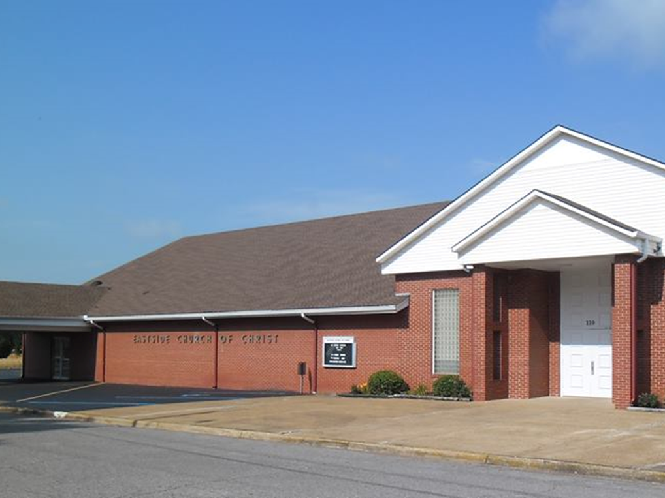
Eastside Church of Christ
Eastside-church.org

