Slide 1
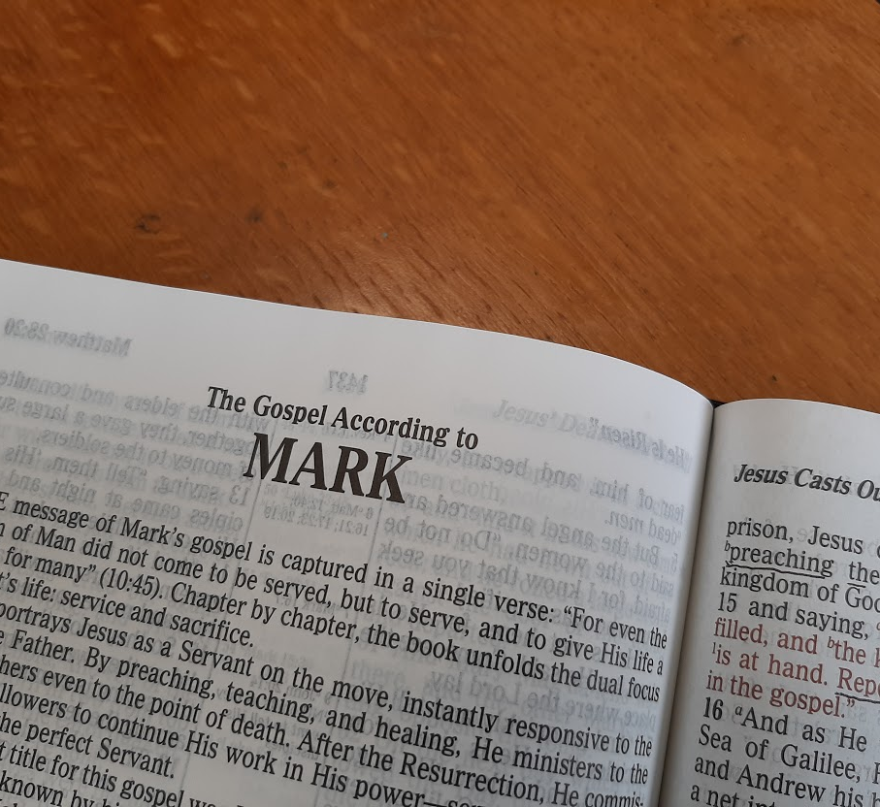
A Study of the Gospel of Mark
Leading the Lost to Belief and Obedience

Slide 2
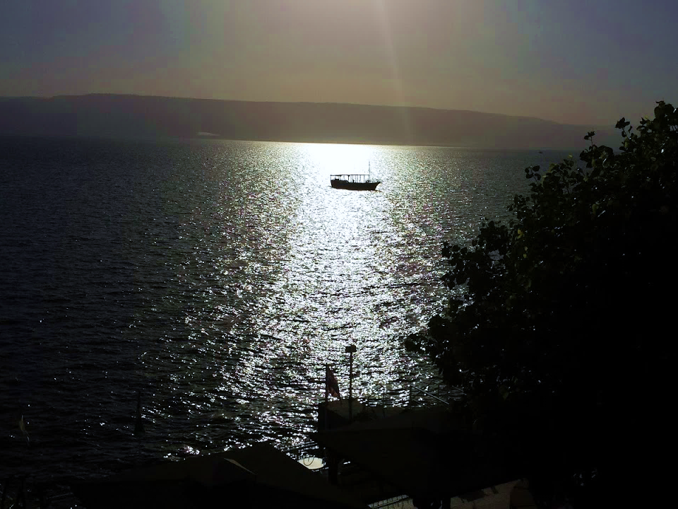
Jesus Does the Impossible
Mark 4:35—6:6

Slide 3
Jesus Does the Impossible (Mark 4:35—6:6)
Jesus Stills the Storm (4:35-41)
After a day of teaching in parables, Jesus wants to cross over the sea. He and the disciples enter the boat.
A great storm arises, and the boat starts taking on water.
Jesus is sleeping on a pillow in the stern. The disciples wake Him saying, “Teacher, do you not care that we are perishing?”
He rebukes the wind and the sea, saying, “Peace be still.”
“There was a great calm.”
Jesus rebukes His disciples for their fear and lack of faith.
Then “they feared exceedingly, and said to one another, "Who can this be, that even the wind and the sea obey Him!”

Slide 4
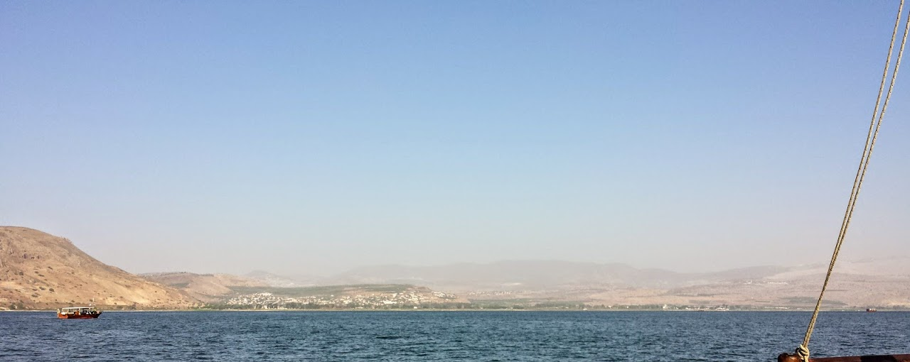
The Sea of Galilee is a pear-shaped lake, with a length from north to south of 13 miles, a maximum width of 8 miles, and a maximum depth of 157 feet. The lake lies 686 feet below sea level, but it is surrounded by steep cliffs and hills, creating swirling wind currents which can foster severe storms.

Slide 5
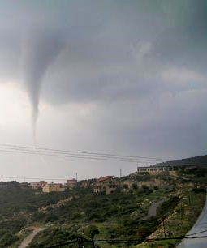
The storm pictured here occurred in Galilee in April of 2006. One resident said, “Believe me, it was like a Tsunami. I thought Hurricane Katrina came to Israel” -- Israel News 04.05.06

Slide 6
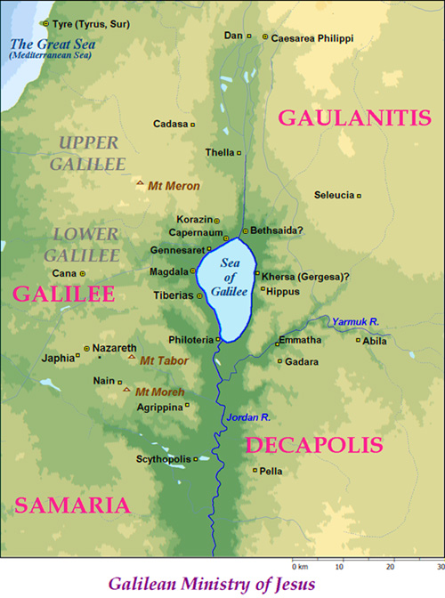
Jesus Does the Impossible
Jesus Stills the Storm (Mark 4:35-41)
What do we learn from this event about different kinds of fear?
What does this event say to us about the humanity and Deity of Jesus?
Notes:
In verse 40 the Greek word for “fearful” is δειλός (deilos), which Thayer says means, “timid, fearful”
In verse 41 the word is φοβέω (phobeō), Thayer’s Definition includes: 1) to be struck with fear, to be seized with alarm
1b1a) of those startled by strange sights or occurrences 1b1b) of those struck with amazement 1b2) to fear, be afraid of one

Slide 7
Jesus Does the Impossible (Mark 4:35—6:6)
Jesus Casts out a Legion of Demons (5:1-20)
Jesus and his disciples disembark in an area inhabited by the Gerasenes (var. Gadarenes or Gergesenes).

Slide 8
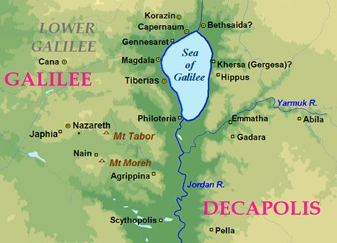
The gospel accounts agree that Jesus came in a boat to the eastern shore of Galilee, to “the country of” the Gergesenes & Gadarenes.

Slide 9
Jesus Does the Impossible (Mark 4:35—6:6)
Jesus Casts out a Legion of Demons (5:1-20)
Jesus and his disciples disembark in an area inhabited by the Gerasenes (var. Gadarenes or Gergesenes).
They meet a man coming out of the tombs who had an unclean spirit (5:2-5)
    No one could successfully bind the man with chains.
    No one could tame the man.
    He dwelt in the mountains and tombs 24/7 crying out and cutting himself.
Notes:
According to Matthew 8:28-34, Jesus and His disciples met two demon possessed men; the accounts of Mark & Luke focus on one.

Slide 10
Jesus Does the Impossible (Mark 4:35—6:6)
Jesus casts out the demons (5:6-13)
  The man runs and worships Jesus.
  When Jesus commands the unclean spirit to come out of the man, he begs Jesus not to torment him.
    The demon called Legion requests to be cast into swine.
  Jesus permits the demons to enter the swine, and the herd of 2,000 runs down a steep embankment into the sea and drowns.

Slide 11
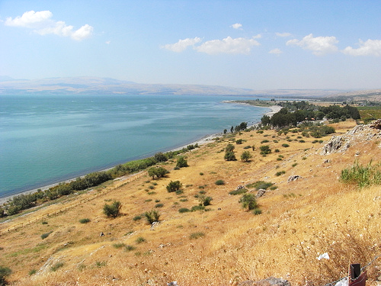
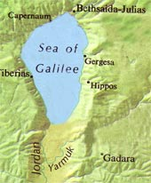
A steep slope descending to the east side of the Sea of Galilee – near Gergesa, modern Kersa

Slide 12
Jesus Does the Impossible (Mark 4:35—6:6)
Jesus Casts out a Legion of Demons (5:1-20)
The swine herders [probably Gentiles] flee and tell of the event in the city and in the country (5:14).
The people of the region come out to see Jesus and the man who had been demon possessed (5:15-16).
They plead with Jesus to depart from their region (5:17).
The man whom Jesus healed asks to accompany Jesus, but Jesus tells him to go home and tell his friends what great things the Lord has done for him (5:18-19).
The man departed and proclaimed his story in the Decapolis, “and all marveled” (5:20).

Slide 13
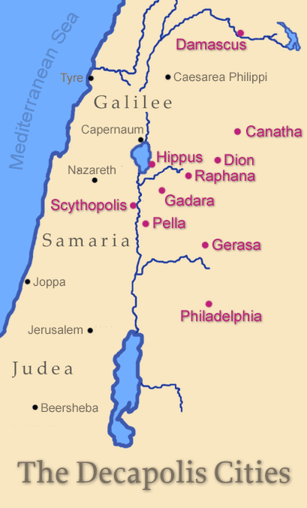
The Decapolis “(Greek: deka, ten; polis, city) was a group of ten cities on the eastern frontier of the Roman Empire in Judea and Syria. The ten cities were not an official league or political unit, but they were grouped together because of their language, culture, location, and political status. The Decapolis cities were centers of Greek and Roman culture in a region that was otherwise [Jewish]” – Wikipedia
Mark is the only gospel writer to mention this region by name (4:25; 5:20; 7:31)

Slide 14
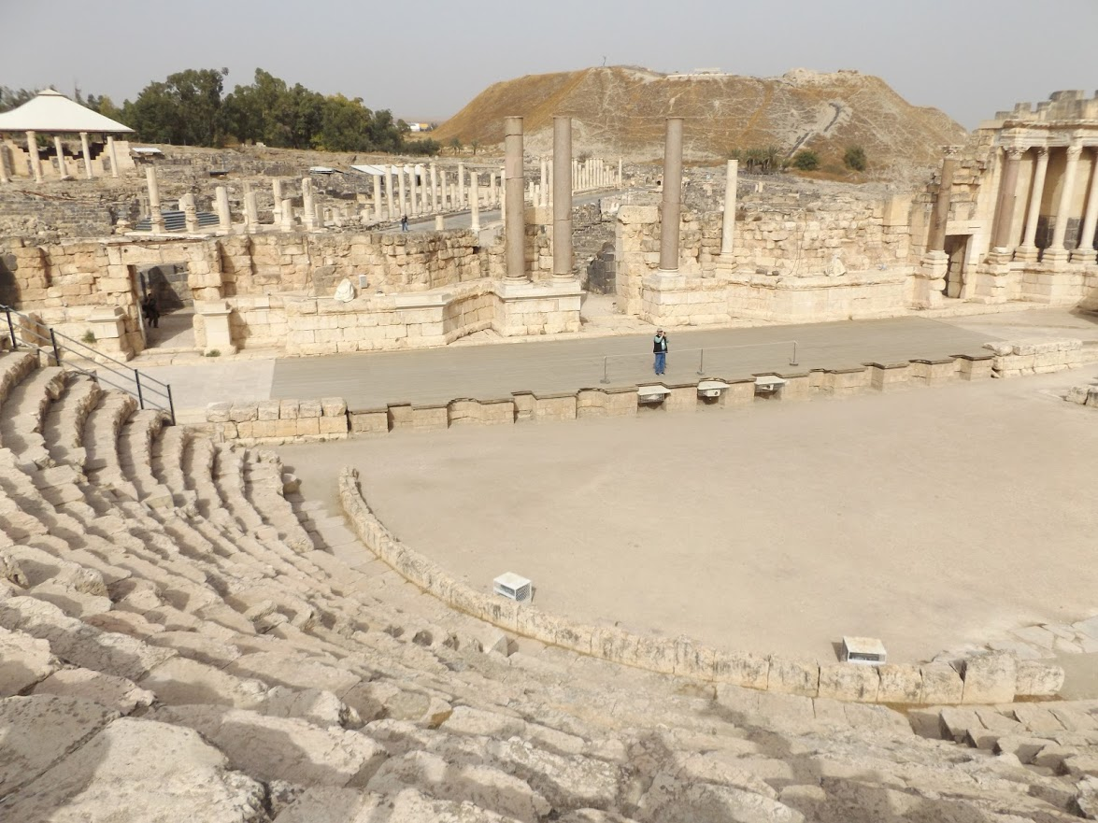
Scythopolis (Beit She’an)

Slide 15
Jesus Does the Impossible (Mark 4:35—6:6)
Jesus heals a Woman with an Issue of Blood and Raises Jairus’ Daughter from the Dead (5:21-43)
  Along with the previous miracle, these two miracles illustrate Jesus’ power to cleanse the unclean.
After Jesus returns to the western shore of Galilee, a ruler of the synagogue named Jairus comes and pleads with Him to heal his dying daughter (5:21-24)
  As Jesus went with him, a multitude thronged around Jesus.

Slide 16
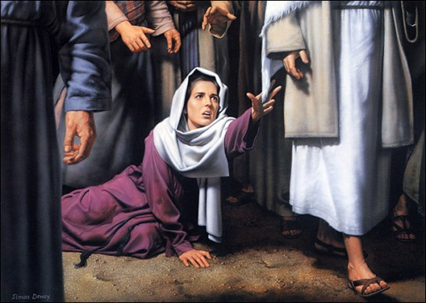
Jesus Does the Impossible (Mark 4:35—6:6)
A woman in the crowd who had suffered with an issue of blood for 12 years touches Jesus’ garment believing she could be healed (5:25-34)
  She is unclean (Lev. 15:25-26).
  She had suffered and spent much seeking healing.
  She is healed when she touches Jesus.
  When Jesus asks, “Who touched me?” she comes forward and tells the whole truth.
  Her faith made her well!
Notes:
*Leviticus 15:25-26 If a woman has a discharge of blood for many days, other than at the time of her customary impurity, or if it runs beyond her usual time of impurity, all the days of her unclean discharge shall be as the days of her customary impurity. She shall be unclean. Every bed on which she lies all the days of her discharge shall be to her as the bed of her impurity; and whatever she sits on shall be unclean, as the uncleanness of her impurity.

Slide 17
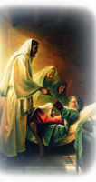
The Raising of Jairus’ Daughter (5:35-43)
  While Jesus is still speaking to the woman, the ruler is informed that his daughter has died.
  Jesus tells Jairus, “Do not be afraid, only believe.”
  Jesus allows only Peter, James and John to follow.
  When Jesus comes to the ruler’s house, He questions why there is such commotion. He says, “The child is not dead but sleeping.”
  He enters the house, takes the child by the hand and says, “Little girl, I say to you arise.”
  Immediately the girl arose and walked. She is 12 years old.
  Jesus commands them not to tell others about the miracle.

Slide 18
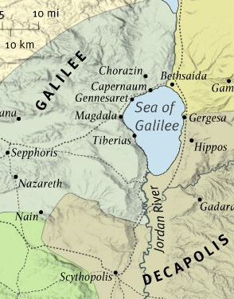
Jesus Does the Impossible
(Mark 4:35—6:6)
Rejection at Nazareth (6:1-6a)
Jesus leaves the Sea of Galilee and travels to Nazareth with His disciples.
People are offended at His teaching and miracles since they knew Him and His family.
Jesus observes that a prophet is honored, but not among those familiar with him.
He did no mighty work there except for healing a few; He marveled at their unbelief.

Slide 19
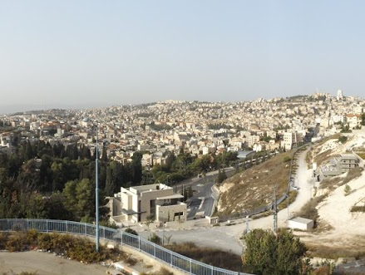
Modern Nazareth

Slide 20
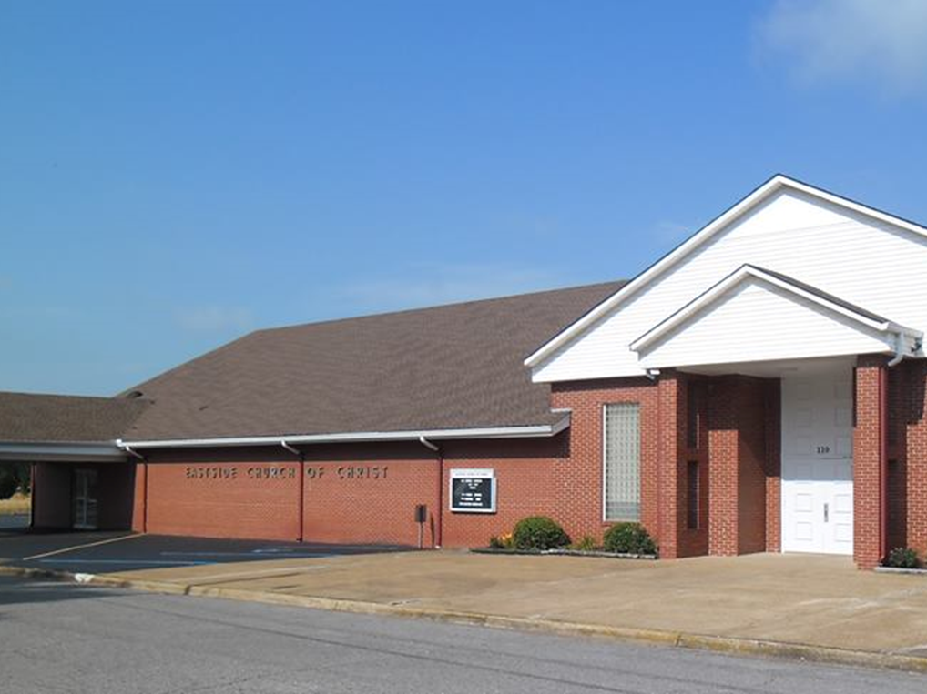
Eastside Church of Christ
Eastside-church.org

