Slide 1


Major Lessons from the Minor Prophets
Amos  Hosea  Zephaniah  Zechariah

Slide 2
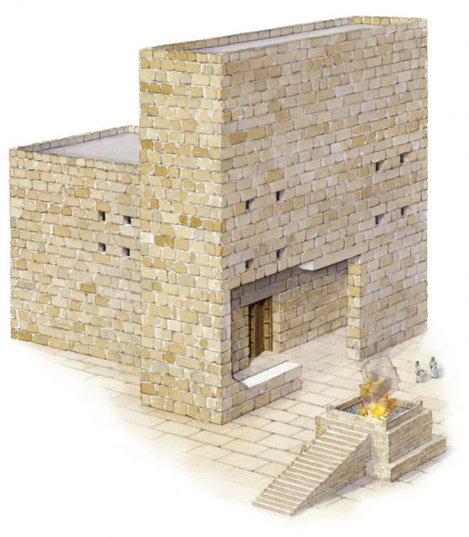
Theme of Zechariah
The Jews were to build the temple and prepare themselves for the coming Messiah who would build the true temple.
Zechariah 4:9
“The hands of Zerubbabel have laid the foundation of this temple; his hands shall also finish it. Then you will know that the LORD of hosts has sent Me to you.”
Zechariah 6:12-13
“Then speak to him, saying, ‘Thus says the LORD of hosts, saying: Behold, the Man whose name is the BRANCH! From His place He shall branch out, And He shall build the temple of the LORD; Yes, He shall build the temple of the LORD. He shall bear the glory and shall sit and rule on His throne; So He shall be a priest on His throne, and the counsel of peace shall be between them both.’”

Slide 3
The Coming Kingdom of God Zechariah 9-14
Chapter 14: The Purity of the Messiah’s Kingdom
The day is coming when spiritual Jerusalem would be savagely attacked (14:1-2)
Although many would fall, the remnant would not be cut off from the city.
The Lord will fight for His people and provide an escape (14:3-5)
Note: Premillennialists apply this literally to the second coming/1000 year reign of Christ.
The fact that it occurs “in that day” proves that it must refer to what the Lord accomplished at His first coming (cf. Zech. 12:10-11; 13:7; John 19:37; Matthew 26:31).
Light comes at night and living waters flow (14:6-8)
Notes:
Matthew 26:31 Then Jesus said to them, "All of you will be made to stumble because of Me this night, for it is written: 'I WILL STRIKE THE SHEPHERD, AND THE SHEEP OF THE FLOCK WILL BE SCATTERED.’
John 19:34-37 But one of the soldiers pierced His side with a spear, and immediately blood and water came out. 35 And he who has seen has testified, and his testimony is true; and he knows that he is telling the truth, so that you may believe. 36 For these things were done that the Scripture should be fulfilled, "NOT ONE OF HIS BONES SHALL BE BROKEN." 37 And again another Scripture says, "THEY SHALL LOOK ON HIM WHOM THEY PIERCED.“

Slide 4
The Coming Kingdom of God Zechariah 9-14
Chapter 14: The Purity of the Messiah’s Kingdom
The Lord will be King over all the earth (14:9)
Jerusalem will be inhabited and peaceful (14:10-11)
A plague will come upon all those who sought to destroy Jerusalem (14:12-14)
All will come to worship the King, and those who refuse will not receive blessings but a plague (14:16-19)
Everything in the Kingdom, from the bells on the horses to the food in the pots shall be “holiness to the Lord” (14:20-21; Romans 12:1)
“He does not bring down what is sacred to a level with common things, but he uplifts ordinary things, that they too, should be sacred, as Paul says, ‘whether ye eat or drink or whatsoever ye do, do all to the glory of God.’” (1Cor. 10:31) – Albert Barnes
Notes:
Romans 12:1 I beseech you therefore, brethren, by the mercies of God, that you present your bodies a living sacrifice, holy, acceptable to God, which is your reasonable service.

Slide 5
Keys to Understanding the Prophets
Consider the political, moral, social, and religious conditions of the time in which the prophet lived.
Consider God’s relation to heathen nations, especially as they interacted with Israel.
Observe the prophecies concerning the coming King and His everlasting Kingdom – the true hope for the future of God’s people.
-- Robert Harkrider, (Minor Prophets
“Spokesmen of God” p. 3)

Slide 6
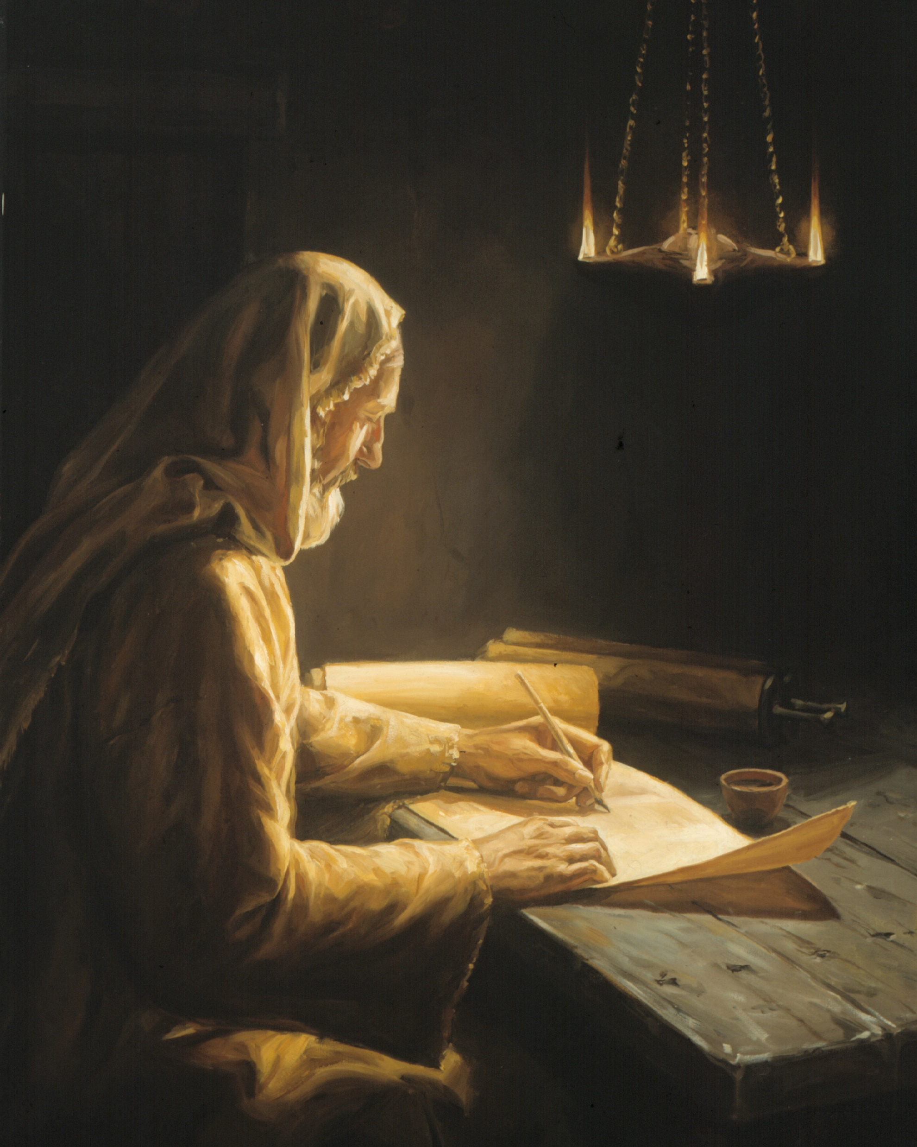
Outline of Amos
Judgment on Eight Nations, "For three transgressions and for four“ (1:3‑‑2:16)
On Damascus (1:3‑5)
On Gaza of Philistia (1:6‑8)
On Tyre (1:9‑10)
On Edom (1:11‑12)
On Ammon (1:13‑15)
On Moab (2:1‑3)
On Judah (2:4‑5)
On Israel (2:6‑16)

Slide 7
Outline of Amos
II. Three Sermons Pronouncing the Judgment of Israel (3:1‑‑6:14)
Sermon to the "whole family" of Israel ‑ A sermon of present warning (3:1‑15)
Sermon to the "cows of Bashan" ‑ Past judgments have gone unheeded (4:1‑13)
Sermon of "lamentation" and "woe" ‑ The future judgment of God on Israel would be overwhelm­ing (5:1‑‑6:14)
III. Five Visions of the Judgment of Israel (7:1‑‑9:10)
Locust (7:1‑3)
Fire (7:4‑6)
The plumb line (7:7‑9)
[Historical Parenthesis] (7:10‑17)
The summer fruit (8:1‑14)
The door posts of the sanctuary (9:1‑10)
IV. Promises of a Bright Future for Spiritual Israel (9:11‑15)

Slide 8
Outline of Hosea
I. God’s love and Israel's adultery, illustrated by Hosea's experience with a wife of harlotry (1-3)
A. Hosea's adulterous wife Gomer (chapter 1).
B. God's adulterous wife Israel (chapter 2).
C. Hosea's "tough love" restores his wife, as God's love would restore Israel (chapter 3).
II. Prophetic discourses on adulterous Israel and her faithful God (4-13)
A. Israel's sins detailed (chapters 4-8).
B. Israel's punishment determined (chapters 9-11).
C. Israel's continuing sin provokes a jealous and loving God (chapters 12-13).
III. Israel's restoration decreed (14)

Slide 9
Outline of Zephaniah
I. God's Judgment upon Judah (1:1-18).
A. A Complete Judgment (1:1-6).
B. An Inevitable Judgment (1:7-13).
C. A Devastating Judgment (1:14-18).
II. God's Call for Judah's Repentance (2:1--3:8).
A. Repent! They may be hidden in the day of the Lord (2:1-3).
B. Repent! For God will judge all the nations (2:4-15).
1. Philistia to the West (2:4-7).
2. Moab and Ammon to the East (2:8-11).
3. Ethiopia to the South (2:12).
4. Assyria to the North (2:13-15).
C. Repent! For if God will judge all the surrounding nations, He will not spare Judah (3:1-7).
III. After judgment, salvation for the remnant (3:8-20).

Slide 10
Outline of Zechariah
Introductory admonition to return to the Lord (1:1-6)
Eight Visions of encouragement and consolation (1:7—6:15).
The horsemen among the myrtle trees (1:7-17).
The four horns and four craftsmen (1:18-21).
The man with the measuring line (2:1-13).
The cleansing of Joshua the High Priest (3:1-10).
The golden lamp stand and the 2 olive trees (4:1-14).
The flying scroll (5:1-4).
The woman in the basket (5:5-11).
Vision of the four chariots (6:1-8).
Symbolic reality: the crowning of Joshua (6:9-15)

Slide 11
Outline of Zechariah
Acceptable fasting and mourning (7:1—8:23).
The question concerning the annual fast (7:1-3).
The fast should be for God and not for self (7:4-7).
God is pleased with righteousness, not hard hearts (7:8-14)
Israel's restoration calls for practicing this righteousness (8:1-17)
In the future, Israel's fasts become occasions of joy and gladness (8:18-23)
III. Destruction of the kingdoms of men and the establishment of the Kingdom of God (9:1—14:21).
Judgment upon the heathen world (9:1-7).
The coming King and His Kingdom (9:8-17).
The redemption and prosperity of the people of God (10:1-12).
Allegory of the shepherds (11:1-17).
“In that day,” God will bless and deliver new Jerusalem, and a fountain for forgiveness will be opened (12:1—13:6).
The purity of the Messiah's Kingdom (13:7—14:21).

Slide 12
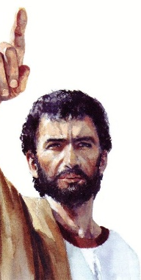
Great Themes of the Minor Prophets
God’s Righteous Judgments and Just Punishments
God’s Merciful Redemption of the Remnant (Amos 9:11-15; Hosea 14; Zeph. 2:9; 3:13)
God’s Glorious Hope for the Future – The King is Coming! (Hosea 3:5; Zeph. 3:14-17; Zech. 6:12-13; 9:9; 14:9, 16-17)
Notes:
Zephaniah 2:9 Therefore, as I live,” declares the LORD of hosts, the God of Israel, “Moab shall become like Sodom, and the Ammonites like Gomorrah, a land possessed by nettles and salt pits, and a waste forever. The remnant of my people shall plunder them, and the survivors of my nation shall possess them.”
Zephaniah 3:13 those who are left in Israel; they shall do no injustice and speak no lies, nor shall there be found in their mouth a deceitful tongue. For they shall graze and lie down, and none shall make them afraid.”
Zephaniah 3:14-17 Sing aloud, O daughter of Zion; shout, O Israel! Rejoice and exult with all your heart, O daughter of Jerusalem! 15 The LORD has taken away the judgments against you; he has cleared away your enemies. The King of Israel, the LORD, is in your midst; you shall never again fear evil. 16 On that day it shall be said to Jerusalem: “Fear not, O Zion; let not your hands grow weak. 17 The LORD your God is in your midst, a mighty one who will save; he will rejoice over you with gladness; he will quiet you by his love; he will exult over you with loud singing.

Slide 13
Great Themes of the New Testament
God’s Righteous Judgments and Just Punishments (Romans 3:19, 23; Rev. 19:1-2)
God’s Merciful Redemption of the Remnant (Romans 11:5; 2 Timothy 1:9; Titus 3:4-5)
God’s Glorious Hope for the Future – The Return of the King! (Matthew 25:31-46)
Notes:
Romans 3:19 Now we know that whatever the law says, it says to those who are under the law, that every mouth may be stopped, and all the world may become guilty before God.
Revelation 19:1-2 After these things I heard a loud voice of a great multitude in heaven, saying, "Alleluia! Salvation and glory and honor and power belong to the Lord our God! 2 For true and righteous are His judgments, because He has judged the great harlot who corrupted the earth with her fornication; and He has avenged on her the blood of His servants shed by her.“
Romans 11:5 Even so then, at this present time there is a remnant according to the election of grace.
2 Timothy 1:9 who has saved us and called us with a holy calling, not according to our works, but according to His own purpose and grace which was given to us in Christ Jesus before time began,
Titus 3:4-5 But when the kindness and the love of God our Savior toward man appeared, 5 not by works of righteousness which we have done, but according to His mercy He saved us, through the washing of regeneration and renewing of the Holy Spirit,

Slide 14

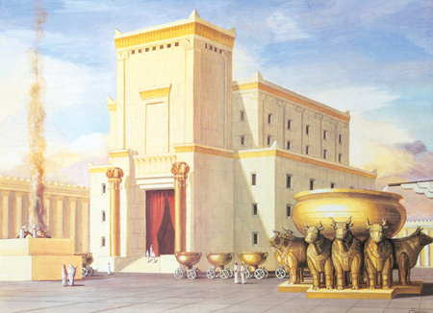
Solomon’s Temple compared to Zerubbabel’s Temple

