Slide 1

The Prison Epistles
A Study of the Letters Paul Wrote While Imprisoned in Rome
Ephesians, Philippians, Colossians, & Philemon

Slide 2
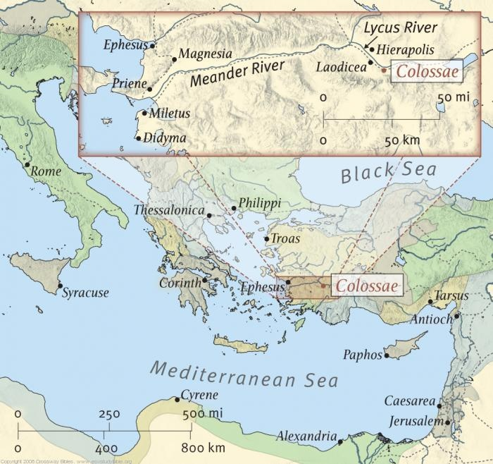

Slide 3
How do we know which Epistles were written from prison?
Ephesians:
(3:1, 4:1) Calls himself a prisoner.
(6:20) Ambassador in bonds.
Philippians:
(1:7,13,14,16) Refers to his bonds (imprisonment).
(1:13) Refers to the Praetorian Guard (NASV).
(4:22) Caesar’s household.
Colossians:
(4:3) Refers to himself as a prisoner.
(4:10) Fellow prisoner to Aristarchus.

Slide 4
How do we know which Epistles were written from prison?
Philemon:
(9) Calls himself a prisoner.
(10) Bonds (imprisonment).
(23) Fellow prisoner with Ephaphrus.

Slide 5
Outline of Ephesians
All spiritual blessings are from God and available to man “in Christ” (1:3, Chapters 1 - 3) God showed his favor toward man, He gave his Son to purchase the forgiveness of our sins, and He provided a plan for our salvation and fellowship with Him.
Walk worthy of your calling (4:1, Chapters 4 - 6) Because of what God has done for us, and because of the great price that was paid for our sins and the great benefit we have as Christians, we must follow God as children, living as our Father instructs us.

Slide 6
Outline of Philippians
Major Theme: Joy in the Lord.
“Joy” found five times. “Rejoice” found eleven.
Despite being in custody awaiting trial, Paul found reason to rejoice in this good church.
Outline of Major Themes.
Chapter 1: Paul’s Present Circumstances.
Chapter 2: Have the Mind, Attitude of Christ.
Chapter 3: Have the Knowledge of Christ.
Chapter 4: Have the Peace of Christ.

Slide 7
Outline of Colossians
Christ is the Head of all Things in Creation and Redemption. Col. 1:1-29.
Don’t be Led Away from Christ. Col. 2:1-23.
Live as those Chosen by God. Col. 3:1-4:6.
Concluding Remarks Col. 4:7-18.
Christ, rather than human rituals and philosophies, is all that you need.

Slide 8
Outline of Philemon
Outline:
Salutation (1-3)
Note of Philemon’s faith and love (4-7)
Paul’s appeal to Philemon on behalf of Onesimus (8-22)
Final greetings (23-25)

Slide 9
Ephesians, Philippians, Colossians, Philemon - Select Passages in Review
Deity of Christ
Php 2:5-11
Col 1:15-19
(John 5:17-18, John 10:30-33, John 1:1,14)

Slide 10
Ephesians, Philippians, Colossians, Philemon - Select Passages in Review
Authority of Christ
Eph 1:17-23
Col 1:14-18
Col 3:17
(Matt 15:9-14)

Slide 11
Ephesians, Philippians, Colossians, Philemon - Select Passages in Review
The Lord’s church
Eph 1:20-23
Eph 3:10-12
Eph 4:4

Slide 12
Ephesians, Philippians, Colossians, Philemon - Select Passages in Review
Change in the law
Eph 2:13-16
Col 2:14-17 (Shadows: I Cor 5:7, Heb 4:9)
Rom 7:12, Heb 8:7, Gal 3:24-25 As you are growing up, you have clothes that you outgrow. While there may be nothing wrong with the clothes themselves, you lay them aside for other, better clothes.

Slide 13
Ephesians, Philippians, Colossians, Philemon - Select Passages in Review
Understanding the Bible
Eph 3:3-4
Eph 5:17

Slide 14
Ephesians, Philippians, Colossians, Philemon - Select Passages in Review
Grace, faith and works
Eph 1:7
Eph 2:8-10

Slide 15
Ephesians, Philippians, Colossians, Philemon - Select Passages in Review
Baptism
Eph 4:5
Col 2:11-13

Slide 16
Ephesians, Philippians, Colossians, Philemon - Select Passages in Review
Walking worthy of our calling, old man / new man
Eph 4 – 6
Col 3 - 4

Slide 17
Ephesians, Philippians, Colossians, Philemon - Select Passages in Review
Husbands / wives, servants / masters, parents / children
Eph 5 - 6
Col 3 – 4
Phm

Slide 18
Ephesians, Philippians, Colossians, Philemon - Select Passages in Review
Husbands / wives, servants / masters, parents / children
Considering the concept from Philemon and Onesimus concerning Onesimus’ responsibility after baptism. Even after baptism, Onesimus still held his responsibility to Philemon and had to return to him. Onesimus was still Philemon’s servant.
Considering an unlawful husband and wife relationship (an unlawful marriage), one would have to leave their partner even after baptism because that relationship would continue, but should not continue to exist (Mark 6:16-18 “not lawful to have”, I Cor 6;11 “were”). If that relationship still exists (they still have their partner), they would still be in adultery after baptism.

Slide 19
Ephesians, Philippians, Colossians, Philemon - Select Passages in Review
Humility
Php 2:3-4
Phm

Slide 20
Ephesians, Philippians, Colossians, Philemon - Select Passages in Review
Dealing with adversity
Eph 6:10-18
Php 4:6-13

Slide 21
Ephesians, Philippians, Colossians, Philemon - Select Passages in Review
Inheritance
Eph 1:18, 5:5
Col 1:12, 3:24

