Slide 1

Did the Bible come from God?
The Proof that’s in the Prophecies!
(Prophecies in Daniel)

Slide 2

Proof that the Bible Came from God
Fulfilled Prophecy
The Bible foretells future events with accuracy, often hundreds of years before they occur.
Only a true and living God has such power! (Isaiah 46:9-10; 42:9).
The fact that the Bible is filled with such accurate prophecies demonstrates that it is a product of the mind of God!

Slide 3
Proof that the Bible Came from God
Fulfilled Prophecy
“For we did not follow cunningly devised fables when we made known to you the power and coming of our Lord Jesus Christ, but were eyewitnesses of His majesty….And we heard this voice which came from heaven when we were with Him on the holy mountain. And so we have the prophetic word confirmed, which you do well to heed as a light that shines in a dark place, until the day dawns and the morning star rises in your hearts” (2 Peter 1:16, 18, 19).

Slide 4

W O R L D H I S T O R Y I N P R O P H E C Y

Slide 5
The Date of Daniel
In order to appreciate the power of the prophecies contained in Daniel, one must assign an accurate date to the writing of the book .
As R. D. Wilson states in the International Standard Bible Encyclopedia, “With the exception of the neo-Platonist Porphyry, a Greek non-Christian philosopher of the 3rd century AD, the genuineness of the Book of was denied by no one until the rise of the deistic movement in the 17th century.”
Those who refuse to believe that such prophecies are possible are compelled to date the book later than the things it prophesies.
The evidence is overwhelmingly against a late date for the Book of Daniel.

Slide 6

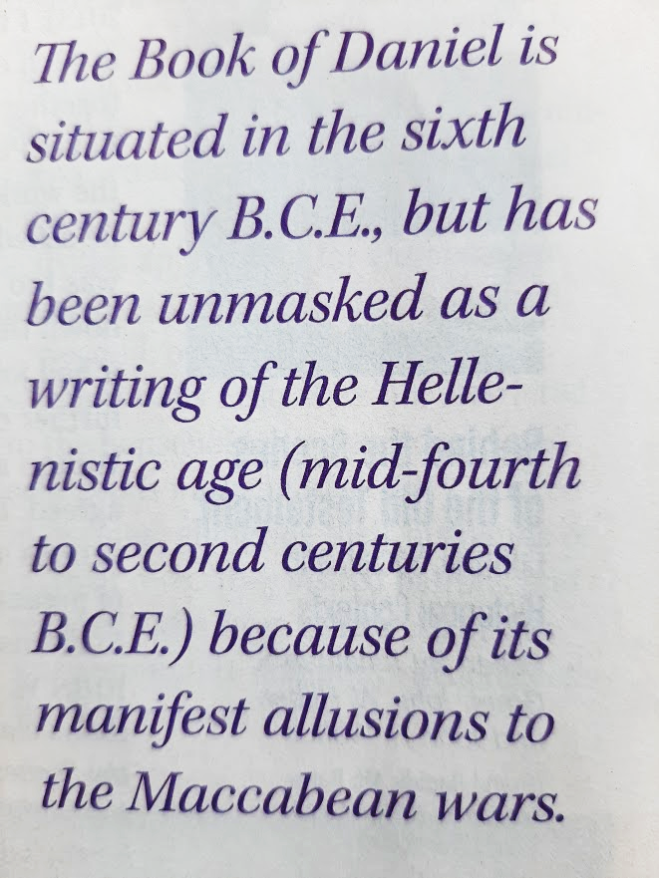
How Old is the Hebrew Bible? Ronald. S. Hendel and Jan Joosten January/February 2020 Vol. 46 No.1
Skeptics must deny the early date of Daniel!
“The Book of Daniel is situated in the sixth century B.C.E., but has been unmasked as a writing of the Hellenistic age (mid-fourth to second centuries B.C.E) because of its manifest allusions to Maccabean wars.”

Slide 7
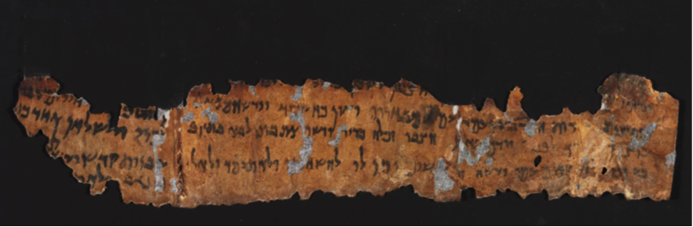
The Date of Daniel
Lines of evidence supporting an early date:
Language
Hebrew AND Aramaic, not Greek.
Borrowed old Persian words (e.g. Ashpenaz)
Dead Sea Scrolls
The EIGHT manuscripts of Daniel found among the Dead Sea Scrolls is a number on par with the number of manuscripts of accepted older OT texts.
The 2nd century B.C. dates for the two oldest Daniel manuscripts preclude it being forged in the second century.

Slide 8
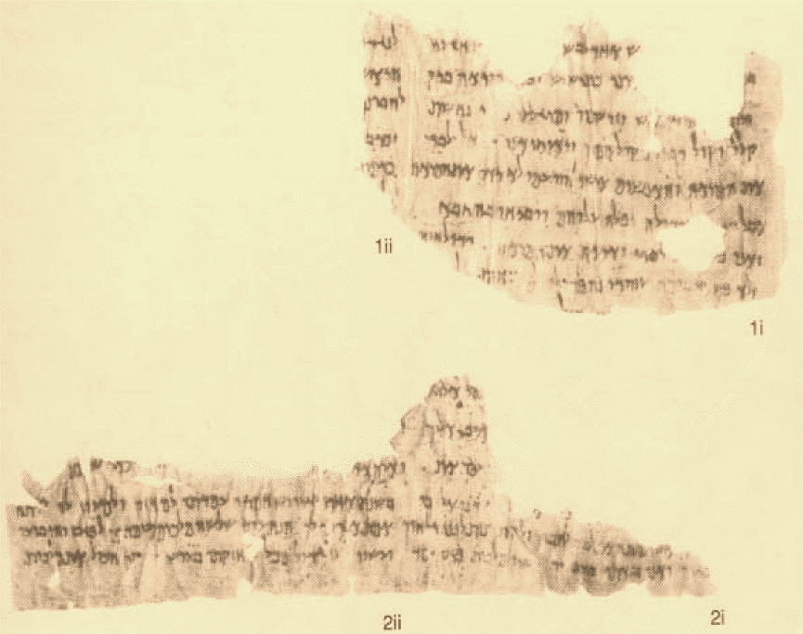
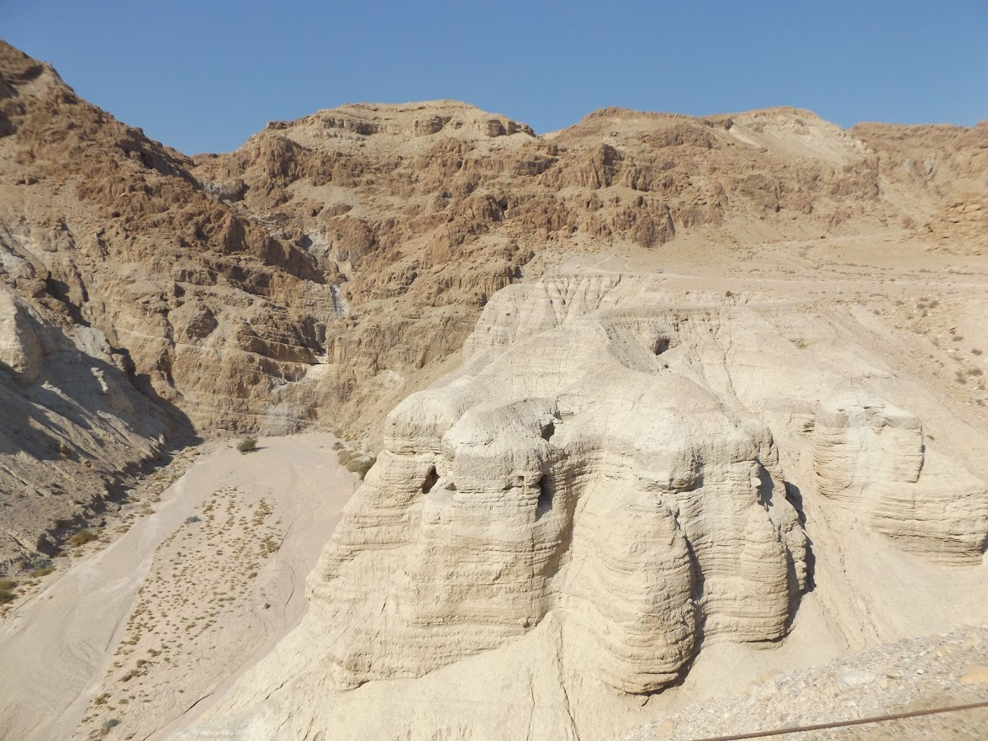
These fragments of Daniel from one of the Dead Sea Scrolls are among the oldest extant copies of the book. Found in Cave 4 at Qumran, they date from 100 to 150 BC.

Slide 9
The Date of Daniel
Lines of evidence supporting an early date:
Language
Hebrew AND Aramaic, not Greek.
Borrowed old Persian words (e.g. Ashpenaz)
Dead Sea Scrolls
The EIGHT manuscripts of Daniel found among the Dead Sea Scrolls is a number on par with the number of manuscripts of accepted older OT texts.
The 2nd century B.C. date of the oldest Daniel manuscript would preclude it being forged in the second century.
Use by other inspired writers (Ezekiel 14:13-21; 28:2-4; Matthew 24:15; Daniel 9:26-27; 11:31; 12:11)
Josephus states that the book of Daniel was shown to Alexander the Great (circa 332 B.C.)

Slide 10
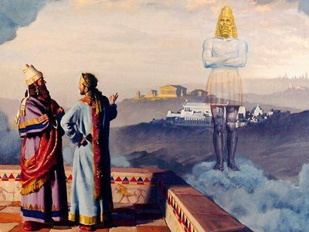
Daniel tells the King about his dream
Daniel 2 – Nebuchadnezzar’s Dream

Slide 11
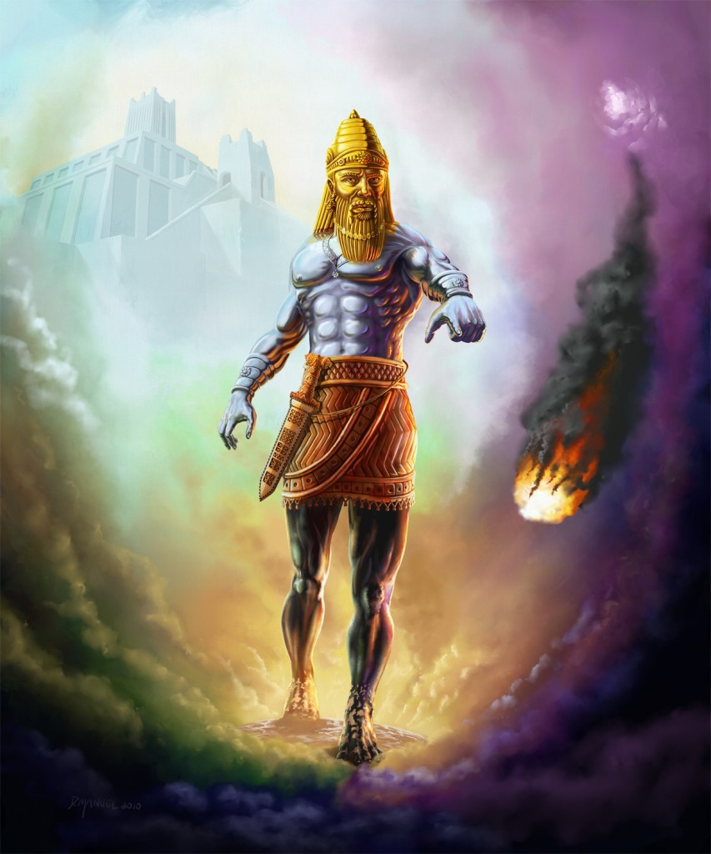
Daniel 2:31-45
Head of Gold Babylon (605-539 BC)
Chest & Arms of Silver Medo-Persia (539-331 BC)
Belly & Thighs of Brass Greece (331-168 BC)
Legs of Iron; feet mixed w/clay Rome (168 BC – 476 AD)
IN THE DAYS OF THESE KINGS the eternal kingdom would be established

Slide 12
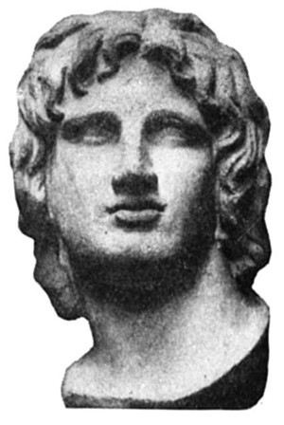
Alexander the Great in Bible Prophecy
Although Alexander the Great is not mentioned by name in the Bible, he is definitely the subject of a number of Bible prophecies, particularly in Daniel chapters 8 & 11.

Slide 13
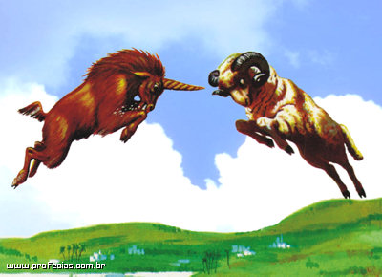
Fulfilled prophecy relating to Persia, Greece, Alexander the Great, and the division of his empire.
These prophecies were made BEFORE the time of Alexander!
“And when the book of Daniel was showed to him (Alexander the Great) wherein Daniel declared that one of the Greeks should destroy the empire of the Persians, he supposed that himself was the person intended.” (Josephus, Antiquities of the Jews, 11.8.5)
Daniel 8:1-8, 19-22

Slide 14
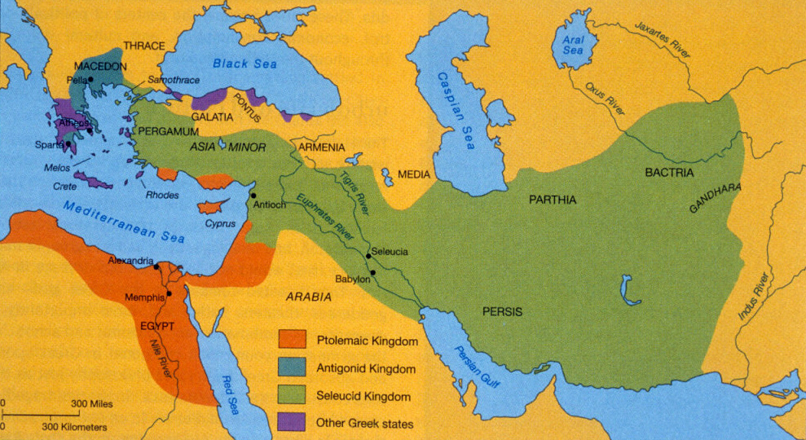
The prophecies of Daniel 8:1-8, 19-22 & 11:3-4 concern Alexander’s conquest of Persia and the ultimate dividing of his kingdom into four parts.
Alexander’s empire was divided between FOUR victorious princes, Ptolemy, Seleucus, Cassander, and Lysimachus.

Slide 15
Background of Daniel 11
Daniel 10 serves as the dramatic introduction to the prophecies of Daniel 11.
The amazing details of Daniel 11, describing the activities of the Ptolemies and the Seleucids in the period between the testaments, relate directly to the well being of Israel.
In Daniel 10:14, Daniel was told that “the vision refers to many days yet to come" and that it concerns “what will happen to your people in the latter days.”

Slide 16
Daniel 11:1-2
Four great kings would arise in Persia, the last of whom would stir up all against Greece (11:2).
Cyrus II the Great (538-530 BC)
Cambyses II (529-522 BC) [Gaumata 522 BC]
Darius I the Great (521-486 BC)
Xerxes (Ahasuerus) (485-465 BC)
Defeated at Salamis in 480 BC
Note that he deposes Vashti in 482 BC and chooses Esther in 477 BC (Esther 1:3; 2:16ff).

Slide 17
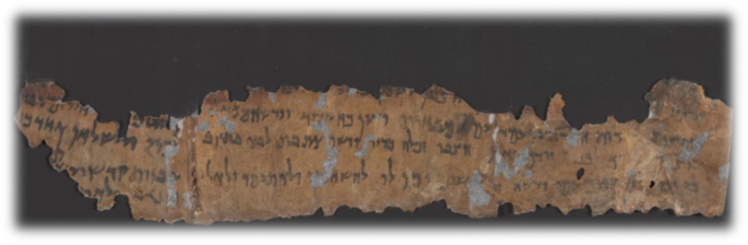
Daniel 11:3-4
The “mighty king” who arose in Greece and ruled with “great dominion” is undoubtedly Alexander the Great (11:3).
His kingdom was divided into four parts (11:4, cf. 8:8)
EGYPT (SOUTH): Ptolemy I Soter I (323-285 BC)
SYRIA (NORTH): Seleucus I Nicator (321-281 BC)
THRACE & ASIA MINOR: Lysimachus
MACEDONIA: Cassander
NOTE: The interactions between Egypt and Syria would greatly affect the wellbeing of Israel for hundreds of years!
In DANIEL 11, the “king of the north” refers to the Seleucid king and the “king of the south” the Ptolemaic king.

Slide 18
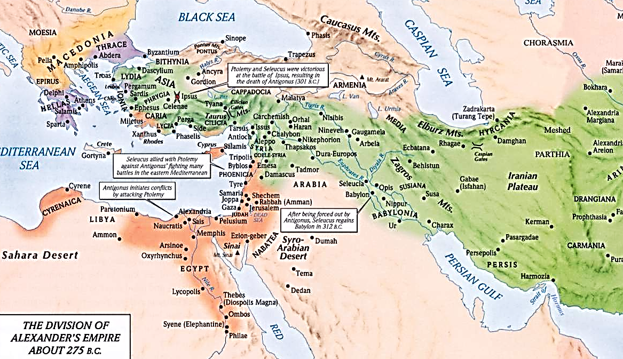

Slide 19
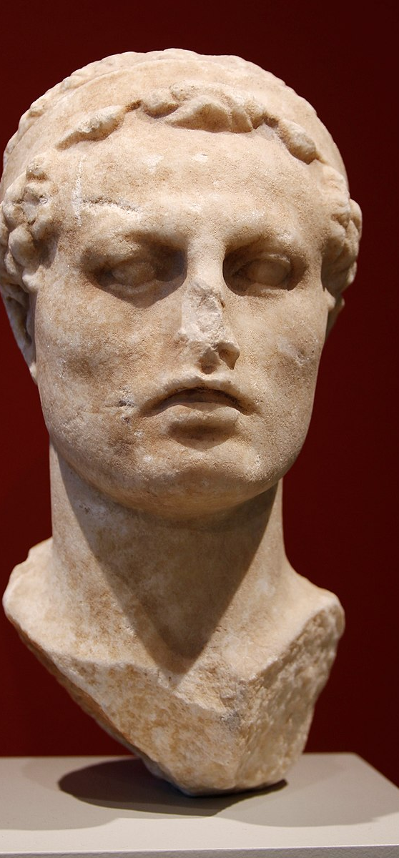
Antiochus Epiphanes in Daniel 11
Antiochus Epiphanes ruled as the Seleucid (Greek) king of the north from 175 to 164 B.C.
He is sometimes identified as the “little horn” of Daniel 8:9-12, 23-25.
His oppression of the Jews led to the rebellion by the Maccabees.
Daniel 11:28 foretells of Antiochus returning home from a military campaign with the wealth of plunder, and moving “against the holy covenant” (11:28)

Slide 20
Daniel 11:29-30a
During the next campaign of Antiochus into Egypt, he is humiliated by the Roman General Popillius Laenas
“Popillius acted in a manner which was thought to be offensive and exceedingly arrogant. He was carrying a stick cut from a vine, and with this he drew a circle round Antiochus and told him he must remain inside this circle until he gave his decision about the contents of the letter. The king was astonished at this authoritative proceeding, but, after a few moments' hesitation, said he would do all that the Romans demanded. Upon this Popilius and his suite all grasped him by the hand and greeted him warmly. The letter ordered him to put an end at once to the war with Ptolemy. So, as a fixed number of days were allowed to him, he led his army back to Syria, deeply hurt and complaining indeed…” (Polybius, The Histories, Fragments of Book XXIX, published in Vol. VI of the Loeb Classical Library edition, 1922-1927).

Slide 21

Daniel 11:30-31
Daniel prophesies that as Antiochus returns back from this campaign, “he shall return and show regard for those who forsake the holy covenant. And forces shall be mustered by him, and they shall defile the sanctuary fortress; then they shall take away the daily sacrifices, and place there the abomination of desolation.” (11:30-31)
“When Antiochus returned from Egypt in 167 he took Jerusalem by storm and enforced its Hellenization. The city forfeited its privileges and was permanently garrisoned by Syrian soldiers.” (“Antiochus IV Epiphanes,” The Encyclopedia Britannica, 2003).
“Ancient sources recount that he outlawed the Jewish religion and ordered the Jews to worship Greek gods…his soldiers descended upon Jerusalem, massacring thousands of people and desecrating the city’s holy Second Temple by erecting an altar to Zeus and sacrificing pigs within its sacred walls.” (History.com, Hanukkah, 9/12/18)

Slide 22

Daniel 11 and the Maccabean Wars
The Maccabees:
A priest named Mattathias and his five sons throw off Syrian/Seleucid rule and eventually gain a measure of independence for the Jews until conquered by the Roman General Pompey in 63 BC.
Known has “the Maccabees” after the nickname (the hammer) given to Judas, the third son of Mattathias.
Their dynasty is called the Hasmonean Dynasty, after the great-grandfather of Mattathias.
The best witnesses that Daniel is actually describing the deeds of the Maccabees are the modern scholars who deny the early date of Daniel!!!!!

