Slide 1


A C T S
Go Tell
the Good
News!
Lesson 5  Acts 4

Slide 2
Repent, so that…
Review
Sins may be blotted out
Times of refreshing may come
That He may send Jesus, the Christ…
Whom heaven will keep until the period of restoration of all things spoken of by God through His prophets:
A prophet like Moses (Deut. 18:15,18-19)
Foretold by all the prophets from Samuel onward
"You are the sons of the prophets and of the covenant"
Covenant made with Abraham (Gen 12:3; 22:18)
God raised Him up for you….first…to bless you by turning you away from sin.

Slide 3
Peter & John Arrested Acts 4:1-4
As Peter and John spoke to the people on Solomon’s porch, “the priests, the captain of the temple, and the Sadducees came upon them.”
At what were they “greatly disturbed?”
Why would this bother the Sadducees in particular? (cf. Matthew 22:23; Acts 23:8)
Why were the apostles put in prison until the next day?
The gospel flourished in the face of persecution! Many who heard the word believed!
The number of men came to be about 5,000!

Slide 4
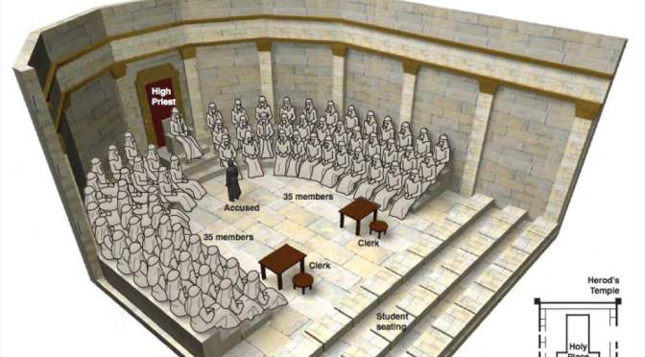
Peter & John Tried Acts 4:5-22
Peter and John are brought before the council
Note the presence of the High Priest(s) who had been complicit in Jesus’ crucifixion (John 18:13, 14, 19, 24)
The council asks a vague question.
Why didn’t they just charge the apostles with “preaching the resurrection?” (cf. Acts 23:6-9)
Sanhedrin Meeting in the “Hall of Hewn Stones” adjacent to the Temple

Slide 5
Peter & John Tried Acts 4:5-22
Peter offers a defense
They had done a good deed for a helpless man who now stood in the presence of the council!
It was accomplished in the name of Jesus Christ Whom the Jews had crucified and God had raised!
The Jews had rejected the Chief Cornerstone & the One Name that saves! (Ps. 118:22; Matt. 21:42-44; 1 Pet. 2:6)
Sanhedrin Meeting in the “Hall of Hewn Stones” adjacent to the Temple

Slide 6
Peter & John Tried Acts 4:5-22
The reaction of the council
They saw the boldness of Peter and John
They perceived their lack of education
They marveled
They realized they had been with Jesus
They could not contradict that the man was healed
When the council conferred, they agreed…
The miracle could not be denied!
They would threaten the apostles to keep them from speaking in Jesus’ name.

Slide 7
Peter & John Tried Acts 4:5-22
When the council threatened Peter and John, the apostles answered and said, “Whether it is right in the sight of God to listen to you more than to God, you judge. For we cannot but speak the things which we have seen and heard.” (Acts 4:19-20)
The council could not further punish the apostles because the people glorified God for the miracle, so they let them go.
The man who had been healed had been “lame from his mother’s womb” (3:2) and was now “over forty years old” (4:22)

Slide 8
A Powerful Prayer for Boldness Acts 4:23-31
The disciples call on God as the Creator.
They note that David had prophesied that rulers would vainly oppose the Christ (Ps. 2:1-2)
That prophecy had truly been fulfilled.
In view of the Jewish threats, they now call on God to give them boldness to speak the word and allow them to continue to perform notable signs in Jesus’ name.
God answered! The place was shaken and they went out and did what they’d prayed for!!

Slide 9
The Disciples Share their Possessions (Acts 4:32-35)
The believers were of “one heart”
With great power the apostles gave witness to the resurrection of the Lord Jesus.
The disciples continued to share their possessions as anyone had need (Acts 2:44-45)
What special circumstance in the early church had resulted in many being in need? (Acts 2:5, 41)
How does the situation change by Acts 6?
Throughout the New Testament, we see disciples being taught to give up possessions to meet “urgent needs” (Luke 12:33-34; Titus 3:14), but there is no indication that this was done as a matter of course in the absence of such needs.
Joses (Barnabas) was an exemplary giver!

