Slide 1


A C T S
Go Tell
the Good
News!
Lesson 6  Acts 5:1—6:6

Slide 2
The Disciples Share their Possessions (Acts 4:32-35)
The believers were of “one heart”
With great power the apostles gave witness to the resurrection of the Lord Jesus.
The disciples continued to share their possessions as anyone had need (cf. Acts 2:44-45)
  What special circumstance in the early church had resulted in many being in need? (Acts 2:5, 41)
  How does the situation change by Acts 6?
  Throughout the New Testament, we see disciples being taught to give up possessions to meet “urgent needs” (Luke 12:33-34; Titus 3:14), but there is no indication that this was done as a matter of course in the absence of such needs.
  Joses (Barnabas) was an exemplary giver!

Slide 3
Ananias & Sapphira
(Acts 5:1-11)
Ananias & Sapphira sold a possession but kept back part of the proceeds.
They had lied to the Holy Spirit (God).
  Did they have the right do what they wished with their property?
  What motivated this deception on their part?
When both Ananias and Sapphira die for their lie, how does the church react?

Slide 4
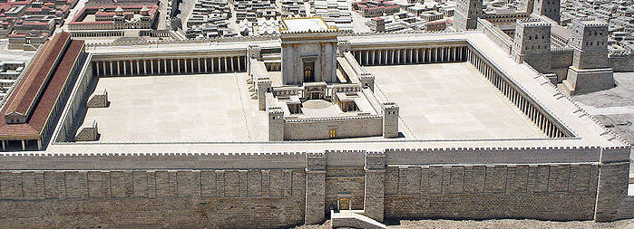
The Apostles Continue their Work (Acts 5:12-16)
The disciples are together on Solomon’s porch.
The apostles continue to perform many miracles, attracting people from other Judean cities (2:43; 3:6-9; 4:33)
Although none of the “rest” dared join them, the saints were highly esteemed by the people. Multitudes of believers were added to the Lord.

Slide 5
The Apostles are Arrested
(Acts 5:17-42)
The High Priest and Sadducees have the apostles imprisoned.
An angel frees the apostles at night.
  What does he command them to do?
  When do they do it?
  What surprise does the Jewish council get when they send officers to bring the apostles for trial?
  When the apostles were found in the temple, why did the arresting officers bring them without violence?
The high priest accuses the apostles of filling Jerusalem with their doctrine and intending to bring Jesus’ blood on the Jews (Matt. 27:25)

Slide 6
The Apostles are Arrested
(Acts 5:17-42)
Peter responds to the charges:
  “We ought to obey God rather than men.”
  You murdered Jesus, but God raised Him.
  God exalted Jesus to be Prince and Savior – enabling Israel to repent and be forgiven.
  The apostles and the Holy Spirit are witnesses.
The reaction of the council
  They were furious and plotted to kill the apostles.
  What motivated this reaction?
Gamaliel counsels restraint and caution.
  He notes that insurrections led by Theudus and Judas of Galilee came to nothing.
  “If it is of God, you cannot overthrow it.”

Slide 7
The Apostles are Arrested
(Acts 5:17-42)
Gamaliel is known outside the Bible in the writings of Josephus and in the Jewish Talmud.
He is described in Acts 5:34 as Pharisee and a “teacher of the law held in respect by all the people”
Acts 22:3 reveals that Saul of Tarsus was one of his pupils.
Noted scholar J.B. Lightfoot says, “This was Rabban Gamaliel the first; commonly, by way of distinction, called Rabban Gamaliel the elder. He was president of the council after the death of his own father, Rabban Simeon, who was the son of Hillel…He died eighteen years before the destruction of Jerusalem, his son Simeon succeeding him in the chair, who perished in the ruins of the city.”
The Jewish Mishnah records, “Since Rabban Gamaliel the Elder died, there has been no more reverence for the law, and purity and piety died out at the same time” (Sotah 15:8)

Slide 8
The Apostles are Arrested
(Acts 5:17-42)
  What can we learn from the apostles here about sharing the good news?
  “…and when they had called for the apostles and beaten them, they commanded that they should not speak in the name of Jesus, and let them go. So they departed from the presence of the council, rejoicing that they were counted worthy to suffer shame for His name. And daily in the temple, and in every house, they did not cease teaching and preaching Jesus as the Christ.” (Acts 5:40-42)

Slide 9
The Apostles deal with the problem of neglected widows
(Acts 6:1-6)
A complaint came against the Hebrews by the Hellenists because their widows were being neglected.
  What was the difference between Hebrews and Hellenists?
The twelve deal with the issue:
  They call the disciples together.
  They explain that serving tables must not take the place of their prime mission which was what?
  They encourage the saints to seek out seven men to be appointed over this business who were to be filled with what?
  How did the multitude react to what their leaders said?

