Slide 1
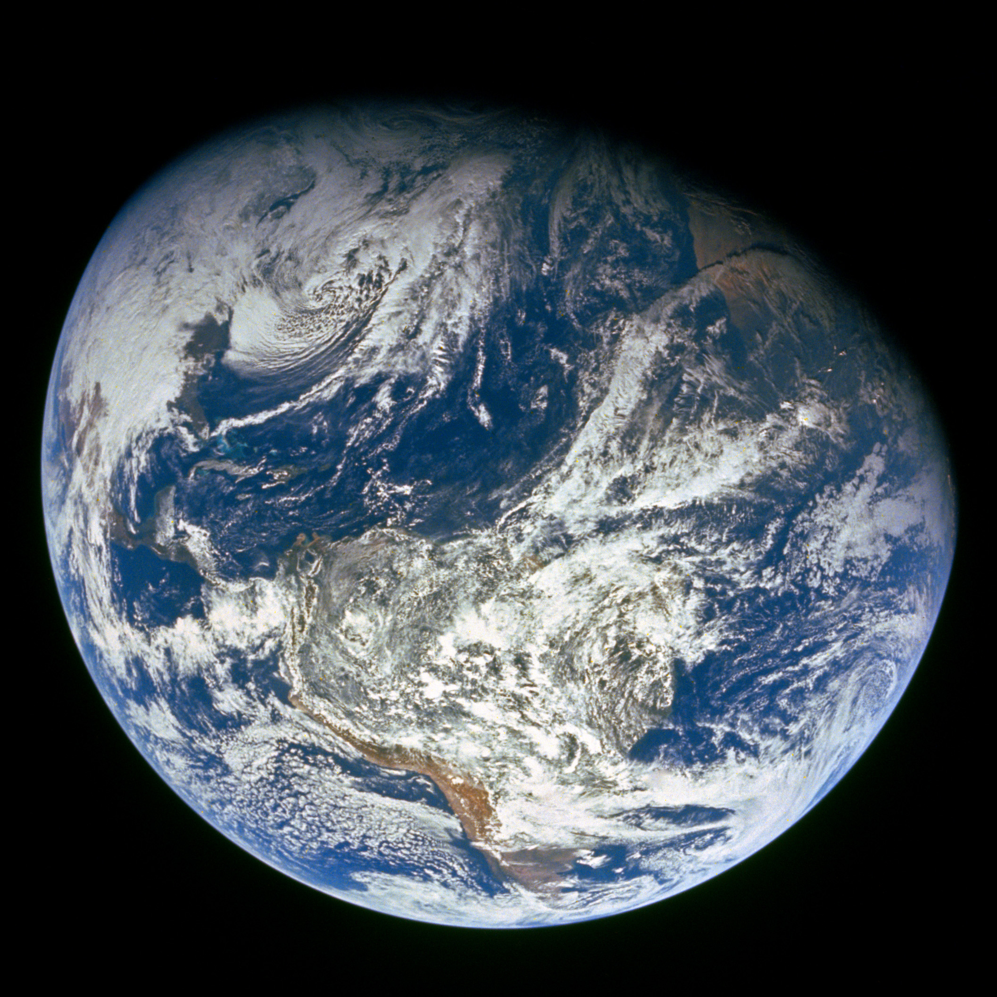
GENESIS
”In the beginning God…”

Slide 2
Review

Slide 3
Four year study of the Bible - 17 Periods
1)
2)
3)
4)
5)
6)
7)
8)
9)
Genesis
10)
11)
12)
13)
14)
15)
16)
17)
Divided Kingdom
Judah Alone
Captivity
Return From Captivity
Years Of Silence
Life Of Christ
The Early Church
The Letters To The Christians
Before The Flood
The Flood
The Scattering Of The People
The Patriarchs
The Exodus
The Wandering In The Wilderness
Invasion & Conquest
Judges
United Kingdom

Slide 4
Outline Of Genesis
Genesis 1-11
3 main stories [Creation, Flood, Scattering of the People]
Genesis 12-50
4 main characters [Abraham, Isaac, Jacob, Joseph]
Divine promises are made and repeated to the Patriarchs (fathers)
13 of the last 14 chapters focus on Joseph’s life

Slide 5
Main Characters Of Genesis
God
Adam & Eve
Cain & Abel
Seth
Noah
Shem, Ham, & Japheth
Abraham, Sarah
Hagar & Ishmael
Bethuel & Laban
Isaac & Rebekah
Jacob & Esau

Slide 6
Main Locations Of Genesis
Garden of Eden
Mountains of Ararat
Babel
Ur
Haran
Canaan
Egypt

Slide 7
Isaac is around 137 years old and almost blind
Esau hates Jacob and threatens to kill him after Isaac dies
Rebekah learns of Esau’s plans and tells Jacob to go away—back to her brother Laban in Haran—for a ‘few days’
She tells Isaac that Jacob should not take a wife from the people of the land

Slide 8
Isaac tells Jacob that he should not take a wife from the daughters of Canaan
Go to Padan Aram to take a wife from the daughters of Laban
Jacob and Esau are 77 at this time
Esau married 2 Hittite women 37 years ago
Esau also marries Mahalath who is Ishmael’s daughter

Slide 9
Favoritism
Lies
Deceit
Hate
Spouse selection
Promises of God

Slide 10
Today’s Lesson - Genesis 28:10 – 30:43
Sunday’s Lesson – Genesis 31 – 33:17

Slide 11
Context
Who?
God
Jacob, Rachel, Leah, and children
Bilhah, Zilpah
Laban
When?
“Patriarchs” – 17 Periods
Isaac is 137 years old
Jacob is 77 years old
Where?
Beersheba, Luz/Bethel, Haran

Slide 12
Today’s Outline
Jacob Leaves Beersheba
Bethel / The Ladder
Jacob Comes to Laban’s House
Jacob Marries Leah (and Rachel)
Children and Bilhah and Zilpah
Jacob Continues Working for Laban

Slide 13
Jacob Leaves Beersheba
Rebekah wanted Jacob to Leave Because Esau hated him Gen 27:41-45
Rebekah told Isaac she wanted Jacob to marry someone other than a Hittite! Gen 27:46
Isaac told Jacob to marry one of Laban’s daughters Gen 28:2
Jacob left Beersheba headed toward Haran Gen 28:10
Haran was about 500 miles from Beersheba

Slide 14
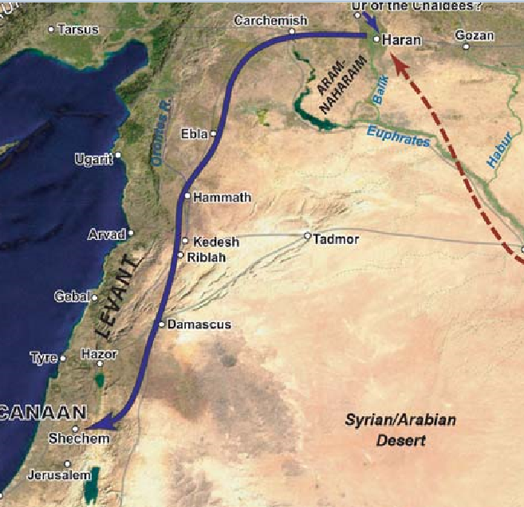
Beersheba

Slide 15
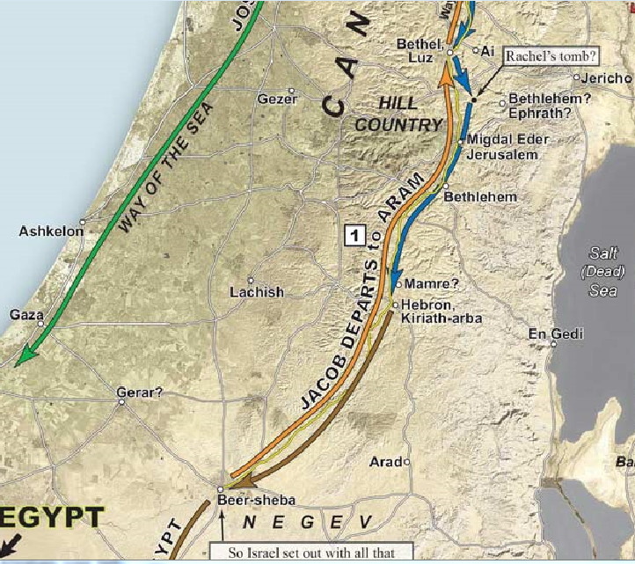

Slide 16
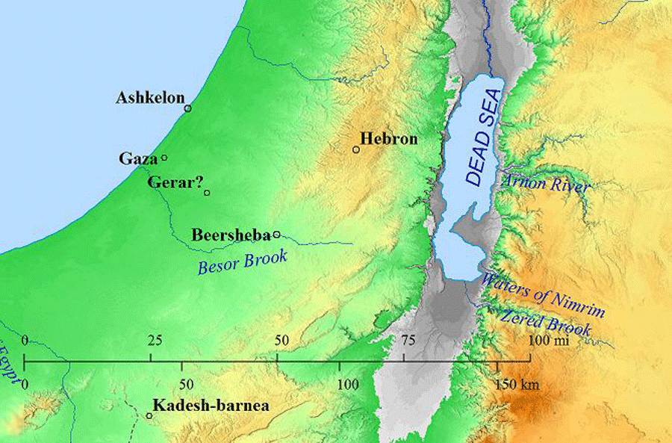
Today’s Lesson - Genesis 20-21

Slide 17
Bethel / The Ladder
Jacob stops for the night at Luz
Luz was 70-80 miles from Beersheba
Jacob had dream:
Ladder setup on earth
Top reached to heaven
Angels of God were ascending and descending on it
John 1:51 Jesus is the way to heaven!

Slide 18
Bethel / The Ladder
Lord stood above the ladder
The Lord told Jacob:
I am giving you the land where you are laying (Land)
Your descendants shall be as the dust of the earth (Nation)
In your seed all the families of the earth shall be blessed (Seed)
I am with you and will keep you where ever you go
I will bring you back to this land
I will not leave you till I’ve done what I have said

Slide 19
Bethel / The Ladder
Jacob said “Surely the Lord is in this place, and I did not know it”
“How awesome is this Place! This is none other than the house of God, and this is the gate of heaven!”

Slide 20
Bethel / The Ladder
Jacob worshipped God by:
Pouring oil on a stone pillar
Vowing that God would be his God if He would provide:
Bread
Clothing
Come back to his father’s house in peace
And having food and clothing, with these we shall be content. I Tim 6:8
Vowing to give a tenth of all God gave him

Slide 21
Vowing a tenth
Gen 14:18 Abraham met Melchizedek (king of Salem and priest of God Most High) when coming back from the battle of the kings
Gen 14:20 Abraham gave Melchizedek “a tithe of all”
Ex 18:1 And Jethro, the priest of Midian, Moses’ father-in-law…
Ex 18:12 Then Jethro, Moses’ father-in-law, took a burnt offering and other sacrifices to offer to God. And Aaron came with all the elders of Israel to eat bread with Moses’ father-in-law before God

Slide 22
Bethel / The Ladder
Jacob renamed Luz to Bethel (House of God)
Bethel:
Abraham passed through or near several times 12:8, 13:3
Deborah, Rachel’s nurse buried near Bethel 35:8
Was near when Joshua ambushed AI Joshua 8
Was part of Samuel’s circuit as judge I Sam 17:15-16
Jereboam setup one of the golden calves there I Kings 12:28-29
Josiah had the altar and high place there broke down 2 Kings 23:15

Slide 23
Jacob Comes to Laban’s House
Jacob stopped at a well near Haran and asked about Laban
Jacob watered Rachel’s (Laban’s) flock
Jacob told Rachel he was a relative
Rachel told Laban, who:
Ran to meet Jacob
Embraced and kissed him
Brought Jacob to his house

Slide 24
Jacob Marries Leah (and Rachel)
After a month, Laban asked Jacob what wages he wanted
Jacob said he would serve Laban seven years for his youngest daughter Rachel
How many people today would wait seven years to marry their spouse?
“So Jacob served seven years for Rachel, and they seemed only a few days to him because of the love he had for her”

Slide 25
Jacob Marries Leah (and Rachel)
At the end of the seven years:
Jacob asked for his wife
Laban had a feast for all the men of the place
Laban brought Leah to Jacob
In the morning Jacob realized what had happened
Laban said it wasn’t right for the younger to marry before the older daughter
Laban told Jacob to give Leah her week and then serve him seven more years for Rachel
The deceiver was deceived!

Slide 26
Though indefensible on Laban’s part, the substitution of Leah for Rachel was a deserved punishment for Jacob.
Having wronged Esau his brother, he is wronged by a “brother.”
Having substituted the younger (himself) for the older (Esau), he is recompensed by having the older (Leah) put into the place of the younger (Rachel).
As Isaac knew not when he blessed Jacob, so Jacob knows not when he marries/lies with Leah.
As Jacob acted at the instigation of his mother, Leah yields to the suggestion of her father.
-- James E. Smith O.T. Survey Series (Vol. 1), pg. 189

Slide 27
Jacob Marries Leah (and Rachel)
Jacob “loved Rachel more than Leah”

Slide 28
Children and Bilhah and Zilpah
Jacob “loved Rachel more than Leah”
Over the next 7 years, Jacob has 12 children:
11 boys
1 Girl (Dinah)
Benjamin is born later in Canaan
Because 12 children were born in 7 years AND because we are not told that there was more than 1 at a time (twins, etc), there must’ve been some overlap of the pregnancies

Slide 29
Children and Bilhah and Zilpah
Leah had the first 4 children
Reuben-“Now therefore my husband will love me”
Simeon-“Because the Lord has heard that I’m unloved”
Levi-”my husband will become attached to me”
Judah-”Now I will praise the Lord”
Rachel told Jacob “Give me children or else I die!”
Rachel gave her maid Bilhah to Jacob to have children by her (reminiscent of Sarah and Hagar)

Slide 30
Children and Bilhah and Zilpah
Bilhah bore:
Dan-”The Lord has given me a son”
Naphtali-”I have prevailed over my sister”
Leah gave her maid Zilpah to Jacob to have children by her (again, reminiscent of Sarah and Hagar)

Slide 31
Children and Bilhah and Zilpah
Zilpah bore:
Gad-”A troop comes”
Asher-”I am happy, for the daughters will call me blessed”
Leah hired Jacob “with my son’s mandrakes”
Leah bore:
Issachar-”God has given me my wages”
Zebulon-”now my husband will dwell with me”
Dinah

Slide 32
Mandrakes - Bibletalkclub.net
Today, mandrakes are used for medicinal purposes.
The main purpose of using mandrakes medicinally is to treat pain and other symptoms of disease. The plant has been used to treat diarrhea and the common cold, as well as pain in the joints and muscles. In addition, mandrake root can be applied directly to skin wounds or sores that have become infected by bacteria or viruses.
Mandrakes are a flowering plant in the nightshade family. The name mandrake comes from the Greek, meaning love apple. They are thought to have been used as an aphrodisiac or medicinal herb in ancient times and have been associated with witchcraft since that time.

Slide 33
Children and Bilhah and Zilpah
“Then God remembered Rachel”
Rachel bore:
Joseph-”God has taken away my reproach”

Slide 34
Sons (and daughter) are born
Leah
Ruben
Simeon
Levi
Judah
Bilhah
Dan
Naphtali
Zilpah
Gad
Asher
Leah
Issachar
Zebulun
Dinah (daughter)
Rachel
Joseph

Slide 35
Leah’s Pre-eminence
She was the actual mother of six sons, half of the twelve patriarchs, and one daughter (Dinah)
Her son Judah succeeded to the headship of the Chosen Nation, through whom the Messiah was born
Her posterity became the principal element in the true Israel, following the defection and loss of the Northern Israel

Slide 36
Leah’s Pre-eminence
David the king who gave his name and title to Christ himself ("the son of David") was her descendant.
Her son Judah gave his name and title to Christ, "The Lion of the Tribe of Judah."
She was buried with Jacob in the cave of Machpelah at Hebron, "presumably before Jacob's descent to Egypt."

Slide 37
Rachel
“Give me children, or else I die!”
She had 2 sons and died in childbirth
Angered Jacob
“Am I in the place of God?”
Introduced concubines into the marriage
Like Sarah
Have sons on her behalf
Be loved more by Jacob

Slide 38
Jacob Continues Working for Laban
At the end of the 14 years (seemingly just after Joseph was born), Jacob told Laban to give him his wives and children and send him away
Laban wanted Jacob to stay because God blessed Laban because of Jacob
“Name your wages”

Slide 39
Jacob Continues Working for Laban
Jacob said his wages would be the:
Speckled and spotted sheep
Brown lambs
Speckled and spotted goats
Laban was happy to make that deal!
Laban separated the sheep that would be Jacob’s and gave them to his sons
They separated their flocks by 3 day’s journey

Slide 40
Jacob Continues Working for Laban
Jacob caused the flocks to bear streaked, speckled and spotted sheep by:
Peeling white strips in almond and chestnut rods
Putting the rods in the watering troughs
Only did this for the stronger livestock conceived
Laban then had the feeble livestock
Jacob had:
Strong livestock
Large flocks
Female and male servants
Camels
Donkeys

Slide 41
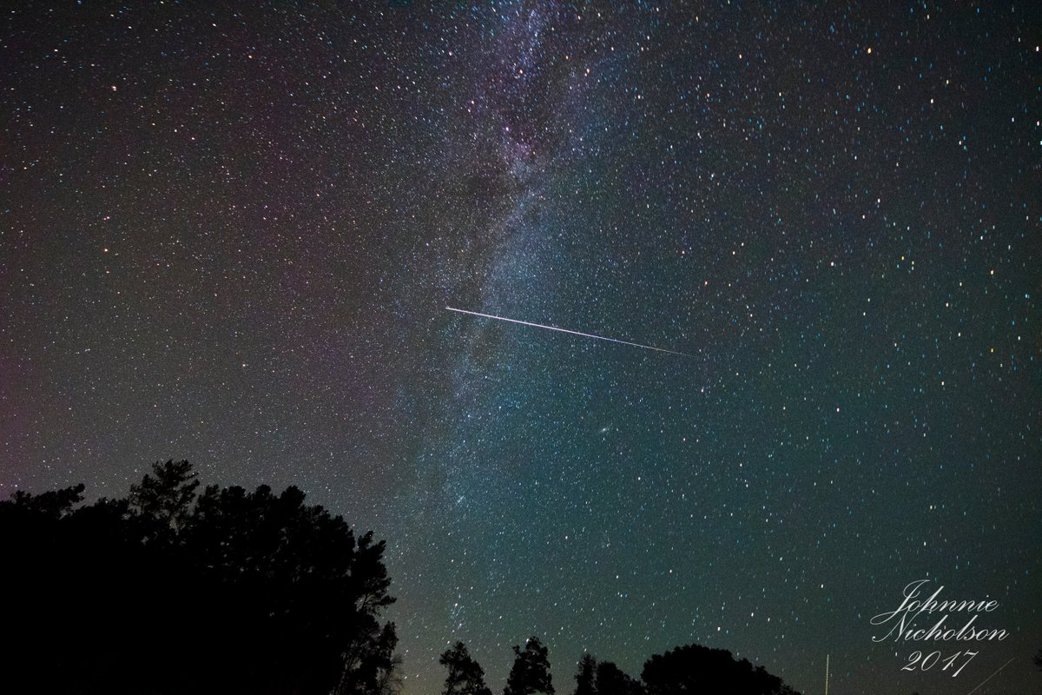
Notes:
Johnnie Nicholson‏
@thekyniche
Follow Follow @thekyniche
More
@lucky13wxman @RyanBeesleyFox5 @BeckePhysics @sudbri @VirtualAstro @jginfla @spann ISS Piercing the Milky Way

Slide 42
Summary and Application

Slide 43
Summary and Application
Love is the strongest motivator to fulfill one’s obligations 1 Jn 5:3 1 Cor 13:1-3, 13
Those who mistreat others often suffer the similar punishment Psa 7:15-16 57:6 Prov 26:27 28:10
God continued to fulfill His promises, providentially using both good and bad choices from man

Slide 44
Wednesday’s Lesson
Genesis 31:1 – 33:17

Slide 45
Follow-Up

Slide 46
Awesome – 39 Times in NKJ
God -
God’s Name –
God’s Actions/Deeds –

