Slide 1
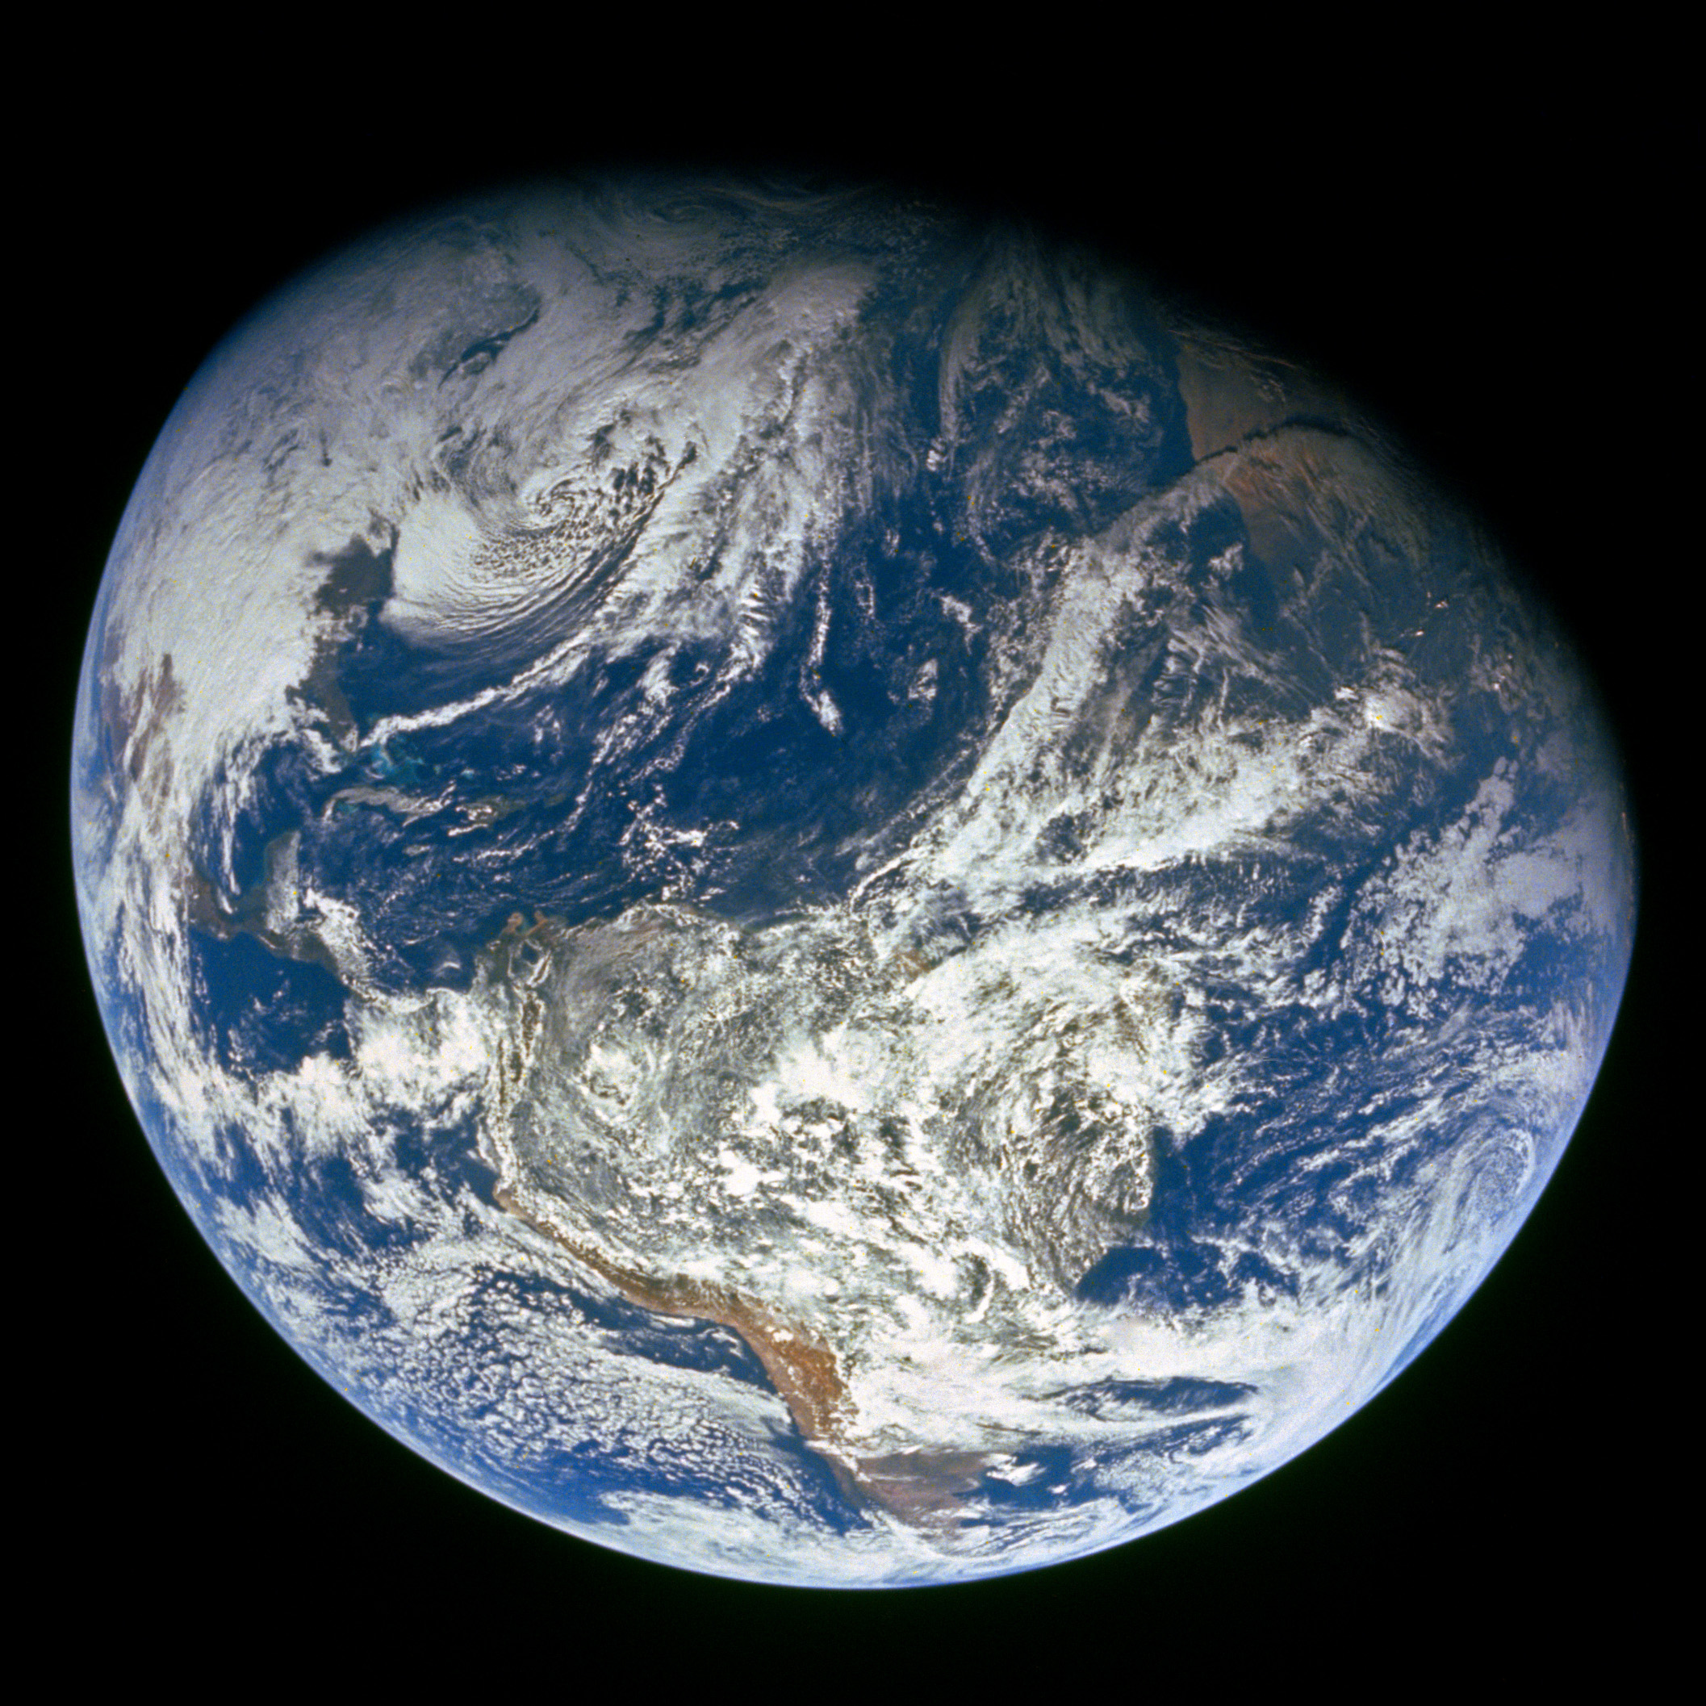
GENESIS
”In the beginning God…”

Slide 2
Review

Slide 3
Four year study of the Bible - 17 Periods
1)
2)
3)
4)
5)
6)
7)
8)
9)
Genesis
10)
11)
12)
13)
14)
15)
16)
17)
Divided Kingdom
Judah Alone
Captivity
Return From Captivity
Years Of Silence
Life Of Christ
The Early Church
The Letters To The Christians
Before The Flood
The Flood
The Scattering Of The People
The Patriarchs
The Exodus
The Wandering In The Wilderness
Invasion & Conquest
Judges
United Kingdom

Slide 4
Outline Of Genesis
Genesis 1-11
3 main stories [Creation, Flood, Scattering of the People]
Genesis 12-50
4 main characters [Abraham, Isaac, Jacob, Joseph]
Divine promises are made and repeated to the Patriarchs (fathers)
13 of the last 14 chapters focus on Joseph’s life

Slide 5
Today’s Lesson - Genesis 40-42
Sunday’s Lesson – Genesis 43-46

Slide 6
Context
Who?
God
Joseph
Butler, Baker
Pharaoh
Joseph’s Brothers
When?
“Patriarchs” – 17 Periods
Joseph is 28 years old at beginning
Where?
Egypt, Canaan

Slide 7
Today’s Outline
Joseph Interprets Butler and Baker’s Dreams
Joseph Interprets Pharaoh’s Dreams
Joseph Becomes Second In Command Over Egypt
Joseph’s Brothers Come to Egypt for Food
Joseph’s Brothers Return Home

Slide 8
Joseph Interprets Butler and Baker’s Dreams
The Butler and Baker Offended the King and were put in prison (No mention of any trial)
The captain of the guard put Joseph in charge of them
The Butler and Baker each had a dream
Joseph could tell they were both sad the next morning and asked about it (Remember Joseph’s dreams? 37:5-11)
“Do not interpretations belong to God? Tell them to me, please.”

Slide 9
Joseph Interprets Butler and Baker’s Dreams
The butler told Joseph his dream about a vine and Pharaoh’s cup
Joseph interpreted the butler’s dream – the butler would be serving Pharaoh again in 3 days
“But remember me when it is well with you”
The Baker told Joseph his dream about 3 white baskets and birds
Joseph interpreted the bakers dream – in 3 days he would be hanged
Notes:
Joseph could have just thought they were sad because they were used to living around the King, probably a pretty good job. Now they are in a dungeon!!
Pharaoh will lift up your head.
Gen 40:14 Joseph asked the butler to "remember me" and "please show kindness to me". Could Joseph have asked these things if he had mistreated the butler? There was no reason before this to believe the butler or the baker would have any pull to get Joseph out of prison. He treated them well because of who he was.
Gen 40:15 Joseph refers to the jail as a dungeon. It wasn't the brightly lit prison of our day with TVs and work out facility!

Slide 10
Joseph Interprets Butler and Baker’s Dreams
Pharaoh’s birthday was 3 days later
Pharaoh had a feast for all his servants
Pharaoh put the butler back in his position
Pharaoh hanged the baker
The butler did not remember Joseph

Slide 11
Joseph Interprets Pharaoh’s Dreams
2 years later, Pharaoh had 2 dreams – fat and skinny cows, plump and thin heads of grain
gaunt = "thin or emaciated“
blighted = "in a badly damaged or deteriorated condition"
None of the magicians or wise men of Egypt could interpret the dream
The butler remembered Joseph and told Pharaoh how Joseph had interpreted the butler and baker’s dreams
Pharaoh sent for Joseph
Joseph is now 30 years old
Notes:
Gen 41-1-7 Strange illustrations using Cows which would never eat each other and grain which would never eat each other! Definitely something that would catch your attention!
Gen 41:14 Can you imagine what state Joseph was in? He had been in the dungeon for AT LEAST 2 years. Doubtful he was buying a new suit every year or even being able to do much basic personal hygeine. Now he is going before the ruler of the land and he has to get cleaned up!

Slide 12
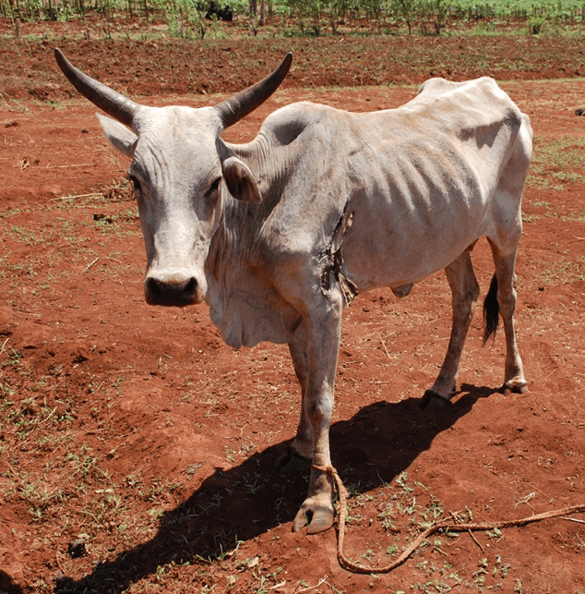
Notes:
Iraq, Turkey, Syria, Jordan, Israel, Egypt

Slide 13
Joseph Interprets Pharaoh’s Dreams
“So Joseph answered Pharaoh, saying, “It is not in me; God will give Pharaoh an answer of peace.”
Pharaoh told Joseph the dreams
Joseph told Pharaoh about the 7 years of plenty and the 7 years of famine
“And the dream was repeated to Pharaoh twice because the thing is established by God, and God will shortly bring it to pass.”
Notes:
Gen 41:16 Joseph show by a couple of different things his humility 1) First, he brings the attention to God! God will provide the interpretation 2) God would provide "an answer of PEACE". Even after all he had been through in Egypt, Joseph still wanted an answer of peace for Pharaoh!
Gen 41:25 "God has shown…"
Gen 41:28 "God has shown…"
Gen 41:32 "the thing is established by God, and God will shortly bring it to pass"

Slide 14
Joseph Interprets Pharaoh’s Dreams
Joseph advised Pharaoh to:
Select a “discerning and wise man” to put over the land of Egypt
Appoint officers to collect 1/5 of the produce during the 7 plentiful years
Store up grain under Pharaoh’s authority
Keep food in the cities for a reserve during the famine years

Slide 15
Joseph Becomes Second In Command Over Egypt
“Can we find such a one as this, a man in whom is the Spirit of God?”
Pharaoh said Joseph would be:
Over Pharaoh’s house
All the people would be ruled by Joseph’s word
Second only in the throne to Pharaoh
“See, I have set you over all the land of Egypt”
Notes:
Gen 41:38 Pharaoh mentions the "Spirit of God". Which god would he be referring to? Amen-Ra? RA = sun god of the Egyptians
Gen 41:41 Seemingly, in one day, Joseph goes from being a prisoner in the dungeon to "over all the land of Egypt"?
Gen 41:41 If Potiphar is still alive, OR his wife, you wonder what they are thinking?
Gen 41:41 Did Pharaoh care that Joseph was in the prison for some reason?
Gen 41:41 Did Pharaoh care that Joseph was a Hebrew(v12) - an abomination to the Egyptians?

Slide 16
Joseph Becomes Second In Command Over Egypt
Pharaoh Gave Joseph:
Signet Ring
Garments of Fine Linen
Gold Neck Chain
The Second Chariot to Ride in
A wife – Asenath, daughter of Poti-Pherah priest of On
“Bow the knee!”
Notes:
Gen 41:14-41 Just from the reading, it seems like it's a matter of minutes or at most hours that Joseph goes from being in the dungeon to being 2nd in command in Egypt.
Pharaoh knows very little about Joseph other than he had interpreted the butler's dream and he had interpreted Pharaoh's dream. That seems pretty impulsive!
But, it was part of God's plan.
1) He had told Abraham his seed would be in a foreign country for 400 years
2) to save them alive during the famine.
Gen 41:43 Seems like what happened to Mordecai in Esther 6:6-11.

Slide 17
Joseph Becomes Second In Command Over Egypt
The priest of On led the worship of the Egyptian sun god…..
The city of On was also known as Heliopolis, “The City of the Sun.” It was the center of worship of the sun god, Ra, and was located 10 miles northeast of modern Cairo. The priests of On were considered to be among the most intelligent and cultured persons in Egypt, and their erudition was second to none.
Notes:
Gen 41:43 Seems like what happened to Mordecai in Esther 6:6-11.
Erudition
Deep, extensive learning. synonym: knowledge.
Learning; scholarship; knowledge gained by study or from books and instruction; particularly, learning in literature, history, antiquities, and languages, as distinct from knowledge of the mathematical and physical sciences.
SynonymsLearning, Scholarship, Lore, etc. See literature.

Slide 18
Joseph Becomes Second In Command Over Egypt
The ancient historian Herodotus reported that “the men of Heliopolis are said to be the most learned in records of the Egyptians” (History 2:3, trans. by G. Macaulay). The high priest in On held the title of “Greatest of Seers.” When Joseph married into this family, he joined a social class befitting a national leader. Also implied in the marriage arrangement was Pharaoh’s confidence that Joseph, too, was a “seer,” or prophet, of the highest caliber.
-- GotQuestions.org

Slide 19
Joseph Becomes Second In Command Over Egypt
Joseph:
Went throughout all the land of Egypt
Gathered food during the years of plenty
Placed the food in the cities near the fields
Gathered grain “as the sand of the sea, until he stopped counting”
Egypt is dry so grain could last longer
Notes:
Gen 41:47-49 One of the things Egypt has going for it for keeping the grain a long time is how dry it is. That helps keep the grain from spoiling.

Slide 20
Joseph Becomes Second In Command Over Egypt
Joseph had 2 sons before the famine years – Manasseh (the firstborn) and Ephraim
Manasseh – “God has made me forget all my toil and all my father’s house”
Ephraim – “God has caused me to be fruitful in the land of my affliction”

Slide 21
Joseph Becomes Second In Command Over Egypt
The Years of Famine Began
“The famine was in all lands, but in all the land of Egypt there was bread”
Pharaoh sent the people to Joseph who needed food
Joseph opened the storehouses and sold to the Egyptians
All countries came to Joseph to buy grain
Notes:
Gen 41:55-57 Pharaoh told everyone to "Go to Joseph".
There were so many people in Egypt and the surrounding countries,
Joseph PROBABLY isn't doing all the selling himself. So for him to be there when his brothers come must've been providence. 42:6
Gen 42:6 Joseph sold to everyone. Surely he had help doing this. Kinda like when Moses father-in-law came to him and gave him advice to find other people help him judge the people. Ex 18:13-27

Slide 22
Joseph’s Brothers Come to Egypt for Food
Joseph is now at least 37 years old
Jacob sent 10 of Joseph’s brothers to Egypt to buy grain
Jacob didn’t send Benjamin “Lest some calamity befall him”
The famine was in the land of Canaan
Joseph was the one who sold to all the people
“And Joseph’s brothers came and bowed down before him with their faces to the earth” 42:6
Joseph recognized his brothers BUT they didn’t recognize him
It’s been at least 20 years since they saw each other
Notes:
Gen 42:7 "Joseph saw his brothers and recognized them". It's been at least 20 years since he saw his brothers. He was approximately 17 when he was sold into Egypt (37:2). He was 30 when he stood before Pharoah (41:46) The seven years of plenty have already passed. We don't know how many years of famine have passed.

Slide 23
Joseph’s Brothers Come to Egypt for Food
Joseph spoke roughly to his brothers – through an interpreter
Joseph remembered the dreams he had about his brothers
“You are spies”
The brothers mentioned they were part of 12 brothers
Joseph told them they would be tested by one of them going after the younger brother and the rest would be put in prison until their return

Slide 24
Joseph’s Brothers Come to Egypt for Food
Joseph put all his brothers in prison for 3 days
On the third day Joseph told them:
One of you will be confined to the prison
The rest carry grain home to your houses
Bring your youngest brother to me to verify your story
If you do that, “you shall not die”
Notes:
Gen 42:17 I bet that was a long 3 days in prison for the brothers!

Slide 25
Joseph’s Brothers Come to Egypt for Food
The brothers now felt guilty concerning how they treated/sold Joseph
Reuben said because they sinned against Joseph, his blood is now required of them
The brothers didn’t realize that Joseph understood them because he talked to them through an interpreter
Joseph:
Turned away from them and wept
Returned to them
Took Simeon and bound him in front of the other brothers
Notes:
Gen 42:21-22 Joseph had probably been on the brothers consciences ever since they sold him.
Gen 42:24 I wonder why Joseph picked Simeon to stay in Egypt in prison? Judah was the one who talked the brothers into selling Joseph (37:26-27)
Gen 42:24 You wonder how the brothers felt when they saw Simeon being bound "before their eyes"?

Slide 26
Joseph’s Brothers Return Home
Joseph commanded his servant to:
Fill his brother’s sacks
Put their money back in their sacks
Give them provisions for the journey
The brothers loaded their donkeys and left
At a camp, one of them found his money in his sack
“their hearts failed them and they were afraid” 42:28
When they got home, they told Jacob the whole story, in particular about having to take Benjamin back to Egypt
Notes:
Gen 42:28 We begin to see how concerned they were when the money was found in their sacks because "their hearts failed them". 42:35 they were "afraid"
Gen 42 Seems like through all of this that Joseph was extracting his ounce of blood from the brothers for selling him.
Gen 42:30 The brothers referred to Joseph as "The man who is lord of the land".

Slide 27
Joseph’s Brothers Return Home
The brothers emptied their sacks and they all found their money
They were afraid
“You have bereaved me: Joseph is no more, Simeon is no more, and you want to take Benjamin. All these things are against me.” 42:36
Reuben begged Jacob to send Benjamin back with him to Egypt
Jacob would not let him go

Slide 28
Joseph’s Brothers Return Home
“My son shall not go down with you, for his brother is dead, and he is left alone. If any calamity should befall him along the way in which you go, then you would bring down my gray hair with sorrow to the grave.” 42:38
Benjamin would be over 20 years old at this time
Notes:
Gen 42:38 "his brother is dead and he is left alone". Joseph and Benjamin were the only sons of Rachel.
Gen 42 Benjamin would be over 20 years old.

Slide 29
Summary and Application

Slide 30
Summary and Application
We should try harder to understand other’s well-being and not just assume everything is ok – Joseph seeing the butler and the baker sad
It’s easy to forget the kindness of others – butler forgot Joseph
To God Be The Glory – Joseph was constantly bringing the focus back to God!

Slide 31
Wednesday’s Lesson
Genesis 43-46

Slide 32
Follow-Up

