Slide 1
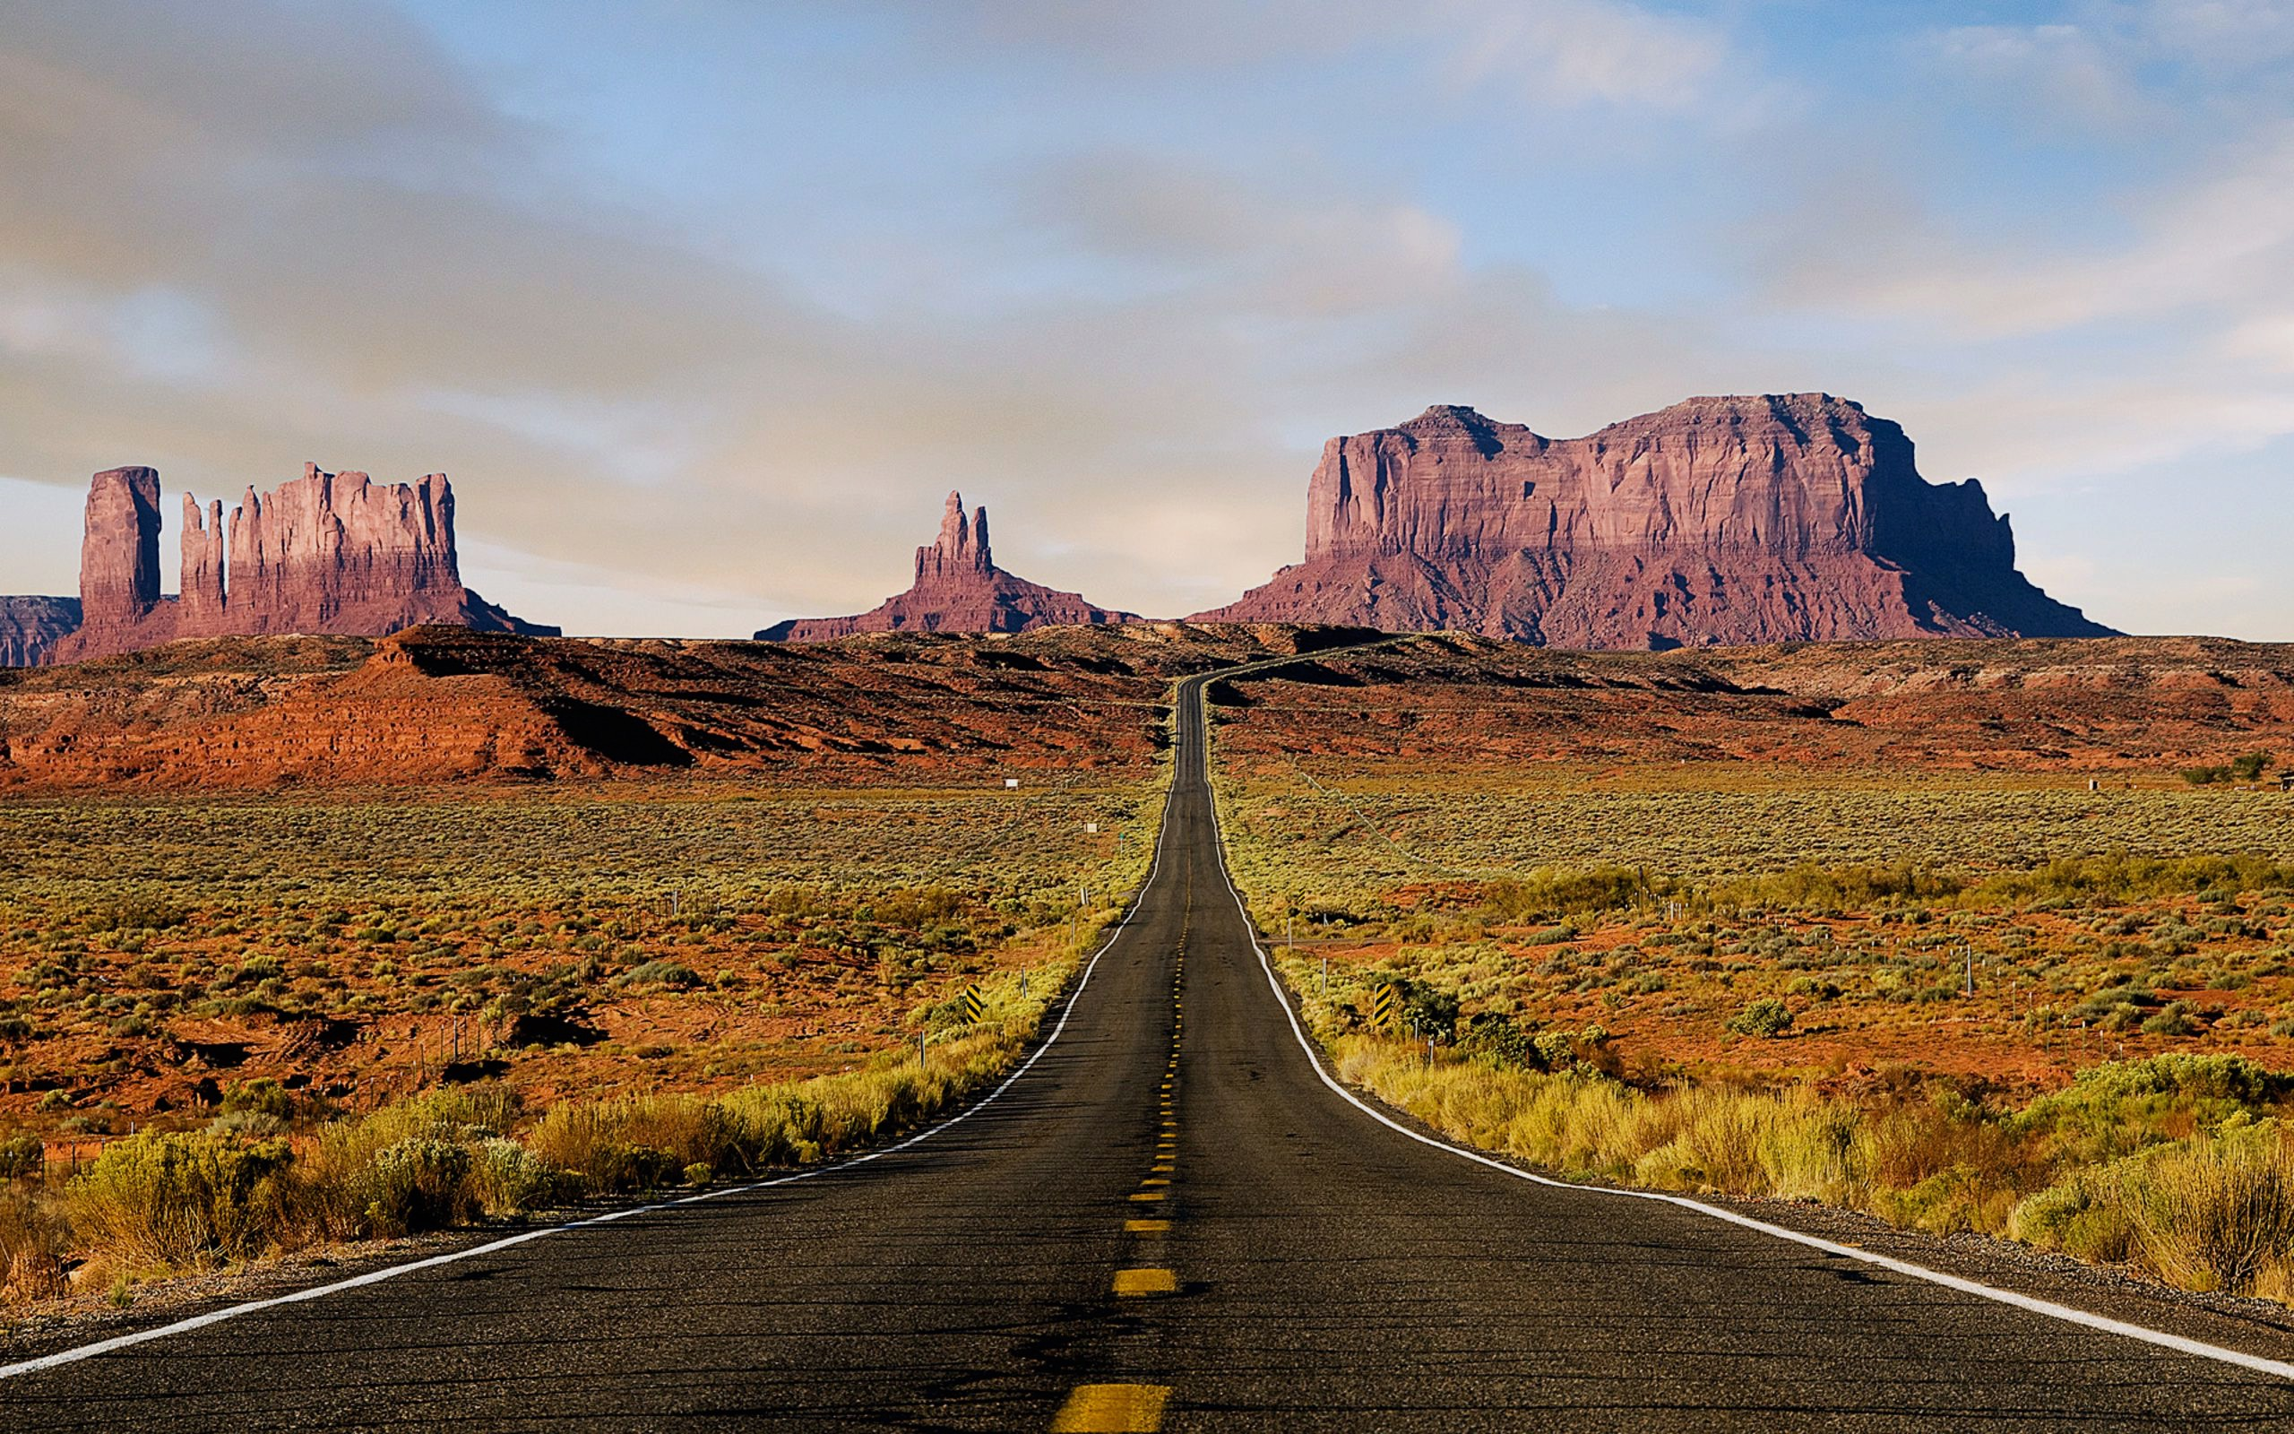
EVANGELISM IN
EXILE

Slide 2
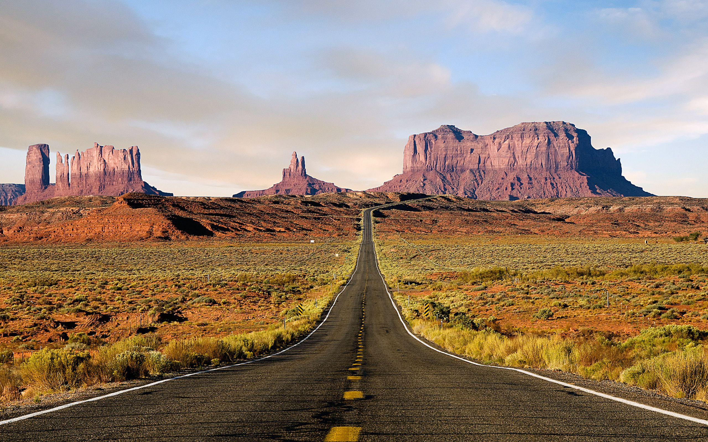
WHAT EVERYBODY WANTS, 1 Pet 1:1-12
A HOLY PRIESTHOOD, 1 Pet 1:13-2:12

Slide 3
HOLINESS L 17-27
CLEANNESS Lev 11-16
PRIESTHOOD Lev 8-10
SACRIFICES - Lev 1-7
TABERNACLE - Ex 25-40
COVENANT - Ex 19-24

Slide 4
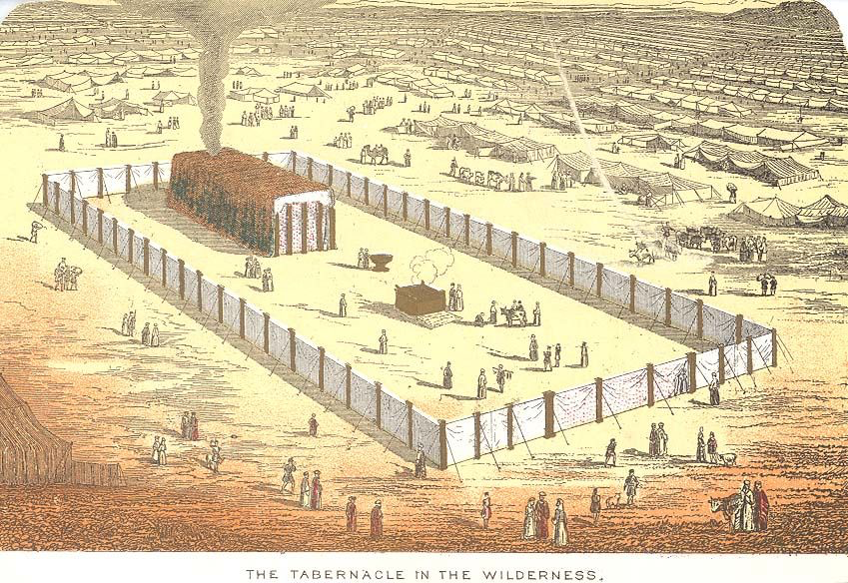
A Holy Priesthood

Slide 5
Principle #1
God saves us from our sins so we can serve him as priests.

Slide 6
Exodus 19
4 ”You yourselves have seen what I did to the Egyptians, and how I bore you on eagles’ wings and brought you to myself. 5 Now therefore, if you will indeed obey my voice and keep my covenant, you shall be my treasured possession 6 and you shall be to me a kingdom of priests and a holy nation.”

Slide 7
Exodus 19
4 ”You yourselves have seen what I did to the Egyptians, and how I bore you on eagles’ wings and brought you to myself. 5 Now therefore, if you will indeed obey my voice and keep my covenant, you shall be my treasured possession 6 and you shall be to me a kingdom of priests and a holy nation.”

Slide 8
Principle #2
The purpose of priests is to honor and glorify God.

Slide 9
Leviticus 10
3 Then Moses said to Aaron, “This is what the LORD has said, ‘Among those who are near me I will be sanctified, and before all the people I will be glorified.’” And Aaron held his peace.

Slide 10
Leviticus 10
3 Then Moses said to Aaron, “This is what the LORD has said, ‘Among those who are near me I will be sanctified, and before all the people I will be glorified.’” And Aaron held his peace.

Slide 11
Leviticus 10
3 Then Moses said to Aaron, “This is what the LORD has said, ‘Among those who are near me I will be sanctified, and before all the people I will be glorified.’” And Aaron held his peace.

Slide 12
Principle #3
Our work as priests is to make sacrifices and to teach people about God.

Slide 13
Malachi 2
11 “For from the rising of the sun to its setting my name will be great among the nations, and in every place incense will be offered to my name, and a pure offering. For my name will be great among the nations, says the LORD of hosts.”

Slide 14
Malachi 2
11 “For from the rising of the sun to its setting my name will be great among the nations, and in every place incense will be offered to my name, and a pure offering. For my name will be great among the nations, says the LORD of hosts.”

Slide 15
Malachi 2
11 “For from the rising of the sun to its setting my name will be great among the nations, and in every place incense will be offered to my name, and a pure offering. For my name will be great among the nations, says the LORD of hosts.”

Slide 16
Malachi 2
7 “For the lips of a priest should guard knowledge, and people should seek instruction from his mouth, for he is the messenger of the LORD of hosts.”

Slide 17
Malachi 2
7 “For the lips of a priest should guard knowledge, and people should seek instruction from his mouth, for he is the messenger of the LORD of hosts.”

Slide 18
I must make sacrifices.
I must teach others.

