Slide 1
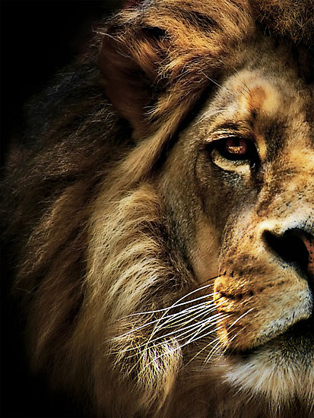
The Book of Daniel

Slide 2
“And your house and your kingdom shall be made sure forever before me. Your throne shall be established forever.” 2 Samuel 7:16
931 BC
722 BC
Northern Kingdom:
ISRAEL
586 BC
597 BC
Saul
David
Solomon
605 BC
Southern Kingdom:
JUDAH

Slide 3
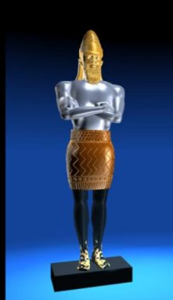
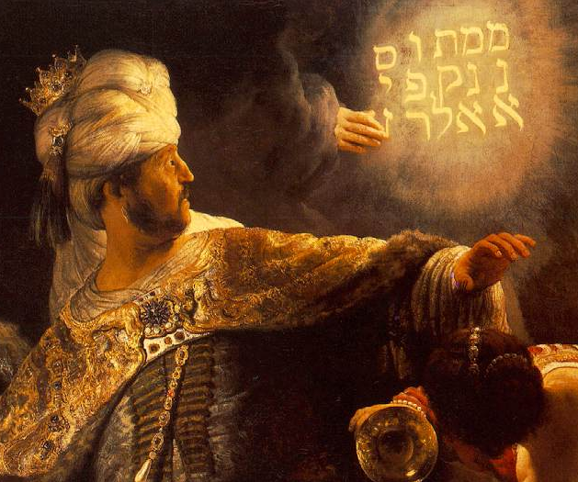
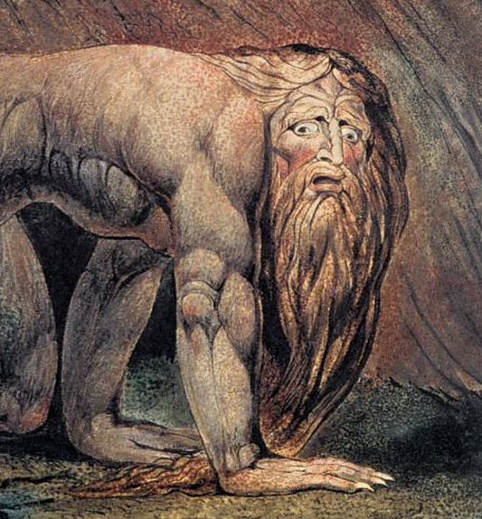
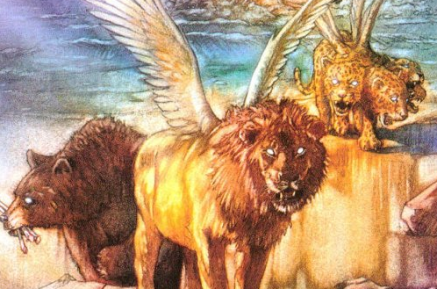
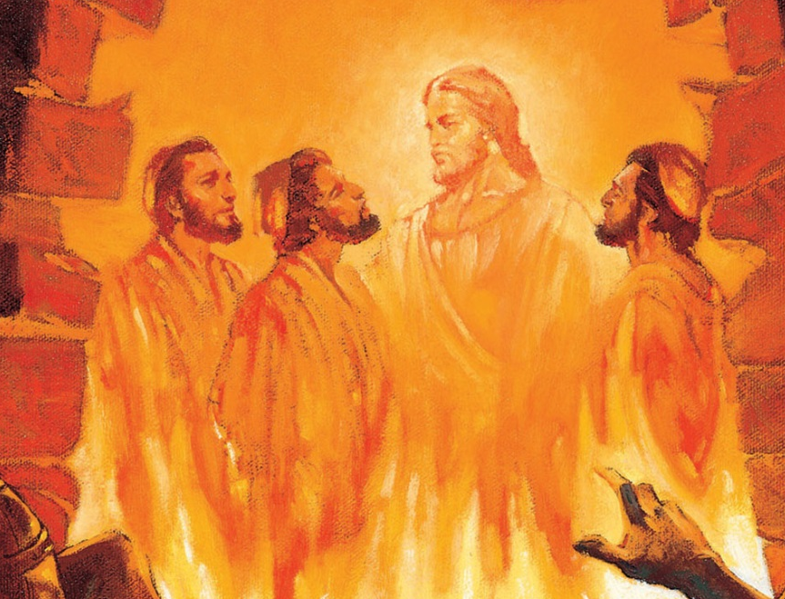
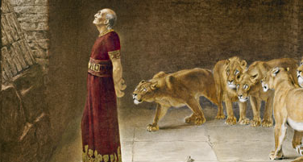
1 2 3 4 5 6 7 8 9 10 11 12
The Book of Daniel
Four empires will rise & fall before the everlasting kingdom.
2
3
4
5
6
7
God rescues & exalts those who are faithful.
Babylonian
Medo-Persian
Grecian
Roman
Aramaic
God humbles the proud.
Fiery Furnace
Lion’s Den
Nebuchad-nezzar
Belshazzar
2
3
4
5
6
7

Slide 4

Pluralism
A condition in which numerous distinct ethnic, religious, or cultural groups are present and tolerated in a society.
The belief that such a condition is desirable or socially beneficial.

Slide 5
How to Survive in a Postmodern World

Slide 6
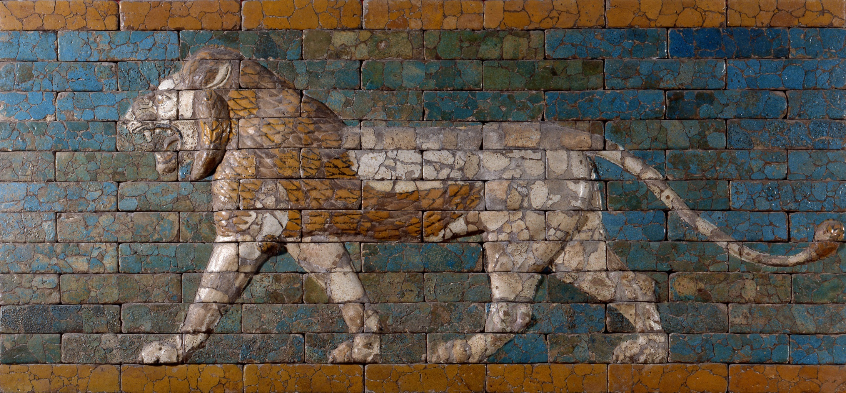
They knew what they believed.

Slide 7
Daniel 3:18
“These men, O king, pay no attention to you; they do not serve your gods or worship the golden image that you have set up.”

Slide 8
Psalm 1:1-3
Blessed is the man who walks not in the counsel of the wicked,
Nor stands in the way of sinners,
Nor sits in the seat of scoffers;
But his delight is in the law of the LORD, and on his law he meditates day and night.
He is like a tree planted by streams of water.

Slide 9
Luke 8:13
And the ones on the rock are those who, when they hear the word, receive it with joy. But these have no root; they believe for a while, and in time of testing fall away.

Slide 10
Colossians 2:6-8
Therefore, as you received Christ Jesus the Lord, so walk in him, rooted and built up in him and established in the faith, just as you were taught, abounding in thanksgiving. See to it that no one takes you captive by philosophy and empty deceit, according to human tradition…

Slide 11
Colossians 2:6-8
Therefore, as you received Christ Jesus the Lord, so walk in him, rooted and built up in him and established in the faith, just as you were taught, abounding in thanksgiving. See to it that no one takes you captive by philosophy and empty deceit, according to human tradition…

Slide 12
Colossians 2:6-8
Therefore, as you received Christ Jesus the Lord, so walk in him, rooted and built up in him and established in the faith, just as you were taught, abounding in thanksgiving. See to it that no one takes you captive by philosophy and empty deceit, according to human tradition…

Slide 13
They stood for what they believed.

Slide 14
Daniel 3:18
“But if not, be it known to you, O king, that we will not serve your gods or worship the golden image that you have set up.”

Slide 15
Joshua 24:15
“And if it is evil in your eyes to serve the LORD, choose this day whom you will serve… But as for me and my house, we will serve the LORD.”

Slide 16
1 Corinthians 16:13
Be watchful, stand firm in the faith, act like men, be strong.

Slide 17
They trusted in the One whom they believed.

Slide 18
Daniel 3:17
“If this be so, our God whom we serve is able to deliver us from the burning fiery furnace, and he will deliver us out of your hand, O king.”

Slide 19
1 Corinthians 15:58
Therefore, my beloved brothers, be steadfast, immovable, always abounding in the work of the Lord, knowing that in the Lord your labor is not in vain.

Slide 20
  Know what you believe!
  Stand for what you believe!
  Trust in whom you believe!

