Slide 1
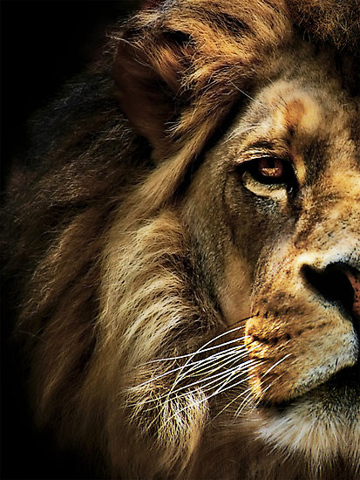
The Book of Daniel

Slide 2
“And your house and your kingdom shall be made sure forever before me. Your throne shall be established forever.” 2 Samuel 7:16
931 BC
722 BC
Northern Kingdom:
ISRAEL
586 BC
597 BC
Saul
David
Solomon
605 BC
Southern Kingdom:
JUDAH

Slide 3
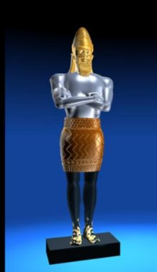
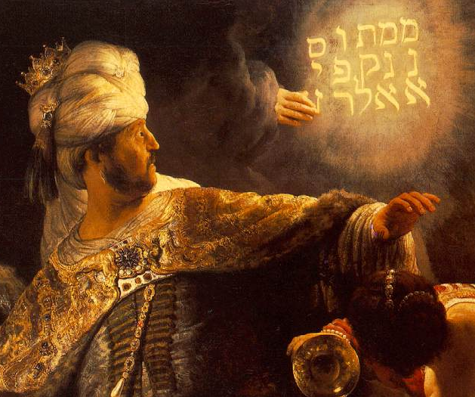
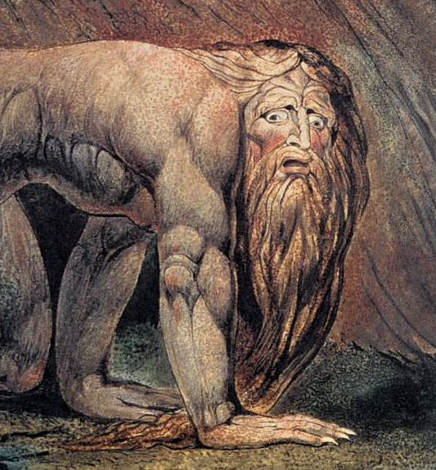
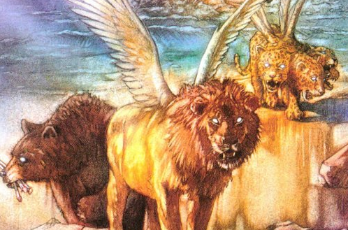
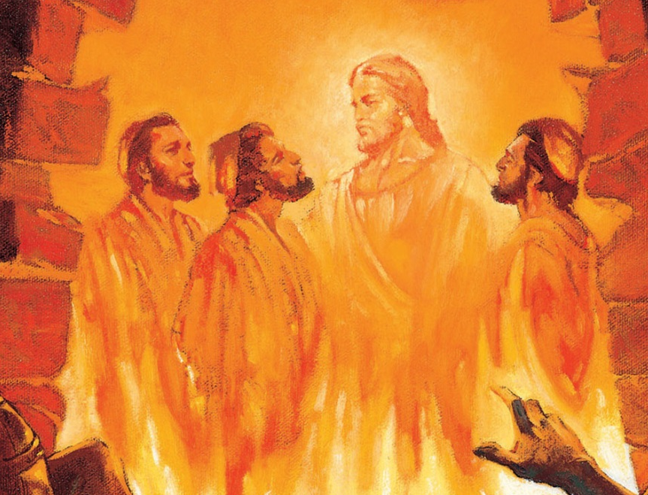
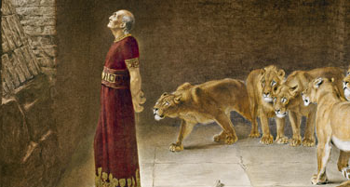
1 2 3 4 5 6 7 8 9 10 11 12
The Book of Daniel
Four empires will rise & fall before the everlasting kingdom.
2
3
4
5
6
7
God rescues & exalts those who are faithful.
Babylonian
Medo-Persian
Grecian
Roman
Aramaic
God humbles the proud.
Fiery Furnace
Lion’s Den
Nebuchad-nezzar
Belshazzar
2
3
4
5
6
7

Slide 4
The Problem of Pride

Slide 5
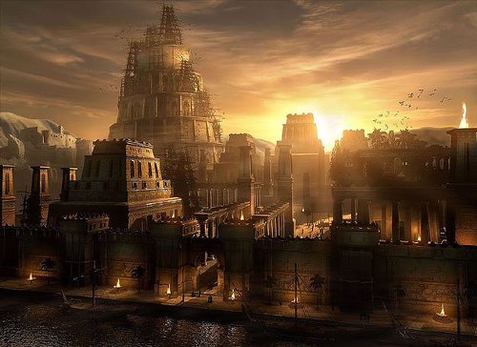

Slide 6
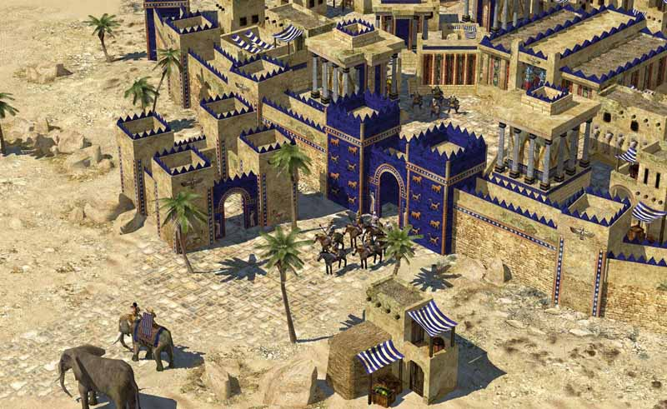

Slide 7
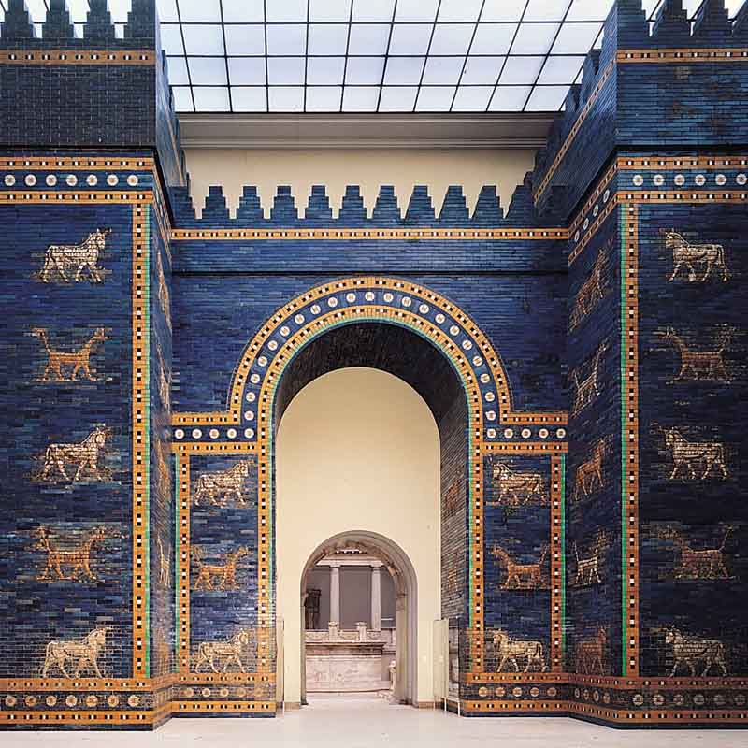

Slide 8
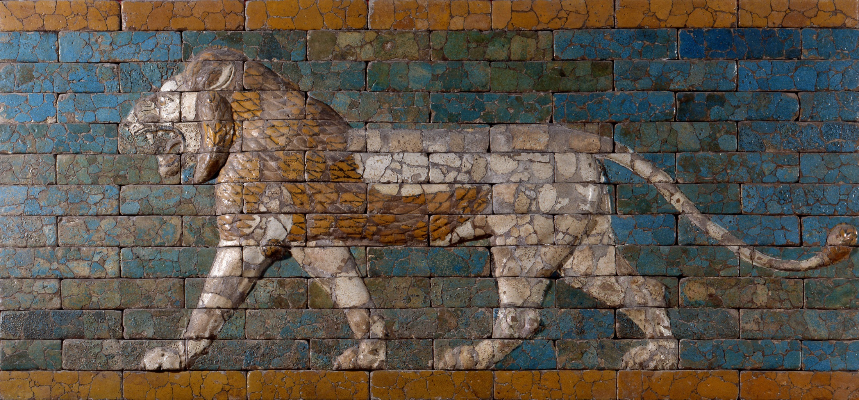

Slide 9
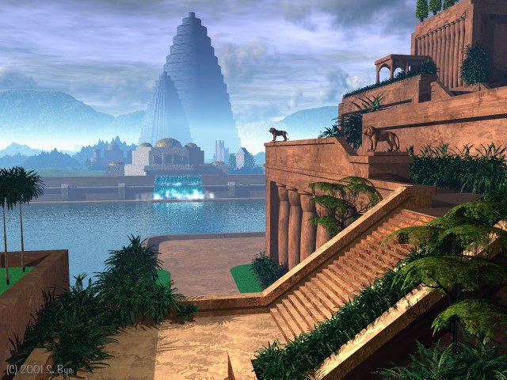

Slide 10
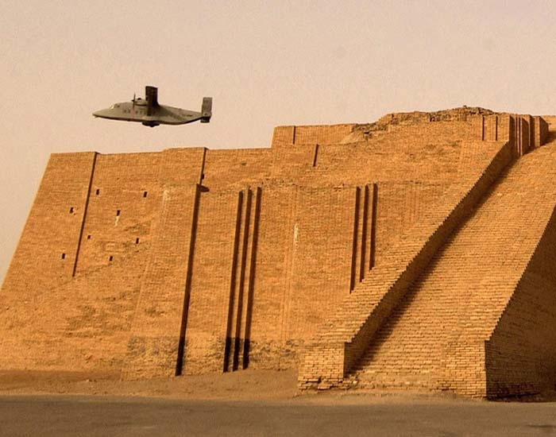

Slide 11
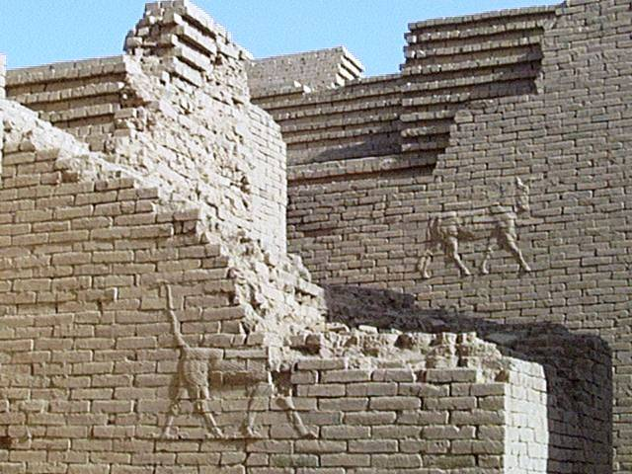

Slide 12
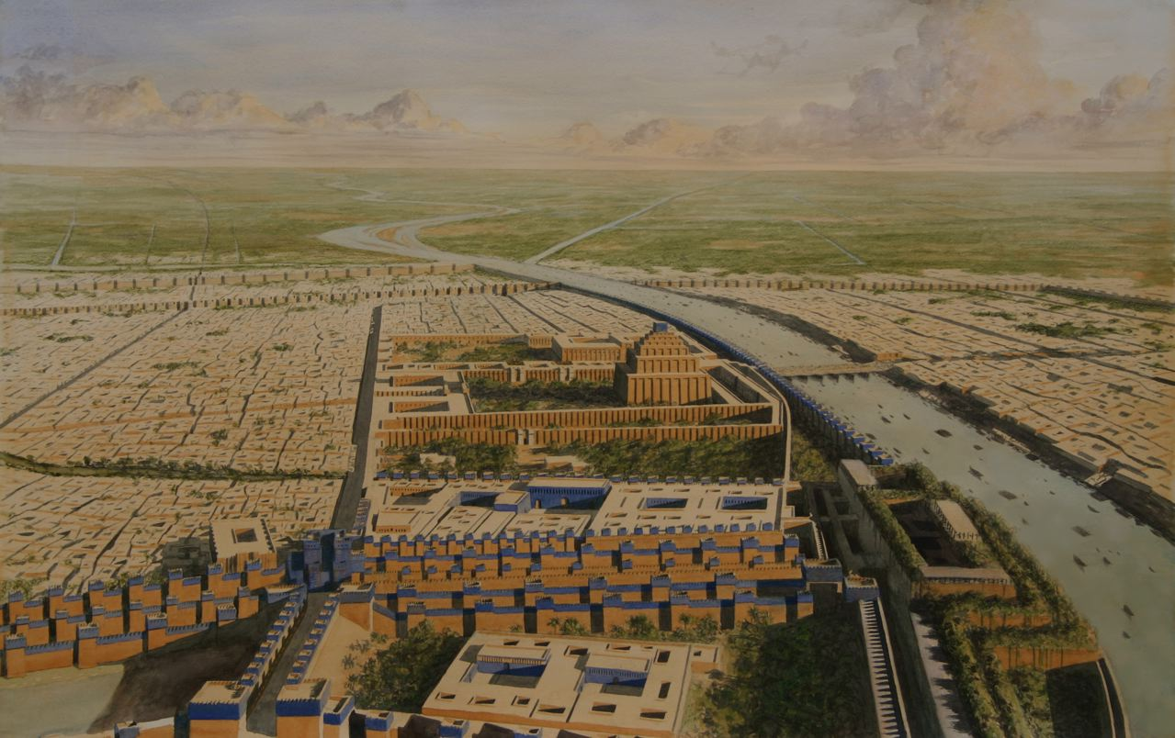

Slide 13
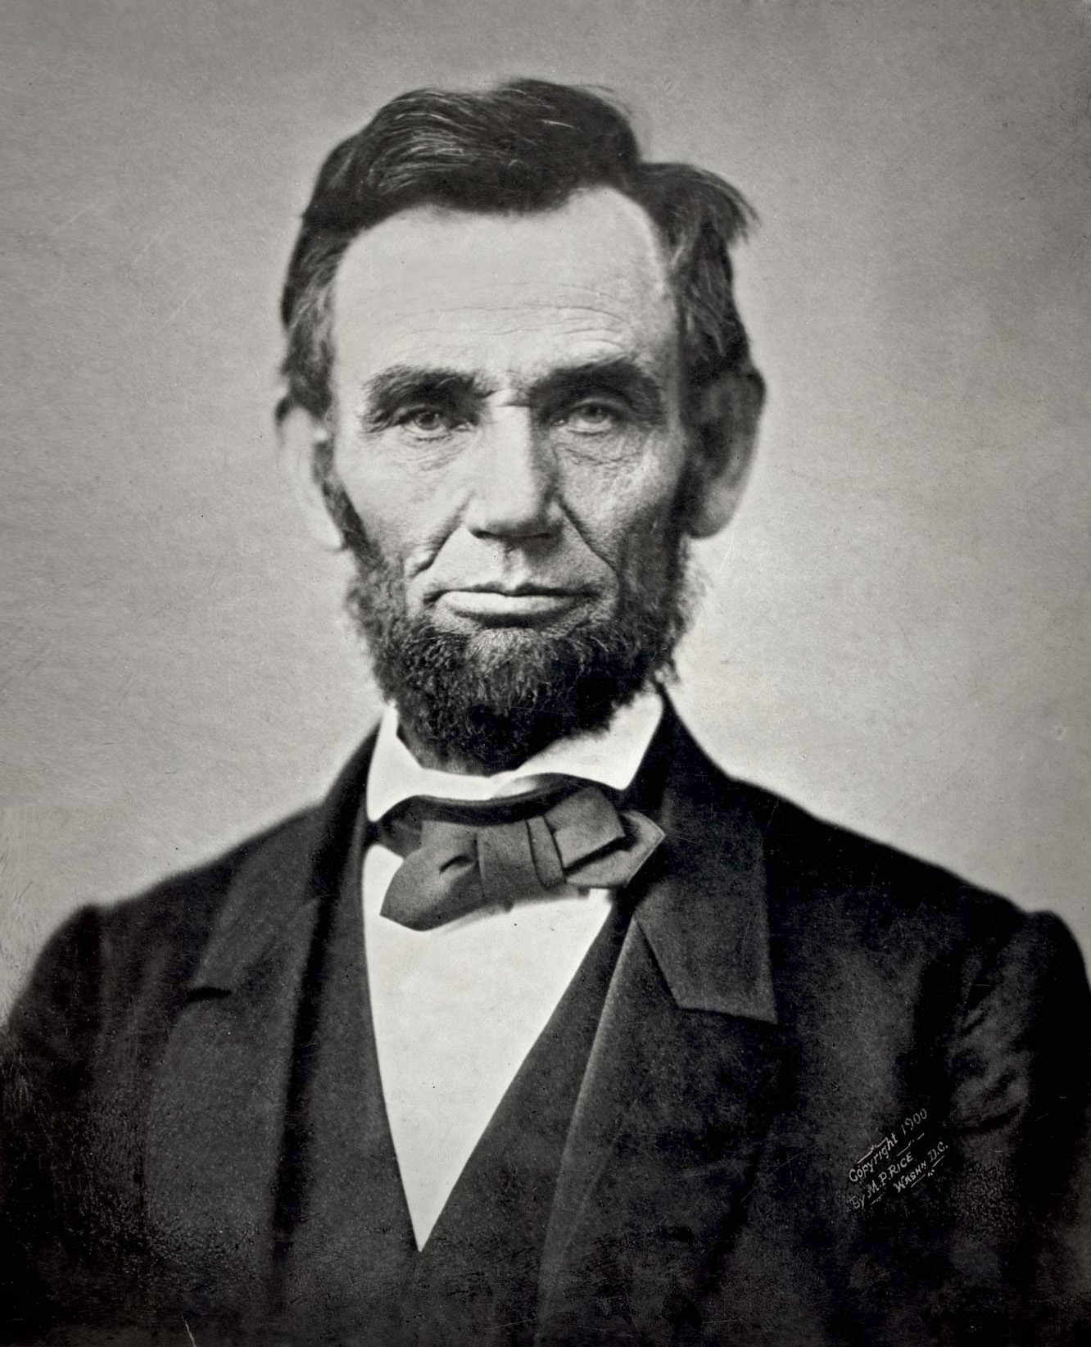

Slide 14
A recipe for pride.

Slide 15
Daniel 4:4
I, Nebuchadnezzar, was at ease in my house and prospering in my palace.

Slide 16
Daniel 4:10
I saw, and behold, a tree in the midst of the earth, and its height was great.

Slide 17
Daniel 4:11
The tree grew and became strong, and its top reached to heaven…

Slide 18
Daniel 4:12
Its leaves were beautiful and its fruit abundant, and in it was food for all.

Slide 19
The mercy of God.

Slide 20
Daniel 4:5
I saw a dream that made me afraid.

Slide 21
Daniel 4:14
“Chop down the tree and lop off its branches, strip off its leaves and scatter its fruit.”

Slide 22
Daniel 4:15
“But leave the stump…”

Slide 23
Daniel 4:19
“My lord, may the dream be for those who hate you and its interpretation for your enemies!”

Slide 24
The sovereignty of God.

Slide 25
Daniel 4:3
His kingdom is an everlasting kingdom, and his dominion endures from generation to generation. (also v 34)

Slide 26
Daniel 4:17
“…to the end that the living may know that the Most High rules the kingdom of men and gives it to whom he wills and sets over it the lowliest of men.” (also v 25, 32)

Slide 27
Daniel 4:34
I blessed the Most High, and praised and honored him who lives forever (also v 2, 25, 32)

Slide 28
Daniel 4:34
Now I, Nebuchadnezzar, praise and extol and honor the King of heaven…

Slide 29
Daniel 4:34
…he does according to his will among the host of heaven and among the inhabitants of the earth; and none can stay his hand or say to him, “What have you done?”

Slide 30
The vindication of God.

Slide 31
Daniel 4:37
…all his works are right and his ways are just; and those who walk in pride he is able to humble.

Slide 32
Humble yourselves, therefore, under the mighty hand of God so that at the proper time he may exalt you.
1 Peter 5:6

