Slide 1
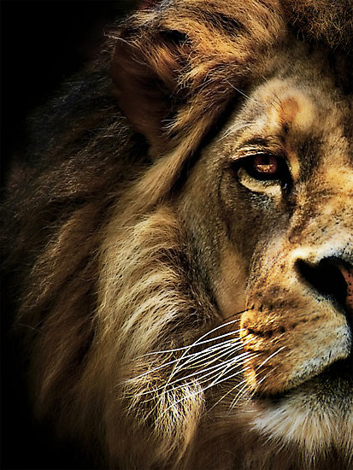
The Book of Daniel

Slide 2
Preparing for the Lions

Slide 3
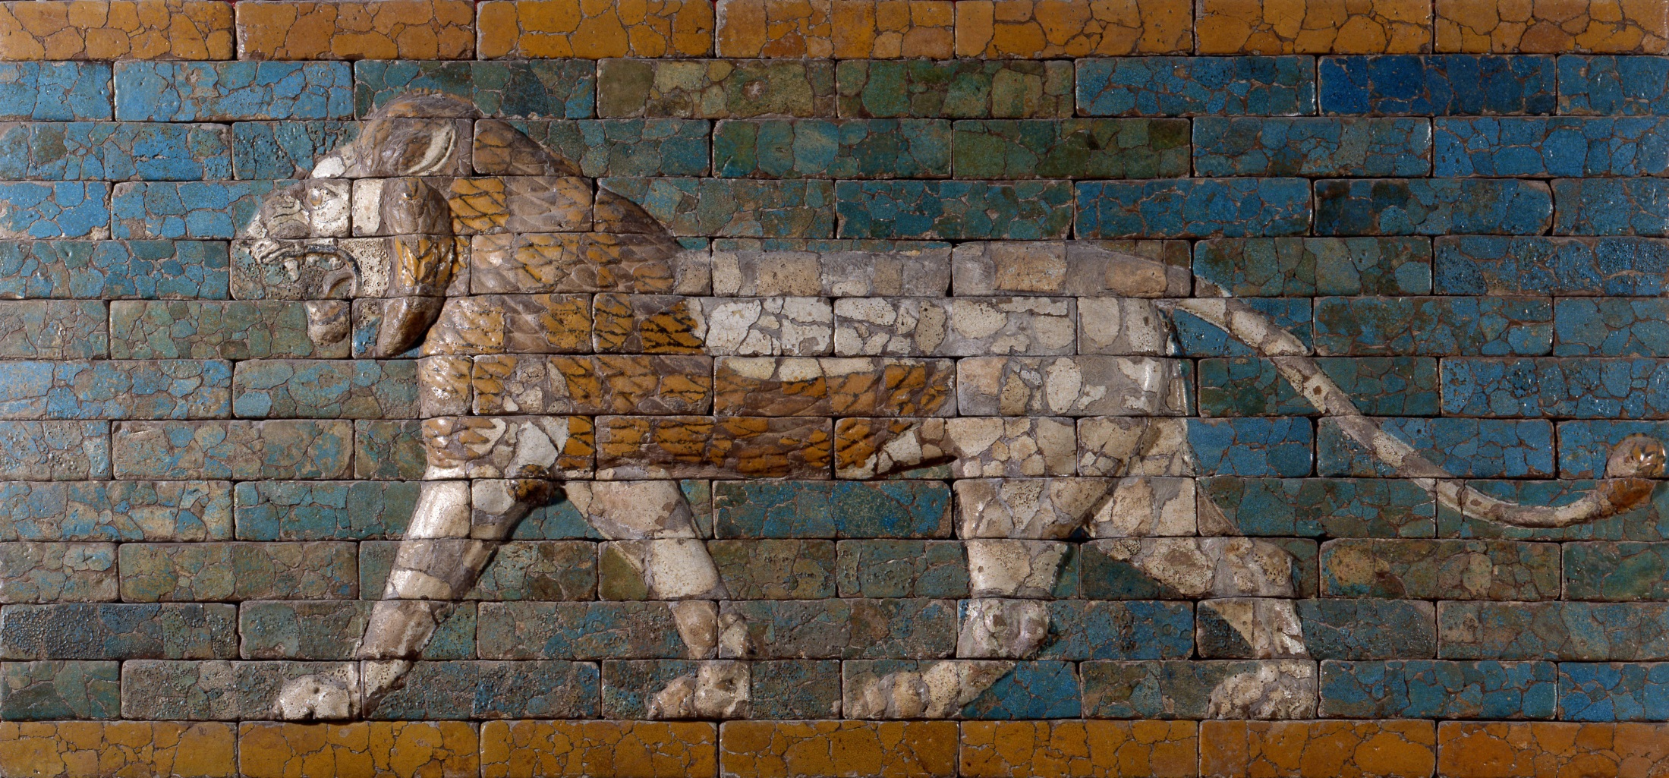
Consistent conduct before God.

Slide 4
1 Peter 2:12
Keep your conduct among the Gentiles honorable, so that when they speak against you as evildoers, they may see your good deeds and glorify God on the day of visitation.

Slide 5
A consistent prayer life before God.

Slide 6
Daniel 6:10
When Daniel knew that the document had been signed, he went to his house where he had windows in his upper chamber open toward Jerusalem. He got down on his knees three times a day and prayed and gave thanks before his God, as he had done previously.

Slide 7
Daniel 6:10
When Daniel knew that the document had been signed, he went to his house where he had windows in his upper chamber open toward Jerusalem. He got down on his knees three times a day and prayed and gave thanks before his God, as he had done previously.

Slide 8
1 Thess 5:17
…pray without ceasing…

Slide 9
Ephesians 5:20
…giving thanks always and for everything to God the Father in the name of our Lord Jesus Christ.

Slide 10
Consistent faith in God.

Slide 11
Daniel 6:16
The king declared to Daniel, “May your God, whom you serve continually, deliver you!”

Slide 12
Daniel 1:8
Daniel resolved that he would not defile himself…

Slide 13
Jeremiah 12:5
“If you have raced with men on foot, and they have wearied you, how will you compete with horses? And if in a safe land you are so trusting, what will you do in the thickets of the Jordan?”

Slide 14
But our citizenship is in heaven, and from it we await a Savior, the Lord Jesus Christ…
Philippians 3:20

