Slide 1
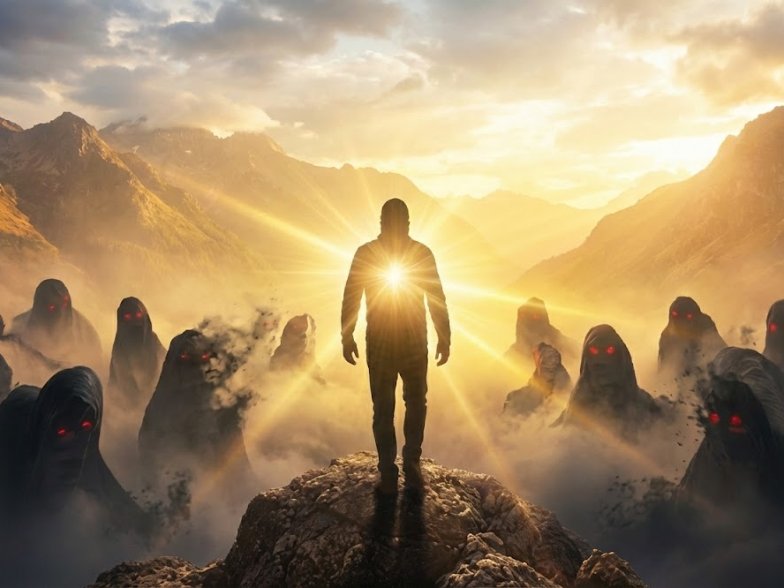
Faith That Drives Out Fear
Why we should trust God instead of fearing things in life.

Slide 2
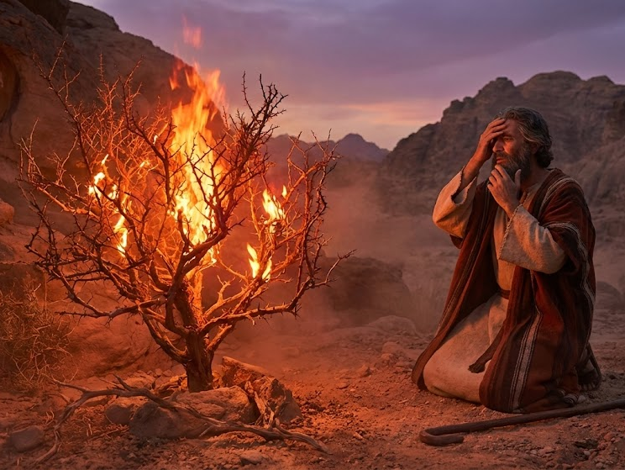
Moses and The Burning Bush
Exodus 3-4

Slide 3
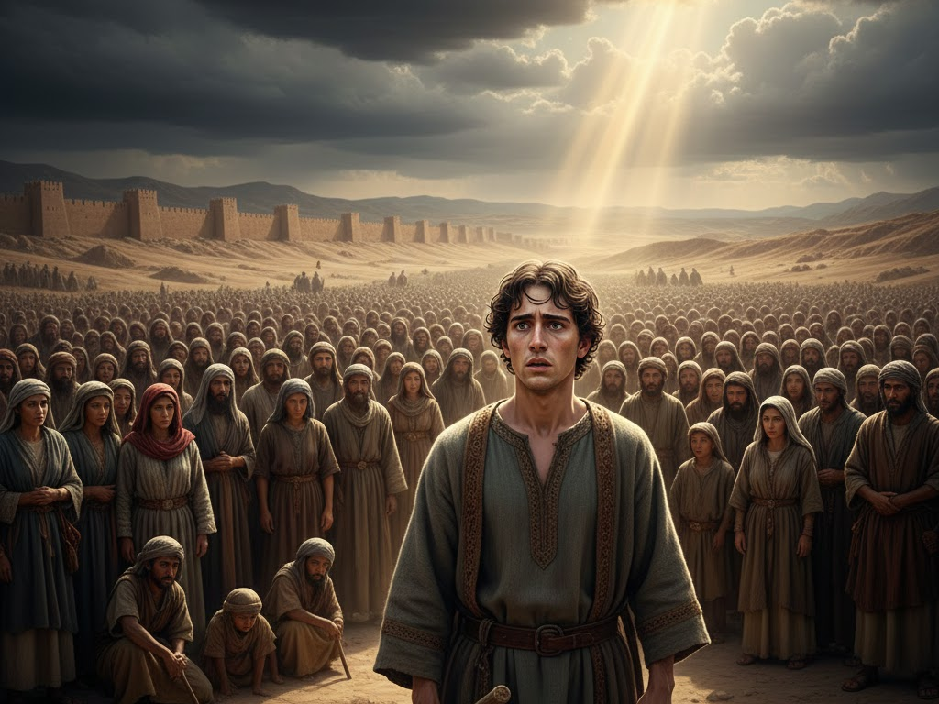
Joshua Taking The Lead of The People From Moses
Joshua 1:1-9

Slide 4
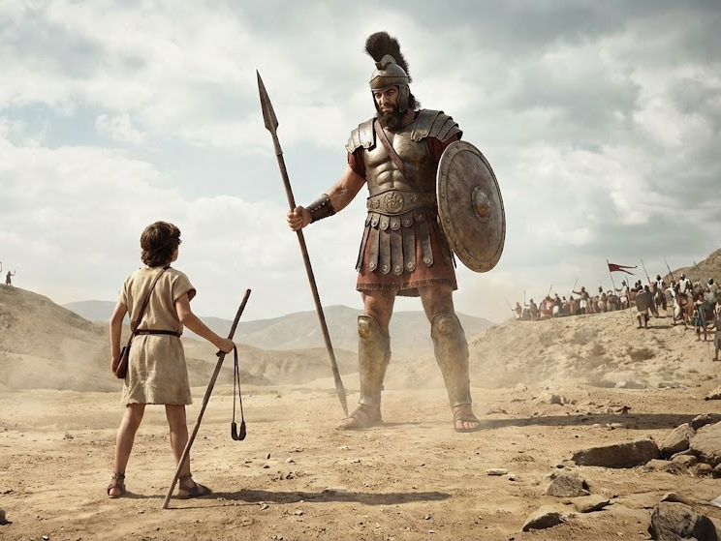
David and Goliath
1 Samuel 17

Slide 5
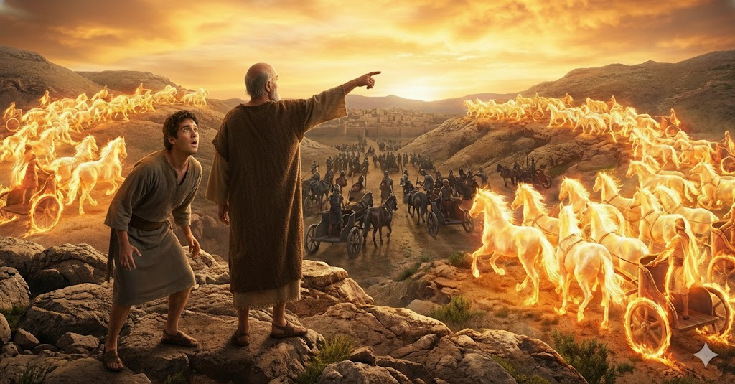
Elisha and His Servant
2 Kings 6:14-17

Slide 6
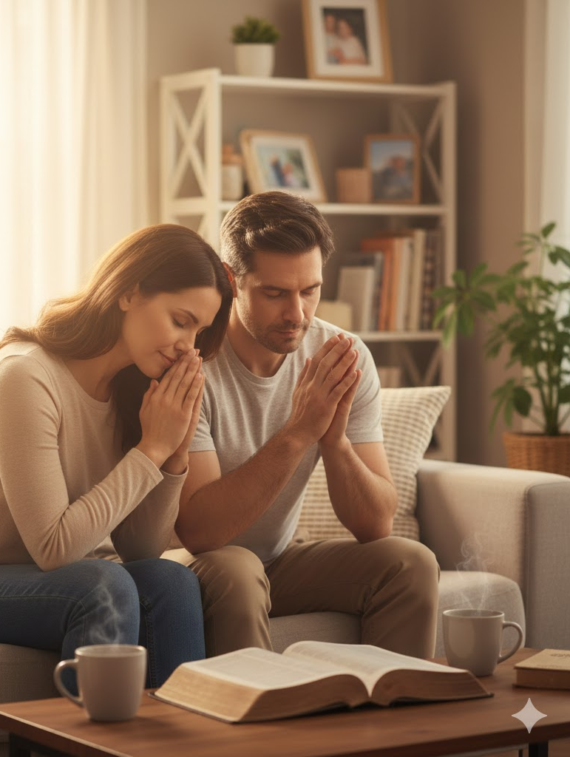
What do we do when we have fear?
Talk to God! Have a relationship with Him!
Phil 4:6-7; Col 3:15; Matt 6:25-34; Rom 8:6

Slide 7

Isaiah 41:10
“Fear not, for I am with you; Be not dismayed, for I am your God. I will strengthen you, Yes, I will help you, I will uphold you with My righteous right hand.”

