Slide 2
Choosing Honesty
Lessons From Genesis 20

Slide 3
Robert Feldman- The Liar in Your Life: How Lies Work and What They Tell Us About Ourselves,
Not only do we lie frequently, but we lie without even thinking about it. People lie while they are getting acquainted an average of three times in a 10-minute period. Participants in my studies actually are not aware that they are lying that much until they watch videos of their interactions.
We are living in a time and culture in which it's easier to lie than it has been in the past. The message that pervades society is that it's O.K. to lie — you can get away with it.
Lying is not seen as being morally reprehensible in any strong way.

Slide 4
The Day America Told the Truth- Patterson
91 percent lie routinely about matters they consider trivial
36 percent lie about important matters;
86 percent lie regularly to parents,
75 percent to friends, 73 percent to siblings,
69 percent to spouses.

Slide 5
Being Honest About Dishonesty?
¹² Therefore let anyone who thinks that he stands take heed lest he fall. ¹³ No temptation has overtaken you that is not common to man. God is faithful, and he will not let you be tempted beyond your ability, but with the temptation he will also provide the way of escape, that you may be able to endure it.
1 Corinthians 10

Slide 6
1. The Impact Of Dishonesty On All
The world may misunderstand who God is-v2-7
⁴ Now Abimelech had not approached her. So he said, “Lord, will you kill an innocent people? ⁵ Did he not himself say to me, ‘She is my sister’? And she herself said, ‘He is my brother.’ In the integrity of my heart and the innocence of my hands I have done this.” ⁶ Then God said to him in the dream, “Yes, I know that you have done this in the integrity of your heart, and it was I who kept you from sinning against me. Therefore I did not let you touch her.

Slide 7
1. The Impact Of Dishonesty On All
The world may misunderstand who God is-v2-7
Causes unnecessary worry and anxiety-v8
It causes sin-v9
Encourages the world to say we have done evil-v9

Slide 8
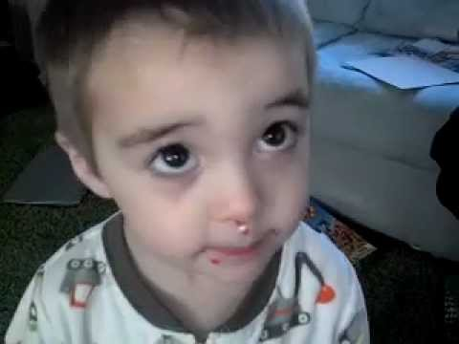
2. Why Do People Of Faith Struggle?

Slide 9
2. Why Do People Of Faith Struggle?
Because we think too much-v11a
Because we are afraid of other people-v11b
Because we are fine with half-truths-v12
Because we dress it up-v13a
Because our friends let us do it-v13b

Slide 10
3. Choose Honesty This Week
Straight Answers
Matthew 5:37
Speak Truth
Ephesians 4:25
Silence
Luke 8:56, Acts 23:22
Set Christ In Our Heart
Philippians 4:8, 1 Peter 3:15

