Slide 2
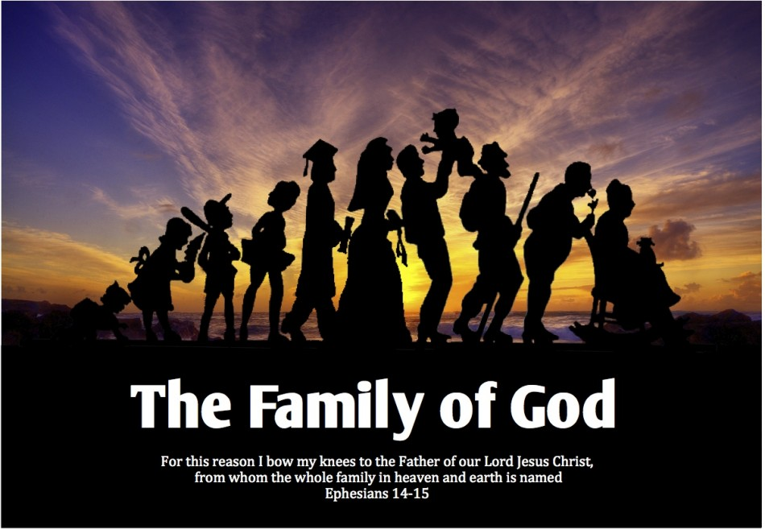
We Are Family
God’s people working together

Slide 3
The Greatest Family
We Are Family

Slide 4
The Greatest Family
I have the best Father.
I have the best Older Brother.
I have the best brothers and sisters.
We Are Family

