Slide 1

Therefore I intend always to remind you of these qualities, though you know them and are established in the truth that you have.
-- II Peter 1:12

Slide 2
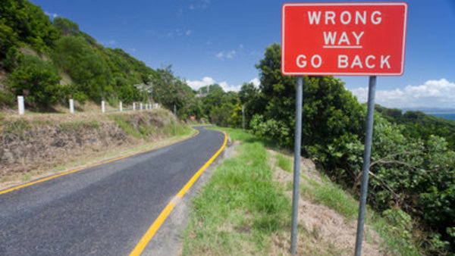
The Wrong Road To Righteousness

Slide 3
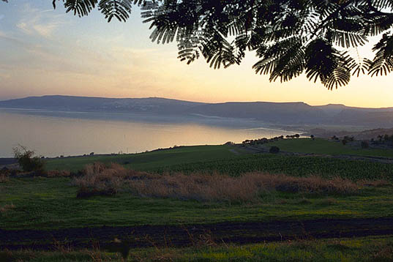
Sermon on the Mount Righteousness

Slide 4
Sermon on the Mount Righteousness
Righteousness: “The Approval of God”
Blessed are those who hunger and thirst for righteousness, for they shall be satisfied. (5:6)
Blessed are those who are persecuted for righteousness' sake, for theirs is the kingdom of heaven (5:10)
But seek first the kingdom of God and his righteousness, and all these things will be added to you (6:33)

Slide 5
Sermon on the Mount Righteousness
Righteousness Personalized
Beware of practicing your righteousness before other people in order to be seen by them, for then you will have no reward from your Father who is in heaven (6:1)
For I tell you, unless your righteousness exceeds that of the scribes and Pharisees, you will never enter the kingdom of heaven (5:20)

Slide 6
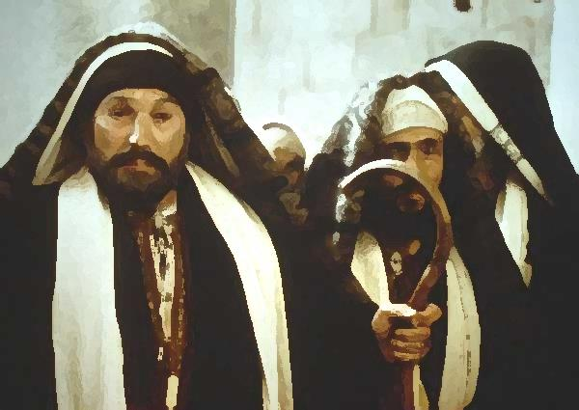
Scribes and Pharisees Righteousness

Slide 7
Scribes and Pharisees Righteousness
Scribes and Pharisees…
  Believed in the law and wanted all to know the law
  Staunchly against law breaking
  Willing to die for God
The Words of Jesus Would Have Been Shocking
  They viewed Him as blind!

Slide 8
Scribes and Pharisees Righteousness
Defining Their Righteousness
  Jesus answers their charge (Matthew 5:17-18)
  Righteousness is not to be taken lightly (19)
  Example of those taking righteousness lightly(20)
    Examples of how they lowered the bar (21-48)
    A “righteousness” based on self-worth (6:1-18)

Slide 9

The Ease of Wrong Road Righteousness

Slide 10
The Ease of Wrong Road Righteousness
Righteousness of Jesus does not come easily
  It is all about transformation!
  As obedient children, do not be conformed to the passions of your former ignorance, but as he who called you is holy, you also be holy in all your conduct – I Peter 1:14-15

Slide 11
The Ease of Wrong Road Righteousness
Righteousness of Jesus does not come easily
  It is all about transformation!
  Failing to transform is to choose self over God
  Self-righteous rarely see themselves as self-righteous

Slide 12
“But woe to you, scribes and Pharisees, hypocrites! For you shut the kingdom of heaven in people's faces. For you neither enter yourselves nor allow those who would enter to go in. Woe to you, scribes and Pharisees, hypocrites! For you devour widows' houses and for a pretense you make long prayers; therefore you will receive the greater condemnation Woe to you, scribes and Pharisees, hypocrites! For you travel across sea and land to make a single proselyte, and when he becomes a proselyte, you make him twice as much a child of hell as yourselves. “Woe to you, blind guides, who say, ‘If anyone swears by the temple, it is nothing, but if anyone swears by the gold of the temple, he is bound by his oath.’ You blind fools! For which is greater, the gold or the temple that has made the gold sacred? And you say, ‘If anyone swears by the altar, it is nothing, but if anyone swears by the gift that is on the altar, he is bound by his oath.’ You blind men! For which is greater, the gift or the altar that makes the gift sacred? So whoever swears by the altar swears by it and by everything on it. And whoever swears by the temple swears by it and by him who dwells in it. And whoever swears by heaven swears by the throne of God and by him who sits upon it. “Woe to you, scribes and Pharisees, hypocrites! For you tithe mint and dill and cumin, and have neglected the weightier matters of the law: justice and mercy and faithfulness. These you ought to have done, without neglecting the others. You blind guides, straining out a gnat and swallowing a camel! “Woe to you, scribes and Pharisees, hypocrites! For you clean the outside of the cup and the plate, but inside they are full of greed and self-indulgence. You blind Pharisee! First clean the inside of the cup and the plate, that the outside also may be clean. “Woe to you, scribes and Pharisees, hypocrites! For you are like whitewashed tombs, which outwardly appear beautiful, but within are full of dead people's bones and all uncleanness. So you also outwardly appear righteous to others, but within you are full of hypocrisy and lawlessness. “Woe to you, scribes and Pharisees, hypocrites! For you build the tombs of the prophets and decorate the monuments of the righteous

Slide 13
“But woe to you, scribes and Pharisees, hypocrites! For you shut the kingdom of heaven in people's faces. For you neither enter yourselves nor allow those who would enter to go in. Woe to you, scribes and Pharisees, hypocrites! For you devour widows' houses and for a pretense you make long prayers; therefore you will receive the greater condemnation Woe to you, scribes and Pharisees, hypocrites! For you travel across sea and land to make a single proselyte, and when he becomes a proselyte, you make him twice as much a child of hell as yourselves. “Woe to you, blind guides, who say, ‘If anyone swears by the temple, it is nothing, but if anyone swears by the gold of the temple, he is bound by his oath.’ You blind fools! For which is greater, the gold or the temple that has made the gold sacred? And you say, ‘If anyone swears by the altar, it is nothing, but if anyone swears by the gift that is on the altar, he is bound by his oath.’ You blind men! For which is greater, the gift or the altar that makes the gift sacred? So whoever swears by the altar swears by it and by everything on it. And whoever swears by the temple swears by it and by him who dwells in it. And whoever swears by heaven swears by the throne of God and by him who sits upon it. “Woe to you, scribes and Pharisees, hypocrites! For you tithe mint and dill and cumin, and have neglected the weightier matters of the law: justice and mercy and faithfulness. These you ought to have done, without neglecting the others. You blind guides, straining out a gnat and swallowing a camel! “Woe to you, scribes and Pharisees, hypocrites! For you clean the outside of the cup and the plate, but inside they are full of greed and self-indulgence. You blind Pharisee! First clean the inside of the cup and the plate, that the outside also may be clean. “Woe to you, scribes and Pharisees, hypocrites! For you are like whitewashed tombs, which outwardly appear beautiful, but within are full of dead people's bones and all uncleanness. So you also outwardly appear righteous to others, but within you are full of hypocrisy and lawlessness. “Woe to you, scribes and Pharisees, hypocrites! For you build the tombs of the prophets and decorate the monuments of the righteous

Slide 14
The Ease of Wrong Road Righteousness
Righteousness requires serious reflection
  Do I thank God daily for the grace He provides?
The saying is trustworthy and deserving of full acceptance, that Christ Jesus came into the world to save sinners, of whom I am the foremost. – I Timothy 1:15

Slide 15
The Ease of Wrong Road Righteousness
Righteousness requires serious reflection
  Do I thank God daily for the grace He provides?
  Do I view commands as a way of being like Him?
Oh that there were one among you who would shut the doors, that you might not kindle fire on my altar in vain! I have no pleasure in you, says the Lord of hosts, and I will not accept an offering from your hand. – Malachi 1:10

Slide 16
The Ease of Wrong Road Righteousness
Righteousness requires serious reflection
  Do I thank God daily for the grace He provides?
  Do I view commands as a way of being like Him?
  Do I keep commandments in the fullest sense?
The end of the matter; all has been heard. Fear God and keep his commandments, for this is the whole duty of man – Ecclesiastes 12:13

Slide 17
The Ease of Wrong Road Righteousness
Righteousness requires serious reflection
  Do I thank God daily for the grace He provides?
  Do I view commands as a way of being like Him?
  Do I keep commandments in the fullest sense?
  Is my worship for His glory?
Therefore let us be grateful for receiving a kingdom that cannot be shaken, and thus let us offer to God acceptable worship, with reverence and awe – Hebrews 12:28

Slide 18
The Ease of Wrong Road Righteousness
Righteousness requires serious reflection
  Do I thank God daily for the grace He provides?
  Do I view commands as a way of being like Him?
  Do I keep commandments in the fullest sense?
  Is my worship for His glory?
  Do I love my brethren?
He also told this parable to some who trusted in themselves that they were righteous, and treated others with contempt – Luke 18:9

Slide 19
The Ease of Wrong Road Righteousness
Righteousness requires serious reflection
  Do I thank God daily for the grace He provides?
  Do I view commands as a way of being like Him?
  Do I keep commandments in the fullest sense?
  Is my worship for His glory?
  Do I love my brethren?
  Is God the reason for my righteousness?
And he said to him, “You shall love the Lord your God with all your heart and with all your soul and with all your mind. – Matthew 22:37

Slide 20

Are You On The Right Road?

