Slide 1
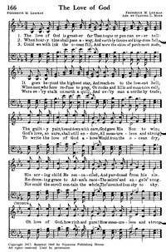
Could we with ink the ocean fill
And were the skies of parchment made
Were every stalk on earth a quill
And every man a scribe by trade
To write the love of God above
Would drain the ocean dry
Nor could the scroll contain the whole
Though stretched from sky to sky

Slide 2

In Step With The Spirit In An Out Of Step World:
The Foundation

Slide 3
In The Beginning…Love
For God so loved the world that He gave His only begotten Son, that whoever believes in Him should not perish but have everlasting life. -- John 3:16

Slide 4
In The Beginning…Love
And the Lord God formed man of the dust of the ground, and breathed into his nostrils the breath of life; and man became a living being. The Lord God planted a garden eastward in Eden, and there He put the man whom He had formed. – Genesis 2:7-8

Slide 5
In The Beginning…Love
And the Lord God formed man of the dust of the ground, and breathed into his nostrils the breath of life; and man became a living being. The Lord God planted a garden eastward in Eden, and there He put the man whom He had formed. – Genesis 2:7-8
Created

Slide 6
In The Beginning…Love
And the Lord God formed man of the dust of the ground, and breathed into his nostrils the breath of life; and man became a living being. The Lord God planted a garden eastward in Eden, and there He put the man whom He had formed. – Genesis 2:7-8
Created
God-Likeness

Slide 7
In The Beginning…Love
And the Lord God formed man of the dust of the ground, and breathed into his nostrils the breath of life; and man became a living being. The Lord God planted a garden eastward in Eden, and there He put the man whom He had formed. – Genesis 2:7-8
Created
Paradise
God-Likeness

Slide 8
In The Beginning…Love
And the Lord God formed man of the dust of the ground, and breathed into his nostrils the breath of life; and man became a living being. The Lord God planted a garden eastward in Eden, and there He put the man whom He had formed. – Genesis 2:7-8
Creation: God’s Selfless Love

Slide 9

In The Beginning…Love
Sin is rejection of God’s selfless love
  Rejection has consequences (Genesis 3:24)
  Sin does not minimize God’s love (Genesis 3:15)
Old Testament demonstrates God’s love
  Love for a people who struggled with sin
  Well evidenced in book of love…Deuteronomy!

Slide 10
I loved your fathers…
  And because he loved your fathers and chose their offspring after them and brought you out of Egypt with his own presence, by his great (4:37)
  But the Lord your God would not listen to Balaam; instead the Lord your God turned the curse into a blessing for you, because the Lord your God loved you. (23:5)

Slide 11
I love You
  Know therefore that the Lord your God is God, the faithful God who keeps covenant and steadfast love with those who love him and keep his commandments, to a thousand generations (7:9)
I Want You To Love Me
  You shall not listen to the words of that prophet or that dreamer of dreams. For the Lord your God is testing you, to know whether you love the Lord your God with all your heart and with all your soul. (13:3)

Slide 12
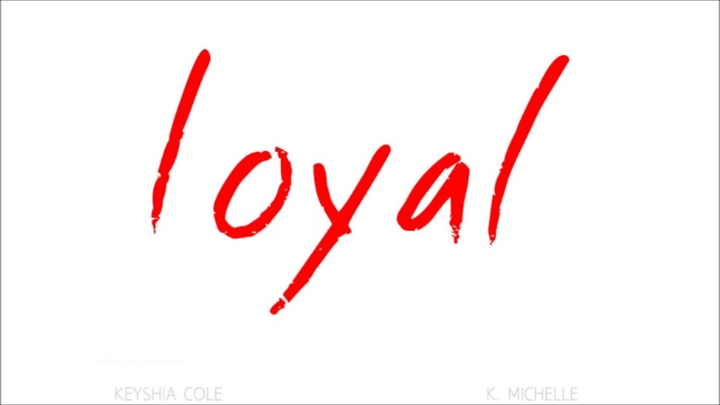
In The Beginning…Love
Message from Old Testament: Loyal Love
  God shows steadfastness, kindness in His actions
By your loyal love you will lead the people whom you have redeemed; you will guide them by your strength to your holy dwelling place. – Exodus 15:13

Slide 13
Loyal Love
Exodus 34:6,7
Numbers 14:18,19
II Samuel 7:15
I Chronicles 16:34,41
I Chronicles 17:13
II Chronicles 5:13
II Chronicles 7:3,6
II Chronicles 20:21
Ezra 3:11
Nehemiah 9:17
Micah 7:18

Slide 14
Loyal Love: The Epicenter of Old Testament
Psalms
36:5,7,10
40:10,11
42:8, 9
51:1
52:1,8
57,3,10
59:16
61:7
62:12
63:3
69:13,16
77:8
85:7,10
86:13,15
88:11
89:2,14,24,28,33
90:14
92:2
94:18
100:5
103:4,8,11,17
106:7,45
107:1,8,15,21,31,43
108:4
109:21
110:1
117:2
118:1-4, 29
119 (8 times)
130:7
136:1-26
138:2,8
143:8,12
145:8
147:11

Slide 15
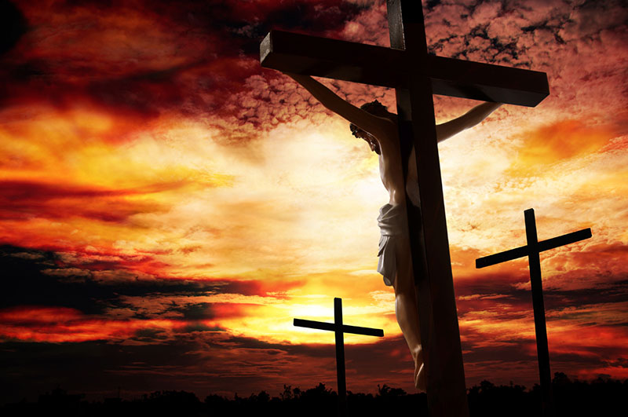
Proof of Loyal Love

Slide 16
For God so loved the world that He gave His only begotten Son, that whoever believes in Him should not perish but have everlasting life – John 3:16
But God shows his love for us in that while we were still sinners, Christ died for us. – Romans 5:8
In this is love, not that we have loved God but that he loved us and sent his Son to be the propitiation for our sins. – I John 4:10

Slide 17
Proof of Loyal Love
In Christ, God hit “reset”

Slide 18
But God, being rich in mercy, because of the great love with which he loved us, even when we were dead in our trespasses, made us alive together with Christ—by grace you have been saved—and raised us up with him and seated us with him in the heavenly places in Christ Jesus, so that in the coming ages he might show the immeasurable riches of his grace in kindness toward us in Christ Jesus. For by grace you have been saved through faith. And this is not your own doing; it is the gift of God, not a result of works, so that no one may boast. For we are his workmanship, created in Christ Jesus for good works, which God prepared beforehand, that we should walk in them. – Ephesians 2:4-10
Created…God-Likeness…Paradise

Slide 19
Proof of Loyal Love
In Christ, God hit “reset”
Steadfast, loyal love given

Slide 20
As it is written, “For your sake we are being killed all the day long; we are regarded as sheep to be slaughtered.” No, in all these things we are more than conquerors through him who loved us. For I am sure that neither death nor life, nor angels nor rulers, nor things present nor things to come, nor powers, nor height nor depth, nor anything else in all creation, will be able to separate us from the love of God in Christ Jesus our Lord. – Rom. 8:36-39

Slide 21

The Fruit of the Spirit…Is Love
Message of love has serious implication
  Matthew 22:36-39
  Only a son if I accept the Father’s love (I Jn. 3:1)
Love for others shows my love for God

Slide 22
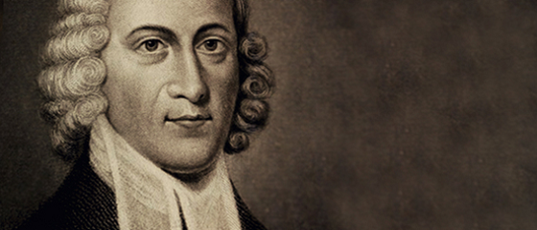
      If love is the sum of Christianity, surely those things which overthrow love are exceedingly unbecoming to Christians. An envious Christian, a malicious Christian, a cold and hard-hearted Christian, is the greatest absurdity and contradiction. It is as if one should speak of dark brightness, or a false truth.
      -- Jonathan Edwards

Slide 23
The Fruit of the Spirit…Is Love
Previous discussion has serious implication
  Matthew 22:36-39
  Only a son if I accept the Father’s love (I Jn. 3:1)
Love for others shows my love for God
  If anyone says, “I love God,” and hates his brother, he is a liar; for he who does not love his brother whom he has seen cannot love God whom he has not seen.

Slide 24
The Fruit of the Spirit…Is Love
To my family
To my brethren
To my friends
To strangers
To enemies
In the same way, let your light shine before others, so that they may see your good works and give glory to your Father who is in heaven.
-- Matt. 5:16

Slide 25
