Slide 1

Therefore I intend always to remind you of these qualities, though you know them and are established in the truth that you have.
-- II Peter 1:12

Slide 2

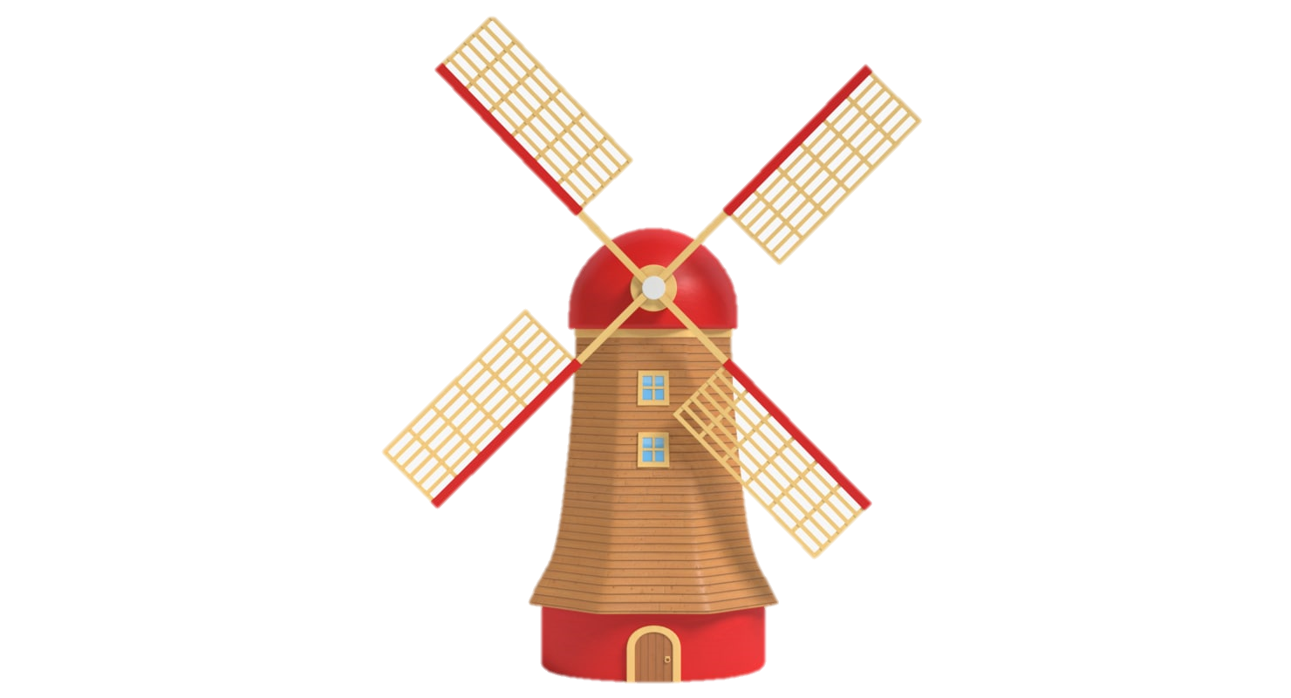

Slide 3
A Windmill In The Soccer Goal
A Study of Instrumental Music in Worship

Slide 4

Instruments in Worship: A Biblical Perspective

Slide 5
Instruments in Worship: A Biblical Perspective
Old Testament
The priests stood at their posts; the Levites also, with the instruments for music to the Lord that King David had made for giving thanks to the Lord—for his steadfast love endures forever—whenever David offered praises by their ministry; opposite them the priests sounded trumpets, and all Israel stood. II Chronicles 7:6

Slide 6
Instruments in Worship: A Biblical Perspective
Old Testament
And his relatives, Shemaiah, Azarel, Milalai, Gilalai, Maai, Nethanel, Judah, and Hanani, with the musical instruments of David the man of God. And Ezra the scribe went before them. – Nehemiah 12:36

Slide 7
Instruments in Worship: A Biblical Perspective
Old Testament
Praise the Lord! Praise God in his sanctuary; praise him in his mighty heavens! Praise him for his mighty deeds; praise him according to his excellent greatness! Praise him with trumpet sound; praise him with lute and harp! Praise him with tambourine and dance; praise him with strings and pipe! Praise him with sounding cymbals; praise him with loud clashing cymbals! Let everything that has breath praise the Lord! Praise the Lord! P. 150

Slide 8

Instruments in Worship: A Biblical Perspective
Old Testament
Authorized?
Used in Worship?
Not Simply to Aid Worship?

Slide 9

Instruments in Worship: A Biblical Perspective
New Testament
And I heard a voice from heaven like the roar of many waters and like the sound of loud thunder. The voice I heard was like the sound of harpists playing on their harps – Revelation 14:2
And I saw what appeared to be a sea of glass mingled with fire—and also those who had conquered the beast and its image and the number of its name, standing beside the sea of glass with harps of God in their hands. – Revelation 15:2

Slide 10
Instruments in Worship: A Biblical Perspective
New Testament
Authorized?
Used in Worship?
Not Simply to Aid Worship?

Slide 11
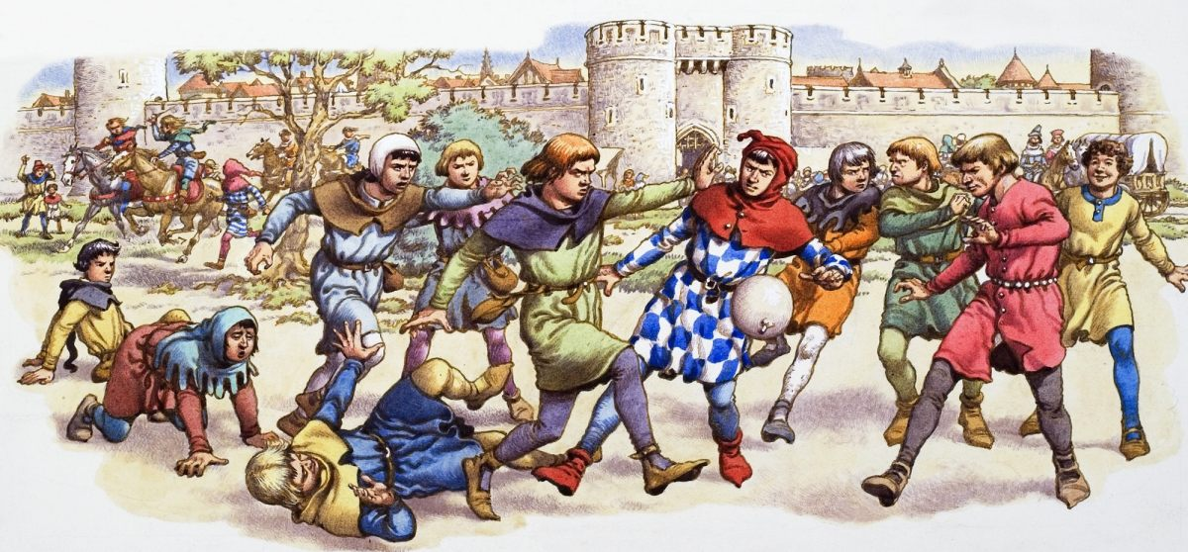

Old Testament
Authorized?
Worship?
Not an aid?
Applicable?
It is said that during medieval times, the old form of soccer used to allow many ill practices like kicking, punching, biting and gouging

Slide 12
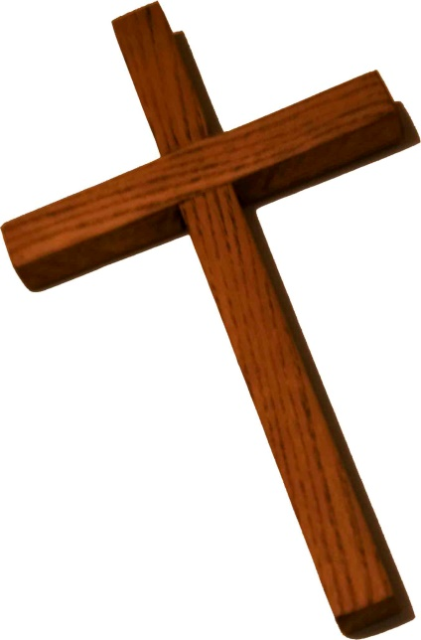
Old Testament
Authorized?
Worship?
Not an aid?
Applicable?
For when there is a change in the priesthood, there is necessarily a change in the law as well. – Hebrews 7:12
Do not think that I have come to abolish the Law or the Prophets; I have not come to abolish them but to fulfill them. For truly, I say to you, until heaven and earth pass away, not an iota, not a dot, will pass from the Law until all is accomplished. – Matthew 5:17-18

Slide 13
Revelation?
Authorized?
Worship?
Not an aid?
Applicable?
Why?
Different situation
Likely symbolic language

Slide 14

Old Testament
Authorized?
Worship?
Not an aid?
Applicable?
Matthew-Jude
Revelation?
Authorized?
Worship?
Not an aid?
Applicable?

Slide 15

Is Silence Prohibitive?

Slide 16

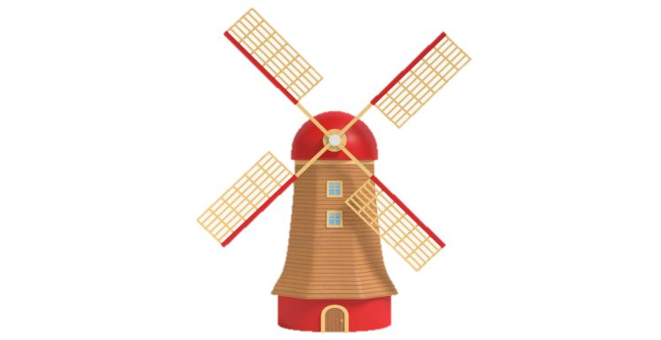

A goal must be placed on the centre of each goal line.
A goal consists of two upright posts equidistant from the corner flagposts and joined at the top by a horizontal crossbar. The goalposts and crossbar must be made of wood, metal or other approved material. They must be square, rectangular, round or elliptical in shape and must not be dangerous to players.
The distance between the posts is 7.32 m (8 yds) and the distance from the lower edge of the crossbar to the ground is 2.44 m (8 ft)

Slide 17
Is Silence Prohibitive?
Addressing one another in psalms and hymns and spiritual songs, singing and making melody to the Lord with your heart – Eph. 5:19

Slide 18
Is Silence Prohibitive?
Addressing one another in psalms and hymns and spiritual songs, singing and making melody to the Lord with your heart – Eph. 5:19
Who?

Slide 19
Is Silence Prohibitive?
Addressing one another in psalms and hymns and spiritual songs, singing and making melody to the Lord with your heart – Eph. 5:19
What?

Slide 20
Is Silence Prohibitive?
Addressing one another in psalms and hymns and spiritual songs, singing and making melody to the Lord with your heart – Eph. 5:19
To Pluck (As on a Harp)
How?

Slide 21
Is Silence Prohibitive?
Addressing one another in psalms and hymns and spiritual songs, singing and making melody with your heart to the Lord – Eph. 5:19
Make Melody With What?

Slide 22
Is Silence Prohibitive?
Addressing one another in psalms and hymns and spiritual songs, singing and making melody with your heart to the Lord – Eph. 5:19
Let the word of Christ dwell in you richly, teaching and admonishing one another in all wisdom, singing psalms and hymns and spiritual songs, with thankfulness in your hearts to God. – Col. 3:16

Slide 23

Who?
One another/The Lord
What?
Songs, Hymns, Spiritual Songs
How?
Singing
Making Melody With Heart
With Thanksgiving
Brand: Wilson
Style: Traditional
Size: #5 (Official size/weight)
Color: Black, White, Silver

Slide 24

What Role Does Tradition Play?

Slide 25
What Role Does Tradition Play?
Post-modernism seeks to make everyone right
Consequently, no one is wrong
On instrumental music…
“I respect your ‘Church of Christ’ tradition and you should respect my instrumental music tradition”

Slide 26
What Role Does Tradition Play?
God’s instructions not based on tradition
All Scripture is breathed out by God and profitable for teaching, for reproof, for correction, and for training in righteousness – II Timothy 3:16

Slide 27
What Role Does Tradition Play?
Tradition argument minimizes God’s standards
Should we be divided over instruments?
No! All should follow God’s plan, not tradition
Is it really a big deal?
Yes! This is worship to the God of Heaven
Cursed be the cheat who has a male in his flock, and vows it, and yet sacrifices to the Lord what is blemished. For I am a great King, says the Lord of hosts, and my name will be feared among the nations. – Malachi 1:14

Slide 28
No Authority To Change

Slide 29


