Slide 1
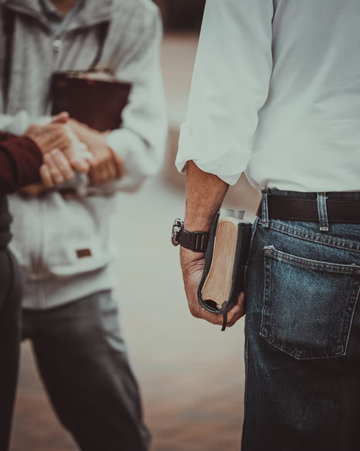
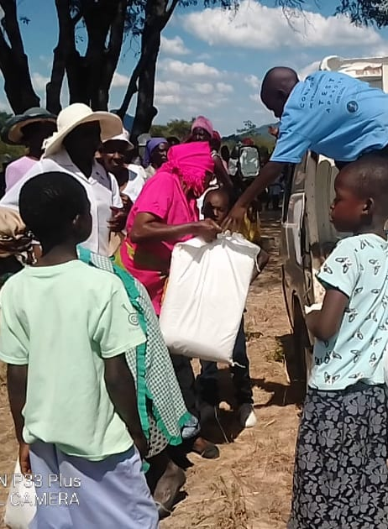

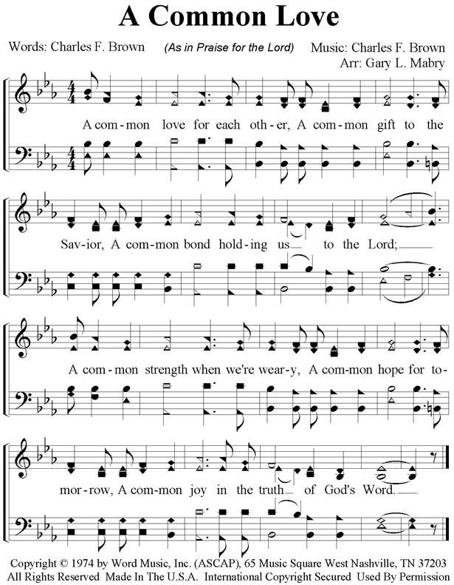
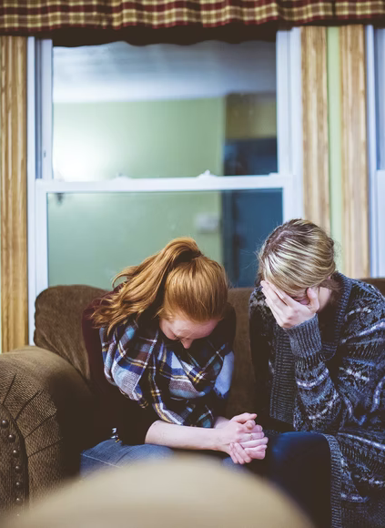
What a Fellowship!
Notes:
Christians share in a wonderful fellowship with Jesus in the Light. We share together in suffering and comfort, in meeting our physical needs, and in the great work of evangelizing a lost world.

Slide 2
Fellowship with Jesus in the Light
This fellowship begins with receiving and believing the apostles’ words (1 John 1:3).
If we walk in the light, we share in fellowship with God and His Son (1 John 1:5-7).
Fellowship with darkness and light are mutually exclusive (2 Cor. 6:14; 1 Timothy 5:22; Ephesians 5:8-11; 2 John 10-11; Romans 16:17)

Slide 3
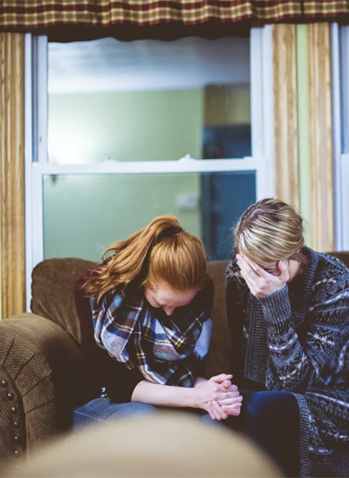
Fellowship in the Suffering and Comfort of Christ
Paul delighted to share in the sufferings of Christ (Phil 3:10 ).
He invited others to have fellowship with him in those sufferings (2 Timothy 1:8 ).
Fellowship in suffering results in fellowship in comfort (2 Corinthians 1:7).

Slide 4
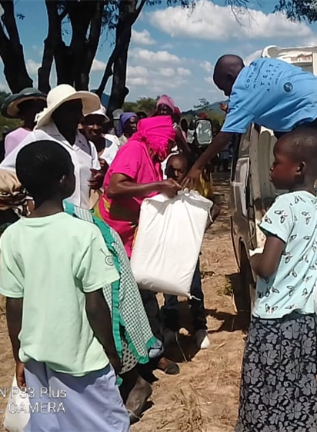
Fellowship in Ministering to Needy Saints
We have fellowship with the needs of the saints and are to be given to hospitality (Romans 12:13).
This fellowship is regarded as an honored privilege by both givers and receivers (2 Corinthians 8:3-4; 9:12-13).

Slide 5
Fellowship in Evangelism
By all participating in sharing the gospel (Galatians 2:9; Luke 5:7; 1 Thessalonians 1:8).
By supporting those who evangelize (Philippians 1:3-7; 3 John 8; Galatians 6:6).
Through prayer (2 Thess. 3:1; Colossians 4:3).

