Slide 1
Notes:
A few weeks ago, Steve had a great lesson on “Judge Not!”. In the same passage (Matthew 7 and Luke 6), God tells us who we should examine and that is ourselves. What are we to do with that beam that is in our eye keeping us from helping our brother. First we are told to notice it and then we should remove it. After taking care of ourselves we are ready to be of service to our fellow man.

Slide 2
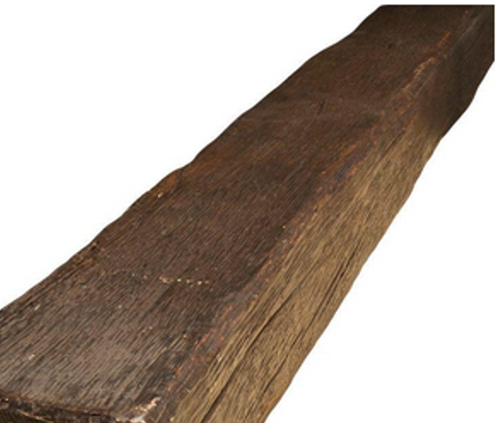
What Are We To Do With The Beam (Luke 6:39-42)
Notes:
A few weeks ago, Steve had a great lesson on “Judge Not!”. In the same passage (Matthew 7 and Luke 6), God tells us who we should examine and that is ourselves. What are we to do with that beam that is in our eye keeping us from helping our brother. First we are told to notice it and then we should remove it. After taking care of ourselves we are ready to be of service to our fellow man.

Slide 3

Matthew 7, Luke 6, Romans 2
Notes:
A few weeks ago, Steve had a great lesson on Matthew 7, Luke 6 and Romans 2 “Judge Not”. In that lesson he warned us of the danger of judging others hypercritically, hypocritically and/or self-righteously. For some reason it has become common for us to make ourselves better not by raising ourselves to a higher standard but rather tearing down those around us. We all know that feeling of knowing the person is coming who criticizes everything you do (or at least it feels that way) as it seems they never have words of encouragement but notice every mistake. Then there are those who elevate and hold people accountable to standards they do not maintain themselves. Lastly, there are those who have made personal choices for standards that are beyond what the scriptures teach but look judgmentally at those who don’t also live up to the same standards. In each of these cases, God says first do not do it and secondly what standard we judge others by is the standard we will be judged by. I don’t know about you but I need God’s grace and mercy. Therefore, I better be ready to show grace and mercy to others.

Slide 4
What Are We To Do With The Beam (Luke 6:39-42)
1. Notice It
2. Remove It
3. Use It
Notes:
Now for today, I would like to move a verse or so down. While these verse may not have been written as a formula for you and me today. I believe there is a very important truth in this verse that we would do well spending some time on this morning.
If you had to do an honest survey of yourself the past few weeks, have you took note of more shortcomings within yourself or in others? This simple question may help us know if we have an issue with judging others while failing to look introspectively.
We don’t want to be a blind guide and to avoid that a simple truth is laid out in these verses.
1: Notice It (the beam in our own eye)
2: Remove it (FIRST)
3: Use it (the process of removing the beam makes one more prepared to help others)

Slide 5

Notice It
Stop Focusing on Others
Examine Yourself (1 Cor. 11:28, 2 Cor. 13:5, Gal. 6:40)
Judge By the Same Standard (John 12:48)
Notes:
It is right to judge ourselves.
2Co 13:5 Examine yourselves [as to] whether you are in the faith. Test yourselves. Do you not know yourselves, that Jesus Christ is in you? --unless indeed you are disqualified.
1Co 11:28 But let a man examine himself, and so let him eat of the bread and drink of the cup.
Ga 6:4 But let each one examine his own work, and then he will have rejoicing in himself alone, and not in another.
We do it by looking in the mirror of His Word (James)
Jas 1:21-25 Therefore lay aside all filthiness and overflow of wickedness, and receive with meekness the implanted word, which is able to save your souls. But be doers of the word, and not hearers only, deceiving yourselves. For if anyone is a hearer of the word and not a doer, he is like a man observing his natural face in a mirror; for he observes himself, goes away, and immediately forgets what kind of man he was. But he who looks into the perfect law of liberty and continues in it, and is not a forgetful hearer but a doer of the work, this one will be blessed in what he does.
We should judge ourselves by the same standard we will be judged by (John 12:48)
Do it Frequently (Luke 9:23, 1 Cor. 9:27, Romans 12:1-2, Acts 17:11)
1Co 9:27 But I discipline my body and bring it into subjection, lest, when I have preached to others, I myself should become disqualified.
Lu 9:23 Then He said to them all, "If anyone desires to come after Me, let him deny himself, and take up his cross daily, and follow Me.

Slide 6
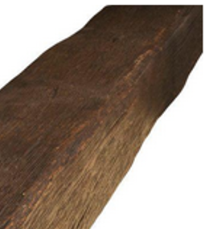
Remove It
It’s a Command (Not a Suggestion)
Some Are Good “Noticer’s” But Poor “Remover’s” (James 1:23-24)
Notes:
Remove it is a command (How many times is repentance commanded in the scripture)
Col 3:8-9 ¶ But now you yourselves are to put off all these: anger, wrath, malice, blasphemy, filthy language out of your mouth. Do not lie to one another, since you have put off the old man with his deeds,
Eph 4:22-23 that you put off, concerning your former conduct, the old man which grows corrupt according to the deceitful lusts, and be renewed in the spirit of your mind,

Slide 7

Refusal
Excuses
Would’ve
Could’ve
Should’ve
Success
Notes:
So with this in mind, let’s take a look at this graphic I ran across a few weeks ago. Think of the language (attitude) we use or the way you think toward the sin in your life. Is it positive? The more positive the language you use the more likely you will be to success in beating it. More importantly, the more positive and absolute you think, the more successful you will be. You can be assured “I won’t” or “I can’t” will equal failure. These are the people that never attempt to server God or others. Then you get to the next category which I fear is much more common (it is with me) and that is I know I should but something gets in the way and I fail to get it done. This is like living in regret and talking about what I should have done, what I could have done, etc… It is better that I will not or can not because it isn’t a refusal to try.
Insert chart and note:
Some make excuses, “I can’t” that is just my personality, etc… Please note, this is calling God a liar. He tells you to remove it and you say, I can’t. It is a scary thing to challenge God.
Some are good “noticer’s” but poor “removers”. (James 1:23-24)
This person is constantly saying, “I am sorry”, “I need to stop that”, i.e. they are a part of the “should have, would have, could have club”. This is rejecting God just like those who refuse or make excuse above.

Slide 8
Remove It
It’s a Command (Not a Suggestion)
Some Are Good “Noticer’s” But Poor “Remover’s” (James 1:23-24)
The Process Creates a Mature Christian (1 Tim 4:15)
Look
See
Remove
Look Again
Notes:
This is a process that should be repeated frequently as we discussed earlier (Look into the perfect law -> see the imperfections -> remove the imperfection -> redo)
1Ti 4:15-16 Meditate on these things; give yourself entirely to them, that your progress may be evident to all. Take heed to yourself and to the doctrine. Continue in them, for in doing this you will save both yourself and those who hear you.
When the scriptures speak of the “elder” not being a novice, this process is part of what makes a mature Christian. The child of God has spent their life, noticing where their life (not their neighbor’s life) doesn’t match up with God’s way and removing the beam. This process makes the Christian closer to God and more like Him.

Slide 9

Use It
Purpose: To See Clearly to Help Your Brother (Luke 6:42)
Never take advice from people who aren’t getting the results you want to experience. —MICHAEL HYATT
Nurture Personal Relationships so you can be of Help (Gal. 6:1)
Notes:
On many occasions, I have heard people talk about this passage and say, if people would just worry about themselves and stop worrying about everyone else, we would be just right.
Note that is not what is said here. It is said, to remove the beam so you can see clearly to help your brother with their speck. So it is actually the opposite. We look at ourselves so that we put ourselves in a place to help others. (Gal 6)
Do not ask advice of someone that you don’t want the results they are getting. Worldly example: Would someone struggling with weight and being out of shape come to me for help and advice? Obviously not. However, what if I carefully planned out an exercise program, healthy diet, etc. and started losing weight and becoming athletic. Then someone would wisely seek me out. Why? I would have obtained the results they would like to have.
2 Tim. 4:15 People should see growth in me.
If someone struggles with drugs (pornography, fornication, homosexuality, hatred, pride, etc.) and I have beat that addiction, it puts me in a place to be a servant of my brother. NOTE: It is important to note, that I need to have “removed the beam” before I can help my brother.
Also note that we must nurture our relationships with our brother before we can be of help to them. As I look around the room, I need to ask myself, have I offended anyone to my right or left to the point they wouldn’t come to me if they needed a brother or sister’s help?
Have I been hypercritical of them or others? Would you seek out someone who was critical of you for help?
Personal example: I have a sarcastic sense of humor. I know this about myself and I know that there are some who are fine with it and much like me. However, there are others who are offended by it. I do my best to control my speech around those who are offended by it simply because I need to cultivate that relationship for their good (not mine).
Lastly, no one needs this relationship/closeness more than our middle, high school and college age students. They live in a world where their faith is being tested every day. Sadly this is also a time when people tend to hurt others more often. Inventory everyone here your age, have you treated each person in a way they would be comfortable coming to for help? If not, STOP and CHANGE! You can. The same goes for all of us.

Slide 10
What Are We To Do With The Beam (Luke 6:39-42)
1. Notice It
2. Remove It
3. Use It

