Slide 3
Blessings of Being Added to the Church

Slide 4
Blessings of Being Added to the Church
You’re not condemned… but saved like other believers. Acts 2:47

Slide 5
Blessings of Being Added to the Church
You’re not condemned… but saved like other believers. Acts 2:47
You’re not alone…you’re in the household of God! Eph. 2:19

Slide 6
Blessings of Being Added to the Church
You’re not condemned… but saved like other believers. Acts 2:47
You’re not alone…you’re in the household of God! Eph. 2:19
You’re in the Household of God!

Slide 7
Unfortunately…

Slide 8
Unfortunately…
Christians do not always live up to their calling to “walk worthy”. Eph. 4:1-3

Slide 9
Unfortunately…
Christians do not always live up to their calling to “walk worthy”. Eph. 4:1-3
Condemnatory judgments by others. Matt. 7:1

Slide 10
Unfortunately…
Christians do not always live up to their calling to “walk worthy”. Eph. 4:1-3
Condemnatory judgments by others. Matt. 7:1
Strife, jealousy, angry tempers, disputes, slanders, gossip, arrogance, etc… 2 Cor. 12:20

Slide 11
Unfortunately…
Christians do not always live up to their calling to “walk worthy”. Eph. 4:1-3
Condemnatory judgments by others. Matt. 7:1
Strife, jealousy, angry tempers, disputes, slanders, gossip, arrogance, etc.. 2 Cor. 12:20
It’s no wonder Christians have difficulty opening up so we can have full fellowship with one another.

Slide 13
Sign of church “growth”

Slide 14
Sign of church “growth”
We’re not talking numbers,* but true spiritual growth among brethren. Eph. 4:11-16

Slide 15
Sign of church “growth”
We’re not talking numbers,* but true spiritual growth among brethren. Eph. 4:11-16
We’re talking about Christians who are growing out of their comfort zone in doing the work of our Lord: privately and publicly…

Slide 16
Sign of church “growth”
We’re not talking numbers,* but true spiritual growth among brethren. Eph. 4:11-16
We’re talking about Christians who are growing out of their comfort zone in doing the work of our Lord: privately and publicly…
Christians who are not satisfied with a “social club” setting, but a genuine “servant-minded” heart.

Slide 17

A Significant Sign of church “growth”: Opening Up

Slide 18
A Significant Sign of church “growth”: Opening Up
Fulfilling passages like James 5:16; Galatians 6:1-2 (confessing our sins to one another or confronting a brother/sister in sin with love) shows our love and need for one another in Christ.

Slide 19
Being Vulnerable = Trusting One Another

Slide 20
Being Vulnerable = Trusting One Another
Brethren are reaching out for prayers and help to our church family…

Slide 21
Being Vulnerable = Trusting One Another
Brethren are reaching out for prayers and help to our church family…
…Exposing their sins, their weaknesses, or intimate petitions...trusting that this church family WILL NOT harm them.

Slide 23


Slide 24
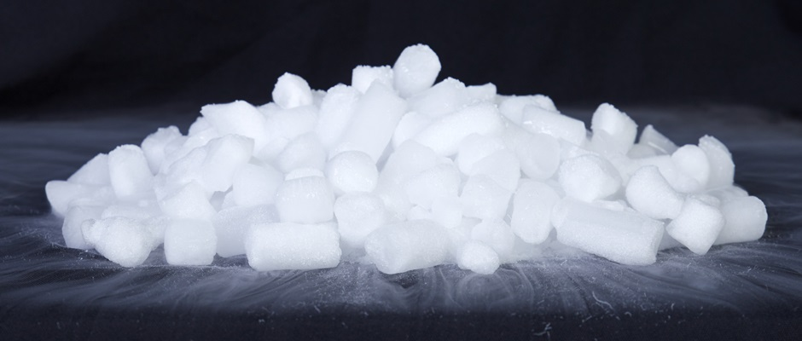

Slide 25
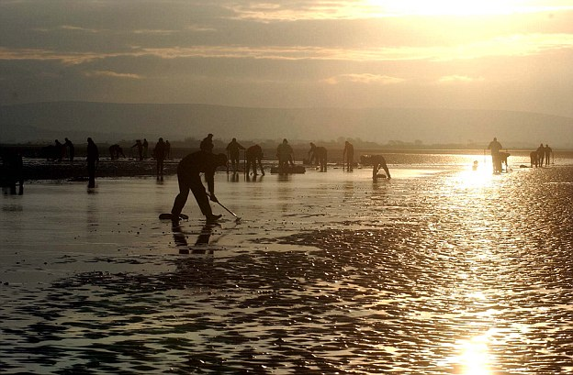

Slide 26


Slide 27
To our Church Family

Slide 28
To our Church Family
We're ALL sinners... who are (or can be) saved by the blood of Christ.

Slide 29
To our Church Family
We're ALL sinners... who are (or can be) saved by the blood of Christ.
Blessings aside, we have trials and other struggles that are REAL.

Slide 30
To our Church Family
We're ALL sinners... who are (or can be) saved by the blood of Christ.
Blessings aside, we have trials and other struggles that are REAL.
IT IS OKAY TO BE VULNERABLE:

Slide 31
To our Church Family
We're ALL sinners... who are (or can be) saved by the blood of Christ.
Blessings aside, we have trials and other struggles that are REAL.
IT IS OKAY TO BE VULNERABLE:
Seek a faithful brother/sister in Christ who you can confide in.

Slide 32
To our Church Family
We're ALL sinners... who are (or can be) saved by the blood of Christ.
Blessings aside, we have trials and other struggles that are REAL.
IT IS OKAY TO BE VULNERABLE:
Seek a faithful brother/sister in Christ who you can confide in.
Seek this family to pray for and love you.

