Slide 1
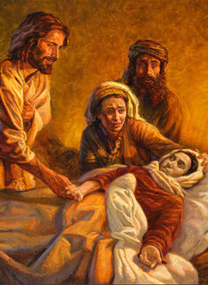
The Great Physician
Matt. 9:12; Heb. 4:14-15; Lk. 5:17-25
Notes:
https://www.freebibleimages.org/illustrations/jvh-miracles/

Slide 2
We Have a Physician Who Has…
Compassion on the sick (Matt. 14:14; 9:12)
Knowledge of our infirmities (Jn. 1:1-3, 14; Gen. 1:26; Heb. 4:14-15; Lk. 5:17-25)
A mind free from distractions and sin
Notes:
https://www.freebibleimages.org/illustrations/jvh-miracles/

Slide 3
We Have a Physician Who Has…
Cooperative patients (Matt. 13)
Helpers
Notes:
https://www.freebibleimages.org/illustrations/jvh-miracles/

Slide 4
Our Work as Helpers
Follow Jesus (Mk. 10:21; 1 Cor. 11:1)
Imitate our Physician
Notes:
https://www.freebibleimages.org/illustrations/jvh-miracles/

