Slide 1
The Witnesses of Jesus
and their testimony

Slide 2
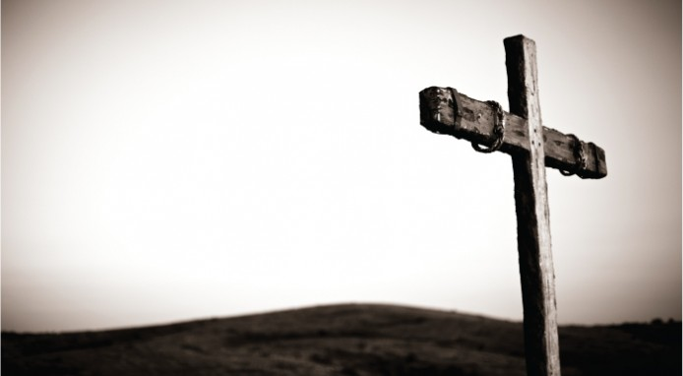
The Importance of Witnesses:
Eye witness testimony is irreplaceable and strong evidence.
Aids in the conviction or acquittal of the accused.
First hand information regarding a crime or an event.

Slide 3
Historical Authenticity of Jesus
“Nero fastened the guilt ... on a class hated for their abominations, called Christians by the populace. Christus, from whom the name had its origin, suffered the extreme penalty during the reign of Tiberius at the hands of ... Pontius Pilatus, and a most mischievous superstition, thus checked for the moment, again broke out not only in Judaea, the first source of the evil, but even in Rome....” Tacitus, Annals 15.44

Slide 4
Historical Authenticity of Jesus
“About this time there lived Jesus, a wise man, if indeed one ought to call him a man. For he ... wrought surprising feats.... He was the Christ. When Pilate ...condemned him to be crucified, those who had . . . come to love him did not give up their affection for him. On the third day he appeared ... restored to life.... And the tribe of Christians ... has ... not disappeared.” - Josephus, Antiquities 18.63-64 (composed circa AD 93-94)
“the brother of Jesus the so-called Christ.” Josephus, Antiquities xx. 200

Slide 5
Historical Authenticity of Jesus
If nothing else, these writings establish the fact that Jesus the Christ lived, was special/powerful when he was alive, and he died all by the end of the first century.

Slide 6
The Importance of Intra-biblical Claims
“The story is claimed as historical (Luke 1:1-4), with the recognition that if it didn’t happen, Christianity as a whole is fallacious (1 Cor 15). Everything hinges on its historical truthfulness.” – Doy Moyer
Establishing a faith on these claims requires us relying on the testimony of the witnesses.

Slide 7
The Testimony of the Witnesses of Jesus: Establishing History
The scriptural testimony of Jesus’ eye witnesses further establishes the historical records of Tacitus and Josephus.
Jesus Lived:
John 1:6-8, 15
1 John 1:1-3
John 15:26-27

Slide 8
The Testimony of the Witnesses of Jesus: Establishing History
The scriptural testimony of Jesus’ eye witnesses further establishes the historical records of Tacitus and Josephus.
Jesus was Special/Powerful:
He was the Son of God (John 1:32-34; 5:31-33, 36; Matt. 3:16-17; 1 John 5:9)
He was the Christ (John 10:24-25; John 12:17-18)
He brought remission of sins and eternal life (Acts 10:43 John 5:39-40)

Slide 9
The Testimony of the Witnesses of Jesus: Establishing History
The scriptural testimony of Jesus’ eye witnesses further establishes the historical records of Tacitus and Josephus.
Jesus Died:
John 21:24
1 Pet. 5:1

Slide 10
The Most Important Testimony of All:
His resurrection (1 Cor. 15:12-19)
The apostles bore witness of Jesus’ resurrection:
Apostles – specifically chosen to be witnesses of the resurrection of Jesus (Acts 1:22; 4:33)
John - John 21:24; 1 John 1:2; Rev. 1:1-2
Paul as a witness of the things he had “seen and heard” – Jesus alive from the dead (Acts 22:15 (Acts 9:17; 1 Cor. 15:8; 26:16; 23:11)

Slide 11
The Most Important Testimony of All:
His resurrection (1 Cor. 15:12-19)
The apostles bore witness of Jesus’ resurrection:
Peter – bore witness of Jesus’ death and resurrection (1 Pet 5:1; 1 Cor. 15:5)
Thomas – places his hands in the holes of Jesus’ hands and side (John 20:27-29)

Slide 12
Why So Important?
Without the resurrection, our faith is futile (1 Cor. 15:12-19).
There is yet to be a provided a logical scientific/alternate explanation for the empty tomb – this is the power of the resurrection!

Slide 13
Why So Important?
“The claim that Jesus died is historical. The claim that people saw Jesus alive is historical. The theology comes in when the explanations are given for how Jesus could have died and then later seen alive again. What accounts for the fact that they were able to make these claims at all? The problem for the unbeliever, then, is that in dealing with these historical claims (dead, alive), there just aren’t any good natural explanations for how that could be possible.

Slide 14
Why So Important?
Because they don’t have a good naturalistic explanation that could bridge the claims, they reject the historical statements. What that means, however, is that their naturalistic philosophy is driving their rejection. They deny the history because they don’t like the theology that explains the history. Yet, they cannot offer a legitimate alternative that is purely natural, believable, probable, and actually fits all the evidence.” – Doy Moyer

Slide 15
Why So Important?
If there is one thing that must be proven to authenticate our beliefs, it must be the resurrection. Without it, our faith is futile, we are still in our sins, and we are of all men the most pitiable.

Slide 16
Can The Witnesses Be Trusted?
Dangers that follow a witness:
Threats
Perjury (if found to lie under oath)
These dangers followed the witnesses of Jesus.
The witnesses of Jesus suffered threats (Acts 4:17-21).
Were they found to be lying, no doubt would they have suffered great consequences.

Slide 17
How Can We Trust These Witnesses?
The multiplicity of them (1 Cor. 15:3-8).
The importance of multiplicity of witnesses was something understood by the Jews (Dt. 17:6).
The more witnesses there are, the more easily truth can be established.
Their willingness to die for their testimony
Their willingness to die is a great testimony to their faith in Jesus – that He lived, died, and was raised from the dead.

Slide 18
Conclusion:
History establishes the life, power, and death of Jesus.
Scriptural witnesses identify the significance of His life, power and death and also provide the most important testimony of all time – His resurrection.
The reliability of the witnesses faces little, if any, legitimate opposition due to the overwhelming quantity of them and the inability to identify significant motives for lying.

Slide 19
What is the ruling of the jury?
2 Tim. 1:8

