Slide 2
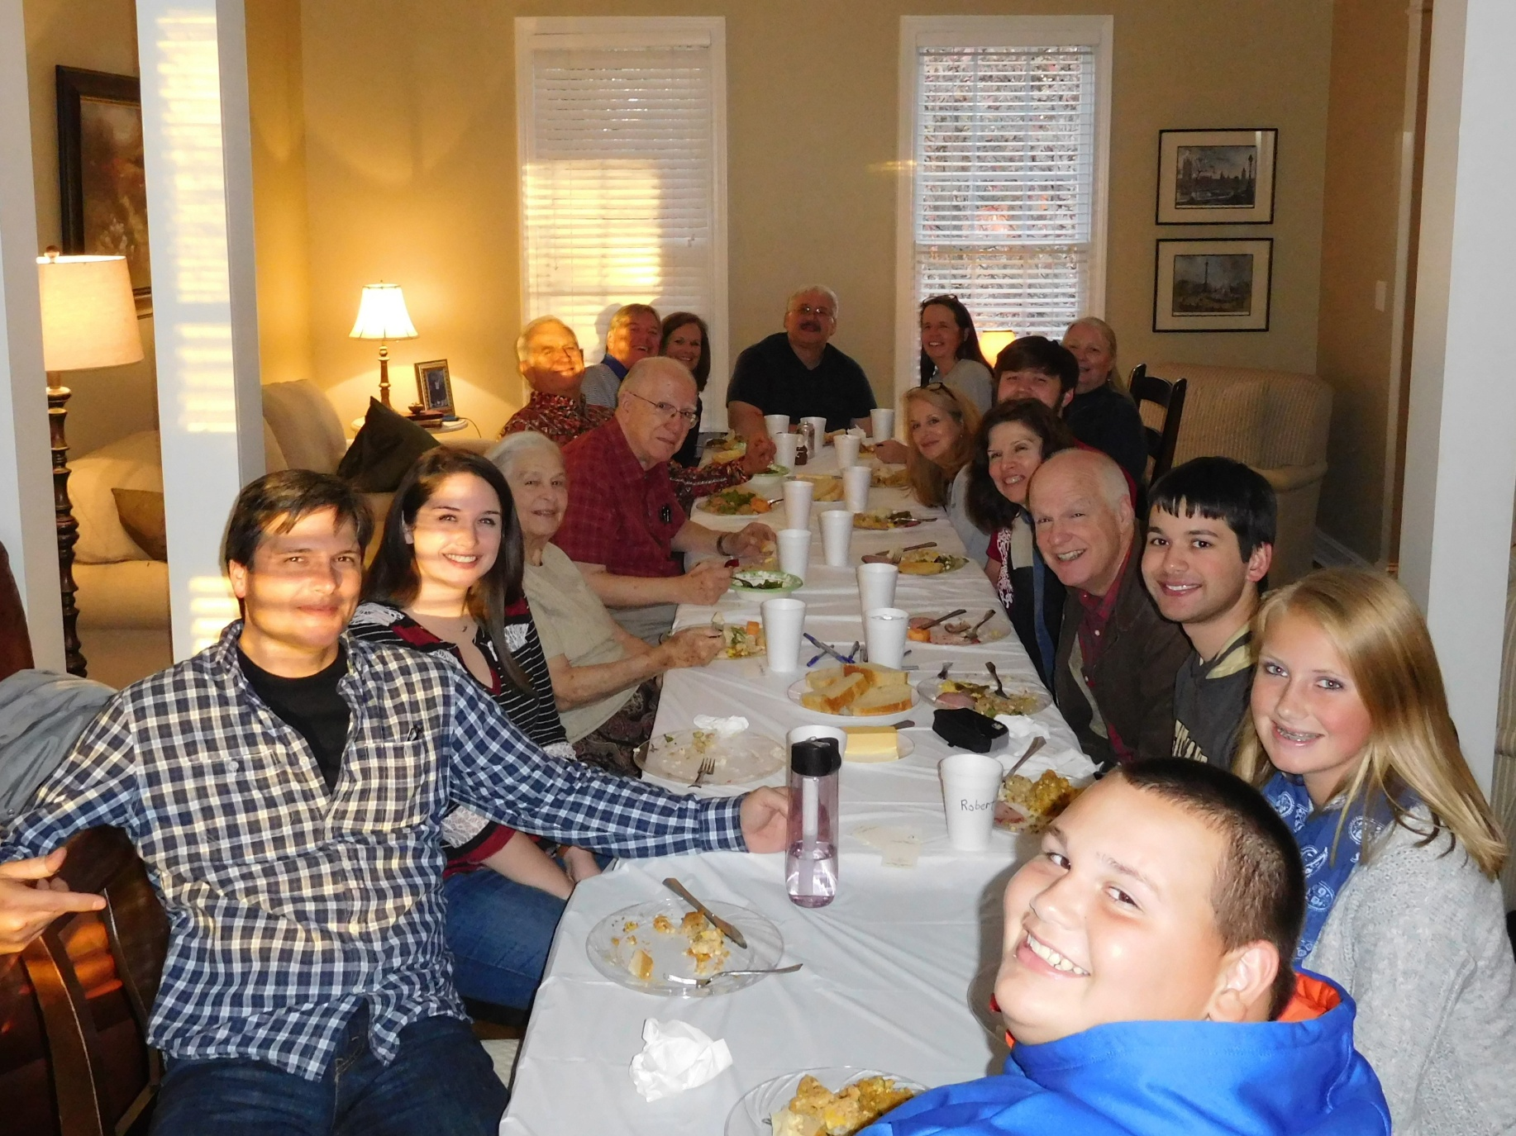

Slide 3
Each Lord’s Day God’s Family Gather Around the “Table of the Lord.”

Slide 4
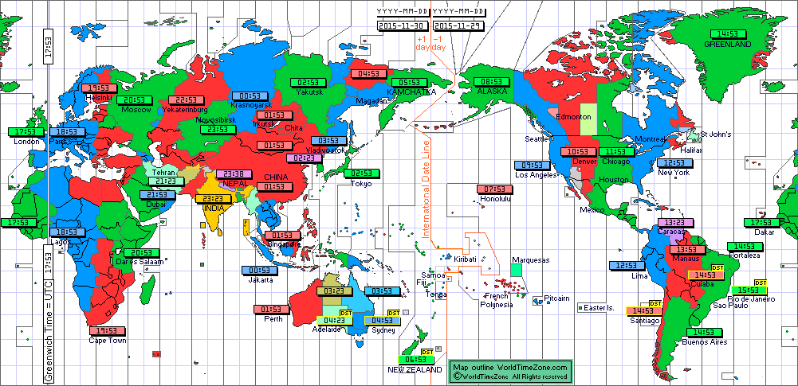
World Time Zones

Slide 5
The day thou gavest, Lord, is ended
The darkness falls at thy behest;
To thee our morning hymns ascended
Thy praise shall sanctify our rest.
We thank thee that thy Church unsleeping,
While earth rolls onward into light,
Through all the world her watch is keeping,
And rests not now by day or night.
The sun that bids us rest is waking
Our brethren 'neath the western sky,
And hour by hour fresh lips are making
Thy wondrous doings heard on high.

Slide 6
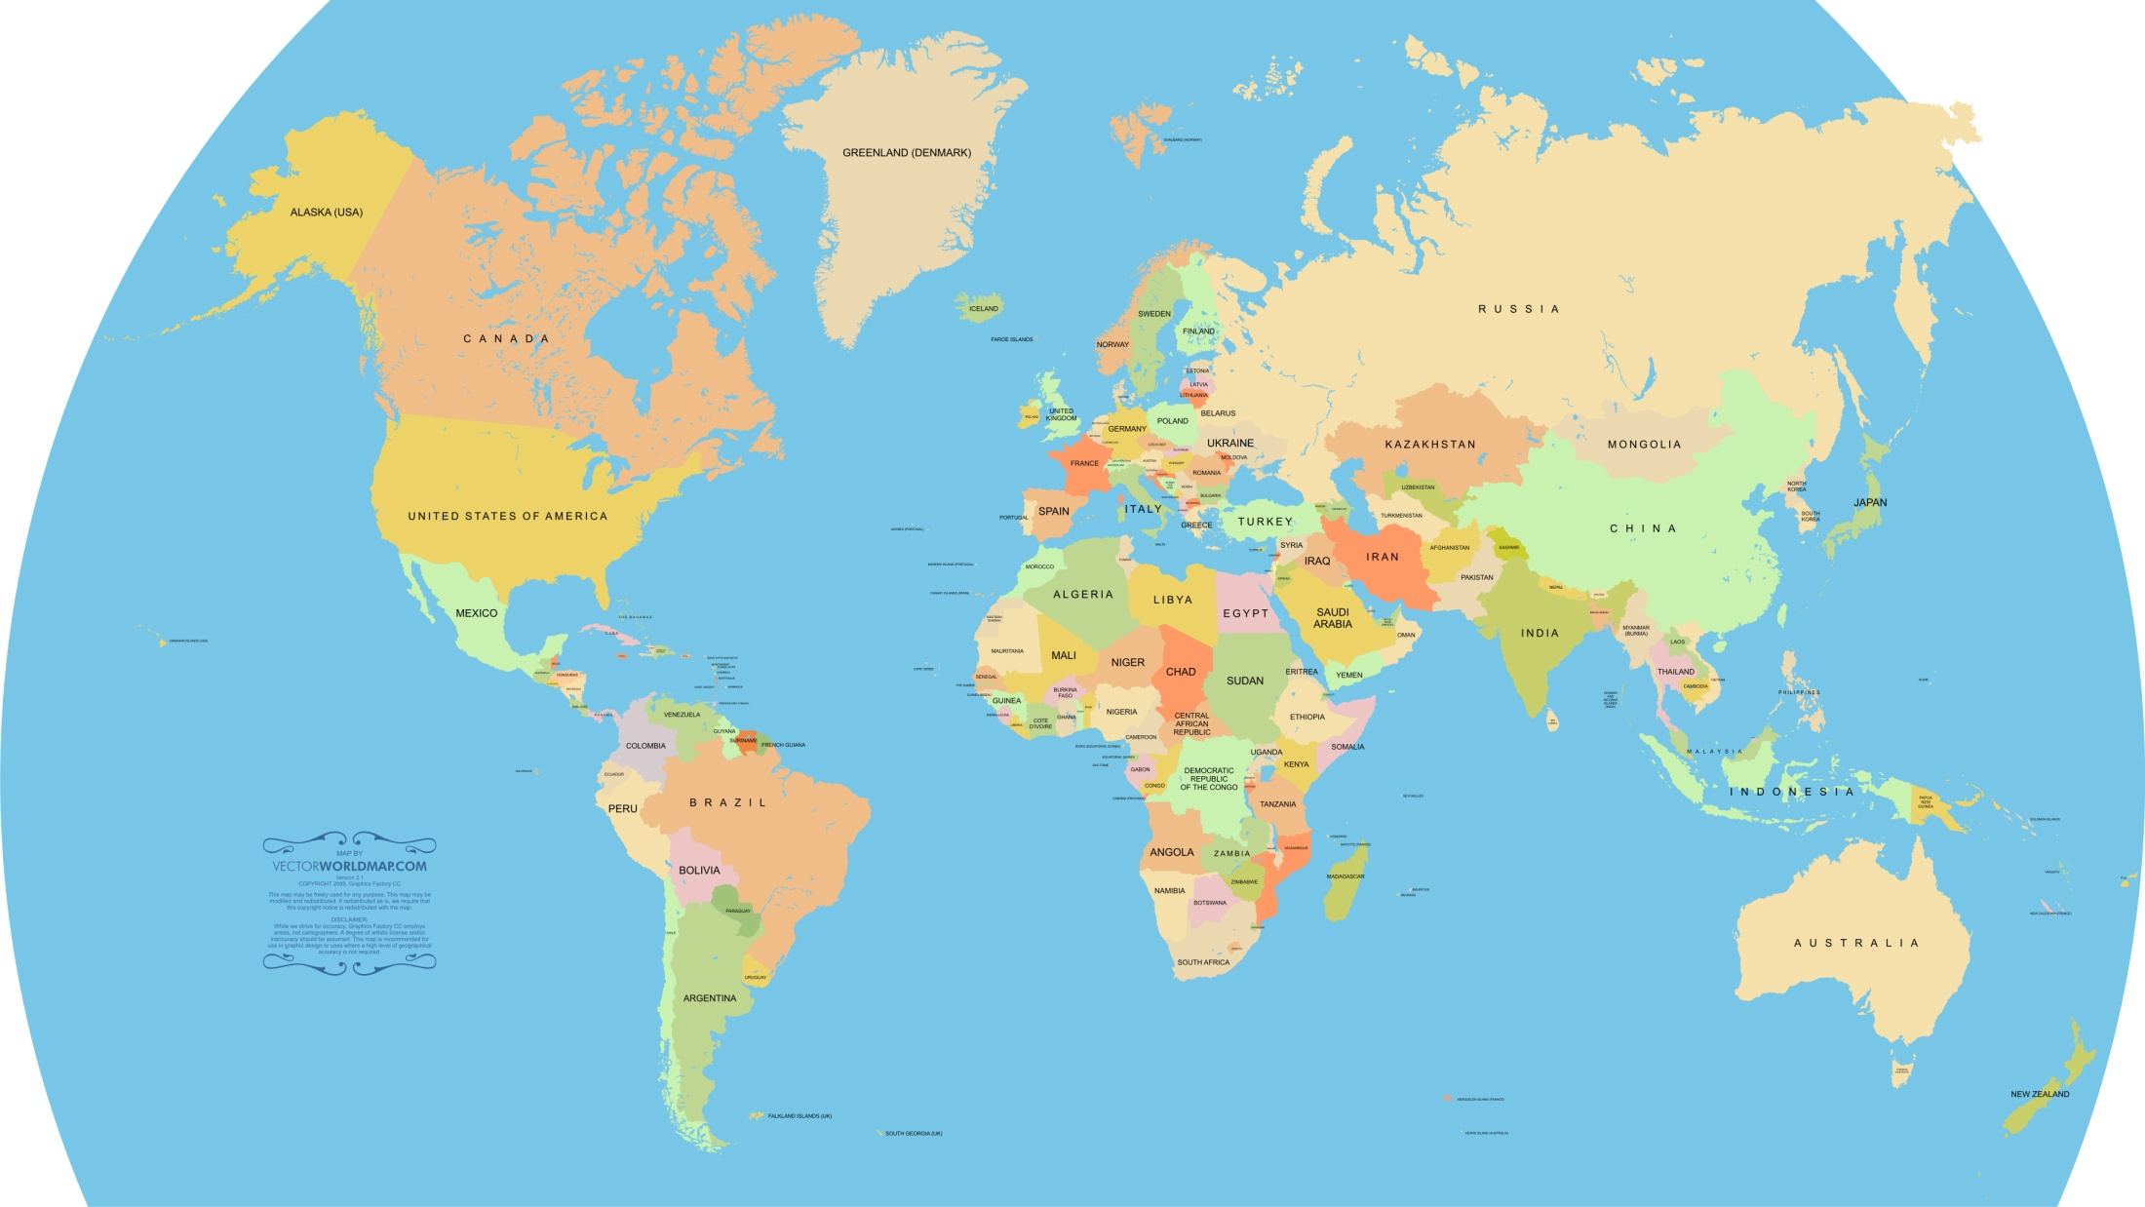
Challenges Faced by Brethren
Unbelief
Govt. Repression
These are not our problems
Crime
Poverty
Disease
Terrorists
Weather
Zika
Famine

Slide 7
Our Problems May be a Greater Threat to Faith!
Their problems are threats to the body.
Our problems threaten our souls!

Slide 8
Challenges We Face
We are rich.
We are not persecuted.
We are surrounded by a supposedly Christian Culture.
Most of us are second and third generation Christians.

Slide 9
1. We are rich!
Danger of Riches
Advantage of Poverty
Deuteronomy 8:7-18
Deuteronomy 31:20; 32:15
2 Chronicles 12:1; 26:16; 32:24-25
Matthew 13:22; 19:23-26
1 Timothy 6:17-18
Deuteronomy 8:3
Matthew 5:3, Luke 6:20
James 1:9-10
James 2:5
Which are more spiritually minded—rich or poor?
Give me neither poverty nor riches—
Feed me with the food allotted to me;
⁹ Lest I be full and deny You,
And say, “Who is the Lord?”
Or lest I be poor and steal,
And profane the name of my God
- Proverbs 30:8-9

Slide 10
2. We are not persecuted
Matthew 5:10-12
Romans 5:3-5
1 Peter 4:12-14

Slide 11
3. We are surrounded by a supposedly Christian Culture.
Our guard is down because we are more “conservative” than many of our neighbors.
Our culture is increasingly Pagan.

Slide 12
Because we cling to conservative American Values, we tell ourselves that we are acting independently of our culture. But conservative attitudes can be just as much a part of the world as liberal ones. Haven’t our attitudes on divorce, entertainment and other issues changed in response to our culture?
What would be the attitude of most Christians today toward a believer who dressed simply and modestly , regardless of fashion? Who took no interest in the violent sports of today? Who refused to watch television programs and movies that centered on immorality or that were spiced with profanity and graphic violence? Let’s be honest—he would probably be viewed as a fanatic.
The [American] road is still moving. We’re only fooling ourselves when we equate conservative attitudes with godly attitudes. Will the Real Heretic Stand Up by David W. Bercot

Slide 13
3. We are surrounded by a supposedly Christian Culture.
Our culture is increasingly Pagan.
Our guard is down because we are more “conservative” than many of our neighbors.
Another Danger
Many of those who stand with us against cultural immorality are in doctrinal error.

Slide 14
4. Most of us are second and third generation Christians.
Israel in time of Judges (Judges 2:7,10)
Seven Churches of Asia (40 years old)
History of churches in America

Slide 15
Survival is Possible
“A Kingdom that cannot be shaken” Hebrews 12:28
Personal Survival - Romans 8:28-39

