Slide 1
. . .

Slide 2
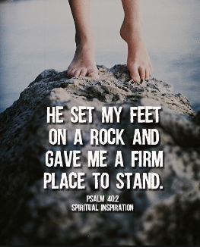
Standing on the Solid Rock

Slide 3
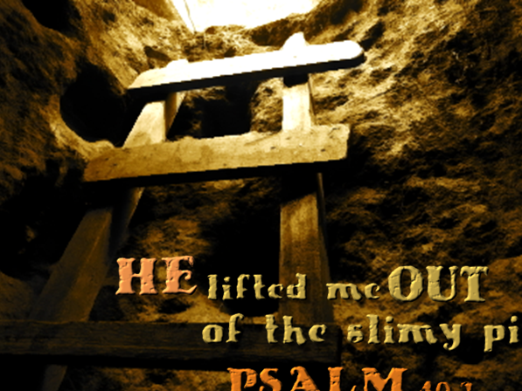
Joseph
Gen. 37, 39-41
How was Joseph able to stand firm?
His deep reverence for God
  Omnipresent Ps. 139:1-12,
  Omniscient 1 Cor.2:10-11, Job 31:4
  Omnipotent Matt. 28:18, Job 38:31-33

Slide 4
Joseph
Gen. 37, 39-41
How was Joseph able to stand firm?
Joseph stood firm because his identity was found in the Lord
As a Slave (Gen. 37:25-28; 39:1-6)
As a prisoner (Gen. 39:21-23)
As second-in-command (Gen. 41)

Slide 5
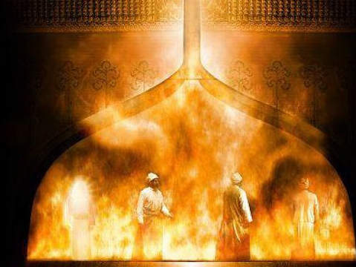
Shadrach, Meshach, Abed-nego
Daniel 3
How did they have the courage to stand up?
Because they knew what God is capable of
(Dan. 3:16-17; Isa. 40:29; Eph.6:10; Ps.46:1-3; Ps. 68; Ps. 119:89-91)

Slide 6
Shadrach, Meshach, Abed-nego
Daniel 3
How did they have the courage to stand up?
Because they knew that they could trust in Him
(Ps.9:10; Ps. 20:7; Isa.43:1)

Slide 7
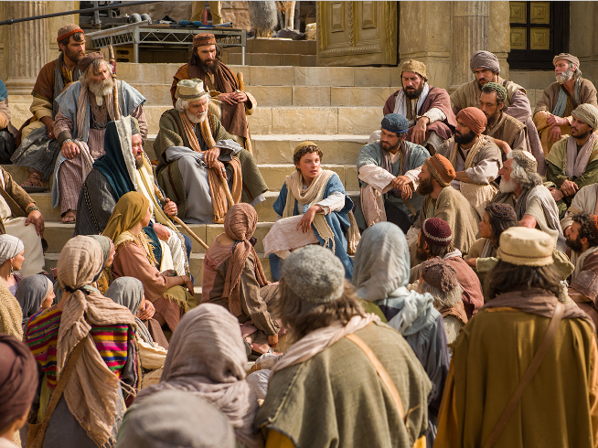
Jesus
Had a purpose to preach
(Mk. 1:38; Mk. 2:17)
Had a purpose to do the will of the Father
(John 6:38; 14:31; 17:1-5)
He walked with God
(John 15:10; John 5:19)

Slide 8
Jesus
He did what pleased the Father
(John 8:29)
He gave up everything for the Father
(Phil 2:5-11)

Slide 9
Conclusion…
Stand on the Solid Rock

Slide 10
. . .

